Slide 1
Obesity is destroying the future
Basel ,Fahed , Sanad and Ghassan​

Slide 2
More die in the United States of too much food than of too little.
”
John Kenneth Galbraith

Slide 3
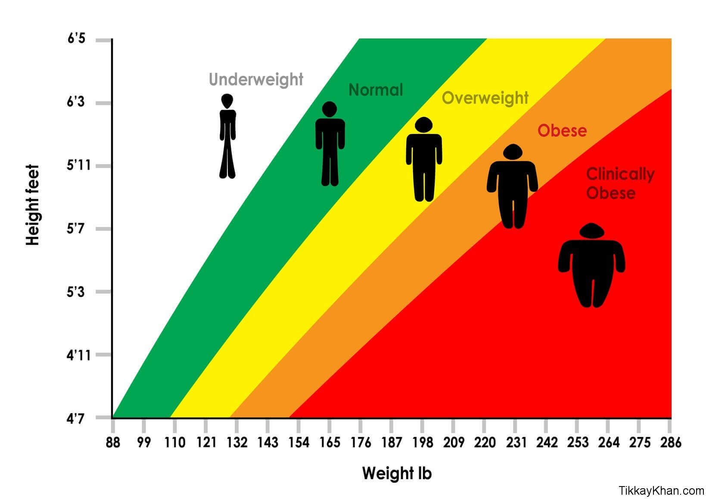
What is obesity?
Obesity is a complicated disease where huge amount of fat is stored in a person´s body. People think it only affects their looks, but it is a medical problem that create heart problems and diabetes and much more.

Slide 4
Today we will be focusing on
Reasons for obesity
The consequences of obesity
Ways to prevent obesity in school

Slide 5

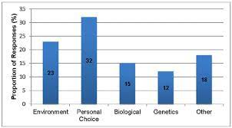
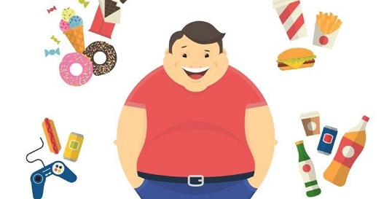
Causes of Obesity
There are many reasons why obesity happen to students, and it depends on 3 main factors:
1-The lack of exercise.
2-The environment and the living of the student.
3-Genetics which can’t be changed.

Slide 6
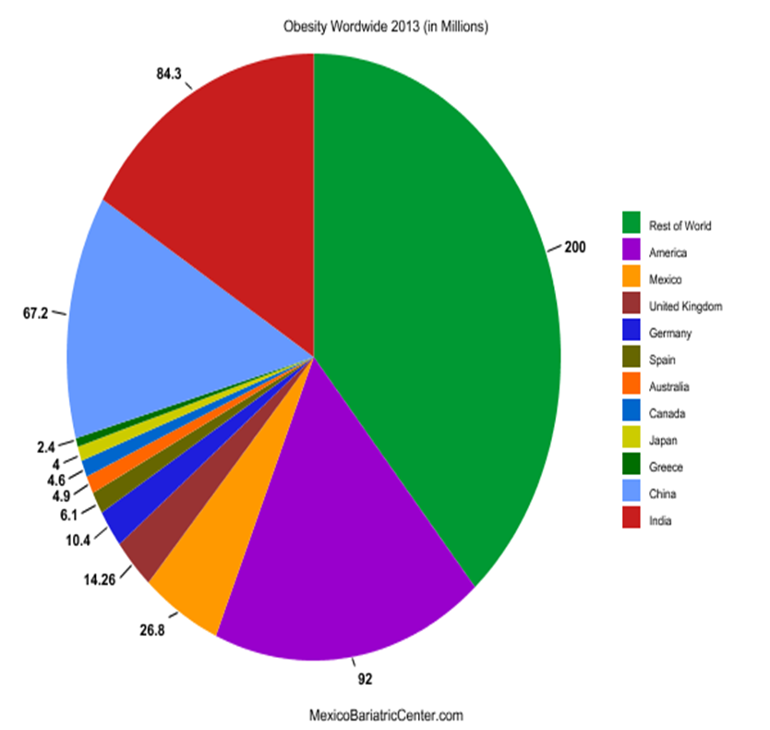
Obesity rates around the world:

Slide 7
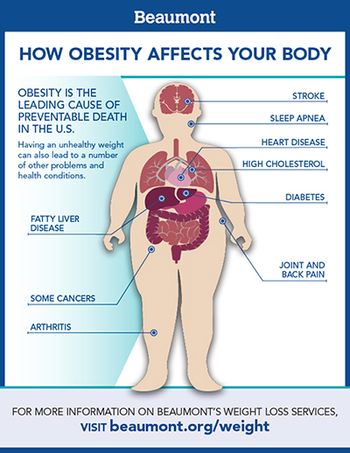
How does obesity affects us?
Depression: obesity affects parts of the brain which alter the persons mood into sadness. Example: Getting bullied and criticized for weight creates depression.
Disability: obesity is impairement of the musculoskeletal system, caused by excessive weight, for ex. chronic back pain.
It diminishes the respiratory system: obesity increases oxygen consumption and carbon dioxide production, while at the same time it stiffens the respiratory system and increases the mechanical work needed for breathing.

Slide 8
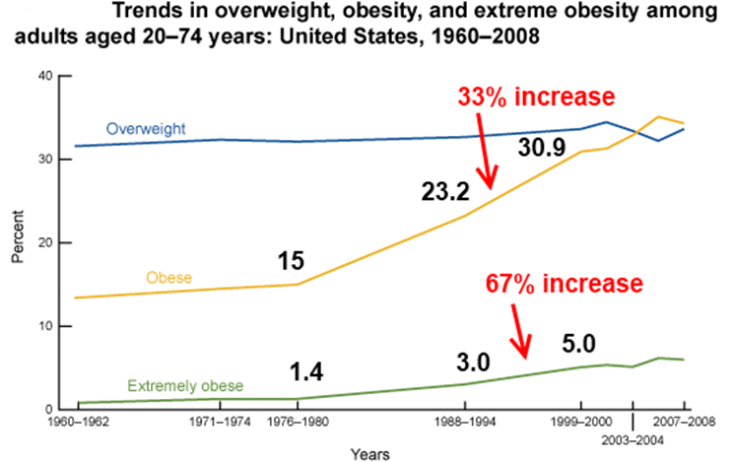
AREAS OF GROWTH
 | B2B | Supply chain | ROI | E-commerce
Q1 | 4.5 | 2.3 | 1.7 | 5.0
Q2 | 3.2 | 5.1 | 4.4 | 3.0
Q3 | 2.1 | 1.7 | 2.5 | 2.8
Q4 | 4.5 | 2.2 | 1.7 | 7.0

Slide 9

How to cure obesity
1-By exercising regularly :
By walking often.
Going to the gym.
Play sports.
Maximize the exercise you can do in P.E classes
2-By following a balanced diet:
By eating large amount of fibers.
Stay away from fast food
Increase the amount of protein you eat and decrease the amount of fat and carbohydrates you consume.
3- By adding new equipment to the gym. Donate 5jds to our campaign at the accounting office to help us eliminate obesity from our school.
4-Go on a weight loss plan supervised by a dietitian.
.

Slide 10

Resources:
Centers for Disease Control and Prevention. (2022, September 15). What can be done. Centers for Disease Control and Prevention. https://www.cdc.gov/obesity/strategies/what-can-be-done.html
Mayo Foundation for Medical Education and Research. (2021, September 2). Obesity. Mayo Clinic.https://www.mayoclinic.org/diseases-conditions/obesity/symptoms-causes/syc-20375742
U.S. Department of Health and Human Services. (n.d.). What causes obesity & overweight?. Eunice Kennedy Shriver National Institute of Child Health and Human Development. https://www.nichd.nih.gov/health/topics/obesity/conditioninfo/cause

Slide 11
Thanks for listening

