Slide 1
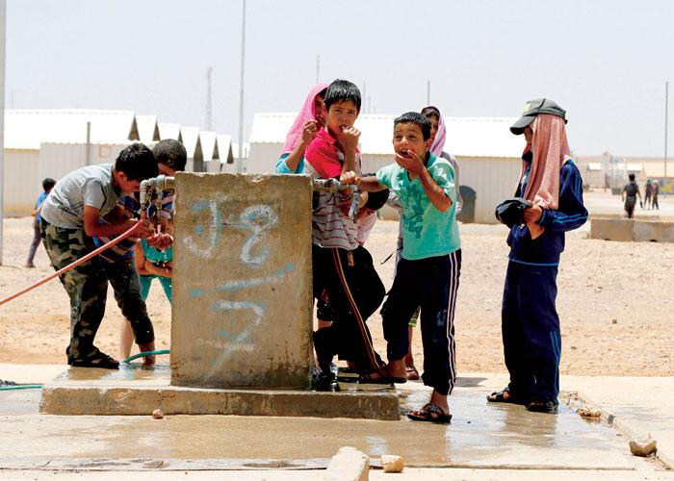
Water crisis in Jordan
Jordan is one of the most water-scarce countries in the world. The country’s renewable water supply currently meets around two-thirds of the population’s water demands, with groundwater being used twice as quickly as it can be replenished.

Slide 2
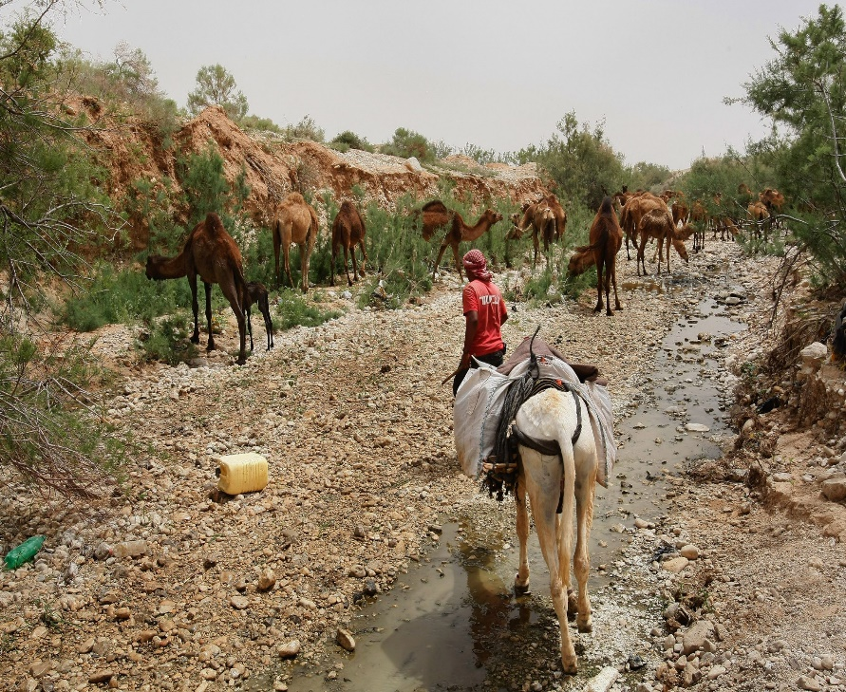
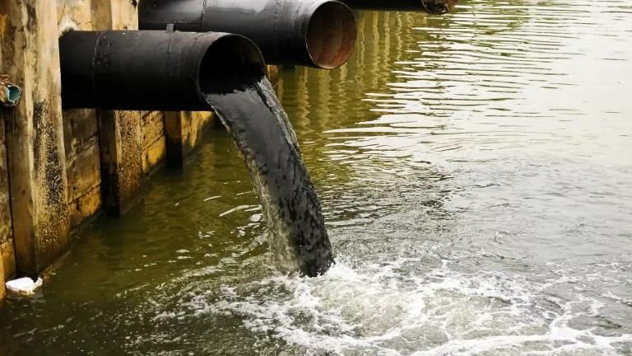
Issues related to water crisis in Jordan
Water scarcity is an issue that strikes at the heart of society a fundamental requirement for life and something constantly taken for granted.
(Water scarcity is the lack of fresh water resources to meet the standard water demand)
Water pollution is a major environmental problem, Water pollution is the pollution of bodies of water, such as lakes, rivers, seas, the oceans, as well as groundwater.

Slide 3
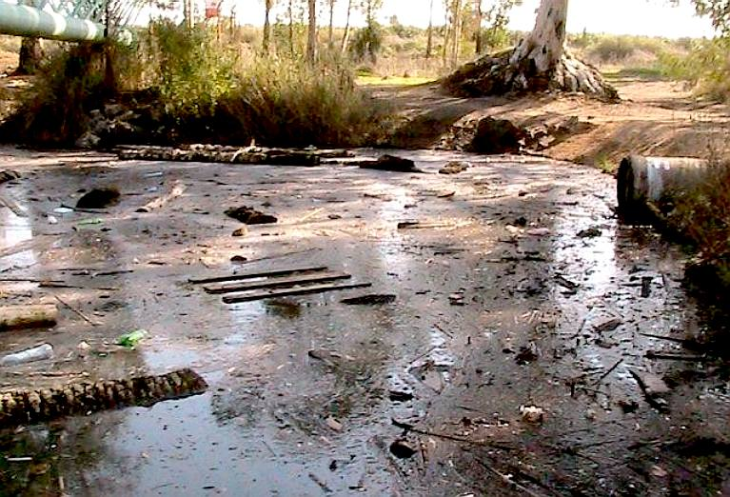
Main causes of water crisis in Jordan (Water pollution)
The overflow of wastewater pumping stations, leaks from sewage systems and exposure to industrial and commercial sources.. Researchers point to improper industrial discharges and lack of regulation as the leading cause of water pollution in Jordan
over-pumping of aquifers seepage from landfill sites, and improper disposal of dangerous chemicals.

Slide 4
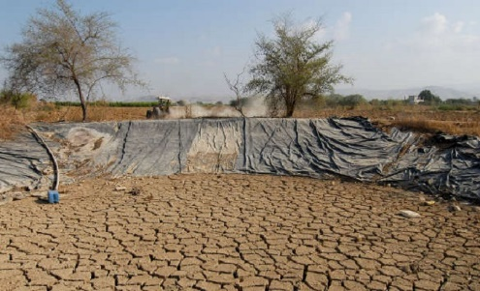
Causes of water crisis in Jordan (water scarcity)
Jordan is experiencing rapid urbanization and an inflow of immigrants and refugees, further increasing demand for water
Climate change is altering patterns of weather and water around Jordan, causing shortages and droughts (decreased rainfall, and lack of dam water)

Slide 5
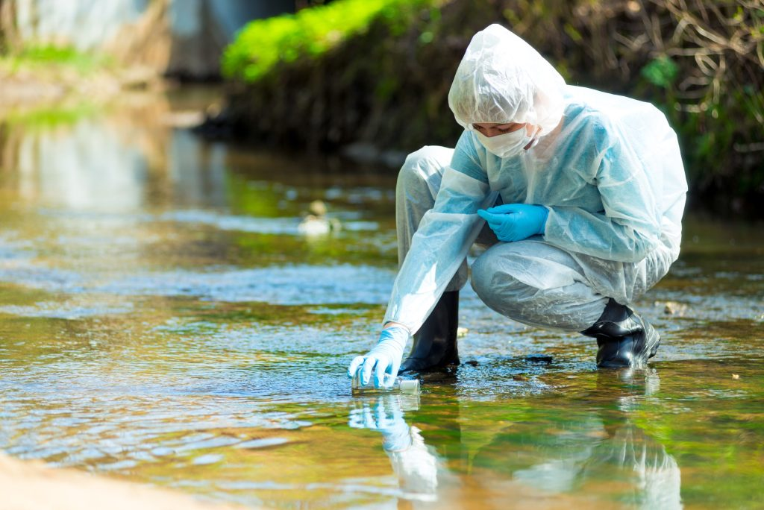
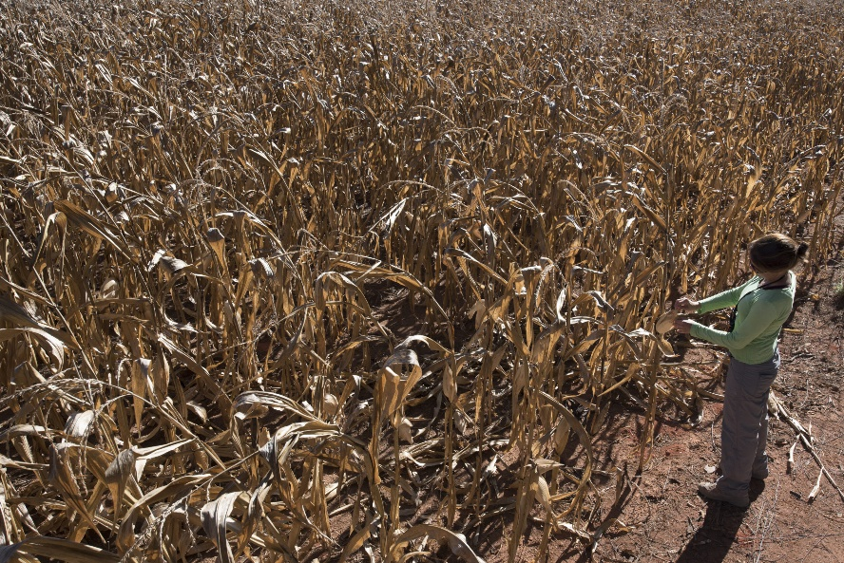
Main consequences of water crisis in Jordan (Water pollution and water shortage)
Shortage of water in schools can undermine school attendance and performance, particularly for girls. Limited access to water results in children and young adults being unable to practice important hygiene behavior like hand-washing and proper disposal of menstruation products.
Reduction in water supply, reduced crop yields, and potential crop failures can significantly undermine Jordan’s agricultural production, increasing the risk that people will face food insecurity and malnutrition
Water pollution increases the risk of many diseases such as diarrhea, skin diseases, malnutrition, cancer, and even increase the risk of infant death

Slide 6
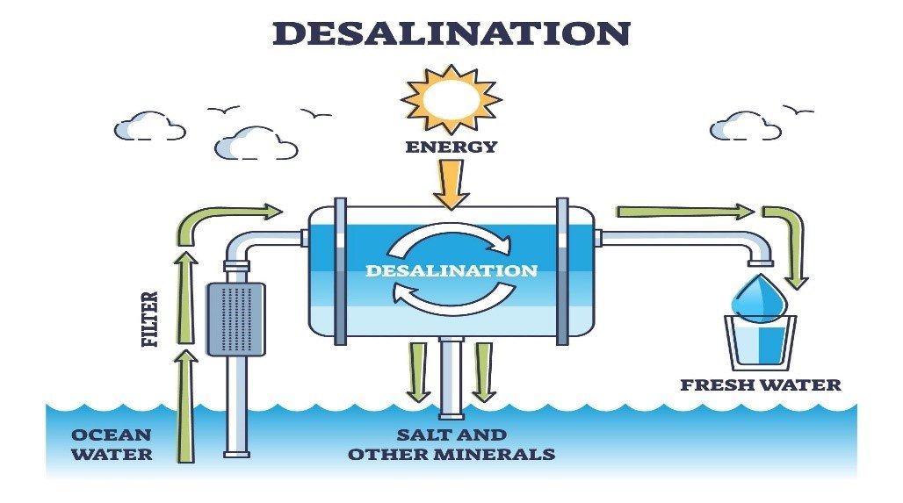
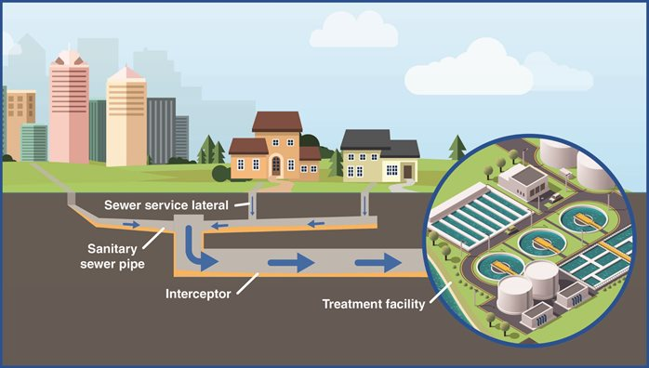
Solutions for water crisis in Jordan
Desalination of seawater and recycling of wastewater. Desalination can provide a safe drinking water to areas facing severe water scarcity.
Building and operating sustainable water and wastewater network, and waste water treatment facilities, leading to lower rates of water pollution

Slide 7
Citation
Water Resources & Environment: Basic page: Jordan. U.S. Agency for International Development. (2022, August 16). https://www.usaid.gov/jordan/water-resources-environment
Saiesha. (2022b, April 14). 7 facts about water scarcity in Jordan. The Borgen Project. https://borgenproject.org/water-scarcity-in-jordan/
| A. D. (2022, May 28). Water scarcity in Jordan: An overview. EcoMENA. https://www.ecomena.org/water-jordan/#:~:text=Groundwater%20resources%20account%20for%2054,of%20Jordan’s%20total%20water%20consumption.
Water stress in Jordan - Executive Summary. UNICEF Jordan. (n.d.). https://www.unicef.org/jordan/water-stress-jordan-executive-summary#:~:text=Longer%2Dterm%20indirect%20effects%20of,access%20to%20resources%20for%20production
Kolb, M. (2023, February 1). Matthew Kolb. Water Scarcity in Jordan: An Examination of the Causes behind the Crisis. https://www.norwich.edu/news/voices-from-the-hill/4043-water-scarcity-in-jordan-an-examination-of-the-causes-behind-the-crisis

