Slide 1
Earthquakes
By: Taimour, Rayan, Adam

Slide 2
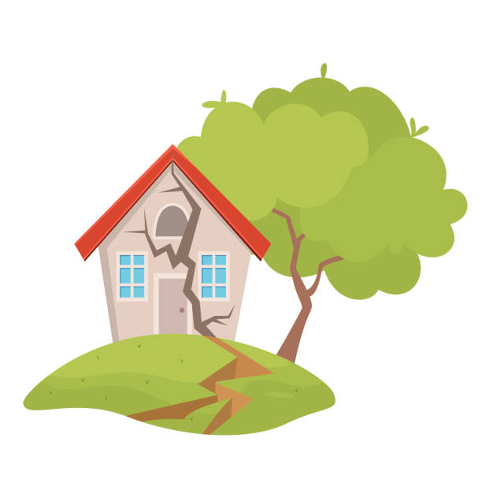
What Causes Earthquakes?
Notes:
An earthquake is caused by a sudden slip on a fault. The tectonic plates are always slowly moving, but they get stuck at their edges due to friction. When the stress on the edge overcomes the friction, there is an earthquake that releases energy in waves that travel through the earth’s crust and cause the shaking that we feel^{. Source: Usgs.gov}

Slide 3
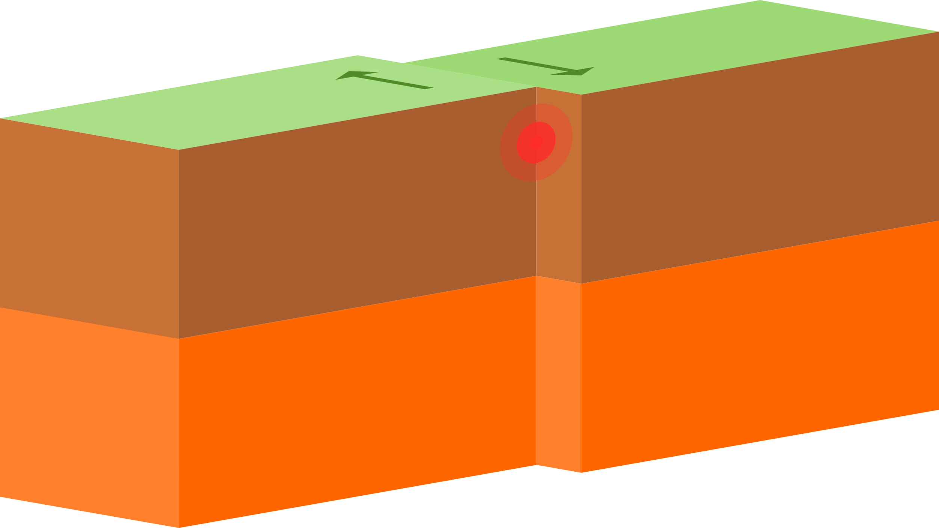
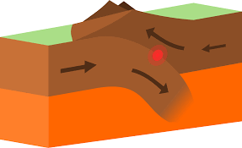
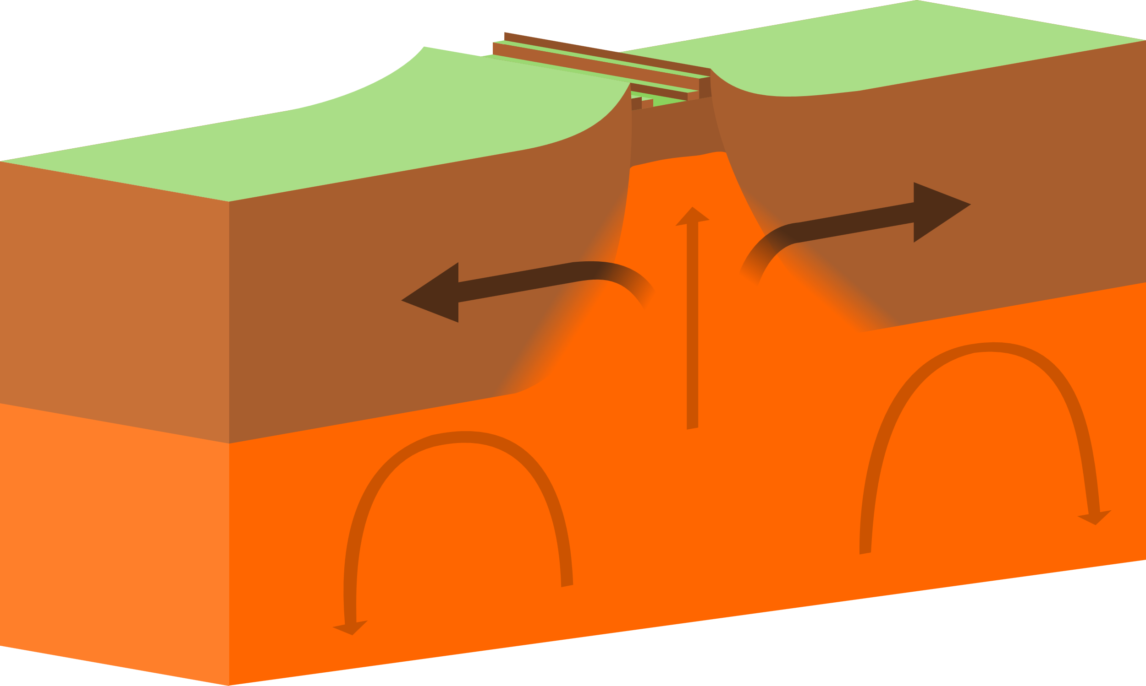
Different Types of Tectonic Plates
Notes:
The types of plate tectonic boundaries are divergent, convergent, and transform. Nationalgeographic.org

Slide 4
The effects of Earthquakes on the Environment
Notes:
Earthquakes can have a number of profound effects on local ecosystems. The most important effect earthquakes have is that they change habitats suddenly . Earthquakes can cause trees to fall, cliffs to crumble and caves to collapse, which can have trickle-down effects throughout the ecosystem usgs.com

Slide 5
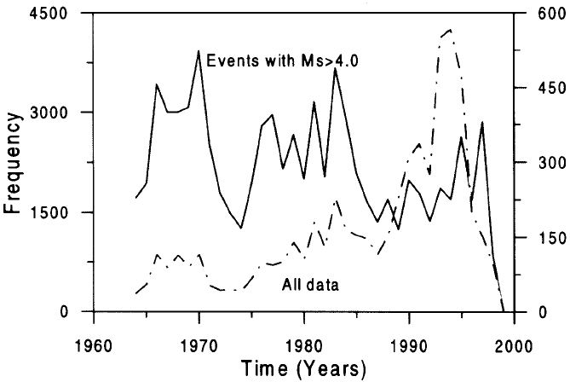
The factors that affect the intensity and frequency of earthquakes.
Notes:
When an earthquake strikes, the intensity of earthquake shaking determines the severity of damage. In turn, the main factors affecting earthquake shaking intensity are earthquake depth, proximity to the fault, the underlying soil, and building characteristics—particularly height. Source: USGS

Slide 6
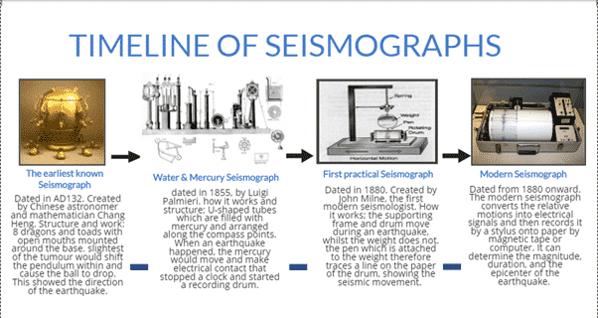
Methods used to detect, measure and predict earthquakes.
Earthquake casualties
Notes:
Seismometers allow us to detect and measure earthquakes by converting vibrations due to seismic waves into electrical signals, which we can then display as seismograms on a computer screen. Seismologists study earthquakes and can use this data to determine where and how big a particular earthquake is. earthquake.usgs.gov

Slide 7
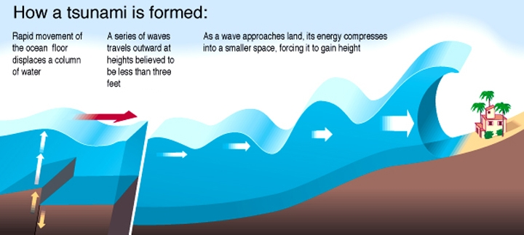
How is a Tsunami Formed?
Notes:
A tsunami is a series of extremely long waves caused by a large and sudden displacement of the ocean, usually the result of an earthquake below or near the ocean floor. This force creates waves that radiate outward in all directions away from their source, sometimes crossing entire ocean basins. Noaa.gov

