Slide 1

English project
By: Fawaz/Faris Saadeh/Yousef/Elias

Slide 2
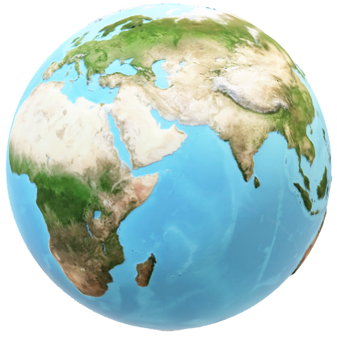
Overview of water crisis
Water covers 70% of our planet, and it is easy to think that it will always be plentiful. However, freshwater—the stuff we drink, bathe in, irrigate our farm fields with—is incredibly rare. Only 3% of the world’s water is fresh water, and two-thirds of that is tucked away in frozen glaciers or otherwise unavailable for our use.

Slide 3
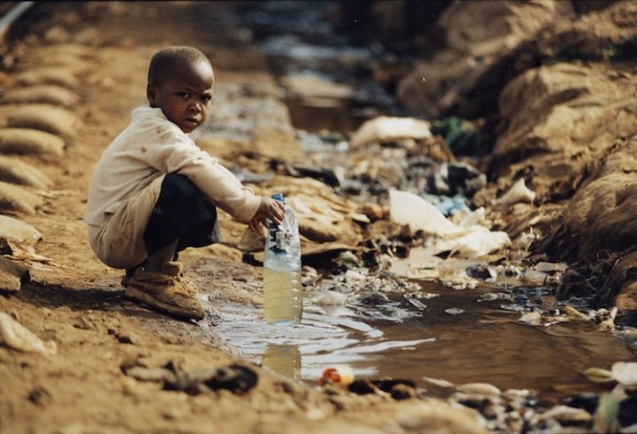
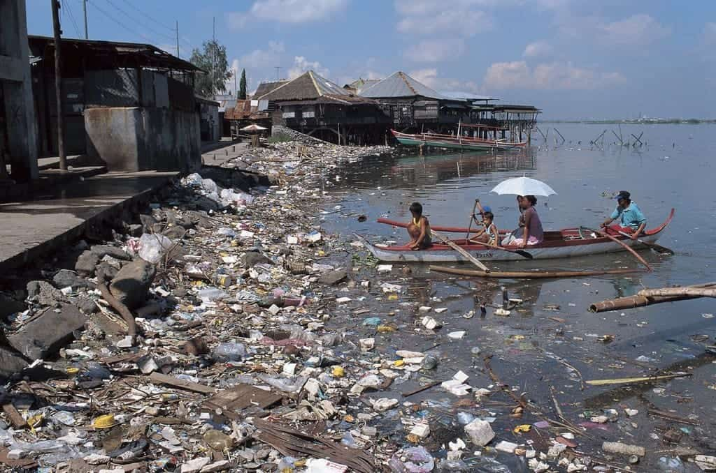
Issues of water crisis
Water pollution
Water shortage

Slide 4
Consequences of water crisis
Water pollution
Water shortage
It causes illnesses
It affects ecosystems
Lack of Access to Clean Water
Increased Global Conflict

Slide 5
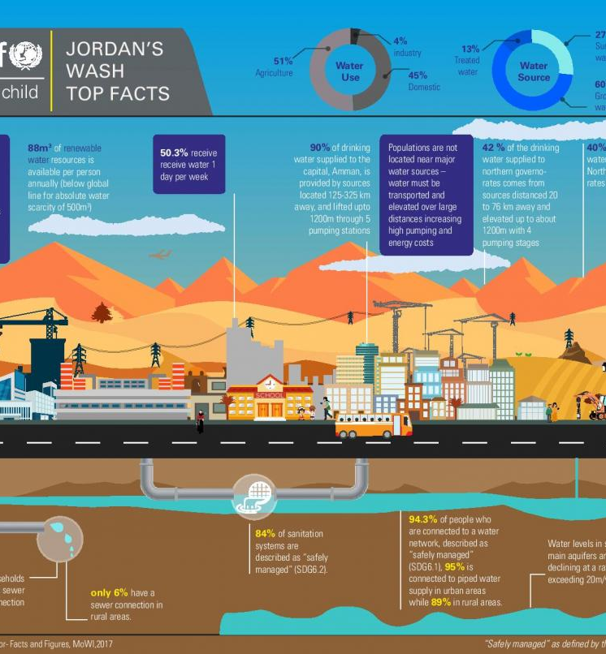
Causes of water crisis
    1. CLIMATE CHANGE
2. NATURAL DISASTERS
3. WAR AND CONFLICT
4. WASTEWATER
5. WATER WASTE
6. INEQUALITY AND AN IMBALANCE OF POWER

Slide 6
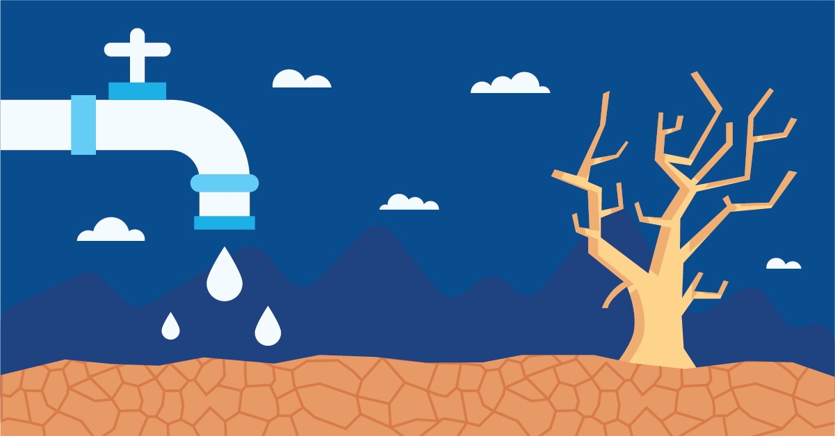
solutions for water crisis
Supporting vulnerable families in host communities with improved water systems and wastewater infrastructure that are sustainable and climate resilient and expanding coverage to unreached areas;
Improving WASH facilities

Slide 7
https://www.seametrics.com/blog/water-shortage-consequences/
https://www.concernusa.org/story/global-water-crisis-causes/
https://www.waterlogicaustralia.com.au/resources/blog/how-people-are-resolving-to-reduce-water-scarcity/
https://water.org/our-impact/water-crisis/
https://www.unicef.org/jordan/water-sanitation-and-hygiene

Slide 8


Thank you for listening

