Slide 1
Bullying
Done by hanna al farah. aoun azar. issa dihmes
https://www.youtube.com/watch?v=pDG1-BCZvTE

Slide 2

What is bullying introduction

Slide 3

Issue or problems in bullying

Slide 4

Reason of bullying

Slide 5
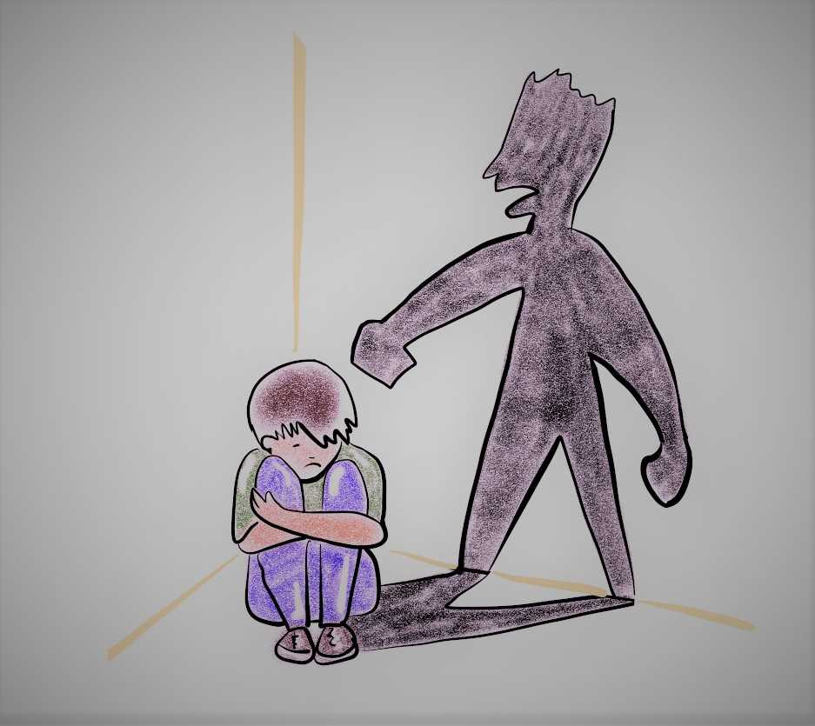
Solutions to bullying

Slide 6
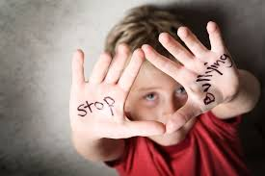
Type of bullyng

Slide 7
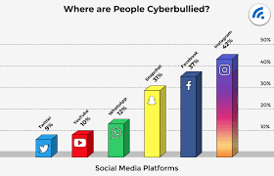
1-social bullying

Slide 8

2-Physical bullyin

Slide 9
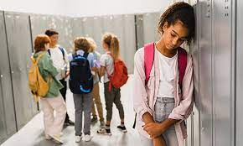
3-Verbal bullying

Slide 10
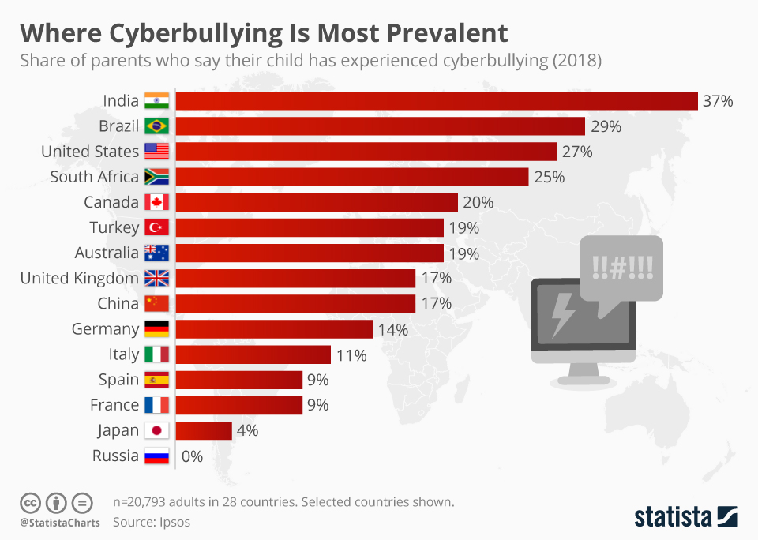
Persentage of bulling in contries
greece | 27% | 0.27 | 27 100
france | 20% | 0.20 | 20 100
russia | 37% | 0.37 | 37 100
sweden | 19% | 0.19 | 19 100

