Slide 1
Obesity
By : Jana,Thalia,Sinthya,Gianna

Slide 2
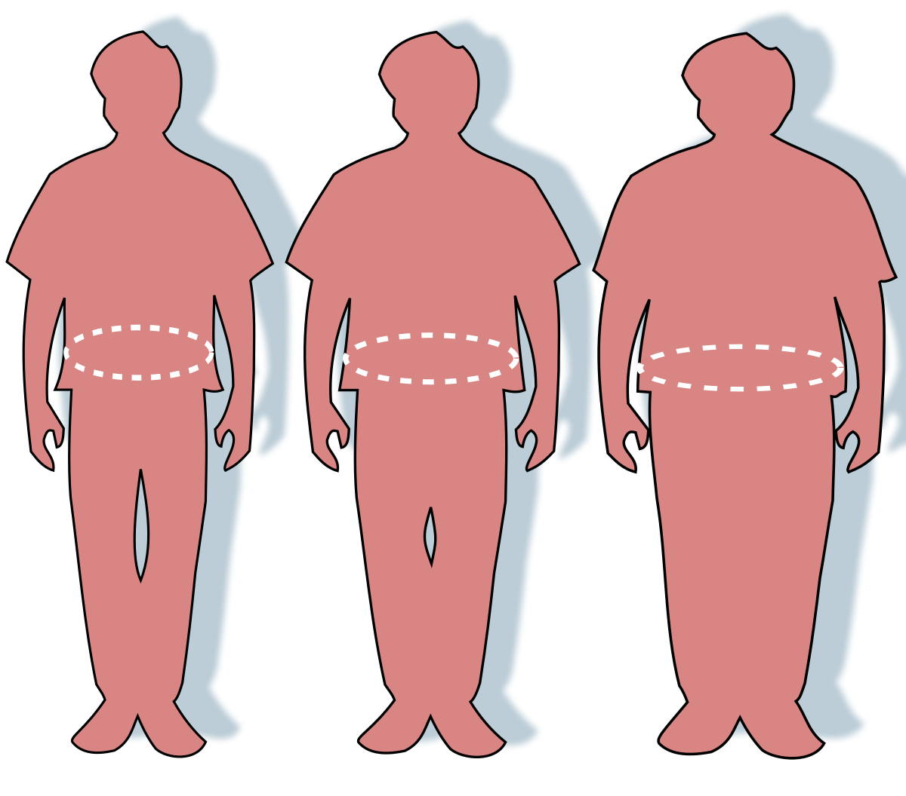
What is Obisety ?
Obesity is a complicated condition which involves an excess of body fat.
obesity is more than simply a physical issue. It is a medical condition that raises the risk of developing other diseases and health issues, such as heart, disease, diabetes, high blood, pressure, and some malignancies.

Slide 3
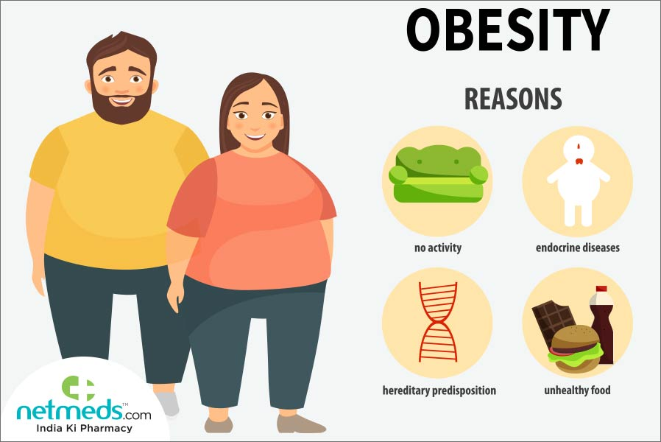
How/why obesity happens:
Obesity is typically created by overeating and inactivity. If you ingest a lot of energy, especially fat and carbohydrates, but don't burn it off through exercise and physical activity, your body will store a majority of it as fat.

Slide 4
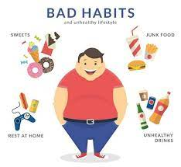
Consequences of obesity:
Carrying excess fat has major health consequences including cardiovascular illness (mainly heart disease and strokes), type 2 diabetes, joint disorders such as cartilage damage, and multiple cancers .
These conditions cause premature death and significant disability.

Slide 5
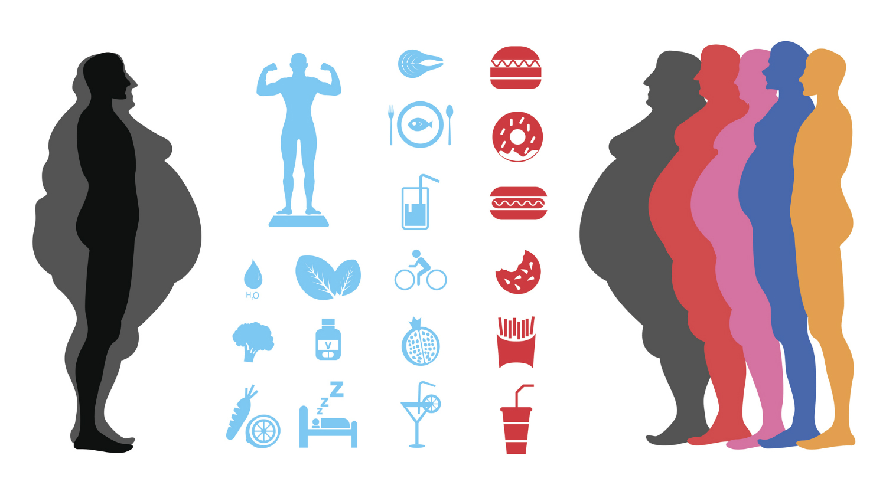
How to cure obesity
Obesity is best treated by eating a low-calorie diet and exercising regularly.
To accomplish this, you should follow the advice of your doctor or a weight loss control health expert (such as a nutritionist).

Slide 6
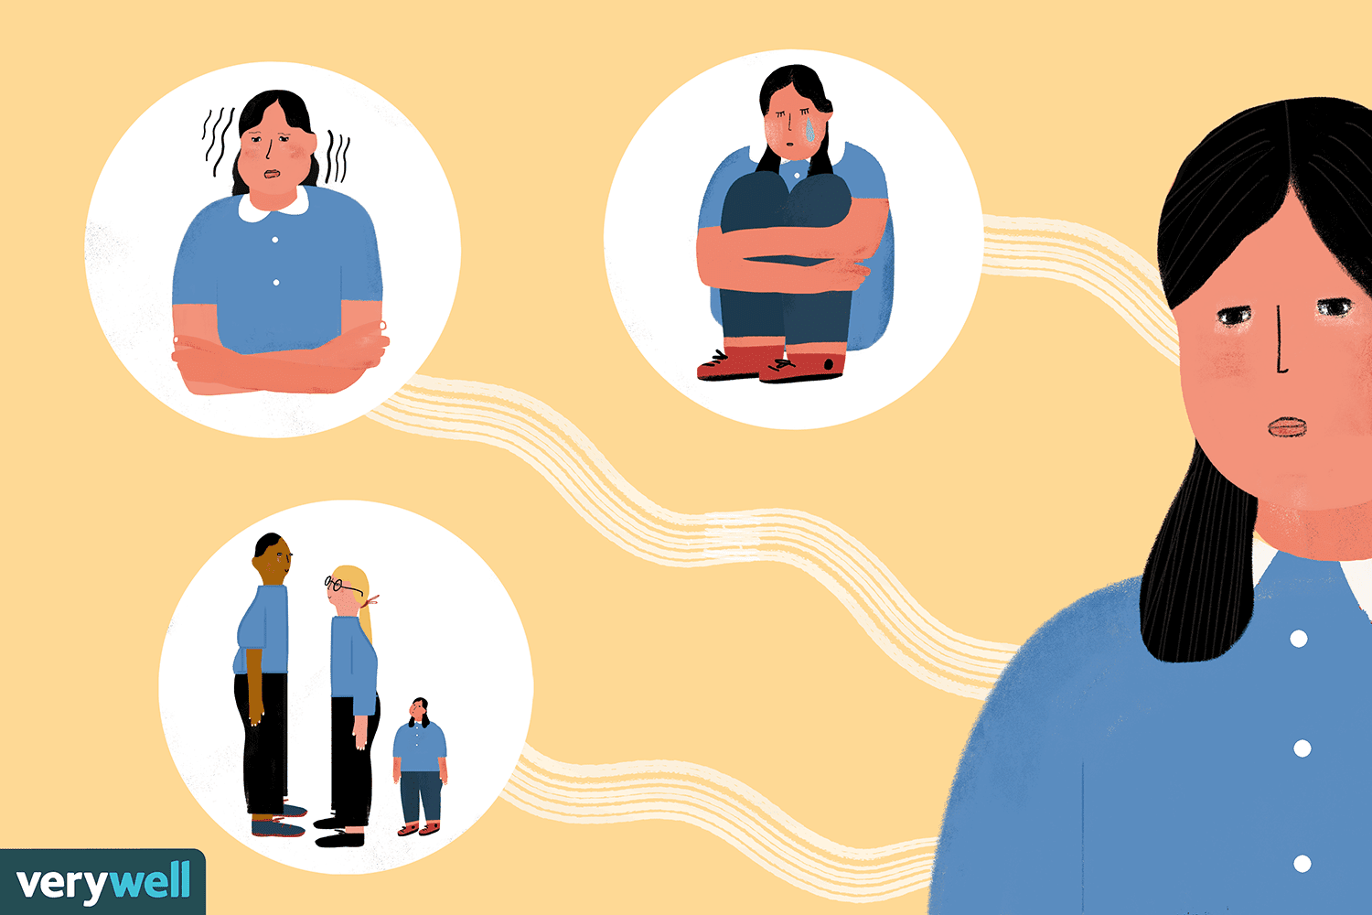
social effects of obesity
likely to encounter discrimination and bias more frequently in some contexts (such as the workplace, travel, education, healthcare, retail, etc.)
less friends.
lower level of education.
lower employment.

Slide 7
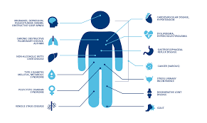
effects of obesity
Death from all causes (mortality).
Hypertension is a term for high blood pressure.
High triglyceride levels, low HDL cholesterol, or high LDL cholesterol (dyslipidemia).
diabetes type 2.
cardiovascular disease.
Stroke.
gallbladder illness.

Slide 8
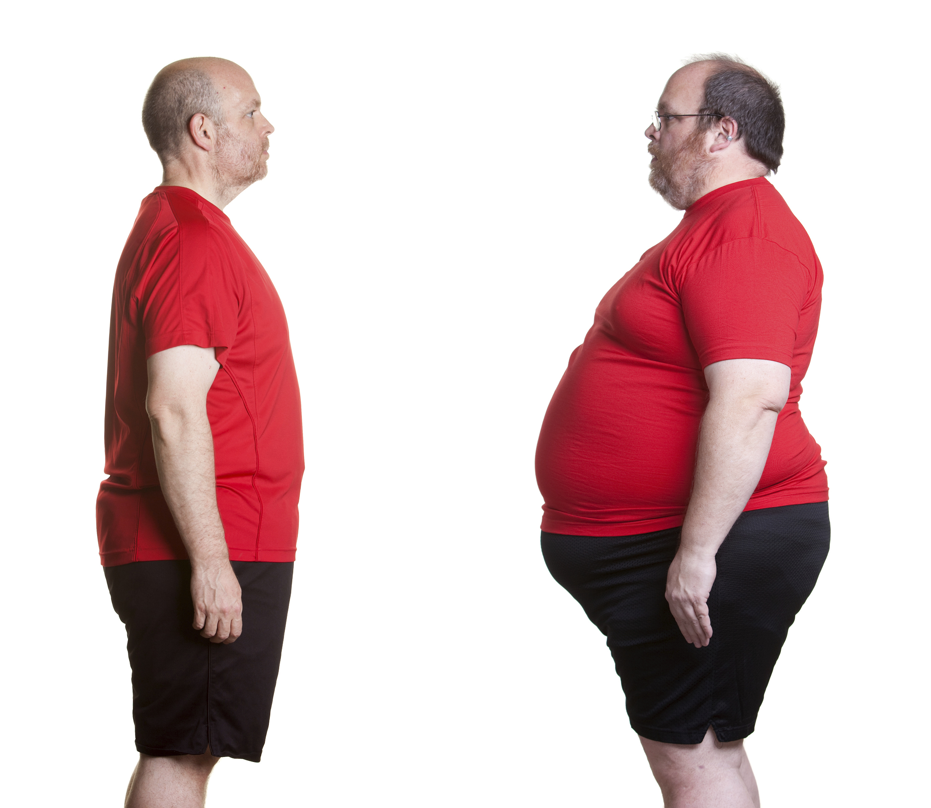
How to prevent Obisity
Making healthier food and drink choices, (such as whole grains, fruits, vegetables, healthy fats, and sources of protein.)
Limiting unhealthy foods (red meat, processed meat, potatoes, refined grains, and sweets) and liquids (sugary drinks)
raising the level of exercise. limiting one's exposure to screens,
television, and other "sit time”
Getting rid of bad habbits
Avoiding stress

Slide 9
resources
https://www.who.int/health-topics/obesity#tab=tab_1
https://www.hsph.harvard.edu/obesity-prevention-source/obesity-causes/#:~:text=Many%20factors%20influence%20body%20weight,food%20and%20physical%20activity%20environment.
https://www.nhs.uk/conditions/obesity/causes/
https://www.cdc.gov/genomics/resources/diseases/obesity/obesedit.htm#:~:text=One%20gene%20or%20many%3F,encodes%20the%20melanocortin%204%20receptor.
https://www.nicswell.co.uk/health-news/there-are-six-different-types-of-obesity-study-argues
https://obesitymedicine.org/why-is-obesity-a-disease/#:~:text=Obesity%20is%20a%20chronic%20disease,%2C%20joint%20diseases%2C%20and%20more.
https://www.mayoclinic.org/diseases-conditions/obesity/symptoms-causes/syc-20375742

