Slide 1
BULLYING
Done By: George Barjeel/Saif Haddad/Rami Hamarneh

Slide 2
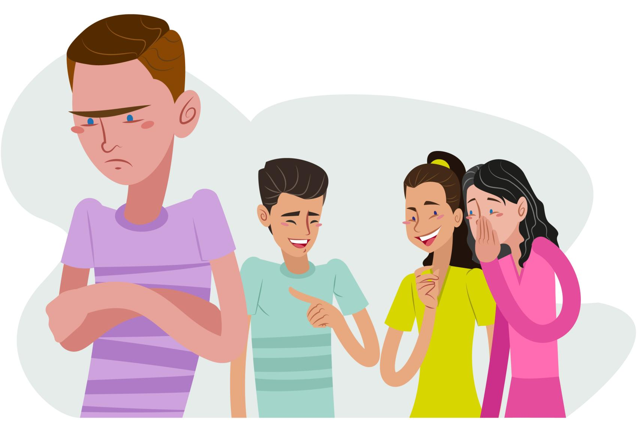
is unwanted aggressive behavior among school-age children that involves or perceived imbalance of power.

Slide 3
Types of bullying:
https://www.positiveaction.net/blog/physical-bullying
https://antibullyingsoftware.com/what-is-the-definition-of-verbal-bullying/
https://www.positiveaction.net/blog/social-bullying
physical
verbal
social
cyber

Slide 4
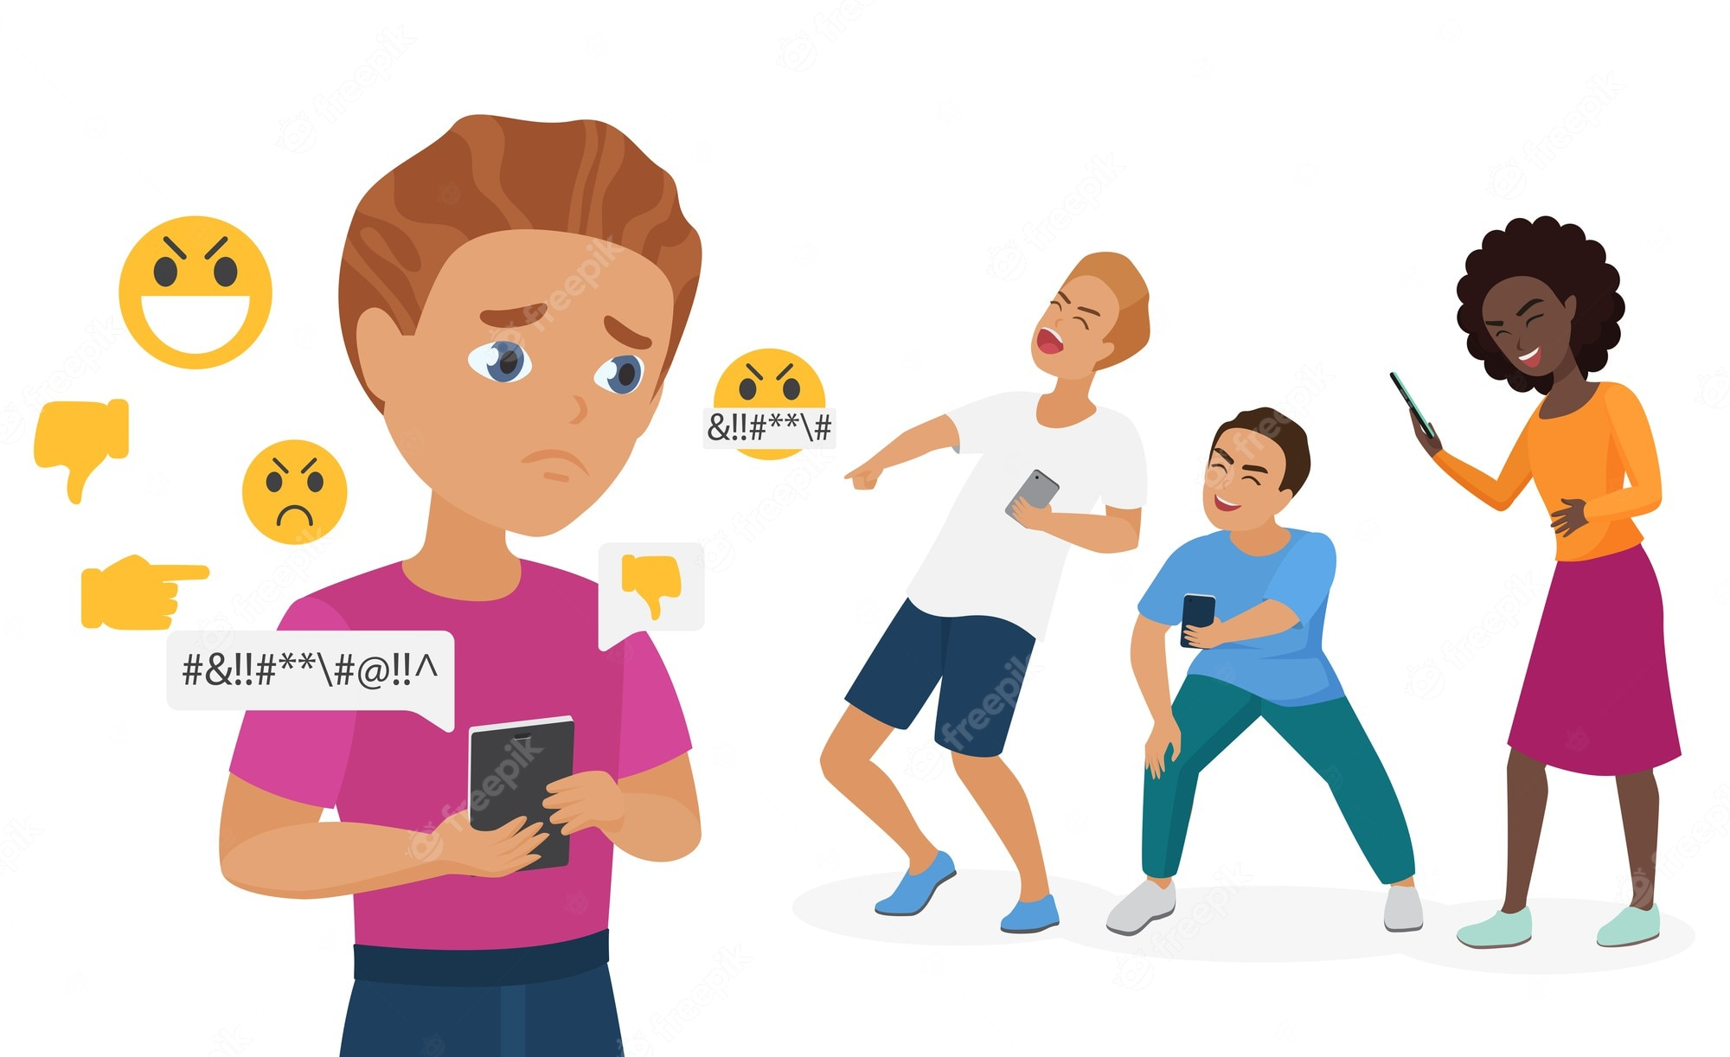
What are the problem off bullying?
Sometimes the cause of bullying is family problems, or the person who is young sees everyone bullying around him so he thinks that bullying is normal

Slide 5
solution
-Be friend to someone who is bullied
-stand up to the bully
-help people understand bullying
-keep the line of communication open
-encourage kids to do what they love

Slide 6
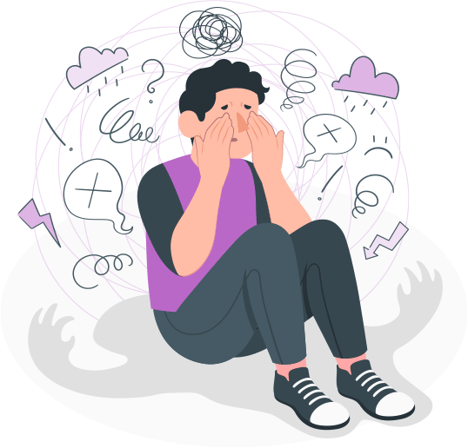
Consequences
Being bullied can leave you feeling helpless, humiliated, depressed, or even suicidal

Slide 7
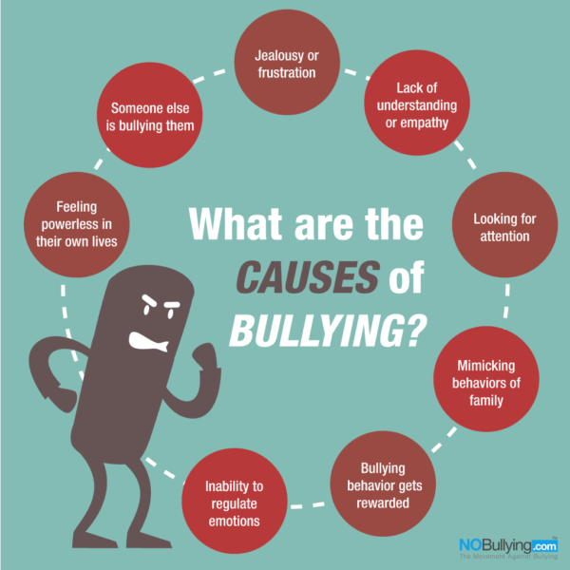
What are the causes of bullying?
Bullying happens most to people whose religonis different,the national and color

Slide 8
The percentage of bullying in jordan
The year | percentage | A decimal fraction | Normal break
2000 | 47% | 0.47 | $$\frac{47}{100}$$
2005 | 5.3% | 0.053 | $$\frac{5.3}{100}$$
2015 | 5.3% | 0.053 | $$\frac{5.3}{100}$$
2020 | 1.7% | 0.017 | $$\frac{1.7}{100}$$

Slide 10
The percentage of bullying in countries
The country | The year | Percentage | A decimal fraction | Normal break
USA | 2000-2020 | 44.6% | 0.446 | $$\frac{44.6}{100}$$
Japan | 2000-2020 | 49.2% | 0.492 | $$\frac{49.2}{100}$$
Saudi Arabia | 2000-2020 | 41.1% | 0.411 | $$\frac{41.1}{100}$$
Palestine | 2000-2020 | 98% | 0.98 | $$\frac{98}{100}$$

Slide 12
https://youtu.be/w6FfxnhRssw

