Slide 1
Circuit Simulations
By: Sanad kakish, Saif jumaian, George fakes, Jad gammoh
8F

Slide 2
Introduction
In this PowerPoint we will tell you about all the circuit simulations we designed for the house that consists of a living room, bathroom, kitchen, bedroom.

Slide 3
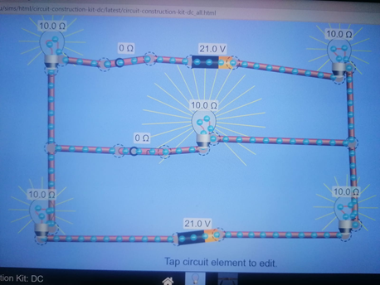
Living Room
The four lights bulbs on the sides are LED light bulbs and the bulb on the center is the main bulb of the room and it is a CFL light bulb.
The first switch which is the switch next to the battery is the main switch it controls all the four switches on the sides.

Slide 4
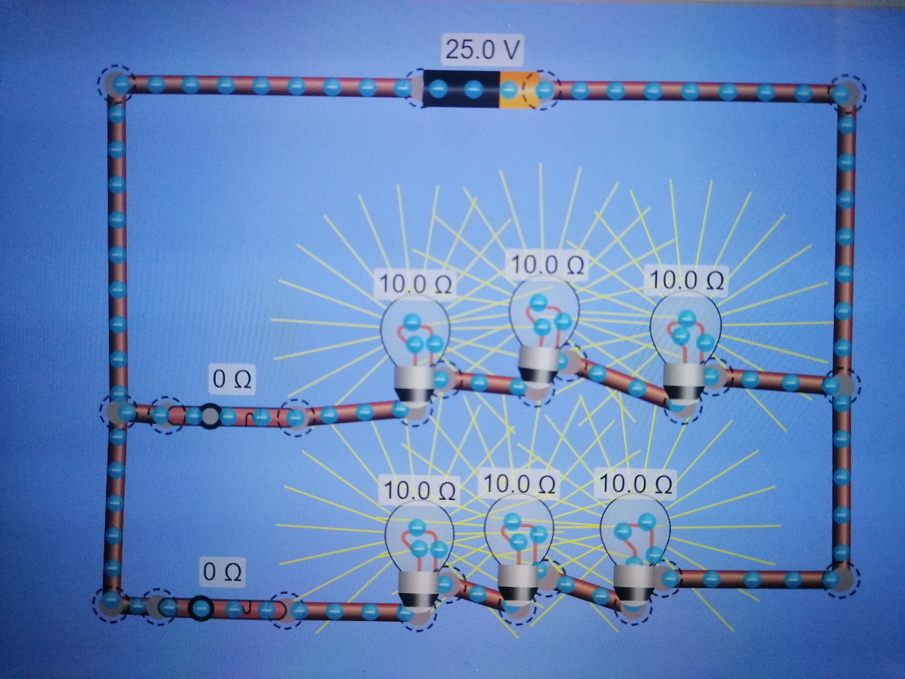
bedroom
In the first and second branch the middle bulb is a motion activated bulb. The bulbs on the sides are LED light bulbs.
2 switches 1 for each branch.

Slide 5
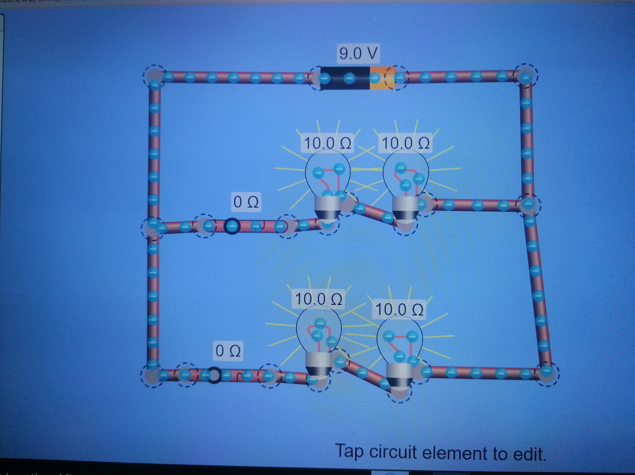
kitchen
All the light bulbs on both branches are LED light bulbs.
2 switches 1 on each branch so each branch can turn on and off independently.

Slide 6
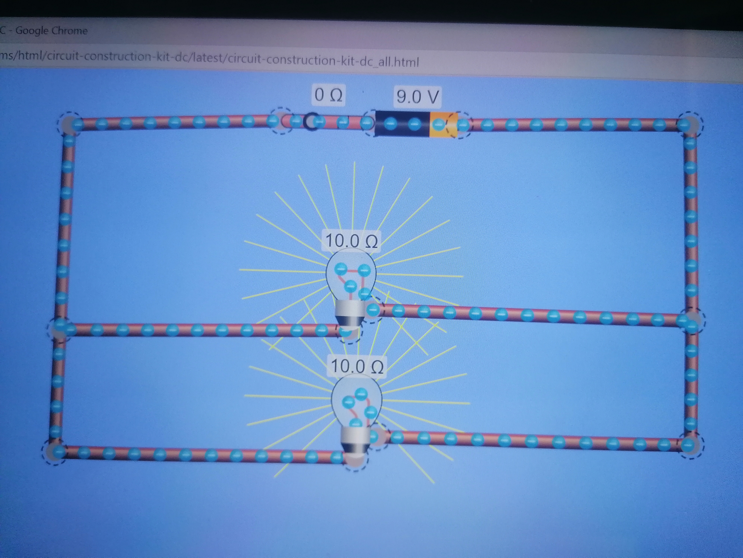
bathroom
The 2 light bulbs are CFL light bulbs.
1 switch next to the battery so it can turn both light bulbs on and off.

