Slide 1
Circuit diagrams for physics
By: Sanad, Saif, Jad g, George

Slide 2
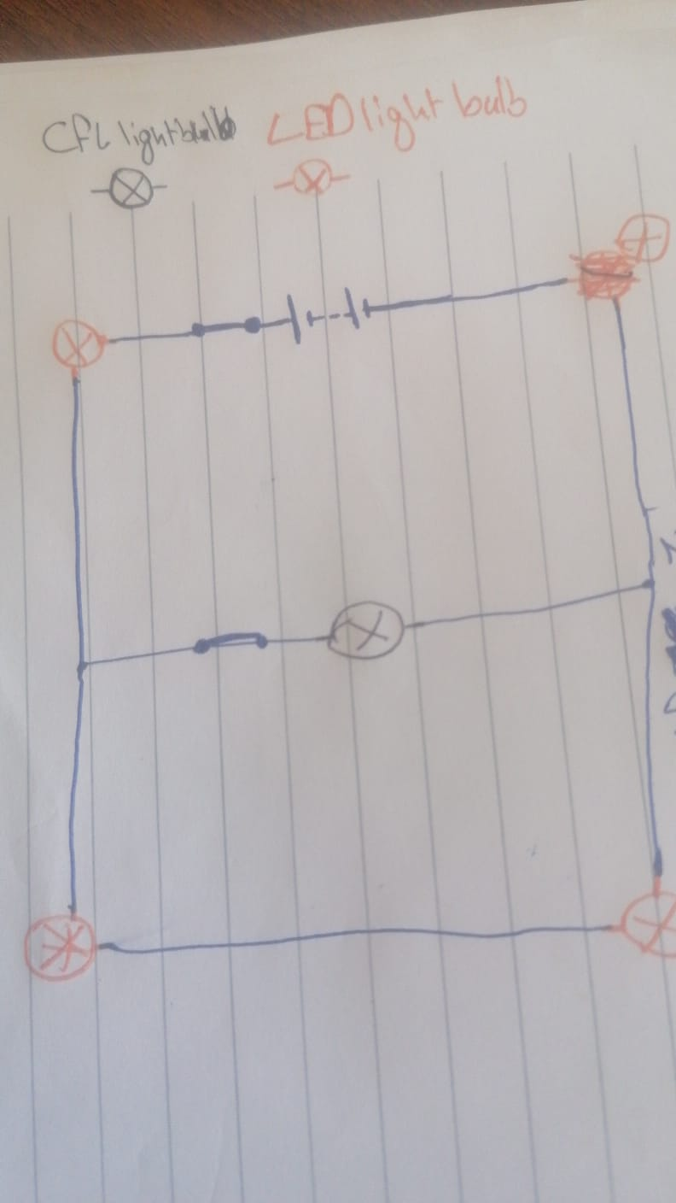
Living room

Slide 3
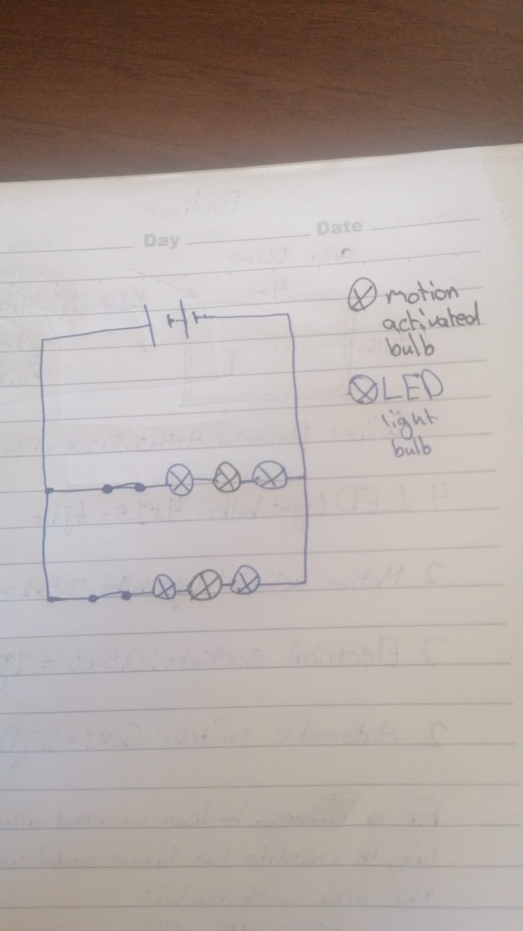
Bedroom

Slide 4
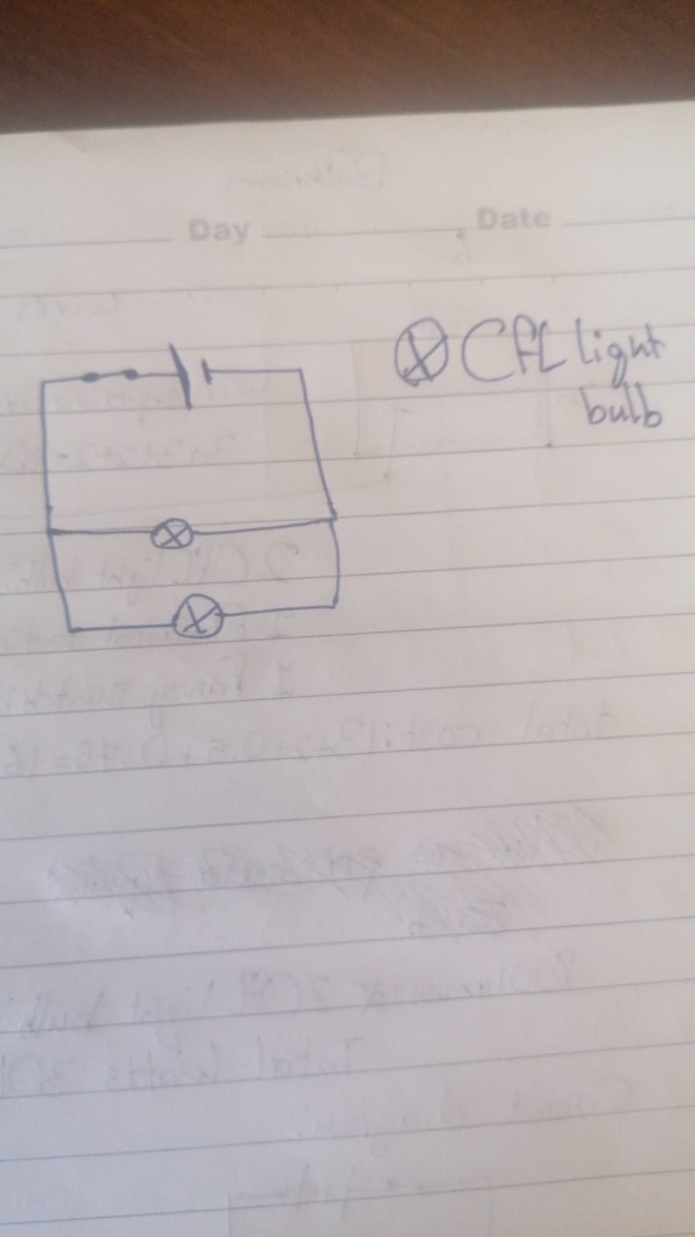
Bathroom

Slide 5
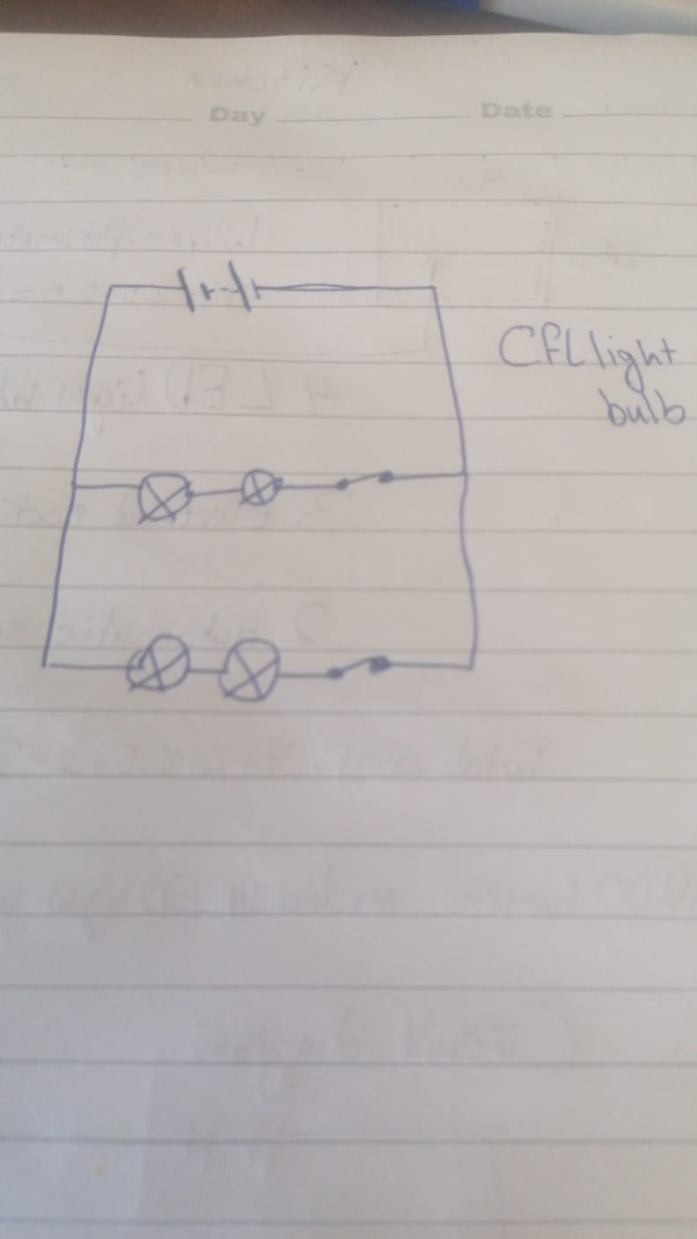
Kitchen

