Slide 1
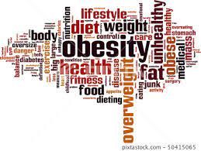
Obesity
By:, Raja’i El Ghoury, Sanad Al Halasa, Ja’afar Dajani and Yazan Abu Qudais

Slide 2
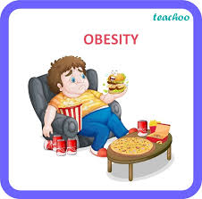
What Exactly Is Obesity?
Obesity, also known as overweight, is a complicated disease. It is when the amount of body fat increases dramatically, which makes the obese person has several health problems, such as heart diseases, high blood pressure, diabetes, some types of cancer, and others; which happens to make a mental impact on the obese person making him feel rejected and embarrassed to engage in society.

Slide 3
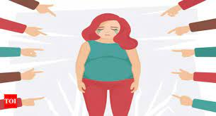
What Are The Mental Effects Of Obesity?
Excessive obesity causes a loss of self-confidence, anxiety, and fear of confronting people. Because the obese person feels embarrassed, ashamed and that he is an unwanted person, he may also be subjected to bullying, which leads him to withdraw himself and stay away from society.

Slide 4
What Causes Obesity?
The main reason behind obesity lies in consuming a large number of calories that exceeds their consumption limits which leads to an increase in the amount of body fat.
The causes usually are under a few factors: genetic, environmental, some diseases, moreover choosing an unhealthy diet, since it includes a large number of complex carbohydrates and simple carbohydrates and who does not usually exercise a lot.

Slide 5
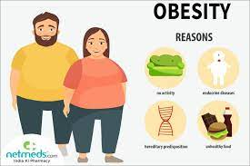
In addition to several factors, including:
Not Sleeping Enough
Smoking
Drinking Alcohol
Getting older
Infection with some diseases such as thyroid lethargy
Some Medicines, such as cortisone
Increased laziness and lack of movement due to excessive reliance on transportation (excessive use of cars)
Lack of exercise

Slide 6
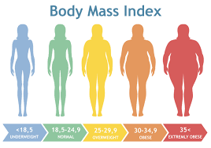
Calculating the appropriate weight for a person is possible by calculating the individual’s
body weight index in kilograms divided by the person’s height in meters.
BMI= Body Weight In Kilograms
Height in Meters Squared
The types of obesity are categorized as follows:
Normal Weight up to 24.9 BMI
Overweight From 25 BMI to 29.9 BMI
Obesity From 30 BMI to 39.9 BMI
Morbid Obesity is over 40 BMI
This index can be considered the best weight classification scale, as it can be used for both genders.

Slide 7
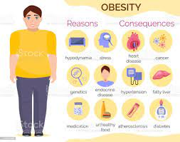
What Are The Side Effects Of Obesity?
Excessive obesity increases the risk of several diseases, such as:
Hypertension
Diseases of the joints
Sleep apnea
Fatty liver, leading to liver failure (cirrhosis)
Depression
Loss of Self-Confidence
Social Anxiety
Excessive obesity leads to an increase in the number of deaths in the world, as this applies to all countries except for parts of Africa and East Asia.

Slide 8
How to overcome the fear of confronting people?
Some ways are:
Complacency; because the world sees you the same way you see yourself.
To have a fun personality.
Body language (walking confidently and lightly among others).
Maintaining cleanliness.
Wear elegant clothes; to raise the morale of the obese person.
Respect and courtesy of others.
Accept rejection from others.
Seek help from psychologists.

Slide 9
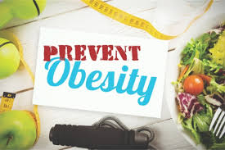
What are some ways of preventing obesity?
Here are some ways:
Adapting a healthy diet
Exercising regularly
Monitoring their weight
Getting a decent amount of sleep (6-8 hours)
Visit a dietitian with good reviews
If needed visit a doctor for fat removal surgery

Slide 10
What is the best course of action?
Firstly the obese person should use ways of preventing obesity and must be willing to do it. Secondly, it will be for the fast food restaurants, as they serve high sugar meals from unnatural recourses. So health organizations should confront them and persuade them to stop using unnatural and unhealthy resources and start using more natural and healthy resources.
If they don’t agree then the organizations should raise awareness about obesity. To add on, even if they accepted to start using natural resources, they should still raise awareness about obesity. This will cause a significant loss in the number of obese people.

Slide 11
Thanks For Listening!

Slide 12
Resources
“Obesity.” Mayo Clinic, 2 Sept. 2021, www.mayoclinic.org/diseases-conditions/obesity/symptoms-causes/syc-20375742
“Obesity and Overweight.” World Health Organization, 19 June 2021, www.who.int/news-room/fact-sheets/detail/obesity-and-overweight
“Obesity: Causes, Types, Prevention & Definition.” Cleveland Clinic, 13 June 2022, https://my.clevelandclinic.org/health/diseases/11209-weight-control-and-obesity
“Health Effects of Overweight and Obesity.” Centers for Disease Control and Prevention, 24 Sept. 2022, www.cdc.gov/healthyweight/effects/index.html
“Building Self Confidence .” بناء الثقة بالنفس،الثقة بالنفس, www.feedo.net/QualityOfLife/Success/BuildingSelfConfidence.htm

