Slide 1
Earthquakes
By: Adam.N, Saif.G, Mustafa, Kareem, Khalil

Slide 2
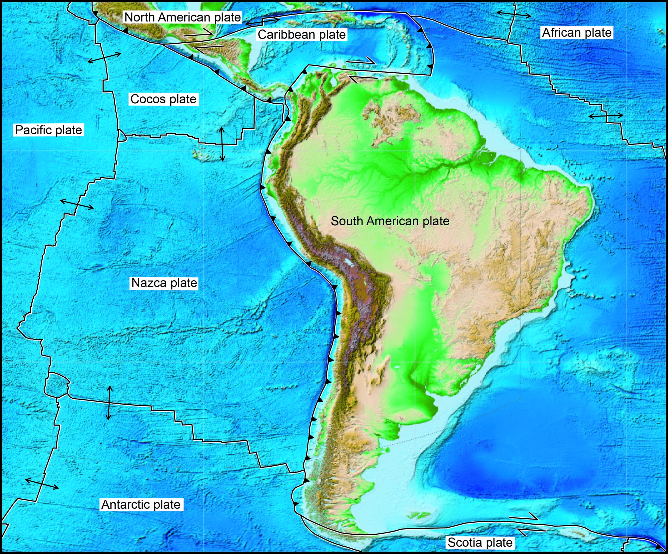
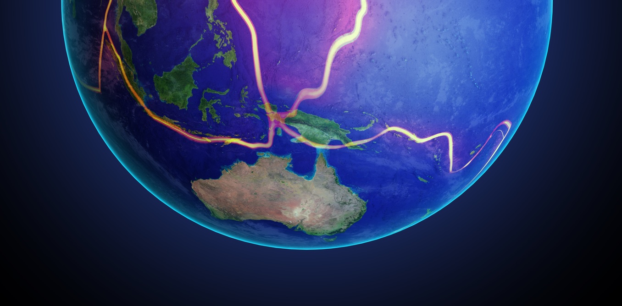
Plate tectonics
Notes:
Plate tectonics is a scientific theory that explains how major landforms are created as a result of earths subterranean movements. There are three kinds of plate tectonic boundaries: divergent, convergent and transform plate boundaries. About 80% of earthquakes occur where plates are pushed together, called convergent boundaries. Below the tectonic plates lies the Earth’s asthenosphere. The asthenosphere behaves like a fluid over very long time scales. There are a number of competing theories that attempt to explain what drives the movement of tectonic plates.

Slide 3
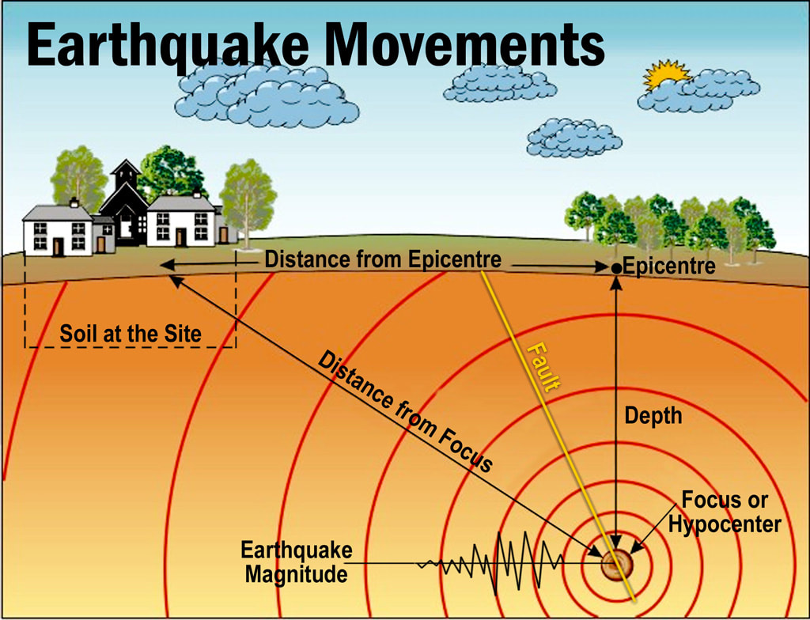
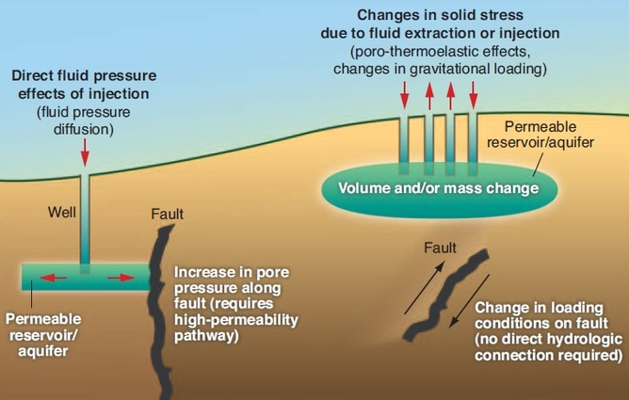
The causes and effects of earthquakes
Notes:
An Earthquake is a sudden trembling of the surface of the Earth. Earthquakes certainly are a terrible natural disaster.
Earthquakes are the result of sudden movement along faults within the Earth.
The dangerous effects of earthquakes are ground shaking, ground rupture, landslides, tsunamis, damage to buildings, and liquefaction. Fires are the most destructive secondary effect of earthquakes. Earthquakes are caused due to sudden tectonic movements in the earth's crust. When the tectonic plates slide over one another, there is a cause of orogeny which results in earthquakes and volcanoes. These disturbances cause vibrations that spread in all directions.

Slide 4
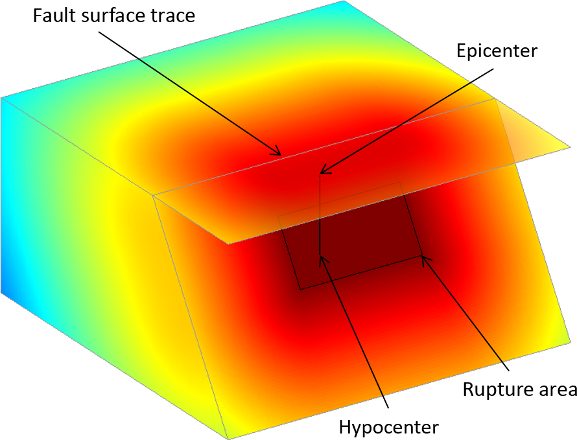
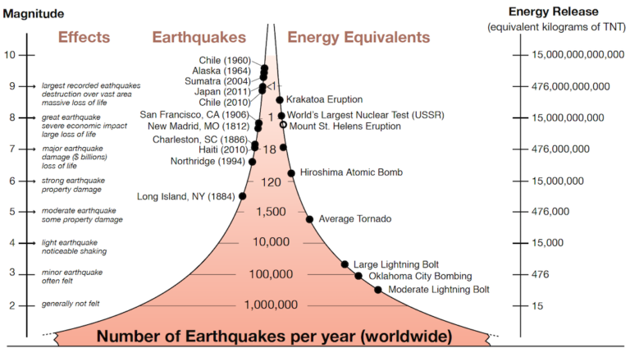
The factors that affect the intensity and frequency of Earthquakes
Notes:
When an earthquake strikes, the intensity of earthquake shaking determines the severity of damage. In turn, the main factors affecting earthquake shaking intensity are earthquake depth, proximity to the fault, the underlying soil, and building characteristics—particularly height.

Slide 5
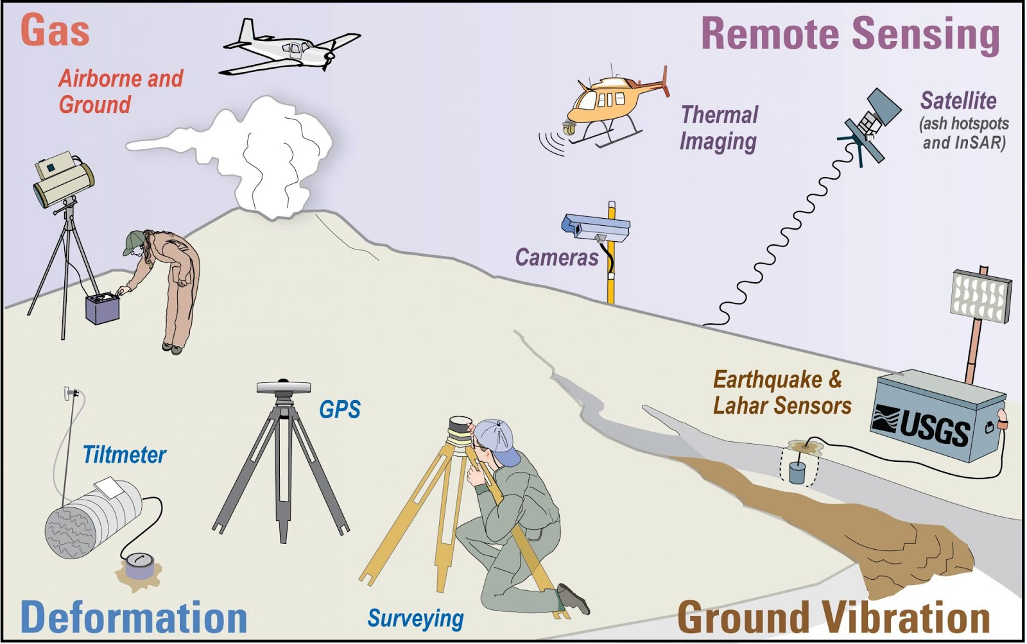
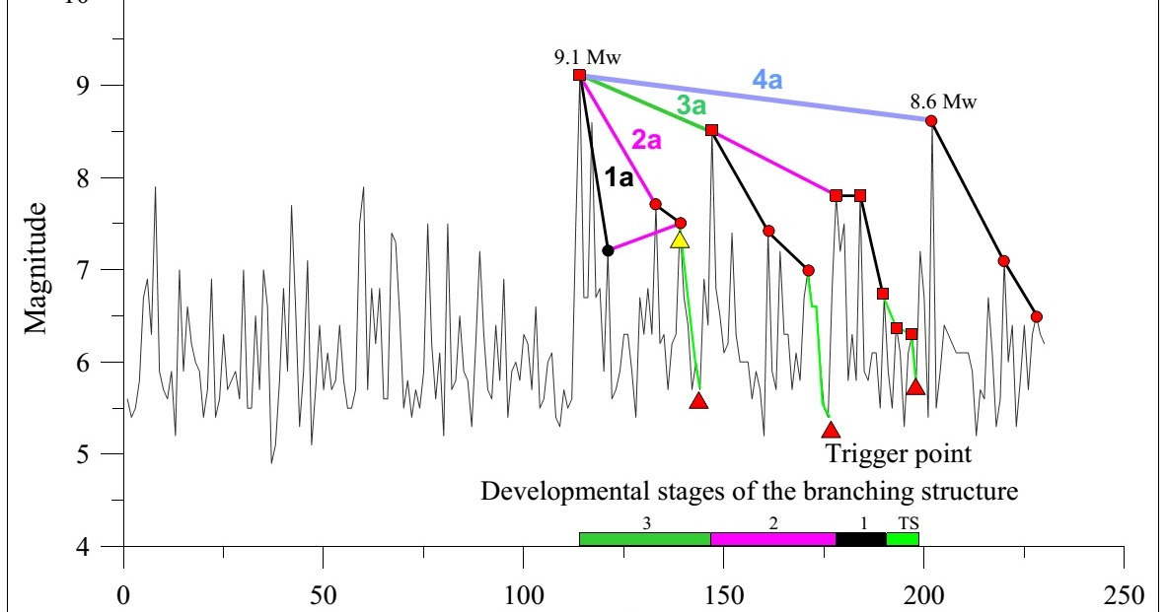
Methods used to detect, measure and predict earthquakes
Notes:
Scientists estimate earthquake probabilities in two ways: by studying the history of large earthquakes in a specific area and the rate at which strain accumulates in the rock. Scientists study the past frequency of large earthquakes in order to determine the future likelihood of similar large shocks. The first widely-used method, the Richter scale, was developed by Charles F. Richter in 1934. It used a formula based on the amplitude of the largest wave recorded on a specific type of seismometer and the distance between the earthquake and the seismometer.

Slide 6
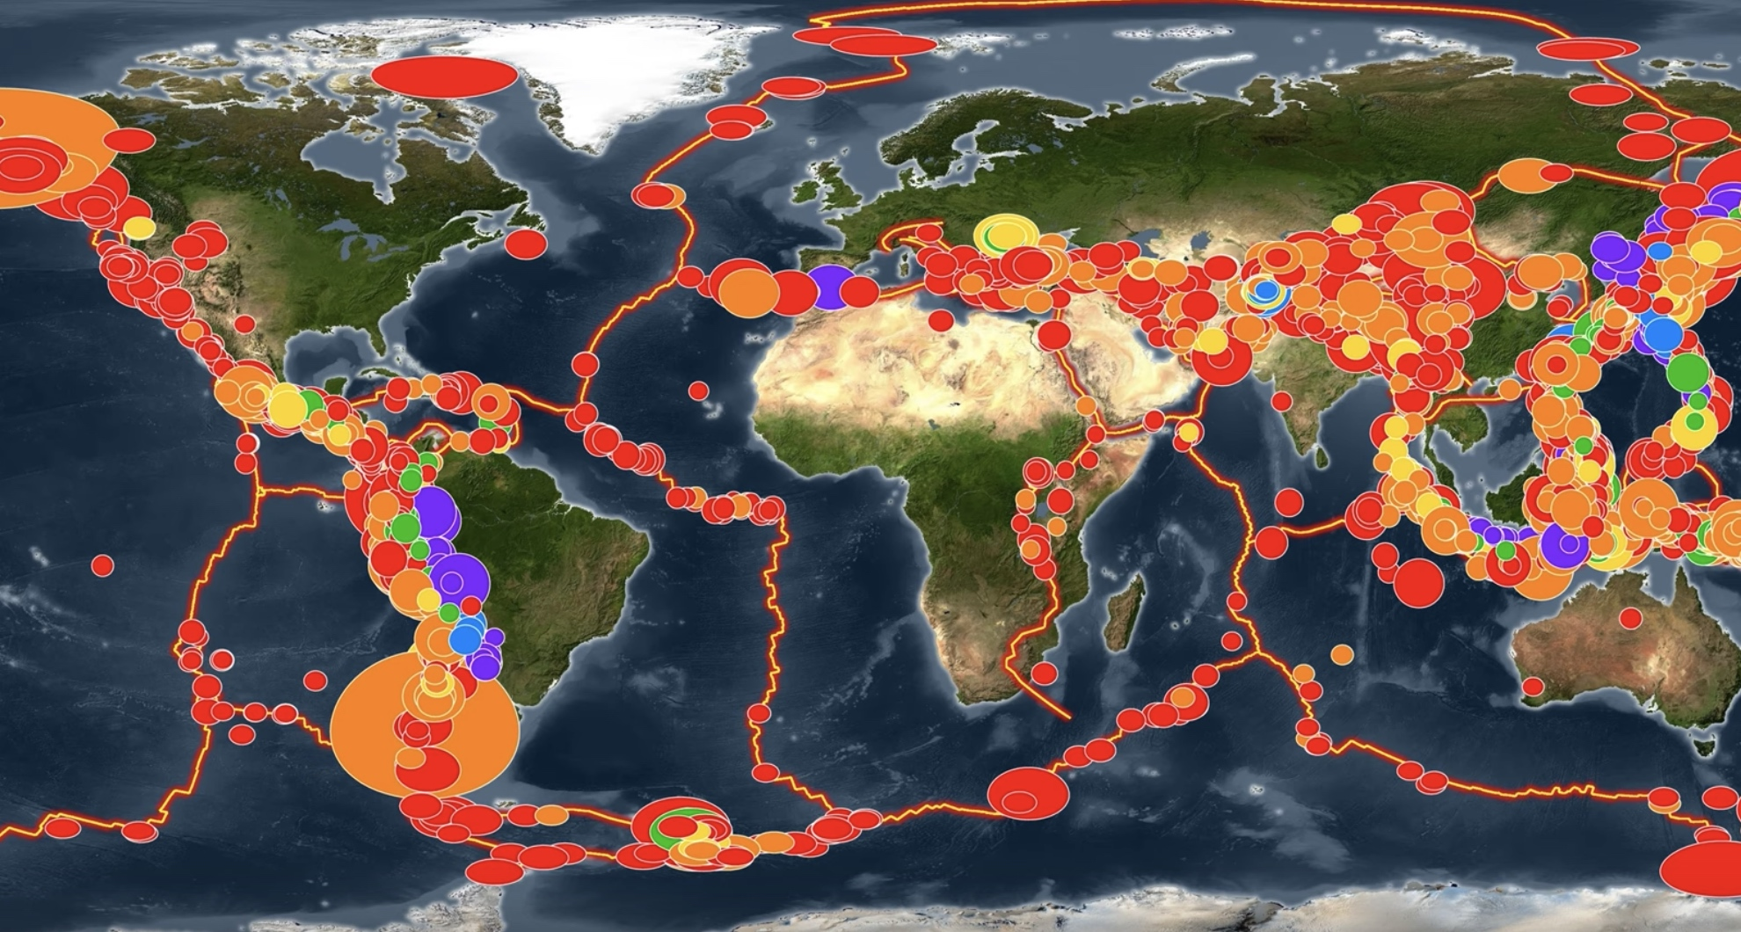
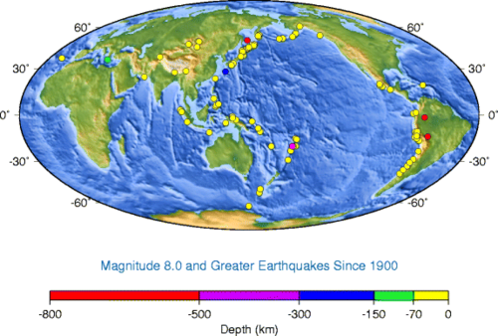
The impacts of earthquakes on the natural environment and ecosystem
Notes:
Earthquake environmental effects are the effects caused by an earthquake, including surface faulting, tsunamis, soil liquefactions, ground resonance, landslides and ground failure, either directly linked to the earthquake source or provoked by the ground shaking. The damages and losses brought by disasters, such as earthquakes, floods, hurricanes, cyclones and so on, can potentially have significant and intense impacts on a nation’s economy. However, despite the importance of assessing the economic impacts of damages and losses in the aftermath of such events, estimating the impacts is rather challenging.

Slide 7
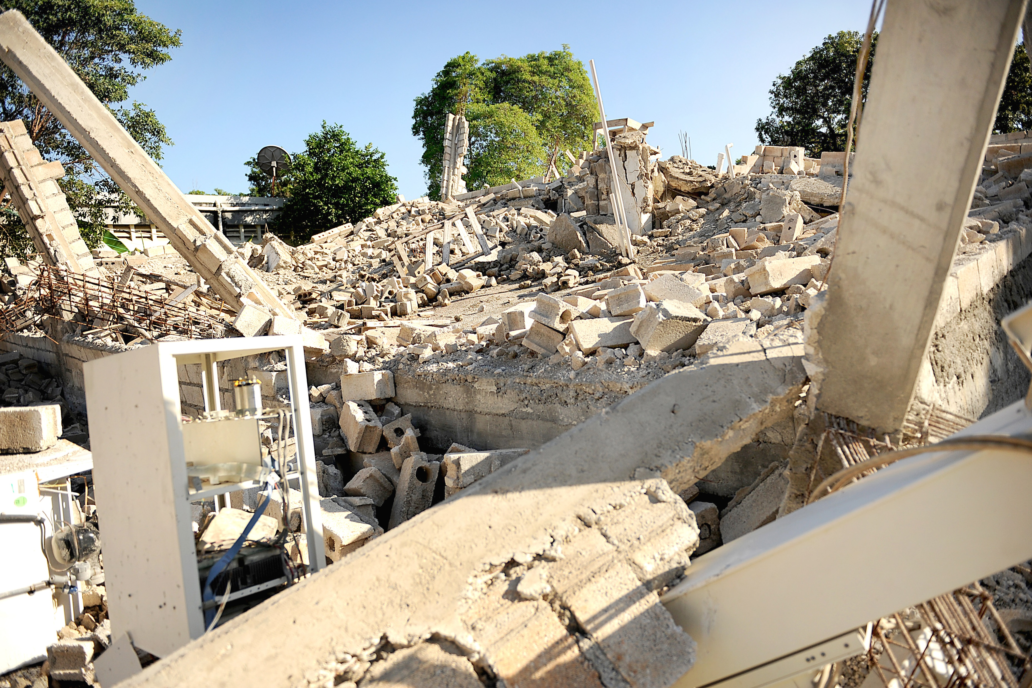
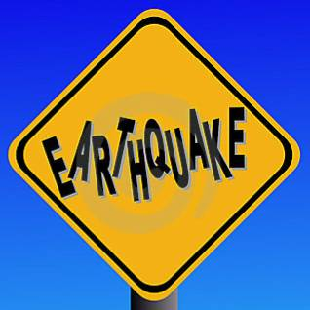
Arguments with reasoning for earthquakes
Notes:
In his recent publication (Albala-Bertrand 2007), Albala-Bertrand analyzed the effect of globalization on disaster impacts from an economic perspective. His main conclusions are: 1. Disaster impacts, such as casualties and economic losses, will be economically localized and thus are unlikely to influence negatively the national economy, even in a long run. 2. Positive features of globalization, like access to larger markets and suppliers, etc., may lead to even more localization of disaster impacts, while negative features of globalization, which are fast efficiency and productivity improvements through privatization and deregulations and lead to thinner and weaker social fabric against emergency situations, make localized disaster impact much more condensed into the local community than before. 3. The synchronization of business cycle caused by globalization, especially with the US economy, may regulate the financial capability for disaster response of the world, especially when the leading economies are under recession.

Slide 8
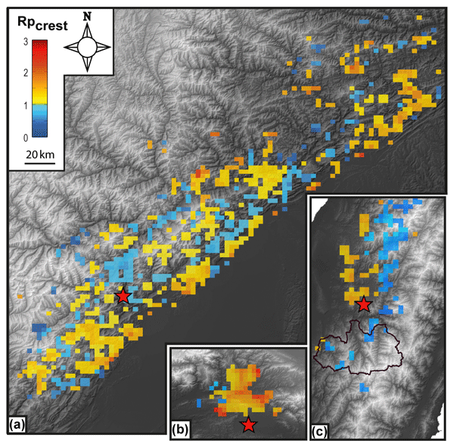
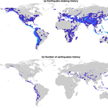
The causes of global and local issues of earthquakes
Notes:
Earthquakes occur when the ground is subjected to so much force that it fractures or breaks. Most earthquakes are associated with tectonic plate boundaries. Induced quakes are caused by human activity, like tunnel construction, filling reservoirs and implementing geothermal or fracking projects.

Slide 9
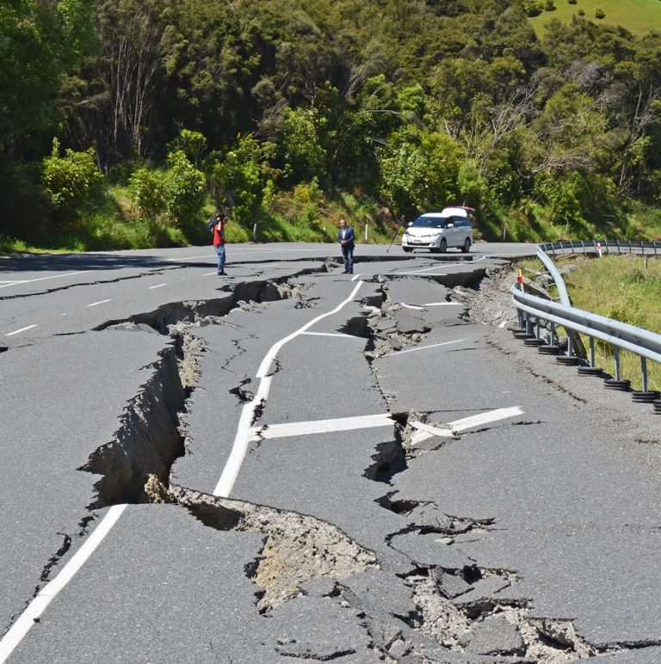
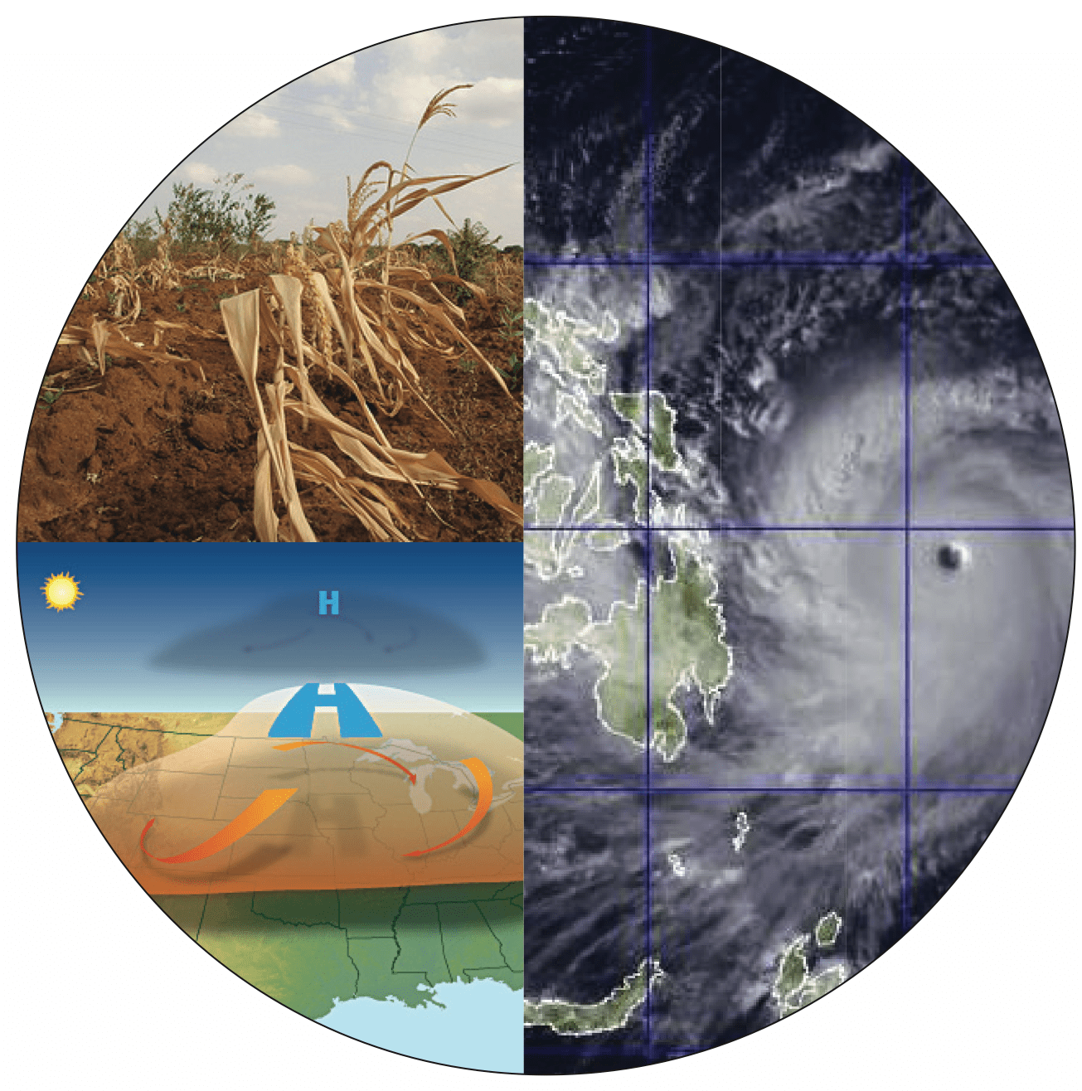
Causes and Other Consequences for Earthquakes
Notes:
Earthquakes can be induced by a wide range of causes including impoundment of reservoirs, surface and underground mining, withdrawal of fluids and gas from the subsurface, and injection of fluids into underground formations.

Slide 10
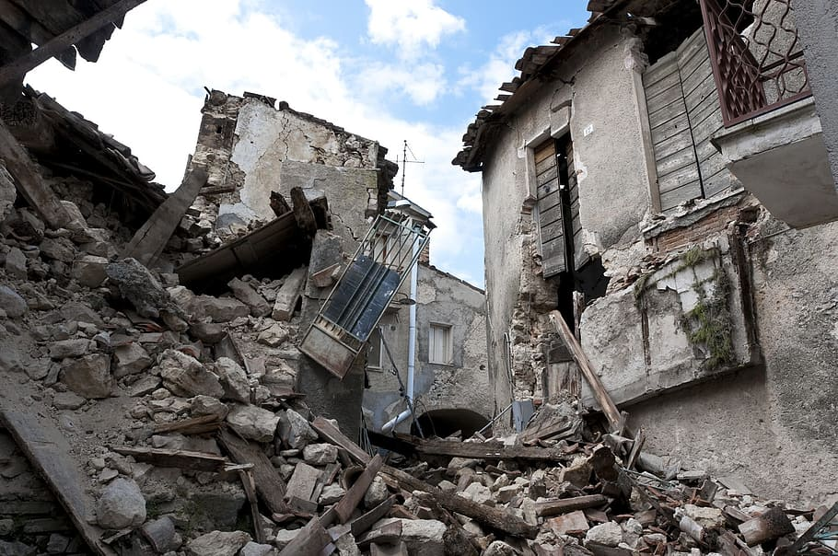
Conclusion of Earthquakes
Notes:
Earthquakes shake the ground surface, can cause buildings to collapse, disrupt transport and services, and can cause fires. They can trigger landslides and tsunami. Earthquakes occur mainly as a result of plate tectonics, which involves blocks of the Earth moving about the Earth's surface.

Slide 11
Recourses and references
https://education.nationalgeographic.org/resource/plate-tectonics/
https://www.usgs.gov/programs/earthquake-hazards/
https://www.iris.edu/hq/inclass/fact-sheet
https://www.open.edu/openlearn/science-maths-technology/geology/earthquakes/
https://www.bgs.ac.uk/discovering-geology/earth-hazards/earthquakes/what-causes-earthquakes/

