Slide 1
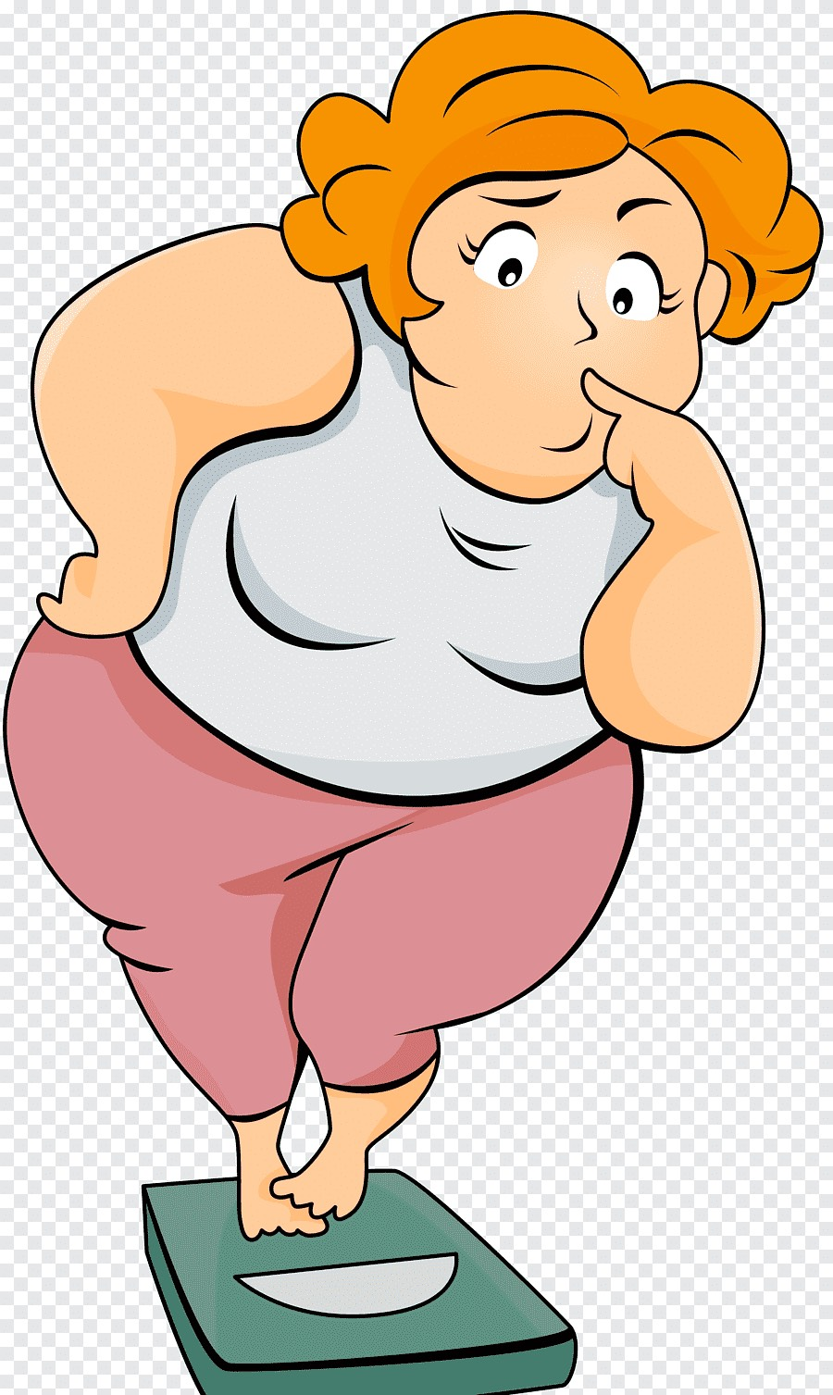
Obesity
Done by: Yasmine Abuaitah and Hind Habash

Slide 2
Table of contents
02
01
03
04
05
What is Obesity?
The Causes of Obesity.
The Health Consequences of Obesity.
Methods for Weight Loss.
06
Our Solution!
The Social Consequences of Obesity.

Slide 3
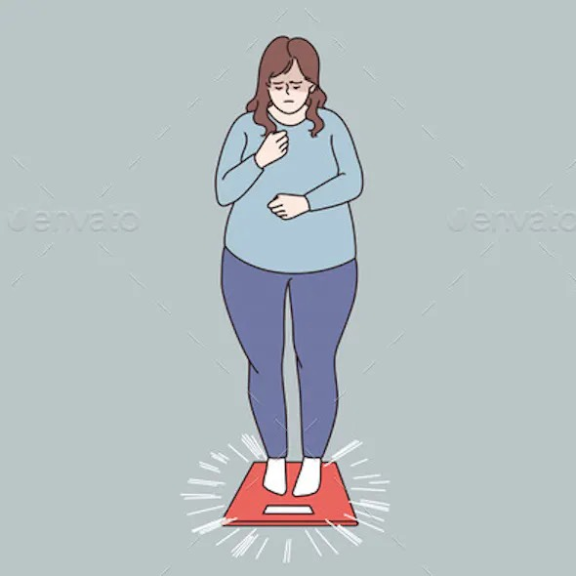
01
What is Obesity?
Obesity is a health condition that involves having too much body fat. Obesity is more than just a visual issue, it's a medical condition that raises the risk of other illnesses and health problems while also having a negative social impact.

Slide 4
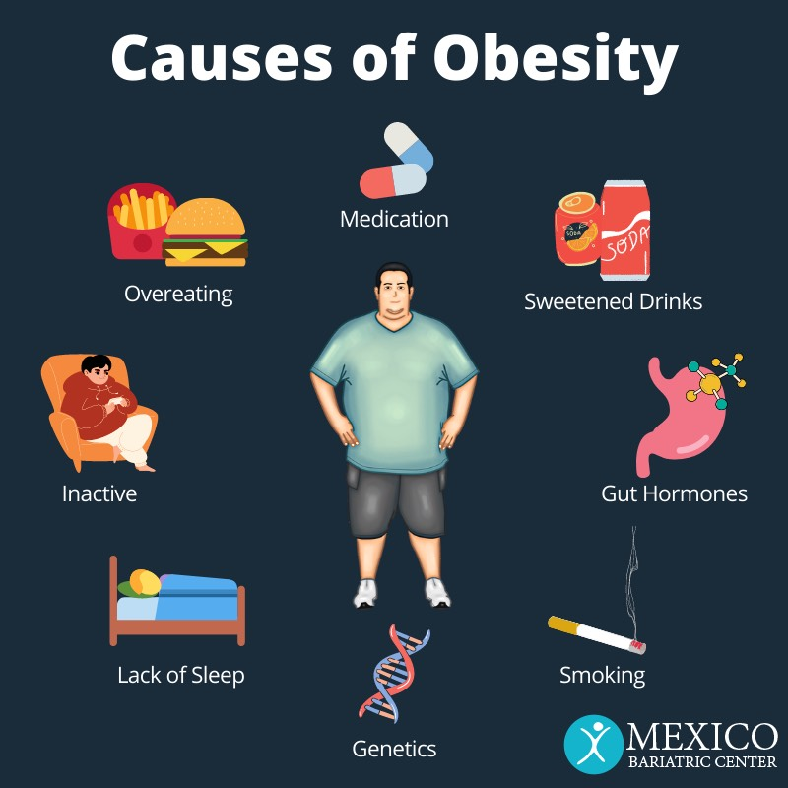
02 What are the Causes of Obesity?
1. Food and Activity.
When people eat more calories than they burn through activity, they gain weight.
2. Environmental Factors.
Lack of accessibility to physical activity, unhealthy food options and food advertising, can make it difficult for people to maintain a healthy weight.
3. Genetics.
Obesity occurs in families according to a clear inheritance pattern caused by changes in a single gene.
4. Health Conditions and Medications.
Some hormonal problems and medicines may cause overweight and obesity.
5. Stress and Emotional Factors.
Some people eat more than usual when they are bored, angry, upset, or stressed.

Slide 5
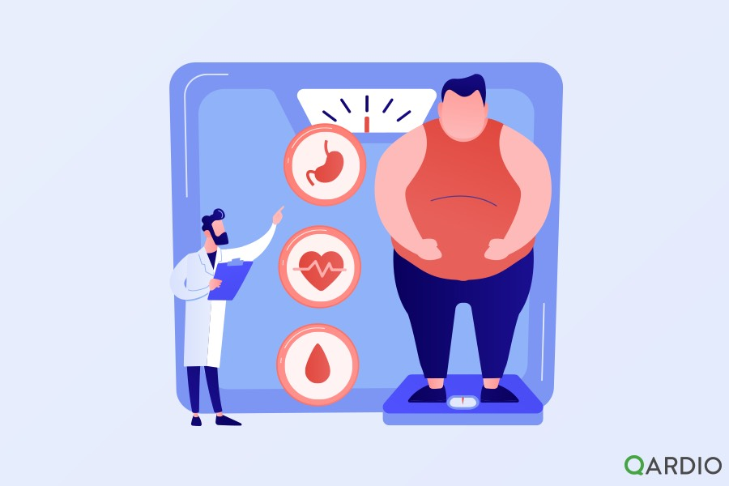
03
What are the Health Consequences of Obesity?
Mortality
High blood pressure (hypertension).
Type 2 diabetes.
Stroke.
Gallbladder disease.

Slide 6
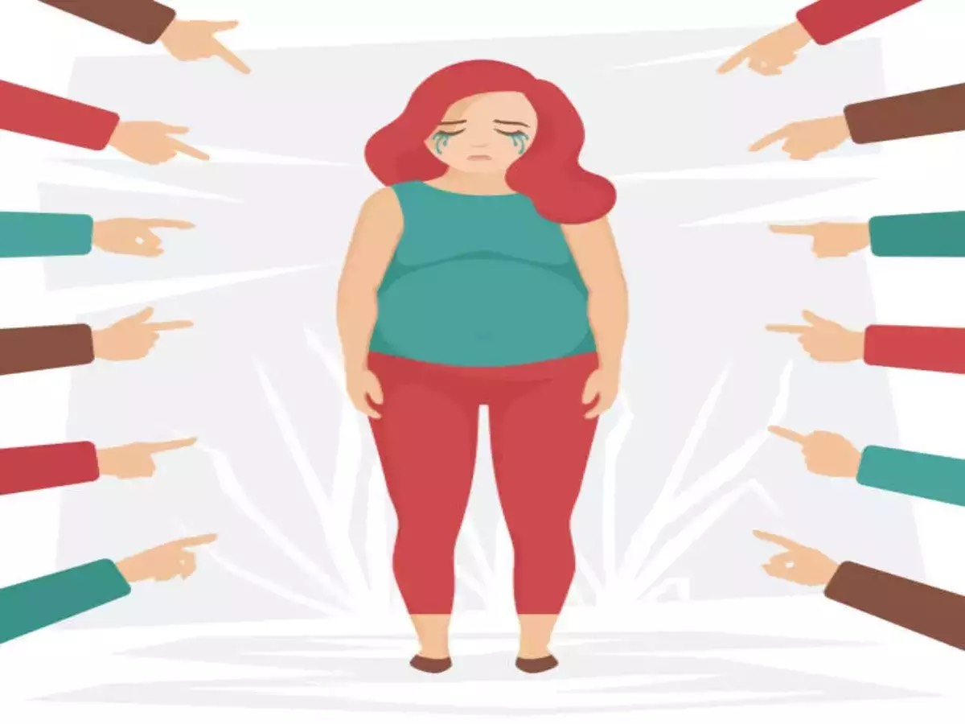
04
What are the Social Consequences for Obesity?
Psychological problems such as anxiety and depression.
Low self-esteem.
Bullying.
Discrimination at school or work.
Decreased employment.

Slide 7
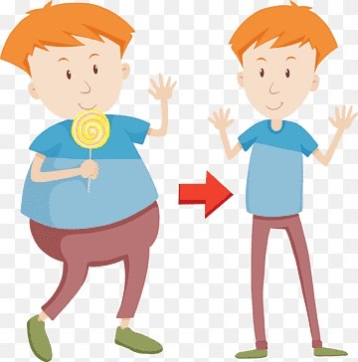
05
Methods for Weight Loss!
Maintaining a more nutritious diet.
Exercising more frequently.
Weight loss medications.
Bariatic surgery.
Updating your habits.

Slide 8

06
Our Solution!
We created a cook book called ”Food for Thought" to avoid the negative effects of obesity. Many nutritious, delicious, and healthy recipes will be included for you to prepare at home. It will aid in weight loss and the maintenance of a healthy diet.

Slide 9
Sources:
https://www.mayoclinic.org/diseases-conditions/obesity/symptoms-causes/syc-20375742
https://www.nichd.nih.gov/health/topics/obesity/conditioninfo/cause
https://www.cdc.gov/healthyweight/effects/index.html

Slide 10
Thank You!

