Slide 1
Water crisis the case of Jordan
Done by : Nadeen Abu dayyeh ,
Angelina Lallas
Yasmeen Alississ
Grade 7 (A)

Slide 2
WATER CRISIS
water deficiency or a lack of safe water supplies. As the population of the world grows and the environment becomes further affected by climate change, access to fresh drinking water decreases. Globally, 785 million people lack access to clean drinking water.

Slide 3
Water Stress in Jordan
Jordan is one of the 10 most water stressed countries in the world , and this issue needs a quick action to solve this huge problem.

Slide 4
Causes & consequences of water crisis in Jordan
Low rate of rainfall
Lack of water resources (Rivers ,sea , lakes… etc)
Rising temperatures(climate change)
Badia is the largest geographical zone of Jordan
High rate of immigration to Jordan .

Slide 5
Suggested solutions
1. Reservoirs (artificial lakes)
can collect water during wet times and store it for use during dry spells
2. Desalination
which involves removing dissolved salt and minerals from seawater (red sea & dead sea)

Slide 6
Suggested solutions
3. Reuse
The water used to wash fruits and veggies can be collected then used for watering potted plants and gardens.
4. Reduce your water usage
for example don’t wash your car with a tub instead with a bucket
5. Awareness & Education
Education is critical to solve the water crisis.
As it must be an important subject at schools to teach students how to deal with water properly.

Slide 7
Three Rs to solve our problem
REDUCE
WATER USAGE
RECYCLE
WATER
REUSE WATER

Slide 8
CONCLUSION
The water security dilemma of Jordan is one of the most important national and strategic issues facing Jordan. The significance and challenges of this issue are even increasing with time passing, as water resources are running scarce.
Jordan needs a very efficient teams and organizations to study all the ways to solve this problem with a great water management programs done from experts.

Slide 9
1. Environmental Protection Agency. (n.d.). EPA. https://www.epa.gov/waterreuse/basic-information-about-water-reuse#uses 2. Water security in Jordan and its future horizons. Strategiecs Think Tank - WATER SECURITY IN JORDAN AND ITS FUTURE HORIZONS. (n.d.). https://strategiecs.com/en/analyses/water-security-in-jordan-and-its-future-horizons 3. Impulse, S. (n.d.). Solutions to water scarcity. how to prevent water shortages? https://solarimpulse.com/water-scarcity-solutions# 4. Water Resources &amp; Environment: Basic page: Jordan. U.S. Agency for International Development. (2022, August 16). https://www.usaid.gov/jordan/water-resources-environment 5. Water stress in Jordan - Executive Summary. UNICEF Jordan. (n.d.). Retrieved April 26, 2023, from https://www.unicef.org/jordan/water-stress-jordan-executive-summary
CITATION &
RESOURCES

Slide 10
Math Amount of rainfall in Jordan
Years | Percent | Fraction | Decimal
2010-2012 | 88% | $$\frac{88}{100}$$ | 0.88
2013-2015 | 85.6% | $$\frac{85.6 }{100}$$ | 0.856
2016-2018 | 97% | $$\frac{97}{100}$$ | 0.97
2019-2021 | 93.7% | $$\frac{93.7}{100}$$ | 0.937

Slide 11
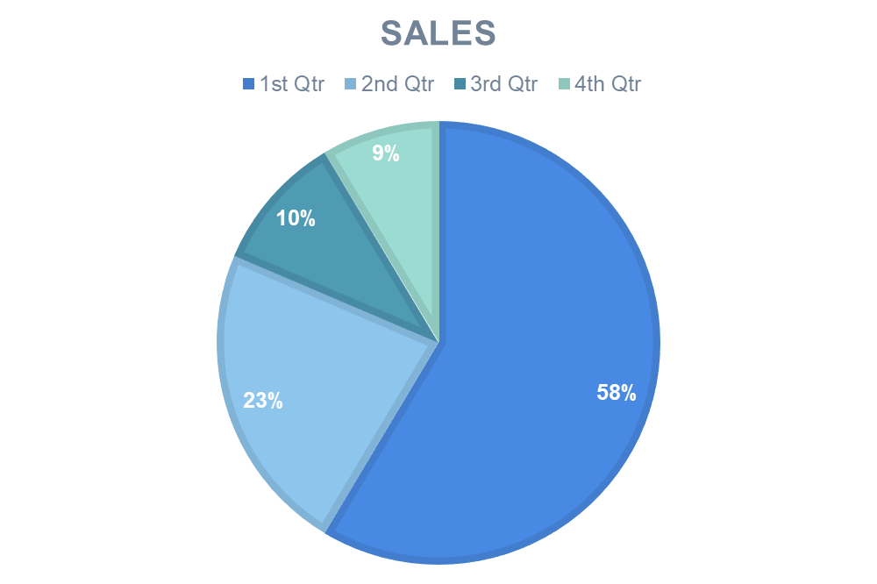

Slide 12
THE END THANKS

