Slide 1
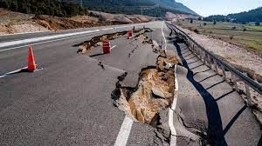
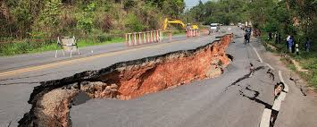
Earthquakes
By : Hashem, Adam, Zaid and Qais

Slide 2
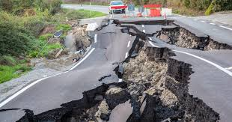
What is an earthquake?
Notes:
An earthquake is a weak to violent shaking of the ground produced by the sudden movement of rock materials below the earth’s surface.
The earthquakes originate in tectonic plate boundary.

Slide 3
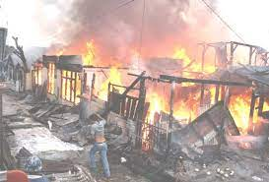
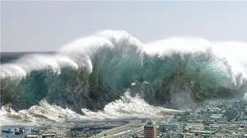
What are the causes and effects of earthquakes?
Notes:
Three common causes of earthquakes are: Divergent: plates moving apart. Convergent: plates coming together. Transform: plates moving past each other.
Common effects of earthquakes are: Ground shaking, landslides, avalanches, fires, and less commonly, tsunamis

Slide 4
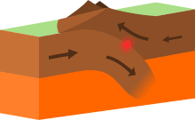
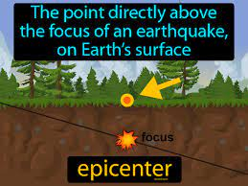
Factors affecting the intensity and frequency of earthquakes
Notes:
Factors that affect the intensity and frequency of an earthquake are: The distance away from the epicenter, the depth of the earthquake and sitting on the meeting point of two land plates.

Slide 5
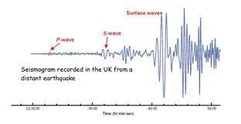
Methods used to detect, measure and predict earthquakes
Notes:
Seismometers are used to detect and measure earthquakes by converting vibrations into electrical signals.

Slide 6
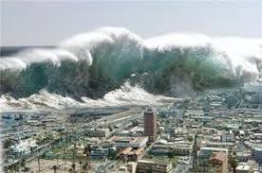
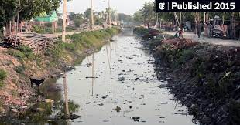
The impacts of earthquakes on the natural environment and ecosystem
Notes:
Earthquakes can affect the environment and the ecosystem in different ways. They mostly damage a lot of things on ground, but can cause massive tsunamis in sea. Earthquakes can also move land around and change the ecosystem, and carry diseases to other places. It can also affect the quality of water causing a water crisis.

Slide 7
Help reduce earthquakes effects on environment
Notes:
We cannot prevent natural earthquakes from occurring but we can reduce their effects by identifying hazards, building safer structures, and providing education on earthquake safety.

Slide 8
Resources
https://en.wikipedia.org/wiki/Earthquake_environmental_effects#:~:text=Earthquake%20environmental%20effects%20are%20the,provoked%20by%20the%20ground%20shaking.
https://www.usgs.gov/programs/earthquake-hazards/what-are-effects-earthquakes#:~:text=The%20effects%20from%20earthquakes%20include,%2C%20and%20less%20commonly%2C%20tsunamis
https://issuu.com/5nv_student/docs/conner_nf#:~:text=Earthquakes%20can%20affect%20the%20ecosystem,carry%20diseases%20to%20other%20places.

