Slide 1
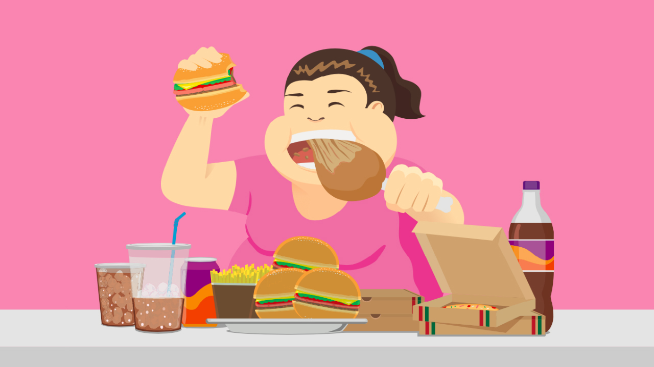
OBESITY
By : dareen al-farah, sama kaawach, LARA SAWALHA, LEEN KURDI.

Slide 2
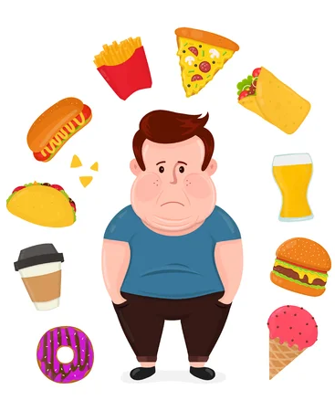
What is obesity?
Obesity is a complicated, chronic disease with many negative factors that can result in excessive body fat. The way your body functions can change if it contains too much additional fat. These changes have the potential to get worse over time, and may have a negative impact on one's health.

Slide 3
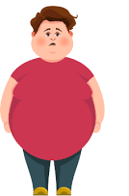
What are the causes of obesity?
Obesity can be caused by many factors, here is a couple :
Eating large amounts of rich in fats and sugar processed or fast food:
These foods provide the body with extra energy that cant be used up in exercise.
high alcohol consumption:
Increases levels of acid in the mouth.
Not being physically active:
the energy not used up by exercise is stored as fat in the body.

Slide 4
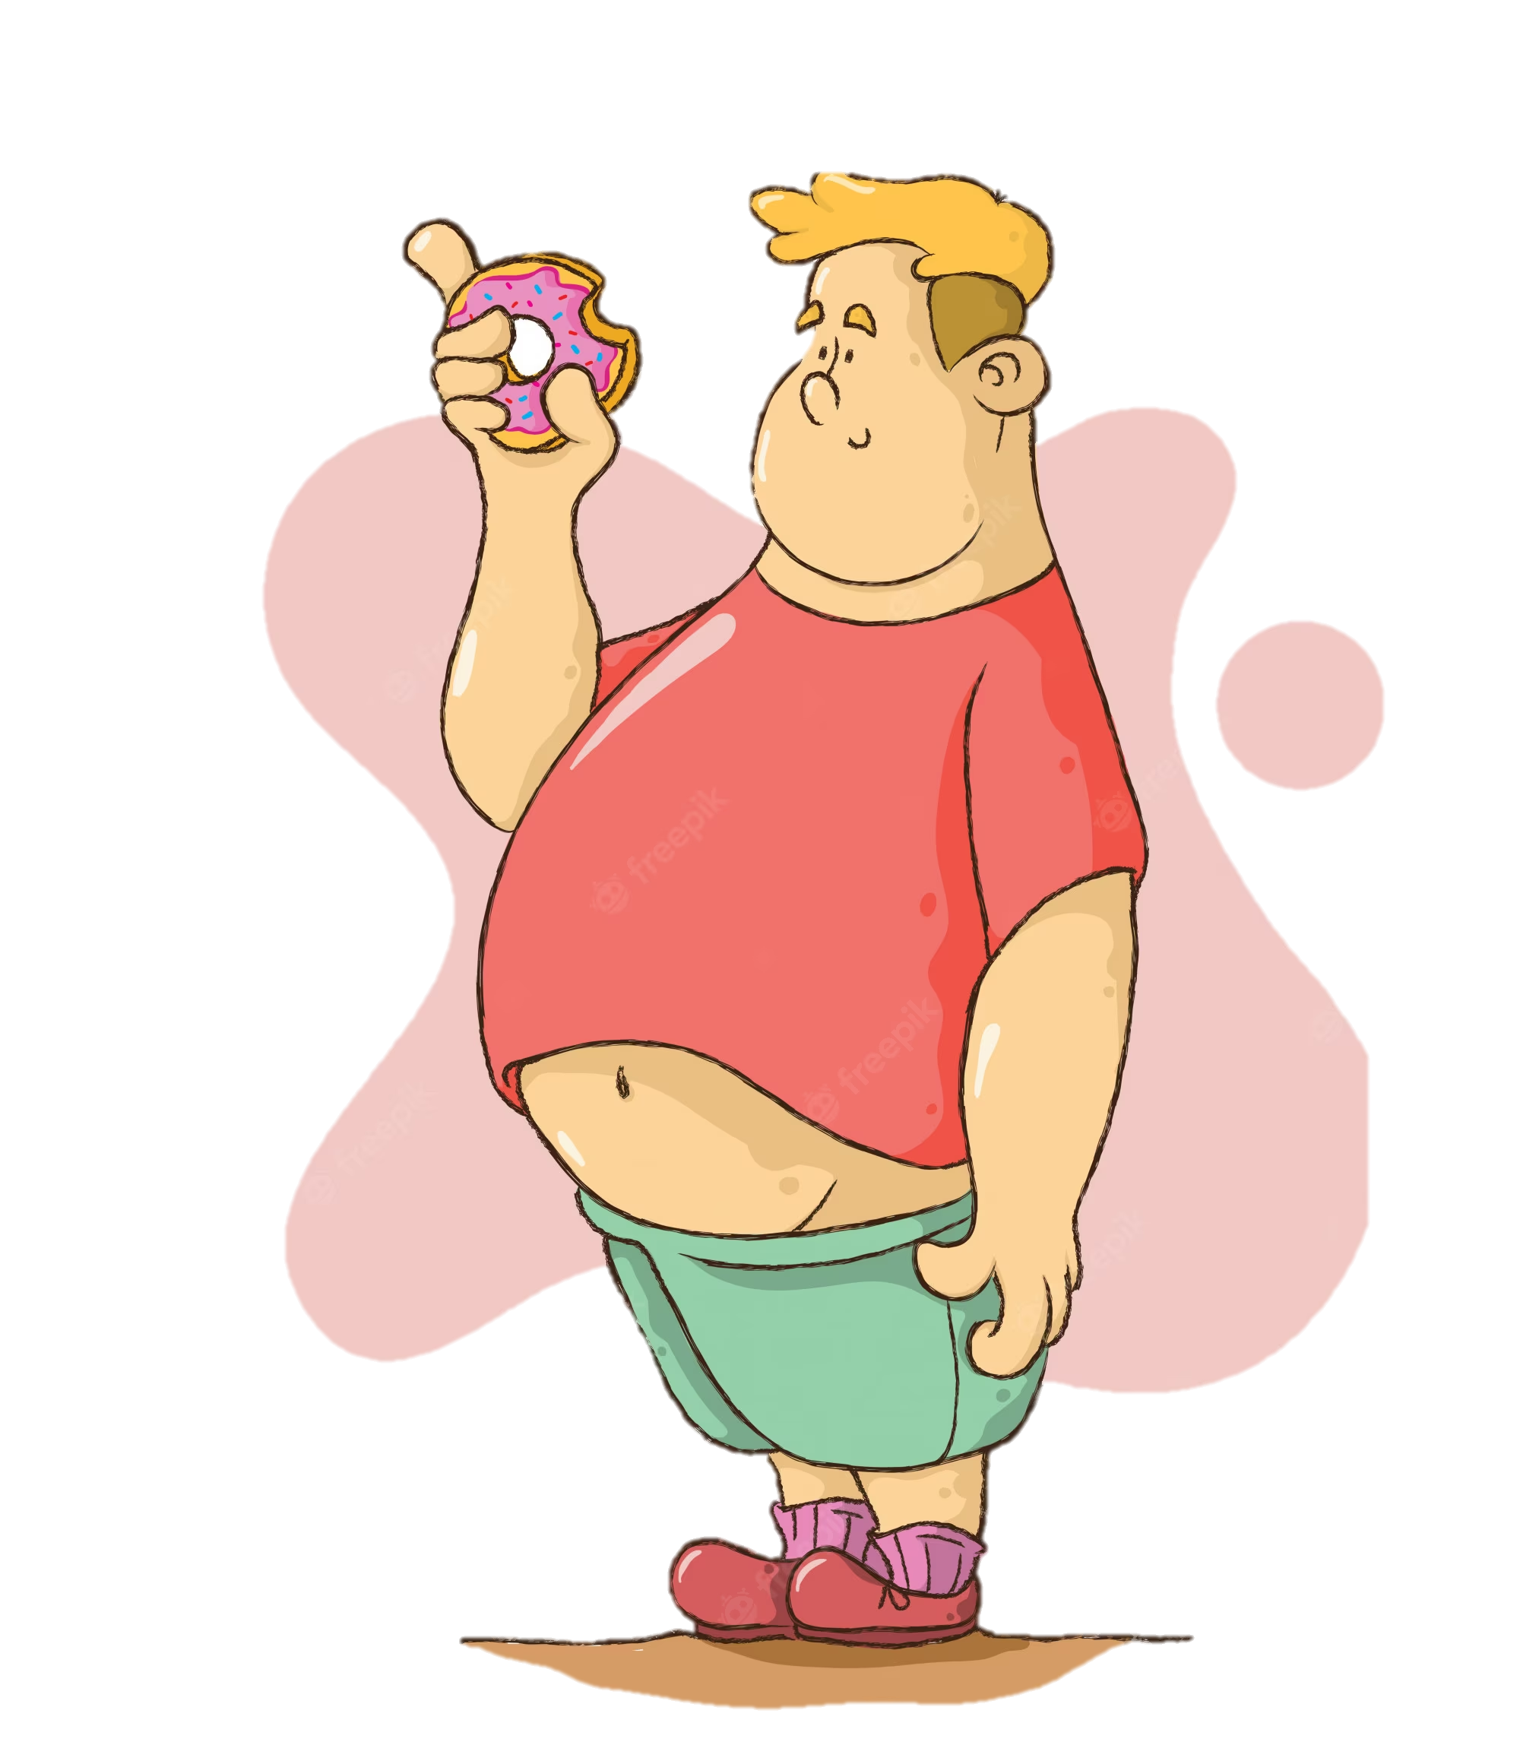
What are the causes of obesity?
Obesity can be caused by many factors, here is a couple :
Genetics:
Symptoms are when children feel overly hungry.
Medical reasons:
Some diseases require the patient to take a large amount of pills which increases weight.
Eating disorders:
A type is eating disorders is binge eating which is eating a lot of food in one sitting without realizing.
Sleep routine:
Not sleeping enough can produce hormones that increase the feeling of constant hunger.

Slide 5
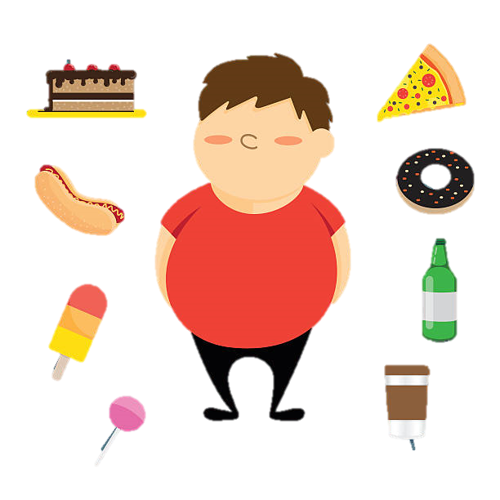
What are the consequences?
Obesity has many consequence, here are some of them :
Fatal heart diseases and strokes:
The cardiovascular disease.
Many major cancer types:
Endometrial, breast and colon.
Type 2 diabetes:
Causes kidney diseases, nerve damage, hearing loss,
vision loss.
High blood pressure.

Slide 6

What are the consequences?
Obesity has many consequence, here are some of them :
High LDL cholesterol, low HDL:
Increases the risk of strokes and heart diseases.
Mental illness:
Depression, anxiety, etc.
Osteoarthritis:
breakdown of cartilage and bone within a joint which causes disability.
Body aches and difficulty with simple physical movement.

Slide 7
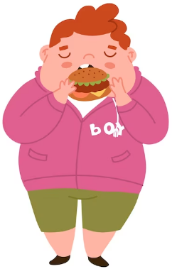
How to prevent obesity:
Having a healthy diet:
Reduce consumption of red or processed meats, refined carbs, and sugary snacks.
Increasing physical activities:
Regular exercise, 1 hour a day.
Taking daily walks:
30 mins a day, 5 times a week.

Slide 8
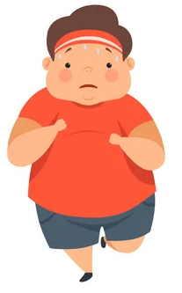
How to prevent obesity:
Staying hydrate:
boosts metabolism, and make exercise easier.
Intake of vitamin supplements:
Calcium,vitamin B5, vitamin B6, vitamin B12, vitamin B complex, and vitamin C.
Improving sleep:
Helps decrease calorie intake and appetite.

Slide 9
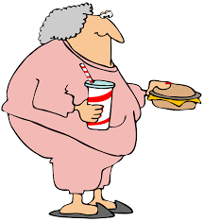
Conclusion
As a conclusion, we talked about the causes, fatal consequences, and the easy way to prevent obesity. Obesity can be caused by many factors and can also put your health at risk. We hope you learnt many important points about this interesting topic.

Slide 10
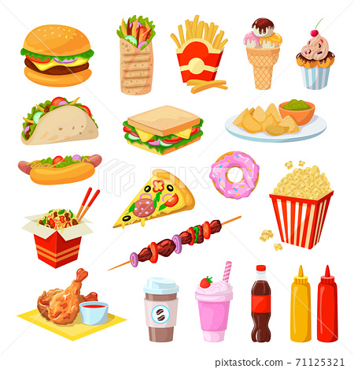
Links used :
https://www.nhs.uk/conditions/obesity/causes/
https://www.nichd.nih.gov/health/topi3cs/obesity/conditioninfo/cause#:~:text=These%20include%20diet%2C%20lack%20of,%2C%20environmental%20factors%2C%20and%20genetics.
https://www.cdc.gov/healthyweight/effects/index.html
https://www.who.int/news-room/questions-and-answers/item/obesity-health-consequences-of-being-overweight#:~:text=Carrying%20extra%20fat%20leads%20to,premature%20death%20and%20substantial%20disability
https://www.hsph.harvard.edu/obesity-prevention-source/obesity-prevention/

Slide 11
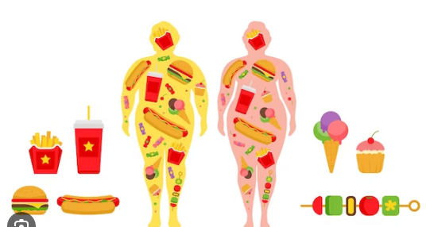
Video to watch about this topic:
https://youtu.be/D--AtATgfyM

