Slide 1
OBESITY
By: Amie Derderian, Angela Naber, Zaina Qursha

Slide 2
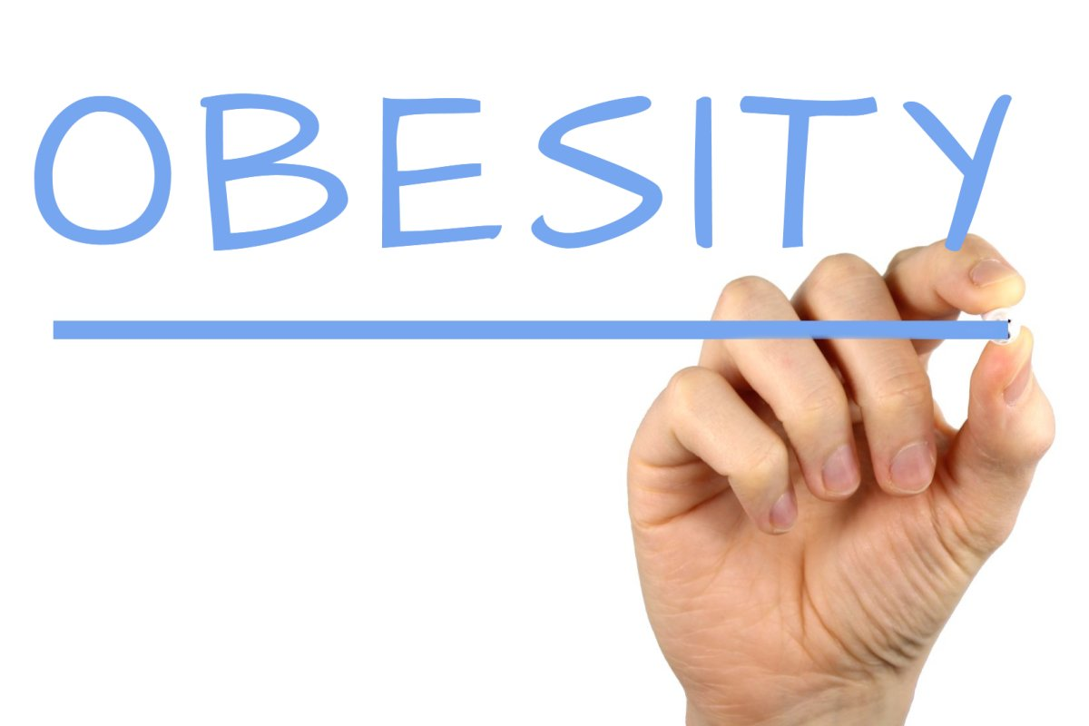
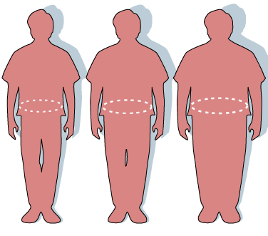
Obesity
Obesity and overweight are defined as abnormal or excessive fat accumulation that presents a risk to health, Obesity and overweight are considered something rather unhealthy than normal height and body type.

Slide 3
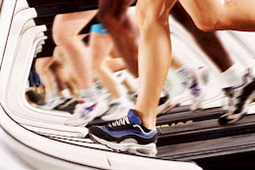
What are the main reasons of obesity:
Many factors form body weight-genes. Body weight genes are affected by such poor diets, too much television watching, too little physical activity. Food and physical activity environment also matters.

Slide 4
SYMPTOMS RELATING TO OBESITY:
breathlesssness
Increased sweating
Snoring
Difficulty doing physical activities
Often feeling tired
Joint and backed pain
Low confidence and self esteem
Feeling isolated

Slide 5
Why is obesity a problem:
Obesity reduces almost every aspect of health from reproductive and respiratory function to memory and mood. Obesity increases the risk of several debilitating and deadly diseases including diabetes, heart disease and some cancers

Slide 6
RISKS OF OBESITY:
All causes of death (mortality)
High blood pressure (hypertension)
High LDL cholesterol, low HDL cholestral or high levels of triglyerides
Type 2 diabetes
Coronary heart diseas
Stroke
Gallblader diseas

Slide 7
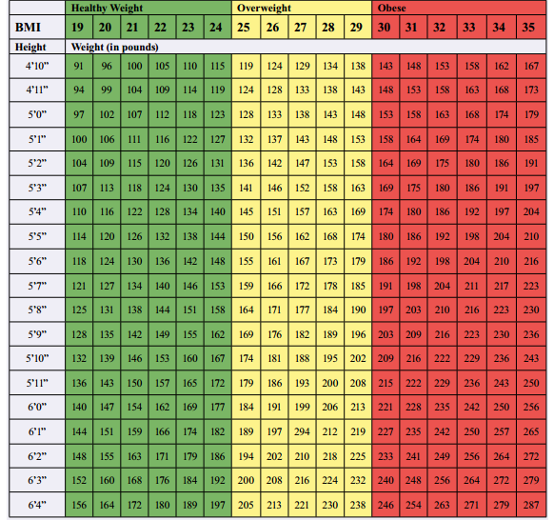
Obesity is usually divided into categories:
Class 1:BMI
Definition: 35>40 kgs
Class 2:BMI
Definition: 40>45 kgs
Class 3:BMI
Definition: 40 kgs and over

Slide 8
SIX TYPES OF OBESITY:
Heavy drinking males
Younger healthy females
Physically sick but happy elderly
Affluent healthy elderly
Unhappy anxious middle aged
Poorest health

Slide 9
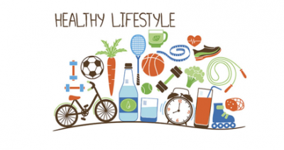
Ways to prevent obesity:
Choosing healthier (whole grains, fruits and vegetables, healthy fats and protein, beverages. Limiting unhealthy foods(refined grains and sweets) potatoes, red meat, (processed meat) and beverages (sugary drinks) increasing physical activity. Limiting television time, screen time and other “sit time”

Slide 10
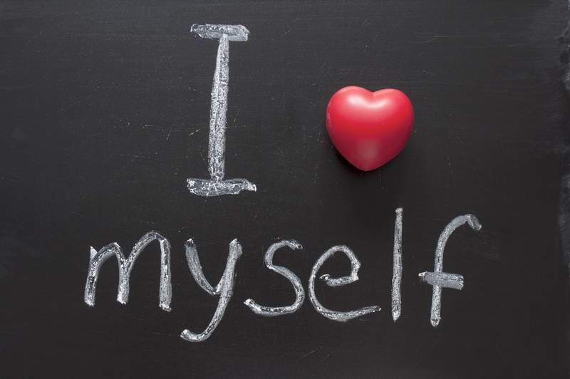
We think that people should have a healthier diet since obesity diminishes almost every aspect of health. When people have a healthier diet their physical health as well as mental will be much better for the person dealing with obesity.

Slide 11
https://www.obesity.org/
https://www.hsph.harvard.edu/obesity-prevention-source/obesity-causes/
https://www.cdc.gov/obesity/basics/causes.html
https://www.who.int/health-topics/obesity#tab=tab_1
https://en.wikipedia.org/wiki/Obesity

