Slide 1
Earthquakes
By Celina and yasmina
6e

Slide 2
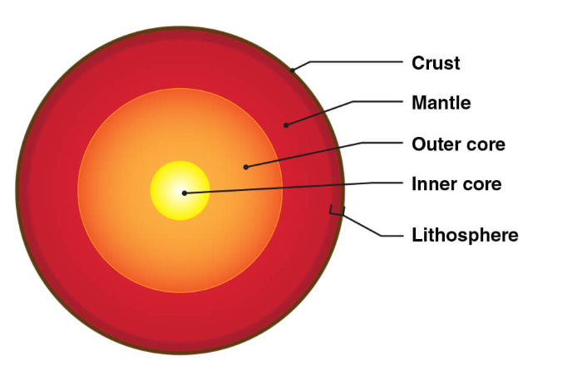
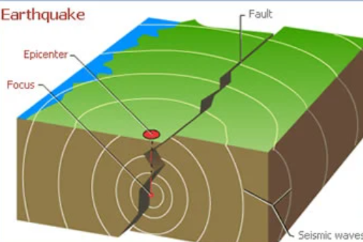
Introduction to earthquakes
Notes:
An earthquake is an intense shaking of Earth’s surface. The shaking is caused by movements in Earth’s outermost layer earth suddenly slip past one another.

Slide 3
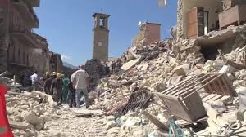
The causes and effects of earthquakes
Notes:
Causes: when 2 two tectonic plates move against each other suddenly in opposite directions
Effects :The effects from earthquakes include ground shaking, surface faulting, ground failure, and less commonly, tsunamis.

Slide 4
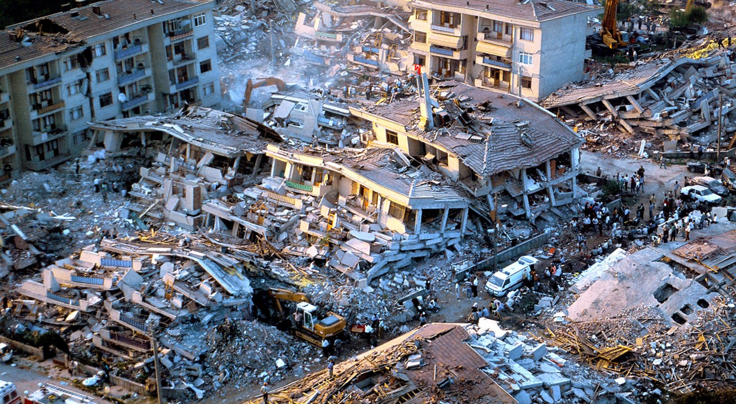
The issues of earthquakes
Notes:
Shock waves caused by earthquakes make buildings collapse, collapsing buildings may kill or injure people

Slide 5
The factors that affect the intensity and frequency of earthquakes
Notes:
The stronger the rock material or larger area or more movement in an earthquake will all contribute to produce a larger magnitude. the larger the magnitude the stronger the intensity of the earthquake.

Slide 6
Methods used to detect, measure and predict earthquakes.
Notes:
Seismometers allow us to detect and measure earthquakes by converting vibrations due to seismic waves into electrical signals, which we can then display as seismograms on a computer screen.

Slide 7
Solutions reduce earthquakes
Notes:
We cannot prevent natural earthquakes from occurring but we can significantly reduce their effects by identifying hazards, building safer structures, and providing education on earthquake safety.

Slide 8
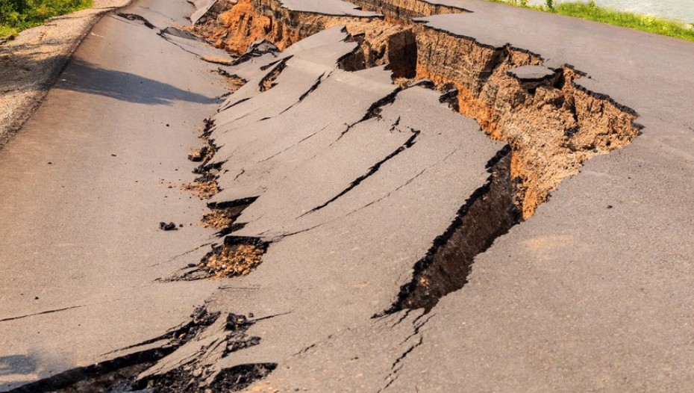
The impacts of earthquakes on the natural environment and ecosystem.
Notes:
The impacts of earthquakes on the natural environment and ecosystem are surface faulting tsunamis sail liquefactions, land slides and ground failure …..etc.

Slide 9
Sources
https://www.usgs.gov/faqs/what-earthquake-and-what-causes-them-happen#:~:text=The%20tectonic%20plates%20are%20always,the%20shaking%20that%20we%20feel
https://www.bgs.ac.uk/discovering-geology/earth-hazards/earthquakes/how-are-earthquakes-detected/#:~:text=Seismometers%20allow%20us%20to%20detect,big%20a%20particular%20earthquake%20is
https://www.bgs.ac.uk/discovering-geology/earth-hazards/earthquakes/
https://spaceplace.nasa.gov/earthquakes/en/
Chemistry Students book

Slide 10
Thank you for listening

