Slide 1
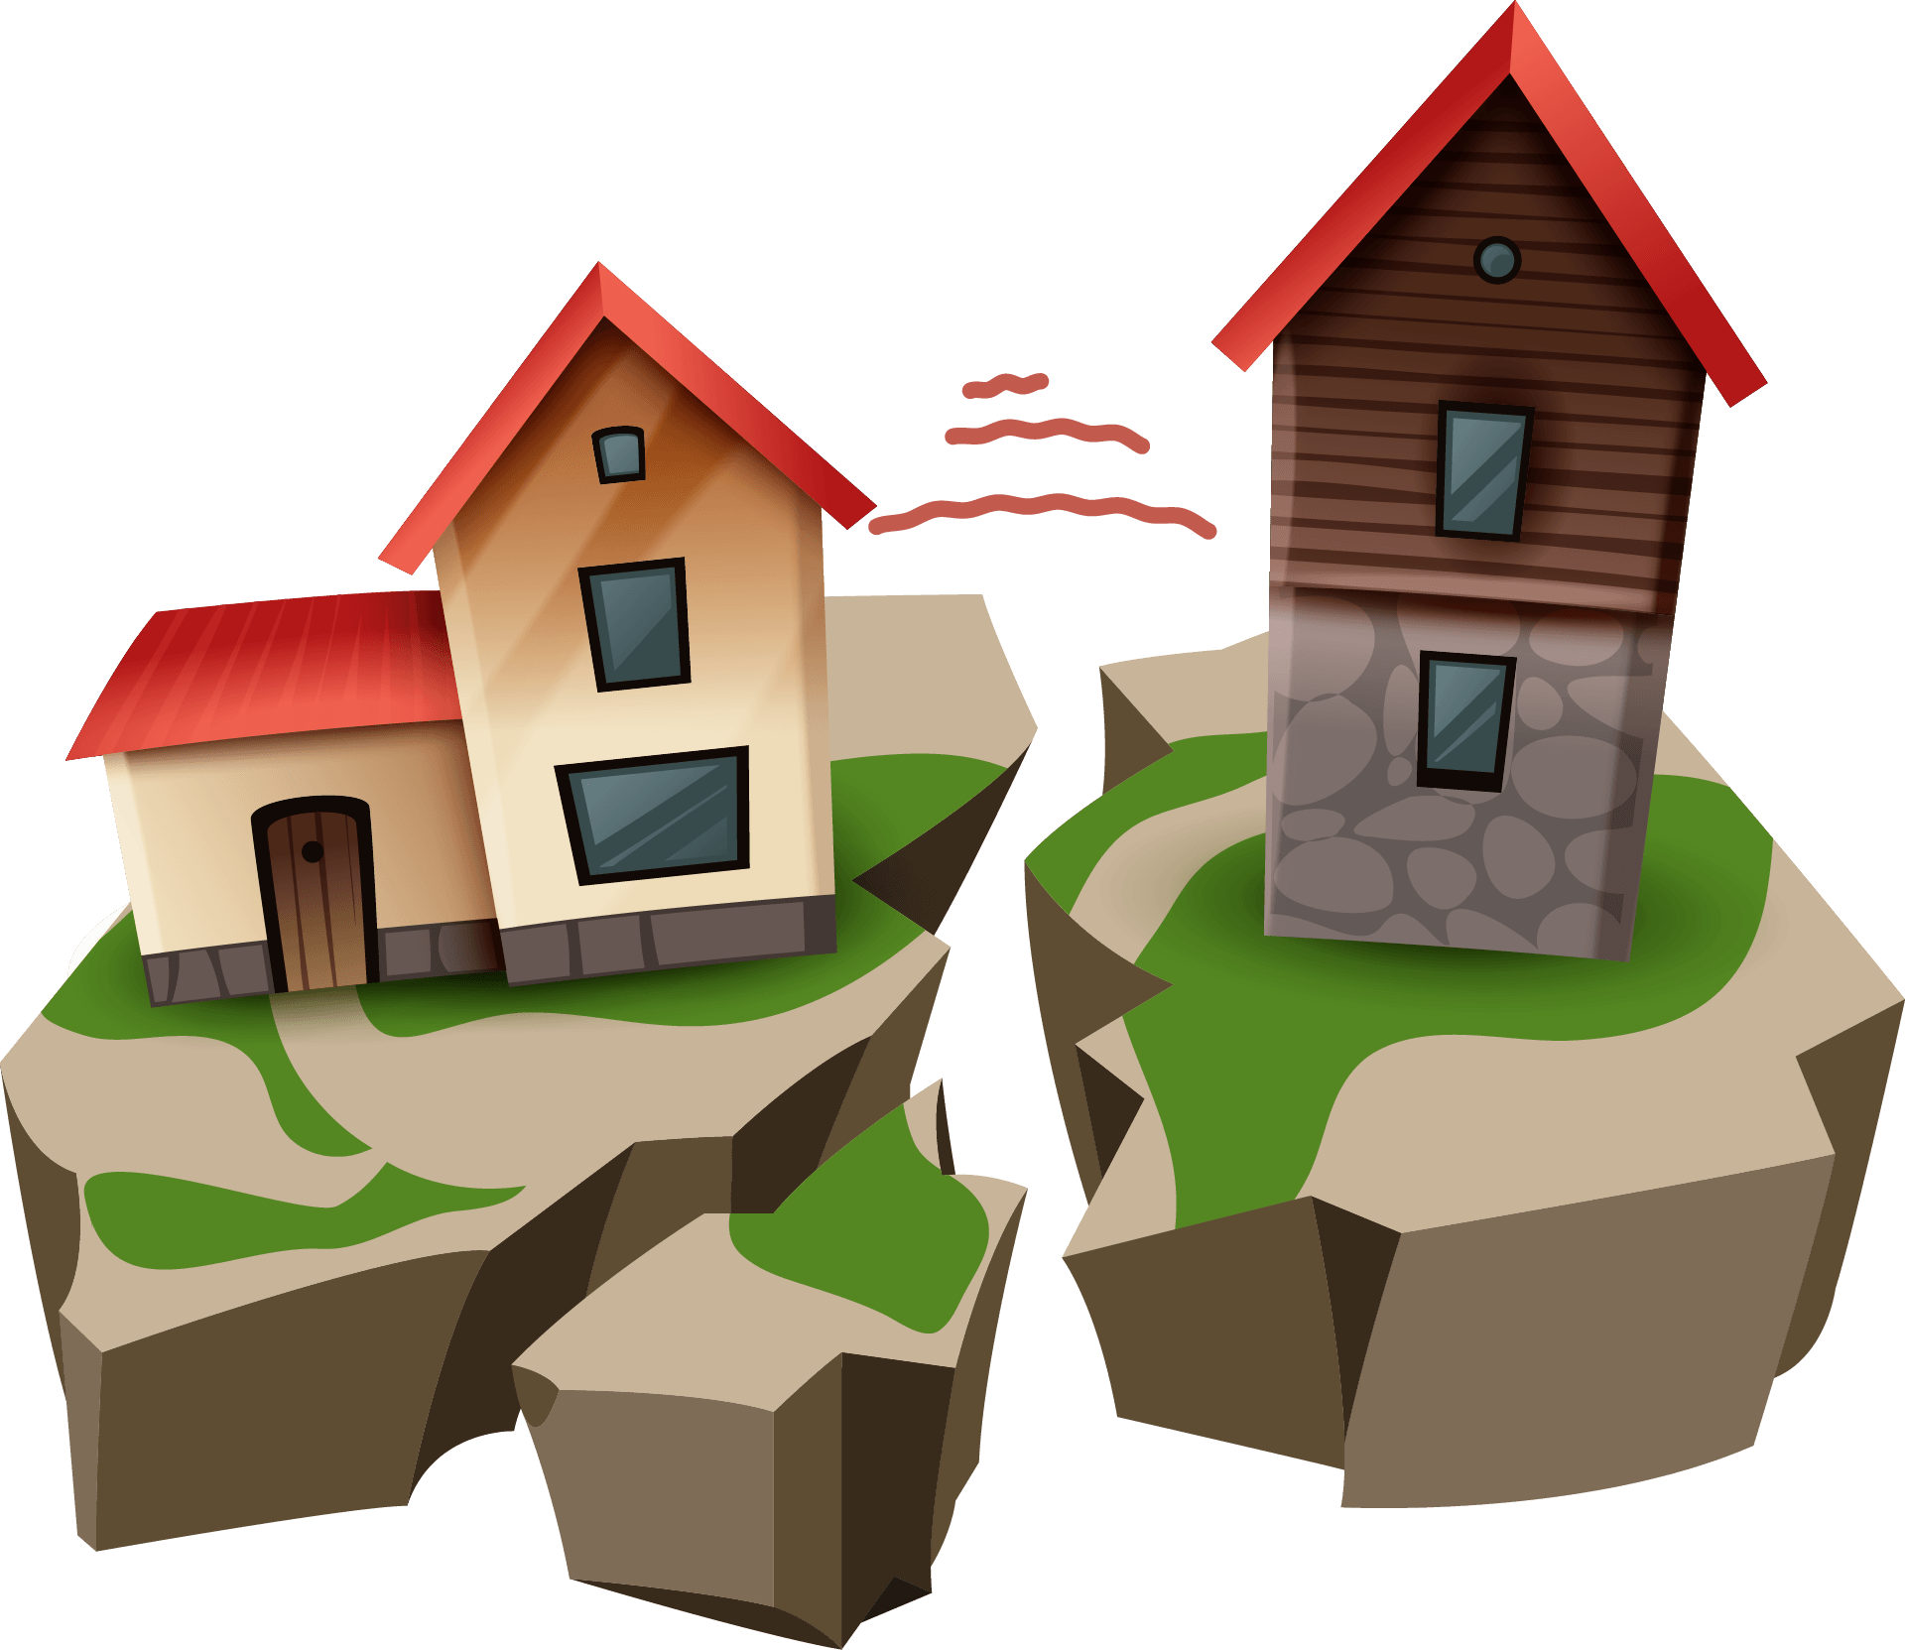
EARTHQUAKES
Raya,Angelina,Sura,Fadwa
6C

Slide 2
INTRODUCTION!!
Introduction :
An earthquake is a weak to violent shaking of the ground produced by the sudden movement of rock materials below the earth's surface.
Notes:
INTRODUCTION : An earthquake is a weak to violent shaking of the ground produced by the sudden movement of rock materials below the earth's surface.

Slide 3
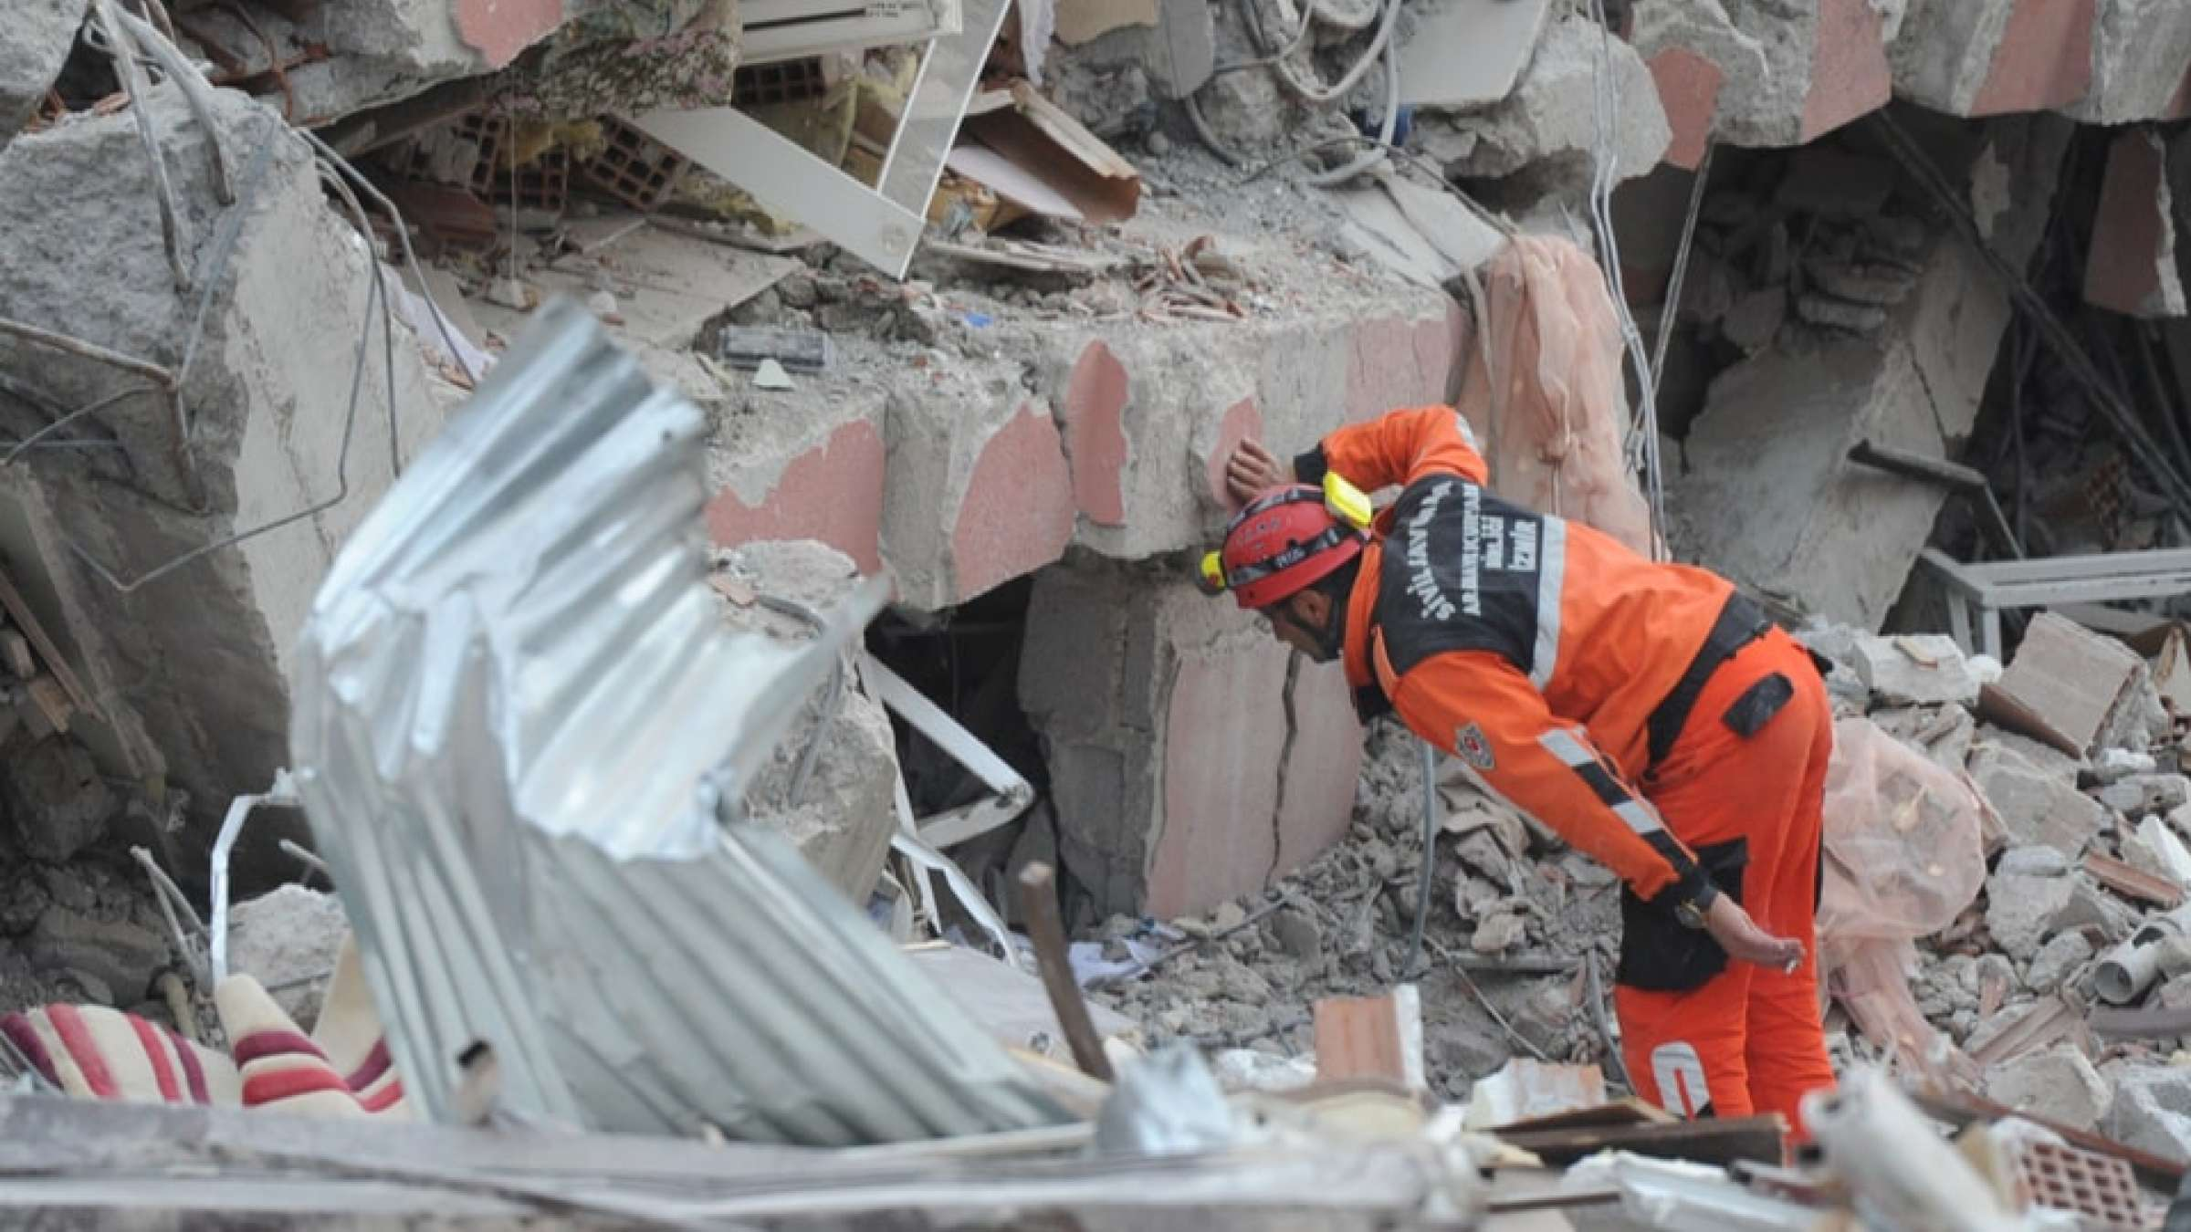
WHAT MAKES EARTHQUAKES?
What makes earthquakes? :
Earthquakes happen when tectonic plates move against each other suddenly. Because of friction, the plates cannot slide smoothly, Sometimes they get stuck. Huge forces build up, Eventually, The two plates overcome the frictional force .The plates slip suddenly there is an Earthquake.
Notes:
What makes earthquakes? : Earthquakes happen when tectonic plates move against eachother suddenly.Because of friction,The plates cannot slide smoothly,Sometimes they get stuck.Huge forces build up,Eventually,The two plates overcome the frictional force.The plates slip suddenly there is an EarthQuake.

Slide 4
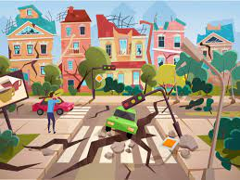
EFFECTS OF EARTHQUAKES
Effects of EarthQuakes:
Ground shaking
Surface faulting
Ground failure
Tsunamis
Some are more common than others
Notes:
Effects of EarthQuakes:
Ground shaking
Surface faulting
Ground failure
Tsunamis
Some are more common than others

Slide 5
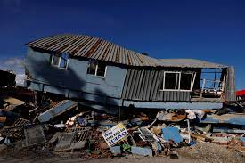
WHAT IS AN EARTHQUAKE?
Intensity :
The distance away from the epicenter.
The depth of the earthquake.
The population density of the area affected by the earthquake.
The local geology of the area.
Frequency :
The higher the frequency, the faster the energy from the earthquake attenuates, or dissipates, with distance.
Notes:
WHAT IS AN EARTHQUAKE?
INTENSITY :
The distance away from the epicenter.
The depth of the earthquake.
The population density of the area affected by the earthquake.
The local geology of the area.
FREQUENCY: The higher the frequency, the faster the energy from the earthquake attenuates, or dissipates, with distance

Slide 6
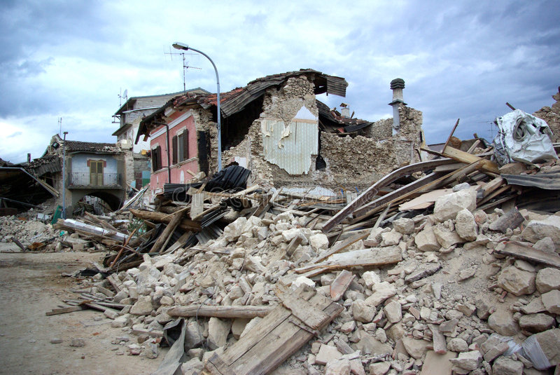
HOW TO DETECT EARTHQUAKES?
How to detect earthquakes? : Seismometers allow us to detect and measure earthquakes by converting vibrations due to seismic waves into electrical signals, which we can then display as seismograms on a computer screen.
Notes:
Effects of EarthQuakes: Seismometers allow us to detect and measure earthquakes by converting vibrations due to seismic waves into electrical signals, which we can then display as seismograms on a computer screen.

Slide 7
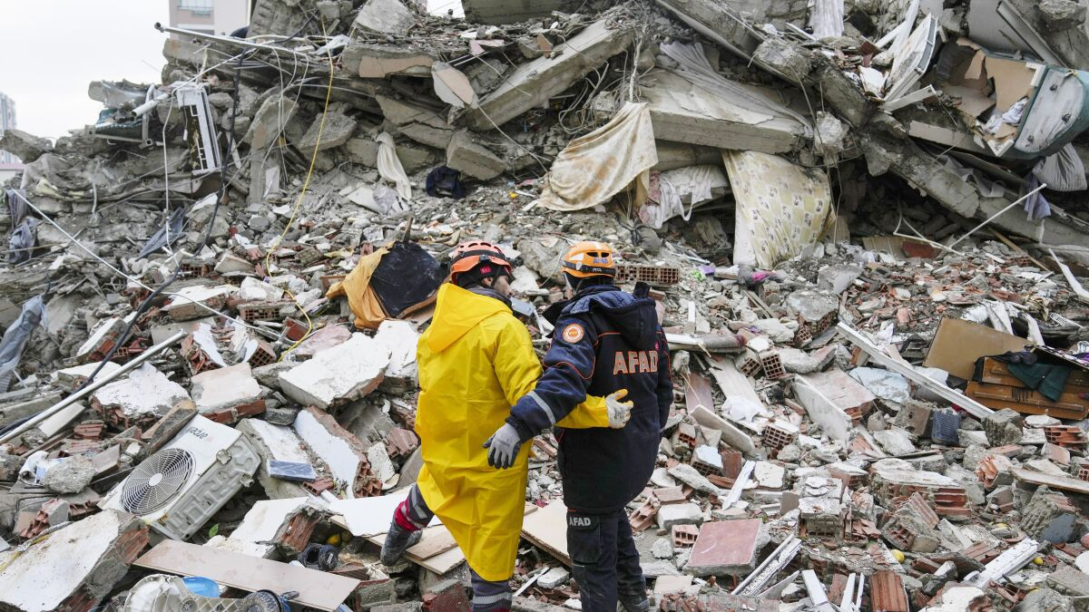
THE IMPACT OF EARTHQUAKES ON THE NATURAL ENVIRONMENT
The impact of EarthQuakes on the natural environment:
Earthquakes can result in the ground shaking, soil liquefaction, landslides, fissures, avalanches, fires and tsunamis.
Notes:
The impact of EarthQuakes on the natural environment: Earthquakes can result in the ground shaking, soil liquefaction, landslides, fissures, avalanches, fires and tsunamis.

Slide 8
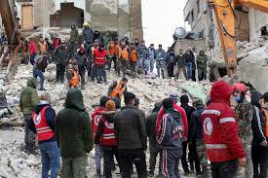
WHAT ARE THE SOLUTIONS AND THE CONCLUSION?
Solutions :
Identifying hazards, building safer structures, and providing education on earthquake safety
Conclusion:
Earthquakes shake the ground surface, can cause buildings to collapse, disrupt transport and services, and can cause fires.
Notes:
Solutions : identifying hazards, building safer structures, and providing education on earthquake safety
Conclusion: Earthquakes shake the ground surface, can cause buildings to collapse, disrupt transport and services, and can cause fires.

