Slide 1
Earthquakes
By: Maya,Rayan,Salma,Joy,Issa

Slide 2
ABOUT EARTHQUAKES
Notes:
An earthquake happens when two blocks of the earth suddenly slip past one another. Each earthquakes vary from each other. It can be a weak or violent shaking of the ground produced by the sudden movement of rock materials below the earths surface.

Slide 3
ISSUES OF EARTHQUAKES
Notes:
1.Earthquakes can result in the ground shaking.
2. They can also result in fires and tsunamis.

Slide 4
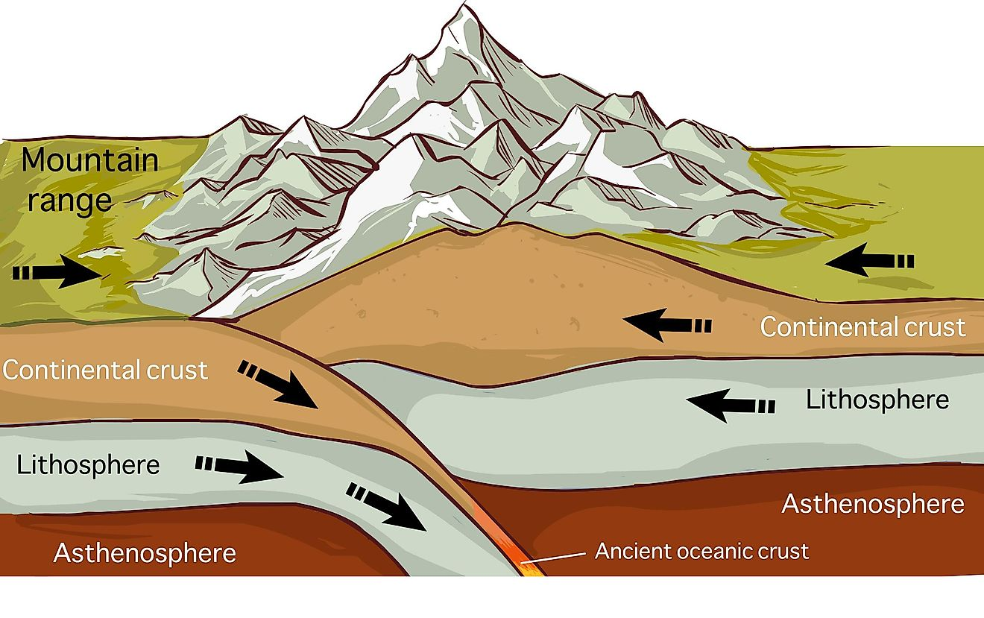
CAUSES OF EARTHQUAKES
Notes:
1.The tectonic plates are always slowly moving, but they get stuck at their edges due to friction. When the stress on the edge overcomes the friction, there is an earthquake that releases energy in waves that travel through the earth's crust and cause the shaking that we feel
2. Surface rupture occurs when movement on a fault deep within the earth breaks through to the surface. NOT ALL earthquakes result in surface rupture

Slide 5
Consequences of earthquakes
Notes:
Some of the consequences of earthquakes are surface faulting and ground failure.

Slide 6
SOLUTIONS FOR EARTHQUAKES
Notes:
We can prevent earthquakes by identifying hazards, building safer structures and providing education on earthquake safety.

Slide 7
METHODS USED TO DETECT, MEASURE AND PREDICTS EARTHQUAKES
Notes:
1.Seismometers allow us to detect and measure earthquakes by converting vibrations due to seismic waves into electrical signals, which we can then display as seismograms on a computer screen.
1.Seismometers allow us to detect and measure earthquakes by converting vibrations due to seismic waves into electrical signals, which we can then display as seismograms on a computer screen.

Slide 8
The impacts of earthquakes on the natural environment and ecosystem
Notes:
1.Large earthquake-induced rock avalanches, soil avalanches, and underwater landslides can be very destructive. Rock avalanches originate on over-steepened slopes in weak rocks.
2.Earthquakes are among the most impressive processes with destructive effects on humans and nature. Secondary earthquake environmental effects (EEE) are induced by the ground shaking and are classified into ground cracks, dust clouds, anomalies, tsunamis, trees shaking and jumping stones.

Slide 9
resources
Https://ui.adsabs.harvard.edu/
https://www.usgs.gov/
https://www.bgs.ac.uk/
https://www.usgs.gov/ (we used this twice)
http://who.int/health-topics/earquakes

