Slide 1
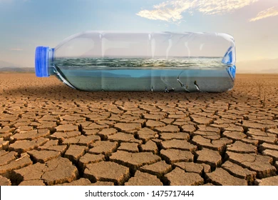
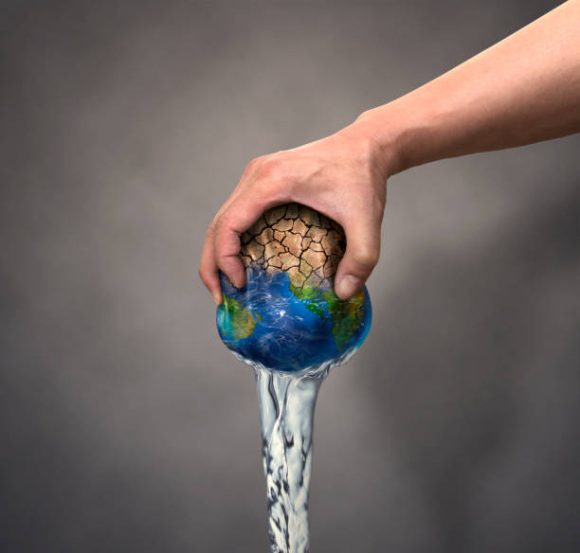
Water Crisis
Made by: Yara Naffa, Lana Alshafei and Yasmeen Ejjeh

Slide 2
What is water crisis in jordan?
Water crisis is a crisis of managing water so badly that billions of People – and the environment – suffer badly. And there are many issues related to the water crisis both nationally and locally in Jordan
Nationally:
The overflow of wastewater pumping stations, leaks from sewage systems and exposure to industrial and commercial waste are polluting Jordan’s surface river sources.
Locally:
The country’s renewable water supply currently needs around two-thirds of the population’s water demands, with ground water being used twice as quickly as it can be replenished.

Slide 3
Causes and Consequences of water shortage
Causes: Increased human consumption is the MAIN CAUSE OF WATER SHORTAGE. Also overuse and wastage of water. Another cause is global rise in freshwater demand. Overuse of aquifers and its consequent slow recharge is also one of the causes.
Consequences: the main consequences of water shortage is that sewage systems can fail and the threat of contracting diseases like surges.

Slide 4
Causes and consequences of water scarcity
Causes: some of the main causes of water scarcity is climate change, natural calamities such as droughts and floods, increased human consumption, overuse and wastage of water, a global side in freshwater demand, and overuse of aquifers and consequent slow recharge
Consequences: consequences od water scarcity can undermine school attendance and performance, particularly for girls.

Slide 5
The courses of action for water shortage
Some of the solutions for water shortage is to:
1. PROVIDE CLEAN, SAFE WATER TO THOSE Who NEED IT MOST.
1.1 billion people worldwide lack access to water and water is the essence of life
2. PROTECT (OR IMPROVE) THE QUALITY OF AVAILABLE WATER IN AN AREA.
to assure a continuing abundance of water that is safe to use for ourselves and future generations.
3. Rainwater Harvesting
Rainwater harvesting can reduce storm water runoff from a property. The elimination of runoff can reduce contamination of surface water with pesticides, sediment, metals, and fertilizers.

Slide 6
The courses of action for water Scarcity
Some of the solutions for water Scarcity is to:
1. Developing water filtration systems.
Effective water filtration systems help ensure freshwater is safe to use.
2. Reduce your water usage
You can reduce your water usage by taking shorter showers, installing low-flow toilets, and collecting rainwater for garden use at home.
3. Protecting wetlands
Wetlands are disappearing at an alarming rate, but conserving wetlands could have a major payoff.

Slide 7
Conclusion
To sum up everything that has been stated so far, water scarcity has become an alarming issue in Jordan day by day. If we do not take the problem of water shortage seriously now, our future generations are going to suffer severely and may even have to buy this necessity at a high cost.

Slide 8
1. Water Crisis | 2. Water shortage | 3. Water scarcity | 4. Water pollution | 5. Water Issues
The link The Coming Global Water Crisis watercrisis.org http://watercrisis.org | The link Water Shortage: Causes and Effects Earth.Org https://earth.org › causes-and-effects-of-water-shortage | The link Water Scarcity UN-Water https://www.unwater.org › Water Facts | The link Water-Pollution.org.uk Water-Pollution.org.uk https://www.water-pollution.org.uk | The link Issues affecting water quality Water Quality Australia https://www.waterquality.gov.au › issues
Citation (N.d.). Water crisis - learn about the global water crisis. Water.org. (n.d.). https://water.org/our-impact/water-crisis/ You have an old browser. The Coming Global Water Crisis. (n.d.). http://www.watercrisis.org/ | Citation Water Shortage | City of Mesa City of Mesa (.gov)https://www.mesaaz.gov › residents › water-shortage | Citation N.d.). The global water crisis. Water.org. (n.d.-a). https://water.org/our-impact/water-crisis/global-water-crisis/ Water crisis - learn about the global water crisis. Water.org. (n.d.-b). https://water.org/our-impact/water-crisis/ Water facts: UN-water. UN. (n.d.-a). https://www.unwater.org/water-facts Water facts: UN-water. UN. (n.d.-b). https://www.unwater.org/water-facts Water facts: UN-water. UN. (n.d.-c). https://www.unwater.org/water-facts You have an old browser. The Coming Global Water Crisis. (n.d.). http://www.watercrisis.org/ | Citation (N.d.). The global water crisis. Water.org. (n.d.-a). https://water.org/our-impact/water-crisis/global-water-crisis/ Home. Water Pollution. (2022, December 6). https://www.water-pollution.org.uk/ Water crisis - learn about the global water crisis. Water.org. (n.d.-b). https://water.org/our-impact/water-crisis/ Water facts: UN-water. UN. (n.d.-a). https://www.unwater.org/water-facts Water facts: UN-water. UN. (n.d.-b). https://www.unwater.org/water-facts Water facts: UN-water. UN. (n.d.-c). https://www.unwater.org/water-facts You have an old browser. The Coming Global Water Crisis. (n.d.). http://www.watercrisis.org/ | Citation (N.d.). The global water crisis. Water.org. (n.d.-a). https://water.org/our-impact/water-crisis/global-water-crisis/ Home. Water Pollution. (2022, December 6). https://www.water-pollution.org.uk/ Water crisis - learn about the global water crisis. Water.org. (n.d.-b). https://water.org/our-impact/water-crisis/ Water facts: UN-water. UN. (n.d.-a). https://www.unwater.org/water-facts Water facts: UN-water. UN. (n.d.-b). https://www.unwater.org/water-facts Water facts: UN-water. UN. (n.d.-c). https://www.unwater.org/water-facts Water issues. Water Education Foundation. (n.d.). https://www.watereducation.org/topic-list-water-issues You have an old browser. The Coming Global Water Crisis. (n.d.). http://www.watercrisis.org/

