Slide 1
Water Crisis
Jad Nassraween
Victor Hatter
Grade 7d

Slide 2
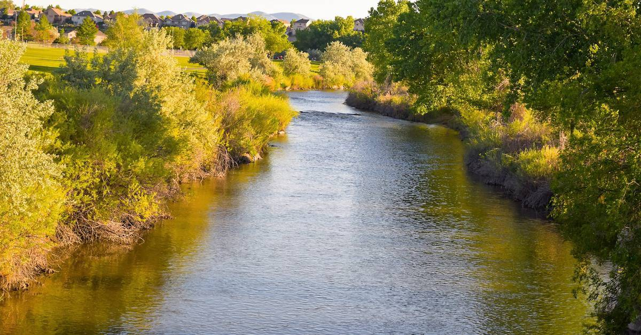
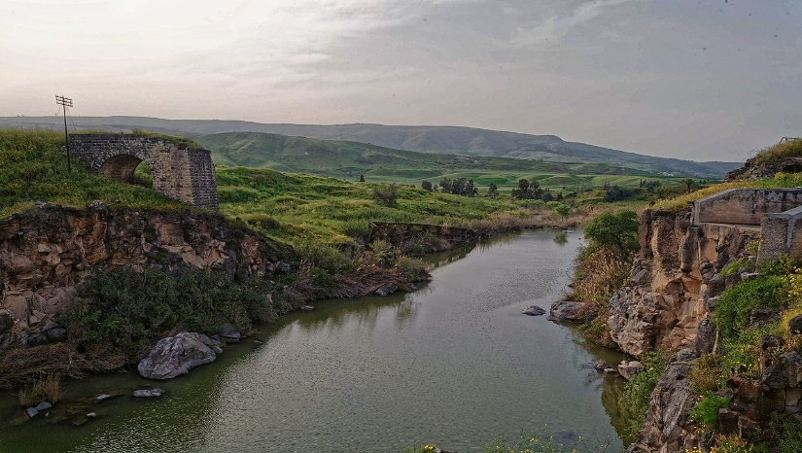
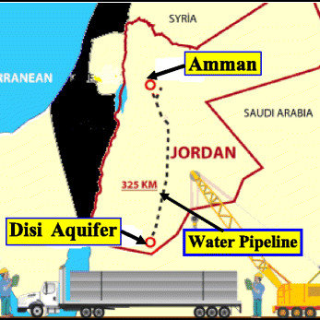
The Water crisis is the lack of fresh water recourses to meet the standard water demand.
The country's major surface water resources, the Jordan River and the Yarmouk River, are shared with Syria who leave only a small amount for Jordan. The Disi Water Conveyance Project from the non-renewable Disi aquifer to the capital Amman, opened in July 2013, increases available resources by about 12%.
Jordan is one of the most water-stressed countries in the world , and without significant interventions, the situation is likely to deteriorate further.
While more than 98% of the population has access to an improved water source, only 93% access a safely-managed source and 86% to a piped network. In urban areas, water is usually available once a week, and less than once every two weeks in rural areas, with reduced frequency during the summer.

Slide 3
Issues :
1- The country’s river is nearly running dry ,the flow in the Jordan River is less than 10 percent of its historical average, and the Yarmouk River, is greatly diminished , the rivers are uneasily shared with neighbors increasing supply from these sources is challenging , all of this has led to an overreliance on extracting groundwater from aquifers , the aquifers are being drained at roughly twice the rate at which they can be replenished naturally .
2- Rapid population growth, because of waves of refugees from Syria and other countries facing conflict ,the government has come under pressure to meet increasing demand on water.
Problems :
1-Water crisis limits access to safe water for drinking and for practicing basic hygiene at home, in schools and in health-care facilities, and the sewage systems can fail and the threat of contracting diseases like cholera flows.
2- Reduction in water supply, reduced crop yields, and potential crop failures can significantly undermine Jordan’s agricultural production.

Slide 4
Water crisis has Impact on:
1- Economic production : Reduction in water supply, and potential harvest failures can significantly undermine Jordan’s agricultural production.
2- Service sector through increased operational costs , Jordan’s economy is heavily reliant on the service sector.
3- Human capital : access to safely managed drinking water has increased to above 85%, from around 54% in 2000, significantly improving the quality of life of millions of Jordanians , despite significant progress, access to quality water, sanitation and hygiene services remains a challenge .The mortality rate credited to water, sanitation and hygiene services -related diseases is 0.6 per 100,000 persons, which is not high compared to the global average, but higher than in advanced economies and several regional peers, the access to improved water and sanitation can reduce child mortality by approximately 20% and prevent death in children under five across developing countries.
Causes :
1- Climate change:
Experts predict that climate change will result in summer temperatures in the Mediterranean region rising between2.2°C and 2.5°C. This will be accompanied by a 4% to 27% decrease in annual rainfall, increasing the risk of droughts.
Increased evaporation and reduction in soil moisture will lead to a higher need for crop irrigation ,climate change is also expected to increase the number of extreme weather events such as rain and snowstorms, which can result in flooding , It will also cause greater variability in annual temperature extremes.
Additional effects include increased risks of flooding, siltation of rivers, dams and lakes; will reduce flows of major rivers such as the Jordan River (by up to 80%) , And all of these risks will have economic, health, water and food security impacts.
.
Notes:
Mediterranean :البحر الابيض المتوسط
Droughts:الجفاف

Slide 5
2-The high water consumption level of the Jordanian people particularly in agriculture has endangered the country's water supply and caused so many shortages, because of this excess, Jordan's water sources have been drained and dried, as well as polluted.
3- Pollution: Pollution is worsening water shortages, the overflow of wastewater pumping stations, leaks from sewage systems and exposure to industrial and commercial waste are polluting Jordan’s surface river sources, even groundwater is not safe from pollution, as many pollutants can leach into underground aquifers.
Consequences:
1- Communities without WASH (Water, Sanitation and Hygiene) infrastructure and hygiene awareness are affected by waterborne diseases and overburden health centers and hospitals, and Schools without WASH infrastructure (Water, Sanitation and Hygiene) can become a high-risk place for infections.
2- Some productive activities (especially agriculture) cannot function without access to water.

Slide 6
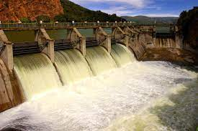
Solutions:
1- Constructing dams, and using fossil aquifers such as Disi.
2- Increasing costs, especially for agricultural water use, and removing water supports.
3- Introducing more guidelines on making agricultural use of water resources more sustainable .
4- Raising public awareness of the growing water crisis and engaging citizens in water protection .
5- Introduce the water crisis concept into school curricula to educate schoolchildren about It to promote an understanding of the value of water and the importance of its protection,
6- plan for future water needs by identifying available resources to reduce the risk of cities running out of water.
7- Increasing taxes could help finance the maintenance of existing water substructure and the development of new projects.
8- Seawater desalination as fresh water source .
9- Rainwater harvesting (RWH) to offer an alternative source for water supply growth in Jordan .

Slide 7
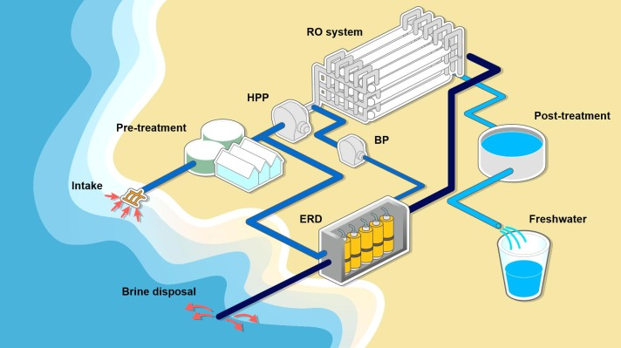
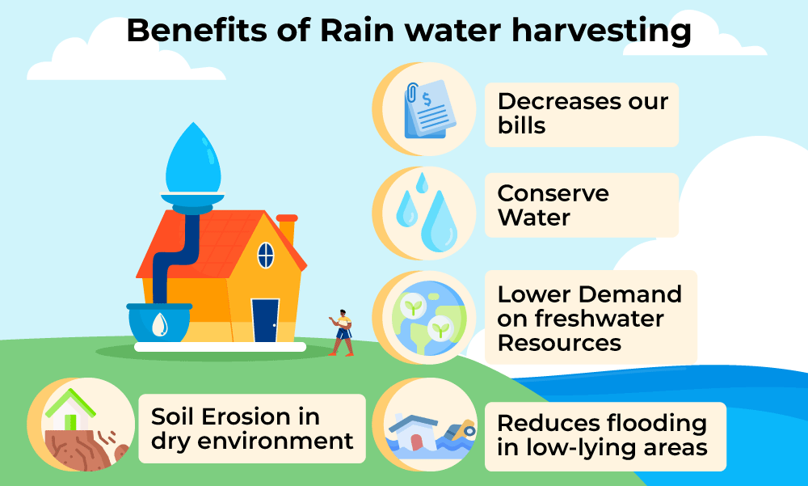
Seawater desalination
Rainwater harvesting (RWH)

Slide 8
The costs of the water crisis in Jordan. UNICEF Jordan. (n.d.). Retrieved May 7, 2023, from https://www.unicef.org/jordan/costs-water-crisis-jordan
Water stress in Jordan - Executive Summary. UNICEF Jordan. (n.d.). Retrieved May 7, 2023, from https://www.unicef.org/jordan/water-stress-jordan-executive-summary
Jordan Country Risk Brief. Climate. (n.d.). https://climate-diplomacy.org/magazine/conflict/jordan-country-risk-brief
Times, N. Y., & last updated: Nov 13, 2022. (2022, November 13). Jordan is running out of water supplies, a grim glimpse of the future - jordan news : latest news from Jordan, mena. Jordan News | Latest News from Jordan, MENA. https://www.jordannews.jo/Section-106/Features/Jordan-is-running-out-of-water-supplies-a-grim-glimpse-of-the-future-24464
Saiesha. (2022, April 14). 7 facts about water scarcity in Jordan. The Borgen Project. https://borgenproject.org/water-scarcity-in-jordan/

Slide 9


