Slide 1
obesity
BY :-Natalie Bouri
Tala Alfarah
Mariana Hourani

Slide 2
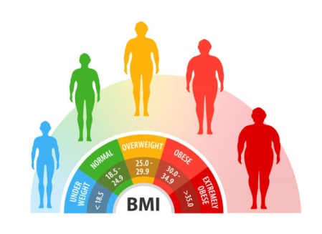

Slide 4
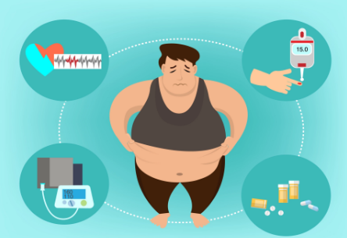

Slide 5
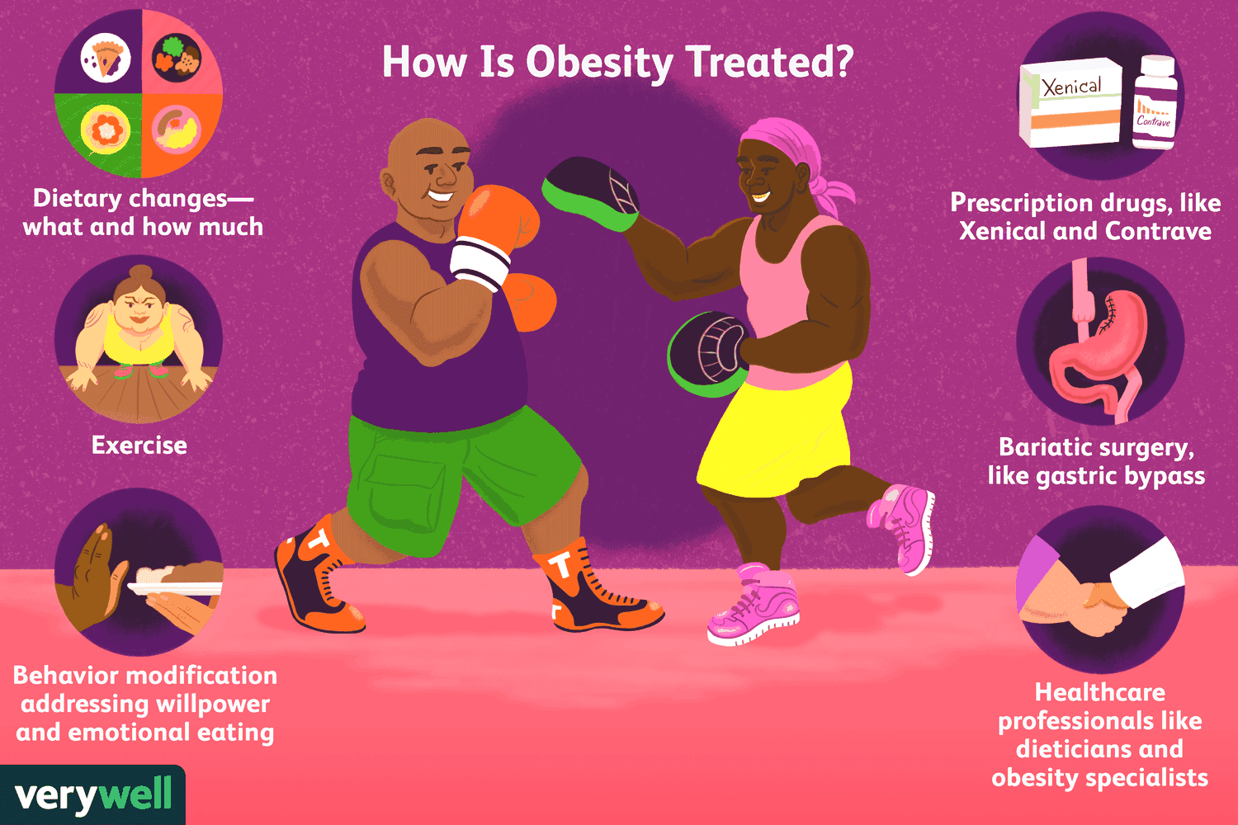

Slide 6
https://youtu.be/3h1nHxgsNyc

Slide 7
TO SUM UP ;-
1
2
3
4

Slide 8
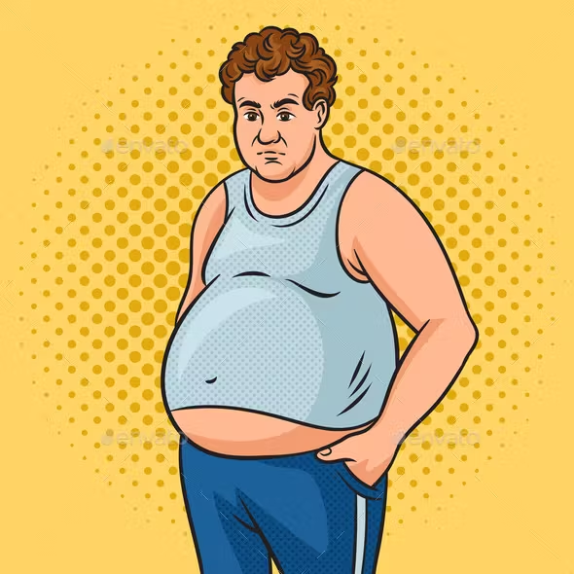
I don’t have time to exercise what can I do ?
If you can give some solutions :-
Back

Slide 9
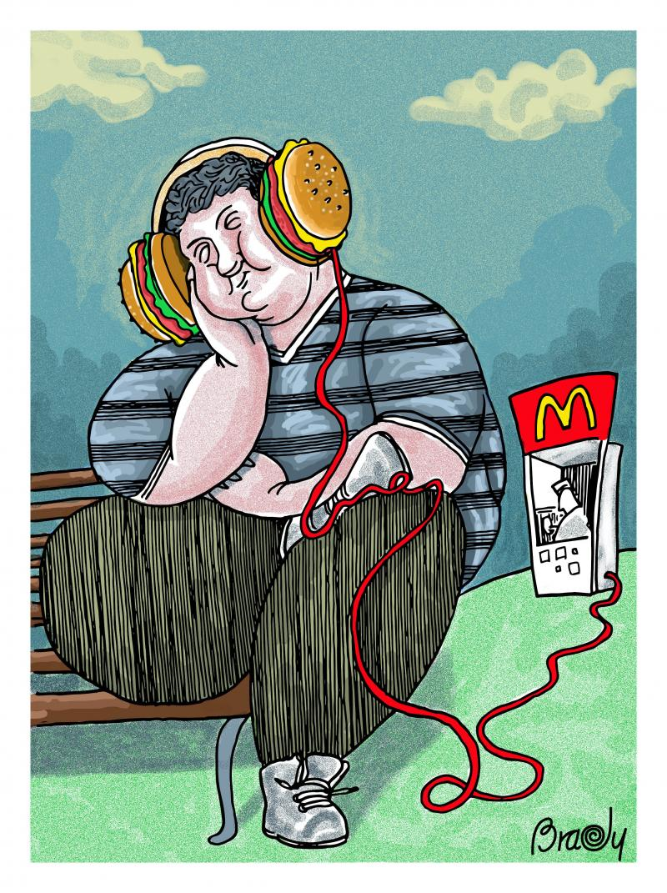
can obesity shorten life expectancy and how ?
Back

Slide 10
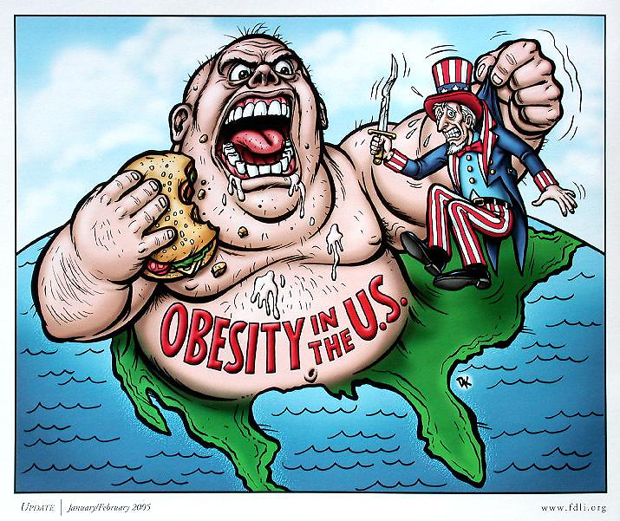
How is obesity treated?

Slide 11
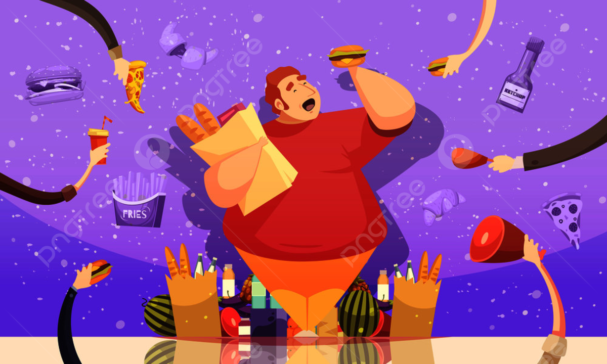
What are the three types of obesity ?

Slide 12
THANK YOU!
HOPE THAT WE HELP YOU GUYS WE ENJOY DOING THIS .

