Slide 1
Obesity
By: Sulaf,Selena,Yasmeen

Slide 2
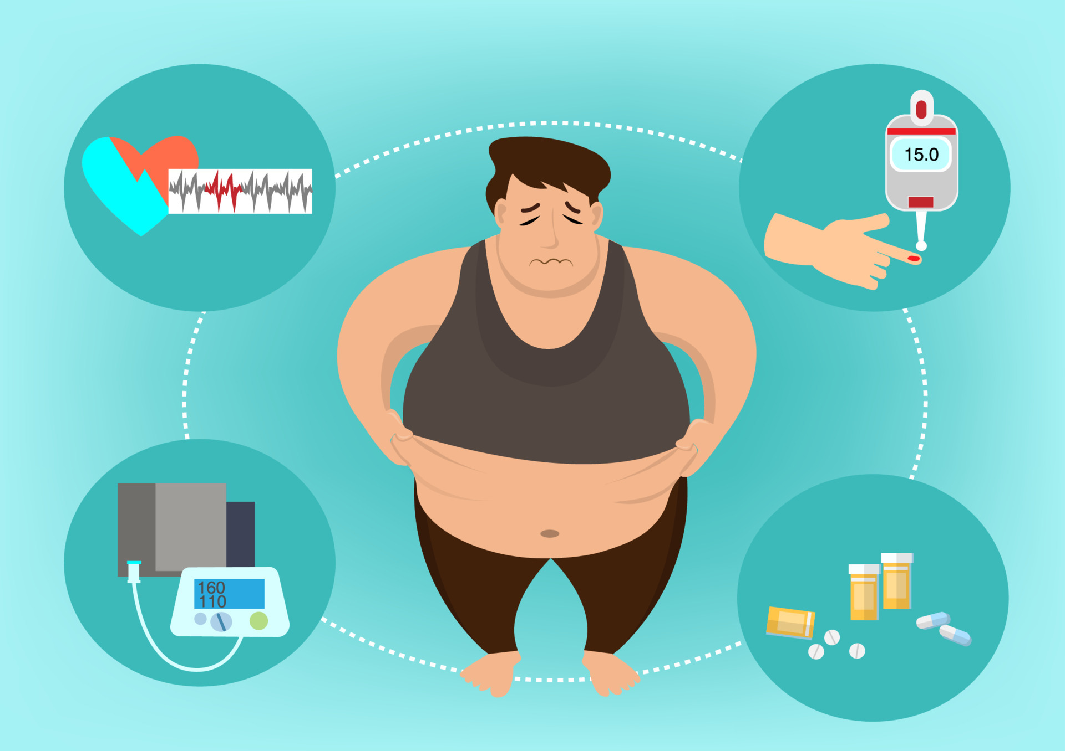
What is obesity?
Obesity also known as overweight is a chronic disease having extra amounts of fat in your body that poses a risk in your health and many more, and it is usually caused by over eating and not doing any exercises.

Slide 3
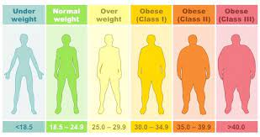
What are the 3 types of classes in obesity?
Class 1 of obesity which has the lowest risk of any health diseases. BMI (body mass index) is 30.0 to 34.9.
Class 2 of obesity which has an average risk of any health diseases. BMI (body mass index) is 35.0 to 39.9.
Class 3 of obesity which has the highest risk of any disease health disease. BMI (body mass index) is identical or greater than 40.0.

Slide 4
Problems that obese people may face
Other than illnesses and what we have stated before:
breathlessness.
increased sweating.
snoring.
difficulty doing physical activity.
often feeling very tired.
joint and back pain.
low confidence and self-esteem.
feeling isolated.

Slide 5
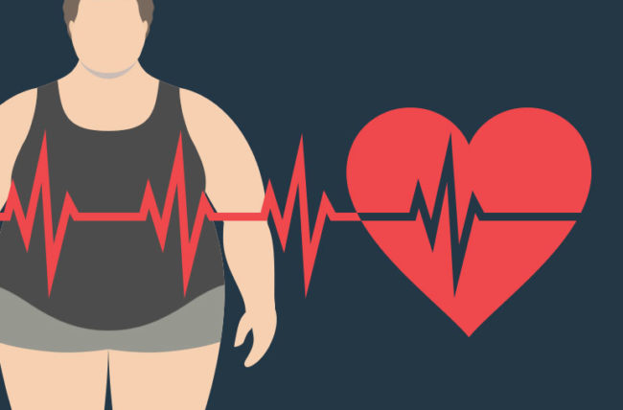
What are the effect of obesity?
Obesity causes many dangerous and deadly diseases like diabetes, heart disease, and some types of cancers.
Also another cause of obesity is that you can get a heart attack or stroke at any moment only by having an extra amount of fat in your body.
A major effect on people is that it can be mental illnesses and most people wouldn’t be happy and it will cause them to become insecure and may escalate to suicide.

Slide 6
Effects points
High blood pressure
High cholesterol
Type 2 diabetes
Coronary heart disease
Stroke
Gallbladder disease
Body pain and difficulty with physical functioning

Slide 7
Recourses
https://www.hsph.harvard.edu/obesity-prevention-source/obesity-consequences/health-effects/#:~:text=Obesity%20increases%20the%20risk%20of,changes%20in%20hormones%20and%20metabolism
677 Huntington Avenue, Boston, MA 02115
https://www.cdc.gov/healthyweight/effects/index.html
Division of Nutrition, Physical Activity, and Obesity, National Center for Chronic Disease Prevention and Health Promotion
https://medlineplus.gov/ency/patientinstructions/000348.htm
National Library of Medicine 8600 Rockville Pike, Bethesda, MD 20894

