Slide 1
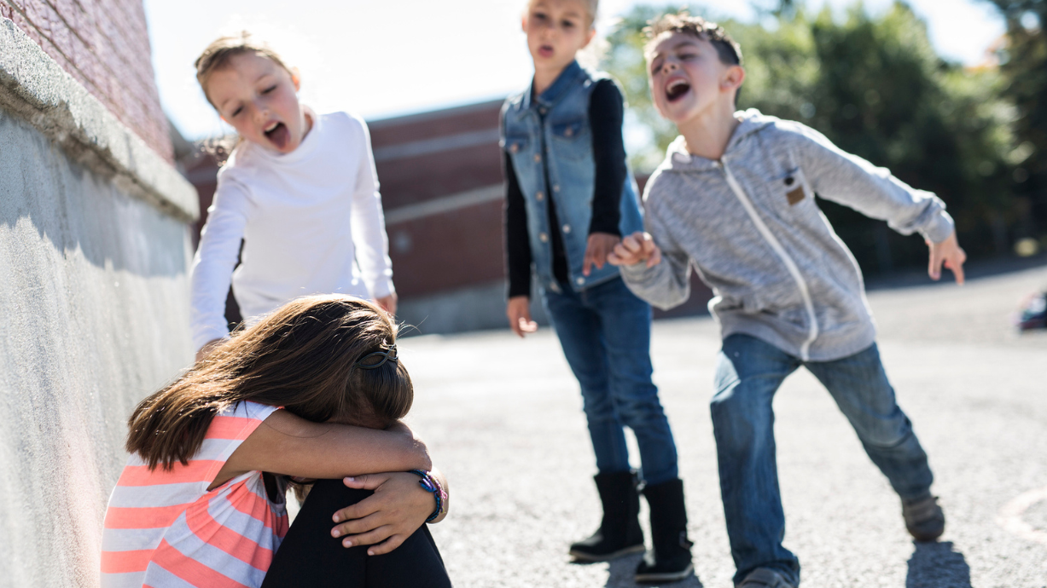
Stop Bullying
Made by : Mary Abu Lail ,Joud Al Shalabi, Ali Hassan

Slide 2

https://youtu.be/rgMwh5Fnp3I

Slide 3
Experiment time!
Conducted by Mary Abulail

Slide 4
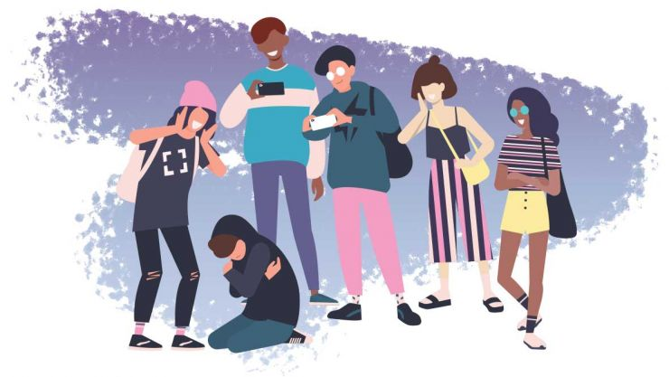
What is bullying?

Slide 5

The problems and issues of bullying:

Slide 6
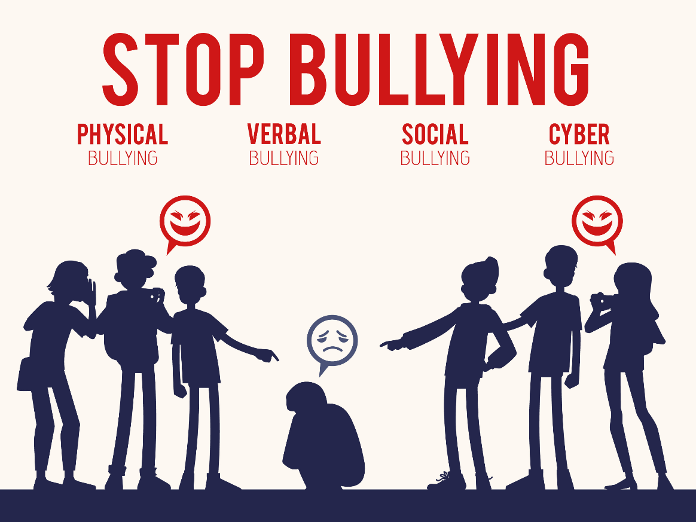
Types of bullying:

Slide 7
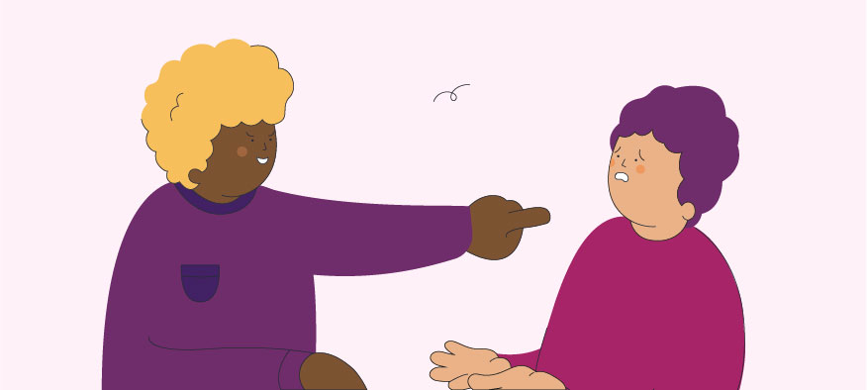
What are the Causes of bullying?

Slide 8
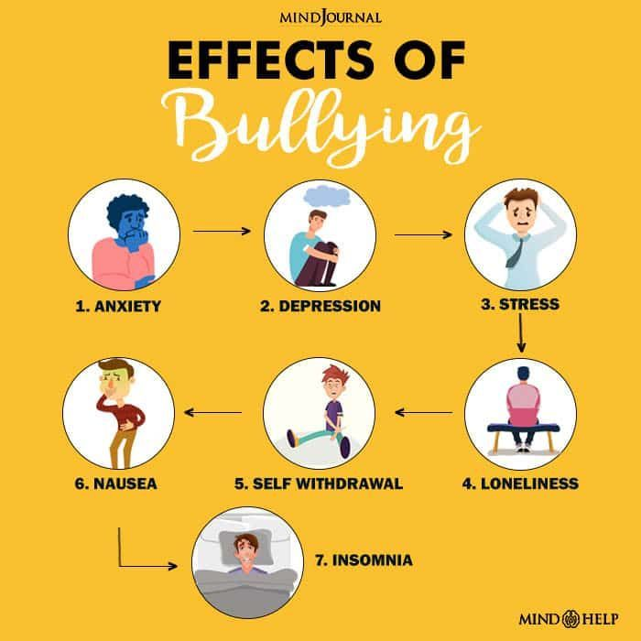
What are the effects and results of bullying?

Slide 9
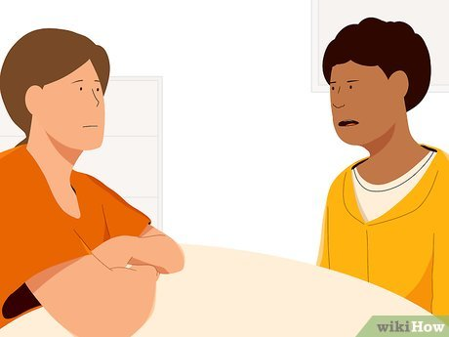
Solutions for bullying:

Slide 10
Game time!
(fill in the blank and true or false)

Slide 11
_____________ : the use of technology to embarrass or harass a person or group
Cyberbullying

Slide 12
To prevent bullying, you should tell an _____ for help or tell the bully to stop
adult

Slide 13
There are 4 types of bullying: Cyber, Physical, ______ , and Social
Verbal

Slide 14
People bully because they think they can gain popularity or power
True/False
True

Slide 15
The most common reason people bully is because of peoples looks
True/False
True

Slide 16
Bullying does not affect peoples mental health
True/False
False

Slide 17
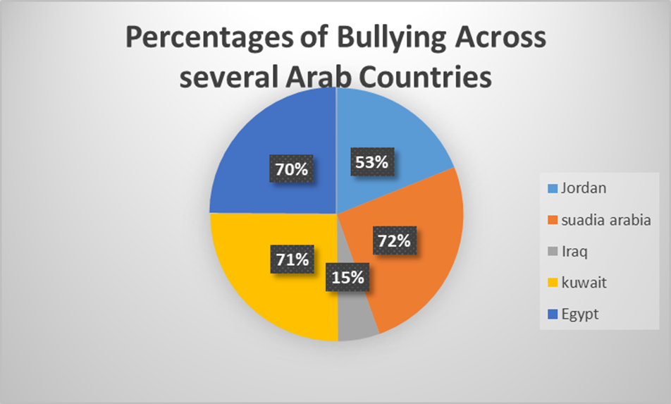
Percentages of Bullying Across
Several Arab Countries

Slide 18
Bullying Across
Several Arab Countries

Slide 19
Thank you for listening to our presentation!

