Slide 1
Obesity
By: Naya Al shami, Salma Moustafa , Maya atawi , Yasmeen al salman

Slide 2
“More die in the United States of too much food than of too little.”
By: John Kenneth Galbraith

Slide 3
Table of Contents
1) What is obesity 2)What causes obesity
3) How does obesity affect your body 4)Ways to reduce obesity
6) Foods that help get rid of obesity 7) Foods that promote obesity 8) What are the types of fat
9) Countries with the highest rates of obesity
10)Which gender has the highest rate of obesity
11)Fun quiz

Slide 4
What is Obesity?
01

Slide 5
What is obesity?
Weight gain that is abnormal or excessive and poses a risk to health is what is meant by the terms "overweight" and "obesity." Overweight is defined as a body mass index (BMI) of 25, and obesity as a BMI of greater than 30.

Slide 6
02
What causes obesity?

Slide 7
What causes obesity?
There are so many factors that causes obesity.
01
Lack of sleep
02
Smoking
03
genetics
04
Medications
05
Gut hormones
06
inactive

Slide 8
03
How does obesity affect your body?

Slide 9
How does obesity affect your body?
Carrying extra fat leads to serious health consequences such as cardiovascular disease (mainly heart disease and stroke), type 2 diabetes, musculoskeletal disorders like osteoarthritis, and some cancers (endometrial, breast and colon). These conditions cause premature death and substantial disability.

Slide 11
04
Ways to reduce obesity?

Slide 12
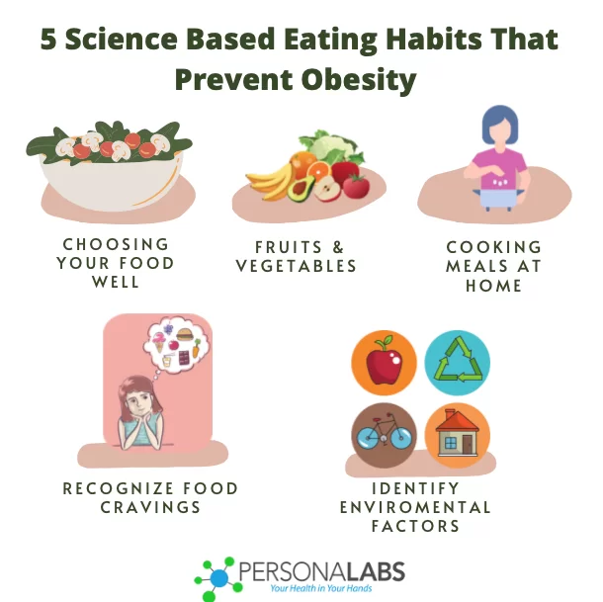
How to reduce obesity?
Eating Healthier options
Working out
(30 min walk)
Avoid stress
(stop worrying)
Avoid watching TV
(2 house a day)

Slide 13
O6
Foods that help reduce the risk of obesity

Slide 14
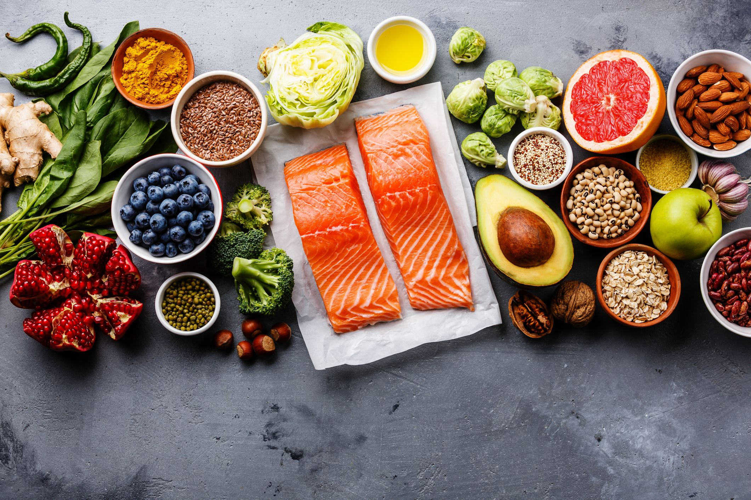
Foods that help reduce the risk of obesity
Whole grain foods
Vegetables and fruits
Plant oil
Top foods that help reduce the risk of obesity

Slide 15
07
Foods that promote obesity

Slide 16
Foods that promote obesity
For you to see results you need to limit theses foods and drinks:
1) Sugar-sweetened beverages (soda, fruit drinks, sports drinks)
2)Fruit juice (no more than a small amount per day)
3)Refined grains(white bread, white rice, white pasta) and sweets.
4)Potatoes (baked or fried)
5)Red meat (beef, pork, lamb) and processed meats (salami, ham, bacon, sausage)

Slide 17
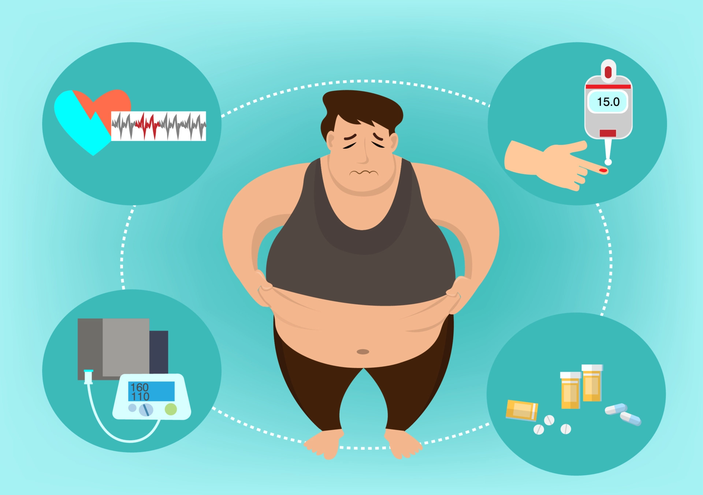
07
08
What are the types of fat
What are the types of fat?

Slide 18
What are the types of fat?
White, brown, and beige are the three various colors of fat cells that can be found in the body. Three types of fat cells can be stored: visceral, subcutaneous, and essential fat.

Slide 20
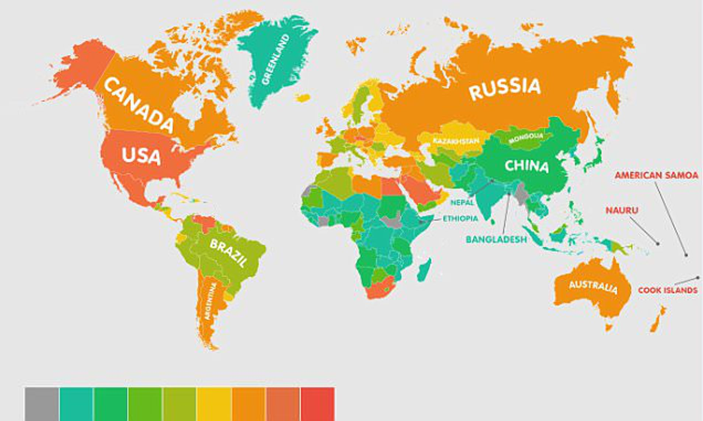
Which country has the highest rate of obesity?
09
09
Which country has the highest rate of obesity?

Slide 21
Countries with the highest rate of obesity
Nauru
Cook Islands
Palau
The World Health Organization (WHO) reports that the Pacific and the Middle East are the regions with the highest rates of obesity. With nearly 30% of their inhabitants being obese, the Pacific island nations of Nauru, the Cook Islands, and Palau have the highest rates of obesity.

Slide 22
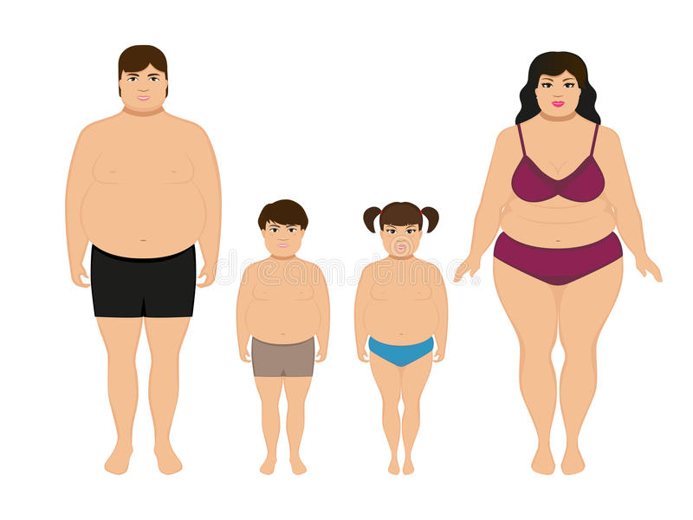
09
09
Which gender has the highest rate of obesity?
Which gender has the highest rate of obesity

Slide 23
Which gender has the highest rating of obesity?
The results show that older women are more likely than older men to be obese (BMI-based obesity: 26.3% vs. 17.6%).
19.8%
Prevalence Of Obesity
Global Average
16.2%
Male Prevalence Of Obesity
Global Average
23.2%
Female Prevalence Of Obesity
Global Average
24.2%
Children Prevalence Of Obesity
Global Average

Slide 25
Fun quiz
1) What causes obesity?
2)How can obesity affect your body?
3)Which gender has the highest rates of obesity?
4)How can you reduce the risk of having obesity?
5)Which country has the highest rate of obesity?

Slide 26
https://www.who.int/news-room/questions-and-answers/item/obesity-health-consequences-of-being-overweight#:~:text=Carrying%20extra%20fat%20leads%20to,premature%20death%20and%20substantial%20disability.
https://www.aarp.org/health/healthy-living/info-2017/health-benefits-body-fat.html
https://www.nhsinform.scot/illnesses-and-conditions/nutritional/obesity#:~:text=Obesity%20is%20generally%20caused%20by%20eating%20too%20much%20and%20moving,by%20the%20body%20as%20fat.
https://www.hsph.harvard.edu/obesity-prevention-source/diet-lifestyle-to-prevent-obesity/
https://www.healthline.com/health/types-of-body-fat#:~:text=There%20are%20three%20different%20types,%2C%20subcutaneous%2C%20or%20visceral%20fat.

Slide 27
Thank you for watching this prestation

