Slide 1
Obesity
Done by: Abdullah Abujaber, Fawzi Zabaneh, Anton Habis

Slide 2
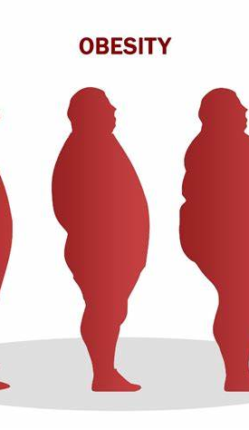
What is obesity?
Weight gain that is abnormal or excessive and poses a risk to health is what is meant by the terms "overweight" and "obesity." Overweight is defined as a body mass index (BMI) of 25, and obesity as a BMI of greater than 30.

Slide 3
What are the causes of obesity?
1. Calories are the units used to measure a food's energy content.
2. A bad diet, obesity does not develop suddenly.
3. The lack of exercise. Another significant factor that contributes to obesity is a lack of physical activity.
4. Genetics
5. Medical factors

Slide 4
How to prevent obesity?
Choosing healthier food and drink options, such as sources of protein, whole grains, fruits, and vegetables, as well as healthy fats. Raising the level of exercise while reducing harmful foods (red meat, processed meat, potatoes, refined grains, and sweets) and fluid (sugary drinks). Reducing the amount of time spent in front of computers, TVs, and other.

Slide 5
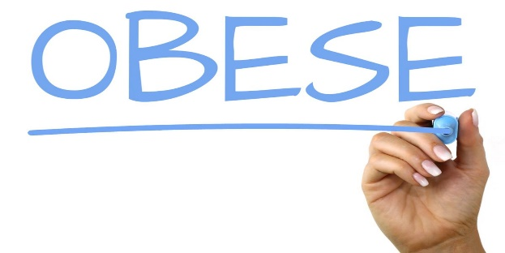
Consequences
Carrying additional weight has detrimental effects on one's health, including endometrial, breast, and colon cancers, type 2 diabetes, musculoskeletal conditions including osteoarthritis, and cardiovascular disease (primarily heart disease and stroke). These ailments lead to early mortality and severe disability.

Slide 6
ADVANTAGES
Stores energy.
Fat serves an important role for storing vitamins.
Keeps us warm
Protects the body from trauma.

Slide 7
Disadvantages
All-causes of death (mortality).
High blood pressure (hypertension).
High LDL cholesterol, low HDL cholesterol, or high levels of triglycerides (dyslipidemia).
Type 2 diabetes
Coronary heart disease
Stroke
Gallbladder disease

