Slide 1
Physics
By: Abdullah Abujaber, Anton Habis, Fawzi Zabaneh

Slide 2
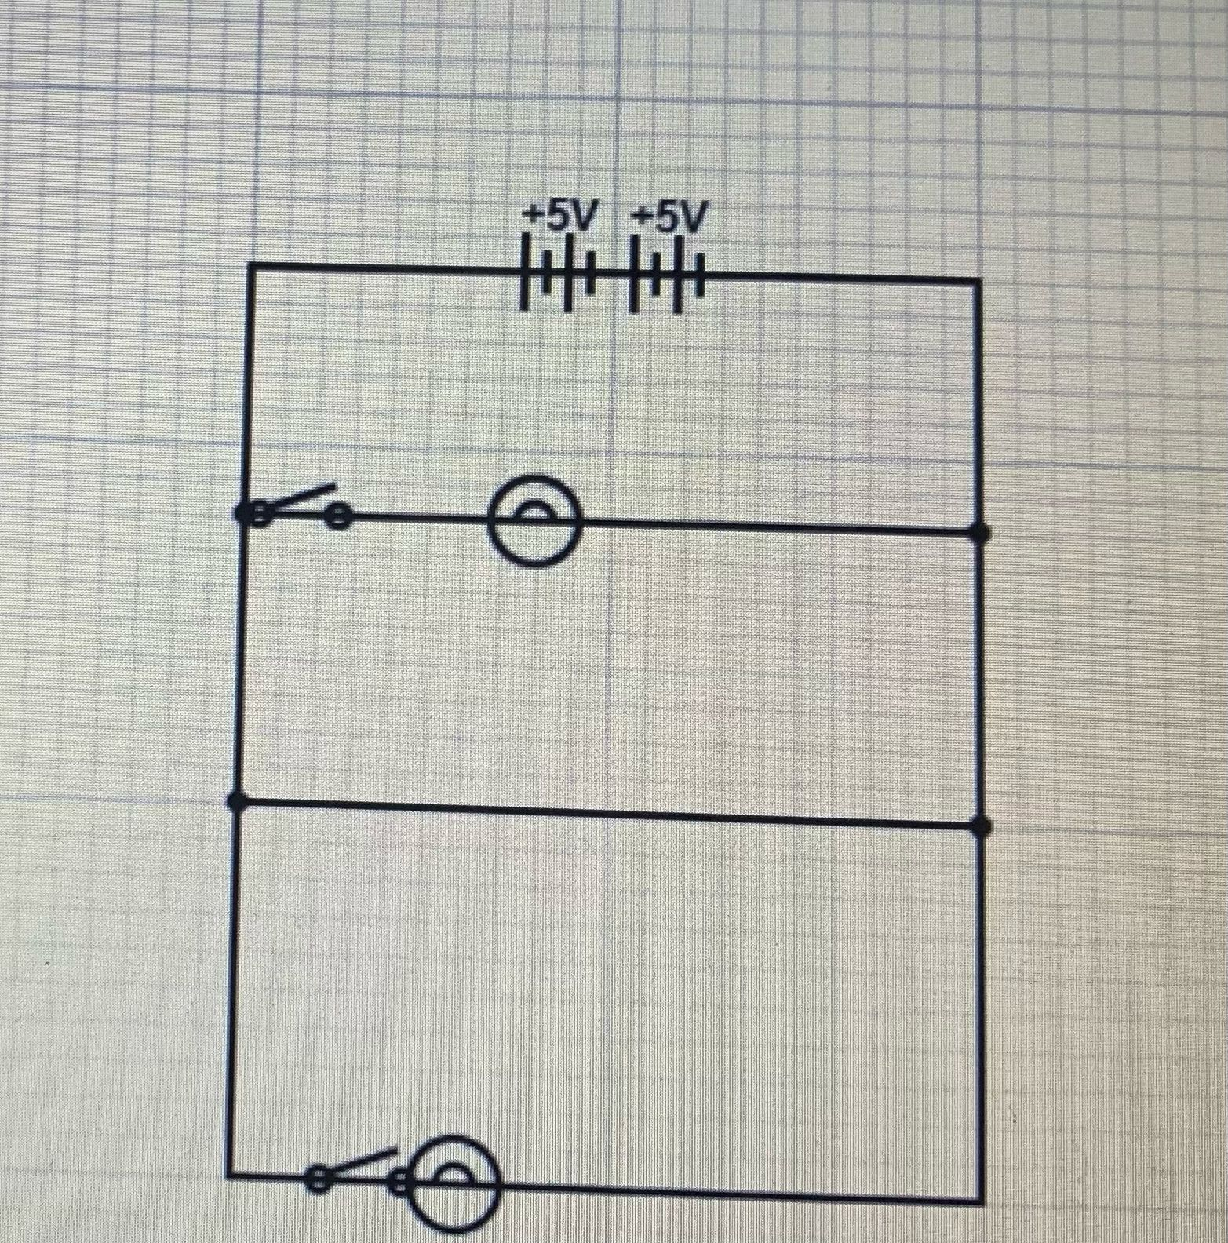
BATHROOM:
We used a total of two bulbs to light it up
Two switches to control each one of them
Price:23JD’S

Slide 3
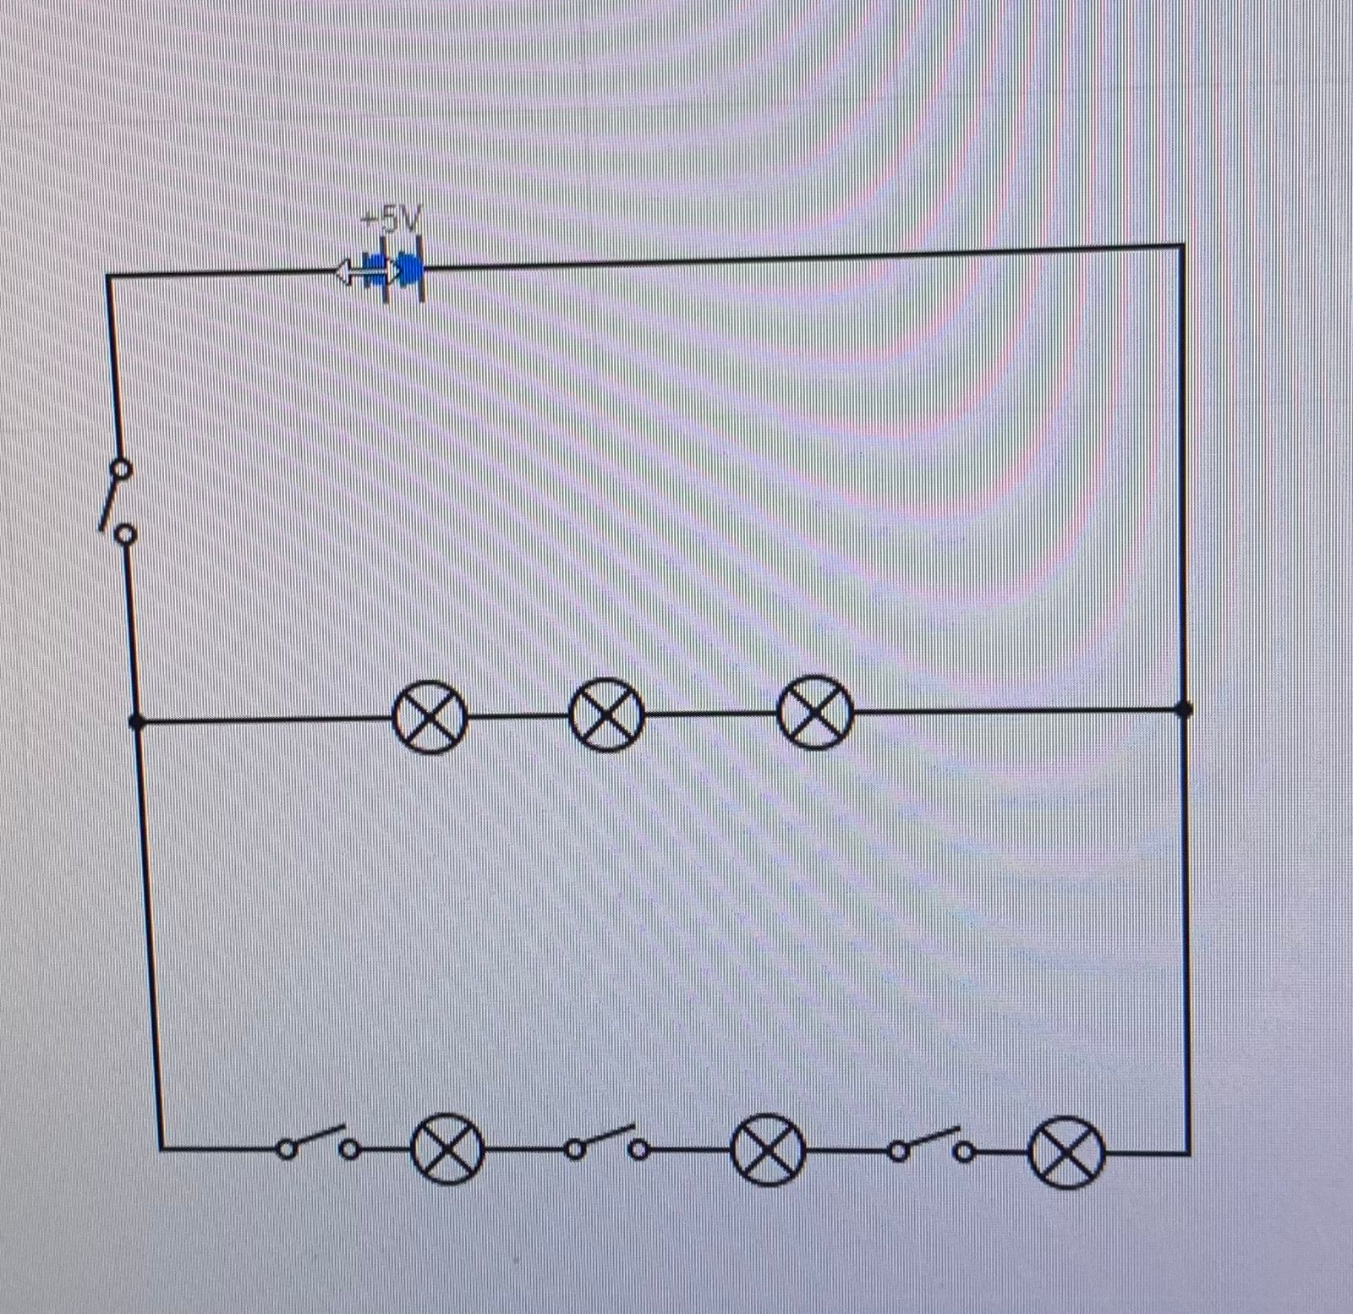
KITCHEN:
We used a total of six light bulbs and four switches
Price:51JD’S

Slide 4
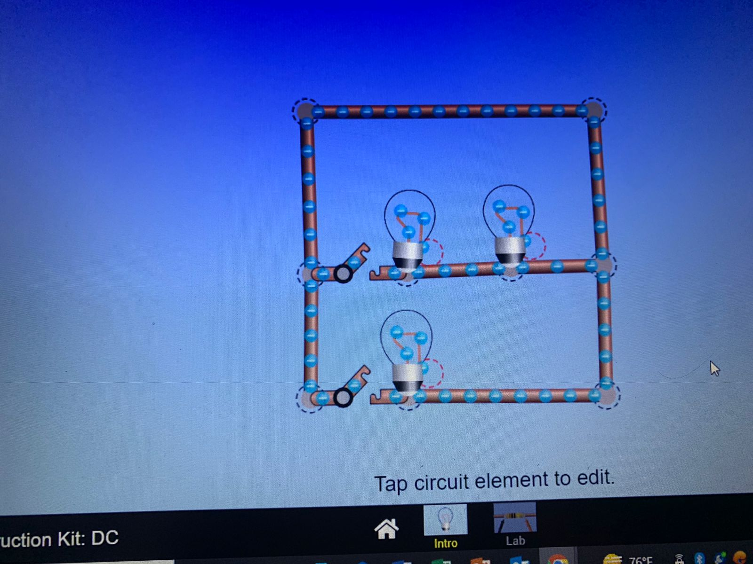
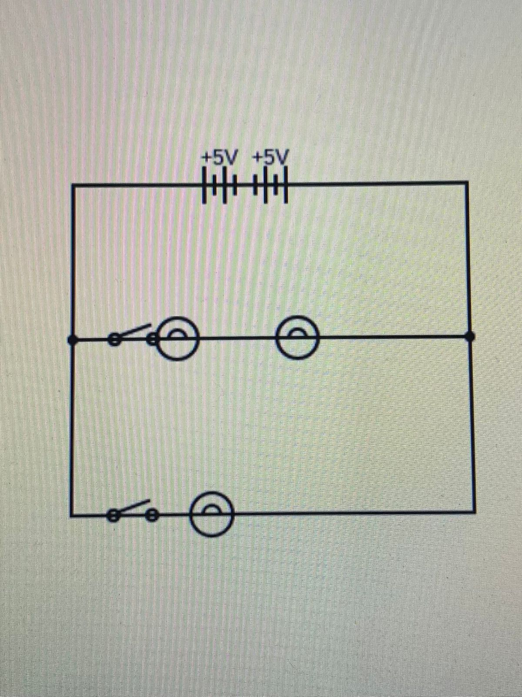
Bedroom:
We used a total of three light bulbs and two switches
Price:37JD’S

Slide 5
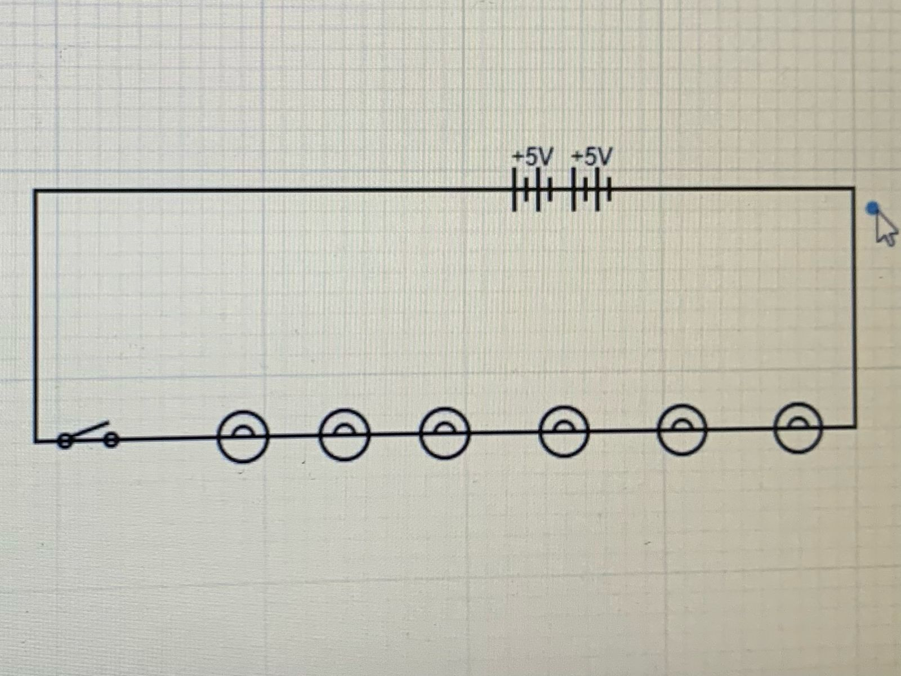
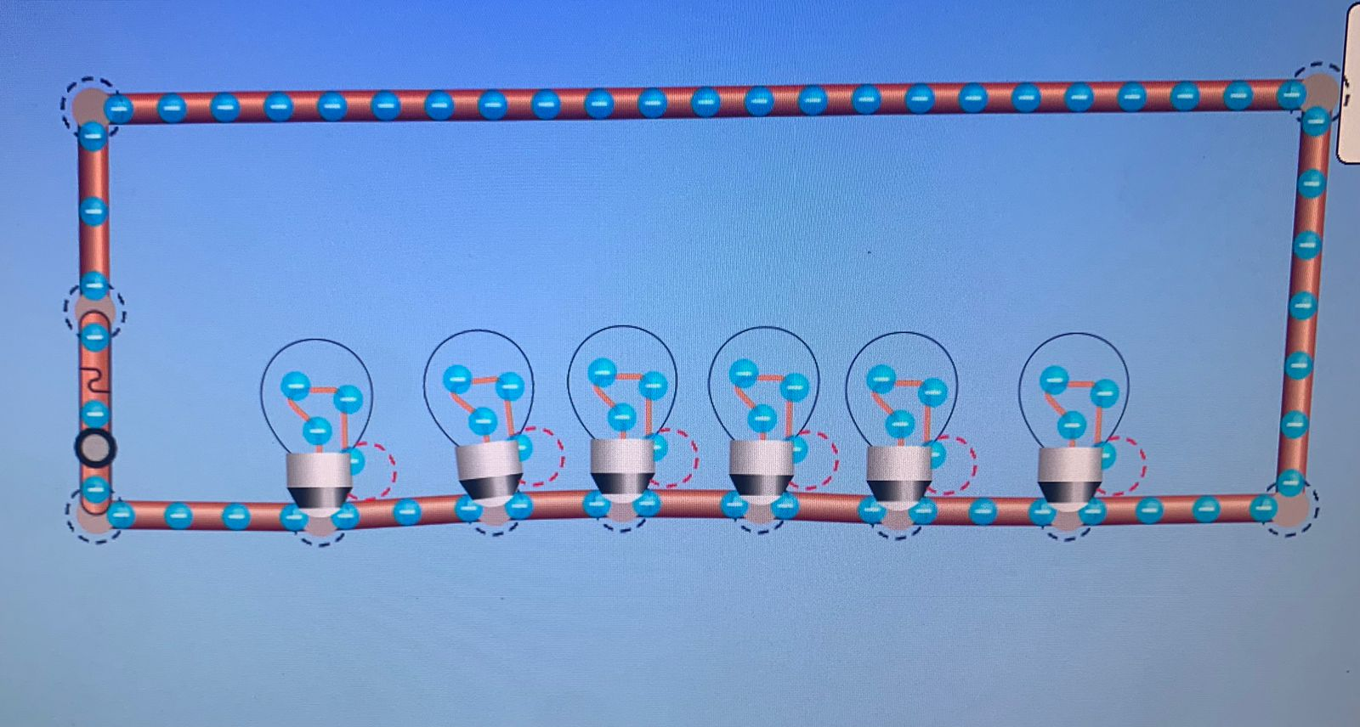
Livingroom:
We used a total of 6 light bulbs and one switches
Price:33.5JD’S

