Slide 1
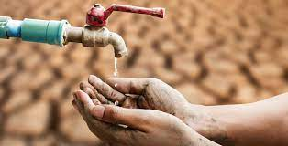
Improving your community - Water Crisis

Slide 2
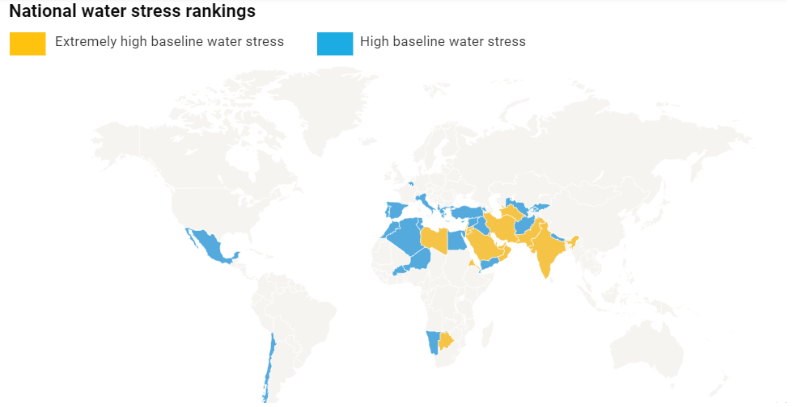

Slide 3
Water scarcity is defined as a water deficiency or a lack of safe water supplies.
As the population of the world grows and the environment becomes further affected by climate change, access to fresh drinking water diminishes. Globally, 785 million people lack access to clean drinking water. Every day, over 800 children die from dirty water.
Jordan is one of the most water-stressed countries in the world and without significant interventions; the situation is likely to worsen further.

Slide 4
Causes of Water Shortage:
1. Droughts and Climate Change: climate change and rising global temperatures are altering rainfall patterns, which in turn, impact the quality and distribution of global water resources.
2. Poor Water Management and Growing Demand: Today, the world’s population is increasing, which translates to a growing demand for water. Also, the increase demand for households are both driving factors behind water shortages.
3. Water Pollution: Water pollution already kills more people each year than war and all other forms of violence combined.
4. Illegal dumping: Industries frequently dispose of their industrial garbage in nearby rivers and lakes since it is an easy and cheap way to get rid of this waste.
5. Natural disasters: like tsunamis, floods may also cause severe water shortages for the local population since important public infrastructure may be destroyed.

Slide 5
Water crisis can affect the below categories:
Agriculture
Agriculture in Jordan consumes more than 51% of the country’s freshwater. Increased water stress can lead to crop failure and increased costs for consumers and businesses.
Industry
Overall, the role of water in industry and manufacturing is less direct than in the case of agriculture, but some sub-sectors still use significant amounts of water in production processes.
Industrial use accounts for only 3% of water consumption in Jordan and is concentrated in a few large sub-sectors, such as Chemicals and Packaging.
Health
The global health burden associated with inadequate water provision is staggering—lack of access to safe Water, Sanitation And Hygiene (WASH) services causes around 1.6m deaths every year.

Slide 6
Consequences of Water Shortage
1. Inadequate sanitation—a problem for 2.4 billion people—can lead to deadly diarrheal diseases, including cholera and typhoid fever, and other water-borne illnesses.
2. Increased Human Conflicts: water shortage prompts increased competition between water users, thus potentially sparking conflicts, which could potentially put millions of lives at risk.
3. Hunger: If there is no water that can be used to help water the crops, then you are going to have people that are going hungry. Animals will also die, which will result in a lack of meat as well.
4. Lack of Education: Water scarcity makes it difficult for people to get the education that they need or that they deserve. Why? Mainly because those children are either too sick to go to school or they are working to help get water to the home and the family.
5. Poverty: people who are dealing with water scarcity are often stuck in poverty. These people are not able to get the resources that they need to be able to thrive and instead are just barely surviving through these difficult times.

Slide 7
Amazing Solutions to Water Scarcity
1. Save Water Whenever Possible: This could mean limiting the use of water, the use of washing machines, and taking quick showers instead of full baths.
2. Education: By educating those who are not dealing with water scarcity, they can be in a position to help. Those who are dealing with it can get educated on how they can prevent the problem from becoming even worse in the future.
3. Recycle Water: There are plenty of technologies available that allow you to recycle rainwater and other water used at home.
4. Improve Practices Related to Farming: Farming and irrigation are often huge factors when it comes to water scarcity. Because of that, we need to improve practices so that we don’t use as much water.
5. Improve Sewage Systems: Without proper sanitation, the water in an area becomes ridden with disease and any number of other problems.

Slide 8
In summary, access to clean water changes everything; it’s a stepping stone to development. When people gain access to clean water, they are better able to practice good hygiene and sanitation.
Children enjoy good health and are more likely to attend school. Parents put aside their worries about water-related diseases and lack of access to clean water. Instead, they can focus on watering their crops and livestock and expanding their incomes.
Done By:
Markella Bursheh
Zeina Khraim
Kareem Wahhab

