Slide 1
Water Crisis
By: Adam M, Faris D, Sanad Q

Slide 2
What is water crisis?
Water crisis is a serious problem, it limits the amount of water a individual can use, Jordan is the 2nd most water scarce country

Slide 3
WHAT IS THE causes of water pollution in Jordan?
How are Jordan's surface river sources being polluted, specifically due to factors such as the overflow from wastewater pumping stations, leaks from sewage systems, and the discharge of industrial and commercial waste?

Slide 4
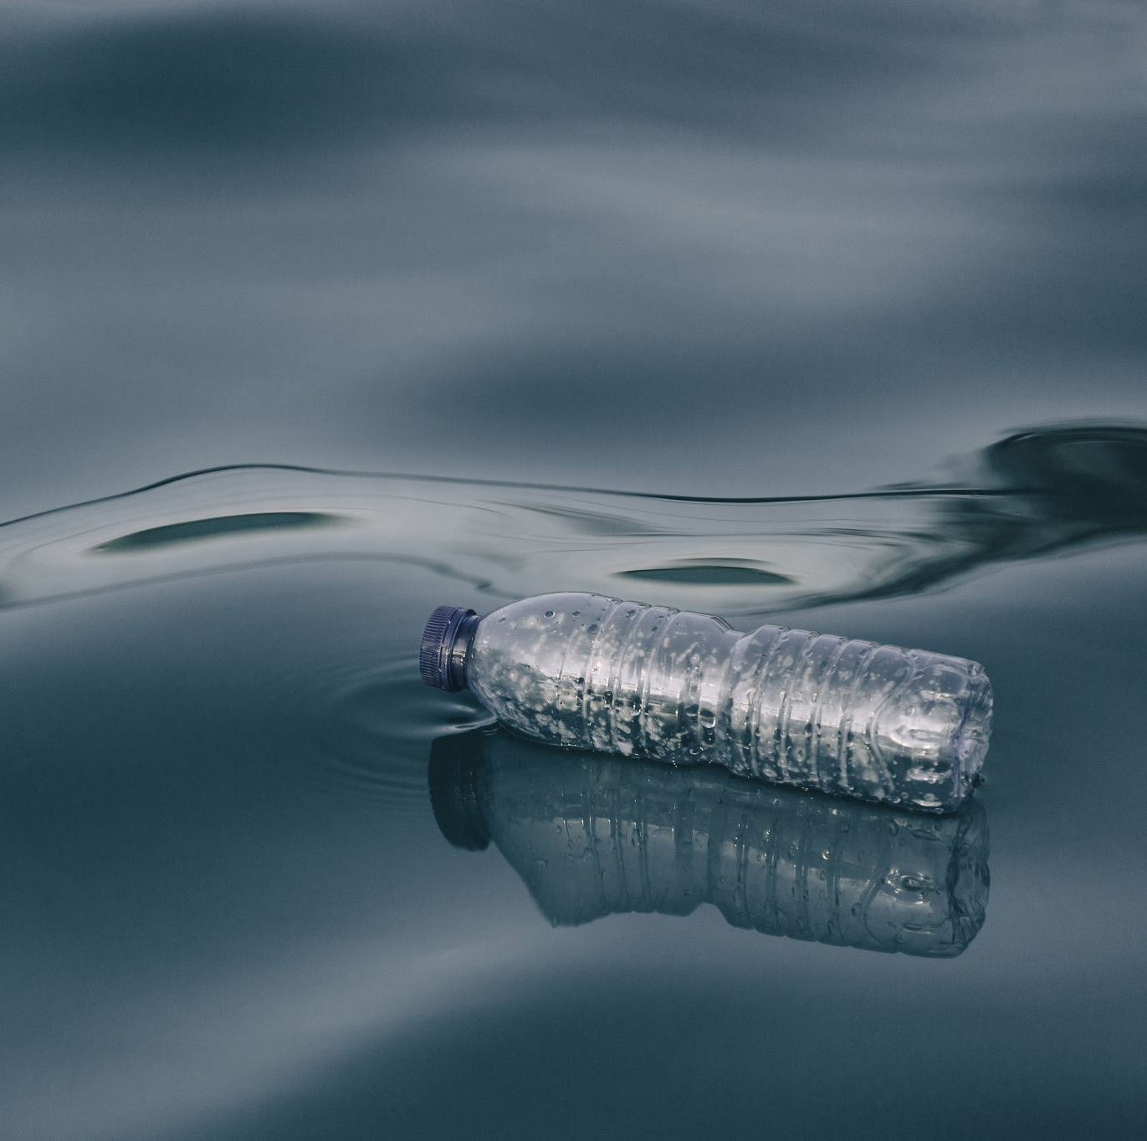
What are the consequences of water pollution in Jordan?
Water shortages can have a notable negative impact on the service sector. As businesses face limited water availability, they may be compelled to implement costly measures like water rationing or seek alternative water sources, resulting in increased operational expenses. Furthermore, the scarcity of water can disrupt supply chains, causing delays in deliveries, higher transportation costs, and added complexities in managing logistics, which can pose challenges to the smooth functioning and profitability of the service sector.

Slide 5
How is water pollution contributing to water shortages in Jordan?
One of the causes are water Pollution : pollution is exacerbating water shortages. The overflow of wastewater pumping stations,leaks from sewage systems and exposure to industrial and commercial waste are polluting Jordan’s surface river sources

Slide 6
What are the pros and cons of planting seedlings in the desert to solve Jordan's water crisis?
In an effort to address the water crisis in Jordan, a potential solution is the strategic planting of seedlings in the desert. This approach aims to utilize available land and resources to create green spaces and increase water absorption. While it offers hope for restoring balance, implementing this solution may pose challenges such as ensuring sufficient irrigation and managing the long-term sustainability of the planted seedlings.

Slide 7
How can tapping deep groundwater reserves help address the water crisis in Jordan, and what challenges and considerations are involved?
To address the crisis in Jordan, tapping deep groundwater reserves is seen as a viable solution. By accessing underground water sources, it offers a potential sustainable supply. However, the environmental impact and long-term consequences need to be carefully considered, along with the need for effective management and monitoring to ensure fair distribution and conservation of this crucial resource.

Slide 8
Citations:
The power of community-led advocacy: Key learnings from Jordan. Homepage. (2023, March 23). https://jordan.mercycorps.org
/ 2, M., 14, A., &amp; 11, A. (n.d.). Ballard Brief. https://ballardbrief.byu.edu/
University, S. (n.d.). Stanford News. https://news.stanford.edu
/ U.S. Agency for International Development. (2023, May 9).
https://www.usaid.gov/ https://www.unicef.org

