Slide 1
Improving Your Community
Water Crisis
Fares Khoury laith ma’sher saif hijazeen
Grade : 7 (a)

Slide 2

A good community
Healthy people in the community, can benefit their country and build it together!
They should have their basic needs from food, education and clean water!

Slide 3
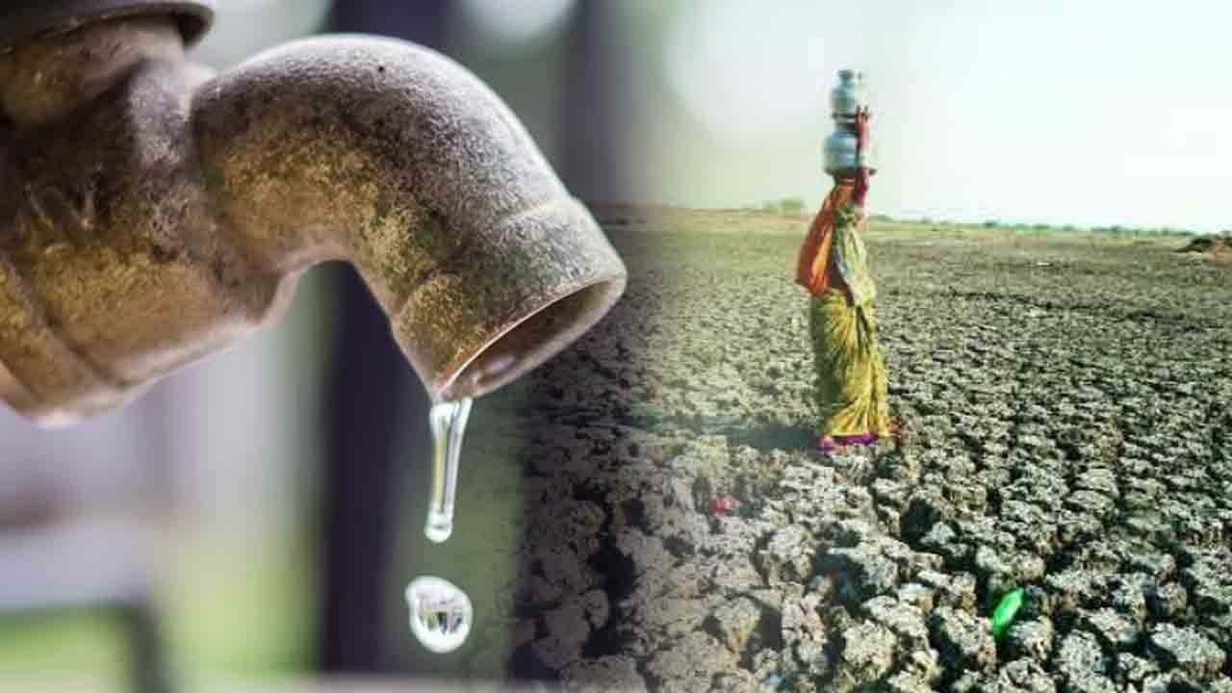
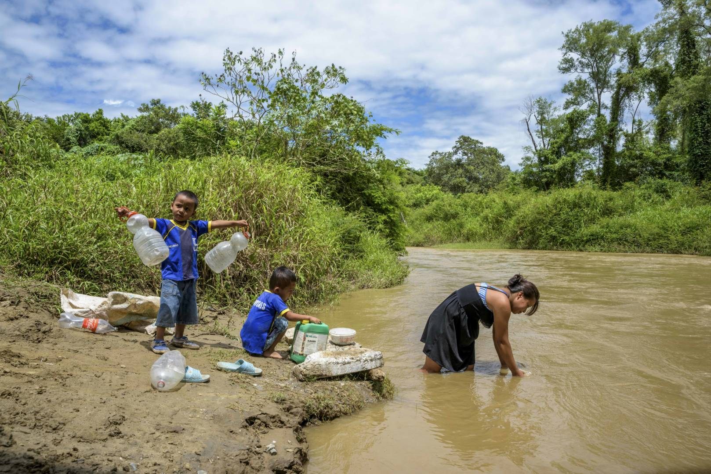
Improving community
Lack of clean water can lead to diseases dryness and deaths for both humans and plants.
Sick people cant build their countries or start projects.
In the following slides we’ll talk about how securing clean water can improve our
community.

Slide 4
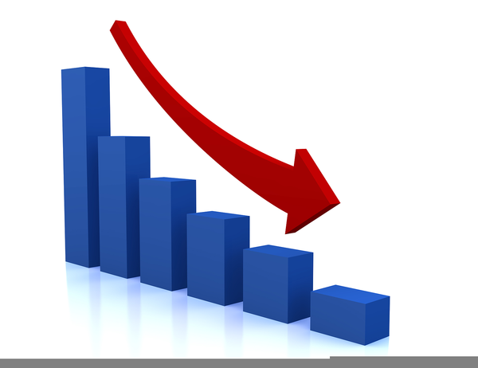
Water crisis in jordan
Jordan’s water resources are rapidly depleting and without significant interventions, the situation is likely to deteriorate further.
In Jordan, less than 100 cubic meters of renewable water resources are available per person annually, which is already significantly below the 500 cubic meters threshold of ‘absolute water scarcity’.

Slide 5
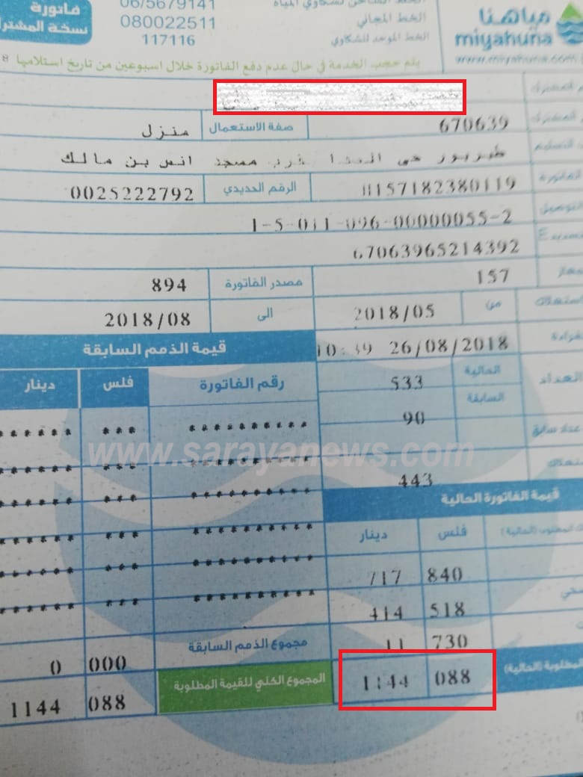
Expectations
Water stress levels are expected to increase at an average annual rate of 1%–1.5% until 2100, making more than 90% of low-income households in Jordan subject to critical water vulnerability.

Slide 7
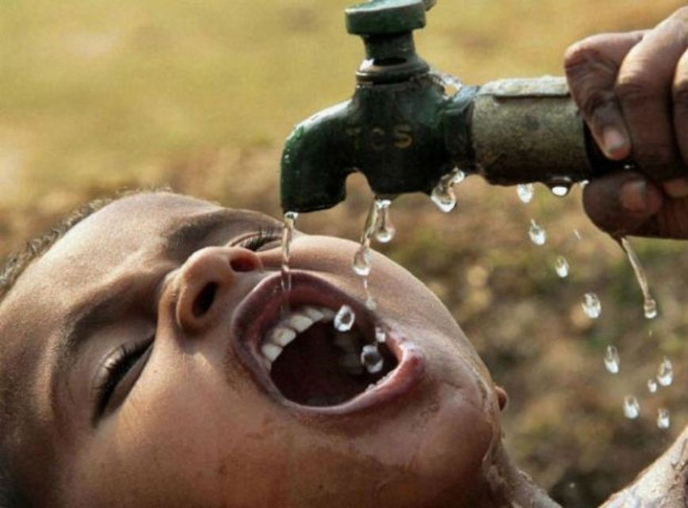
Causes
The causes of the water crisis are varied and include:
Climate change
Population growth
Urbanization
Poor governance
Pollution

Slide 8
Consequences of water crisis
Consequences of the water crisis are severe and far-reaching, including:
Health risks
Food insecurity
Economic costs
Social and political instability
Environmental degradation.

Slide 9
Some Solutions to lack of clean water
Provide clean, safe water to those who need it most.
Protect (or improve) the quality of available water in an area
Collect and store rainwater to use later on.
Collect and store rainwater to use later on.
Find more effective ways of using the water we need in our day-to-day lives.

Slide 10
Wrap Up
To sum up, there is a serious issue with the availability of clean water all over the world and Jordan Is affected by this issue.
Lack of clean water causes many issues related to environmental and political situation.
This issue also has many sequences and can be solved in many ways, as mentioned.

Slide 11
References
اامطار المنخفض الجوي تساهم برفع النسب المئوية للامطار. كل الاردن. (n.d.-a). http://www.allofjo.net/index.php?page=article&id=140501
امطار allofjo.net)/ كل الاردن
9 Water scarcity solutions - and why they work/https://www.concernusa.org/story/water-scarcity-solutions-that-work/#Build%20Community%20Focus%20and%20Ownership%20Around%20Local%20Water%20Systems%20and%20Resources%E2%80%A6/Concern Worldwide/April 15, 2022
Team, W. (2023, May 6). Understanding the water crisis: Causes, effects, and solutions. WWF7 Water Resources. https://worldwaterforum7.org/understanding-the-water-crisis-causes-effects-and-solutions/#:~:text=Effects%20of%20the%20Water%20Crisis%201%20Human%20Health,of%20natural%20habitats.%20...%204%20Socioeconomic%20Development%20

Slide 12
Thank you

