Slide 1
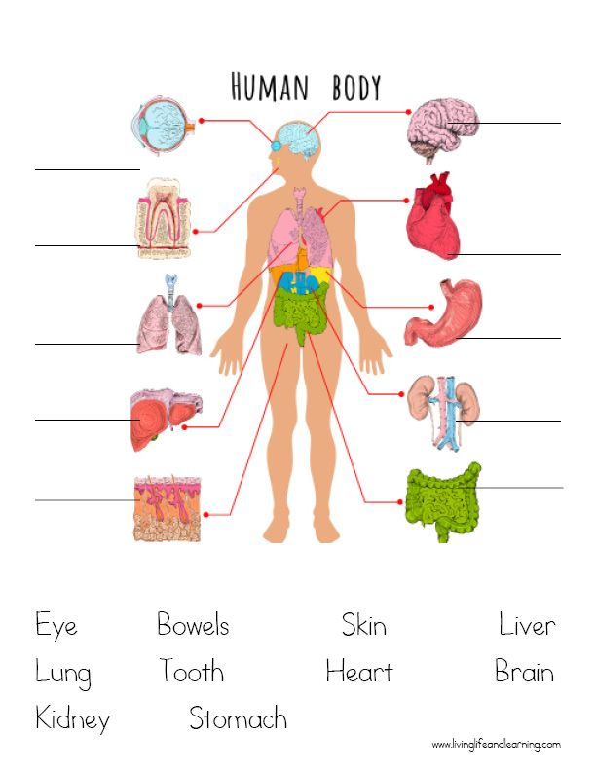

Slide 2
The brain
The brain is the most complex part of the human body. This three-pound organ is the seat of intelligence, interpreter of the senses, initiator of body movement, and controller of behavior. the brain is the source of all the qualities that define our humanity.

Slide 3
The heart
The heart is a muscular organ. This organ pumps blood through the blood vessels of the circulatory system. The pumped blood carries oxygen and nutrients to the body, while carrying metabolic waste such as carbon dioxide to the lungs. In humans, the heart is approximately the size of a closed fist and is located between the lungs, in the middle compartment of the chest, called the mediastinum.

Slide 4
The teeth
Your teeth are part of your digestive system. They break down foods by crushing or cutting them before you swallow. Most humans have 32 teeth, although some have more, and some have fewer. Enamel (the protective outer layer of your teeth) is the hardest substance in the human body.

Slide 5
The lungs
Your lungs are the pair of spongy, pinkish-gray organs in your chest. When you inhale (breathe in), air enters your lungs, and oxygen from that air moves to your blood. At the same time, carbon dioxide, a waste gas, moves from your blood to the lungs and is exhaled (breathed out).

Slide 6
The liver
The liver is a critical organ in the human body that is responsible for an array of functions that help support metabolism, immunity, digestion, detoxification, vitamin storage among other functions. It comprises around 2% of an adult's body weight.

Slide 7
The kidney
The kidneys are two bean-shaped organs, each about the size of a fist. They are located just below the rib cage, one on each side of your spine. Healthy kidneys filter about a half cup of blood every minute, removing wastes and extra water to make urine.

Slide 8
The eye
The human eye is a sensory organ, part of the sensory nervous system, that reacts to visible light and allows humans to use visual information for various purposes including seeing things, keeping balance

Slide 9
The skin
The skin is the largest organ of the body and acts as a protective barrier between the internal organs and the external environment.

Slide 10
The stomach
The stomach is a muscular organ located in the upper abdomen, just below the ribcage. It is part of the digestive system and plays a crucial role in the process of breaking down food. The main functions of the stomach are to store food, mix it with digestive juices, and gradually release it into the small intestine for further digestion and absorption of nutrients. The stomach also secretes acid and enzymes that help in the breakdown of food and kill harmful bacteria.

Slide 11
The bowels
the bowels are the intestines responsible for digestion and absorption of nutrients, with the small intestine breaking down food and the large intestine absorbing water and forming waste.

