Slide 1
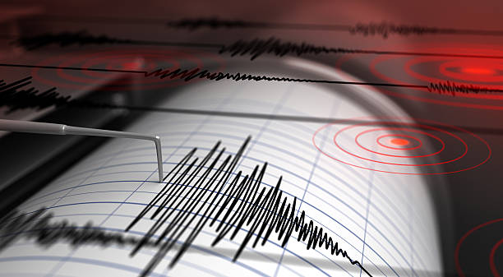
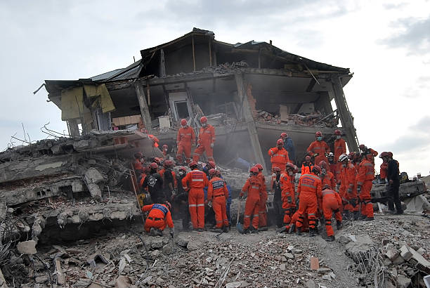
Earthquakes

Slide 2
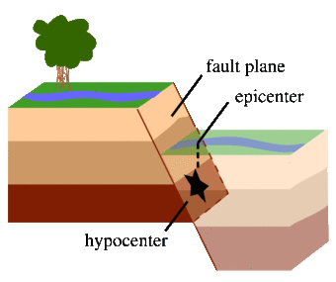
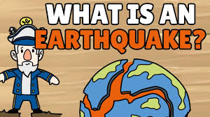
What is an earthquake?
Notes:
What is an earthquake?
An earthquake is what happens when two blocks of the earth suddenly slip past one another. The surface where they slip is called the fault or fault plane.
The location below the earth’s surface where the earthquake starts is called the
hypocenter, and the location directly above it on the surface of the earth is called
the epicenter. Sometimes an earthquake has foreshocks.
These are smaller earthquakes that happen in the same place as the larger
earthquake that follows. Scientists can’t tell that an earthquake is a foreshock until the
larger earthquake happens. The largest, main earthquake is called the mainshock.
Mainshocks always have aftershocks that follow. These are smaller earthquakes that occur afterwards in the same place as the mainshock. Depending on the size of the mainshock, aftershocks can continue for weeks, months, and even years after the mainshock!

Slide 3
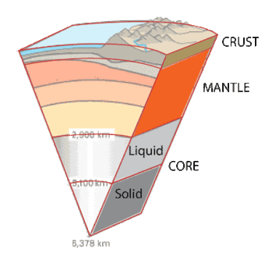
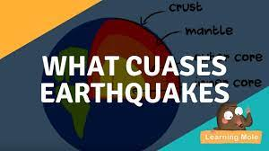
What causes earthquakes and where do they happen?
Notes:
What causes earthquakes and where do they happen?
The earth has four major layers: the inner core, outer core, mantle and crust. The crust and the top of the mantle make up a thin skin on the surface of our planet.
But this skin is not all in one piece – it is made up of many pieces like a puzzle covering
the surface of the earth. Not only that, but these puzzle pieces keep slowly
moving around, sliding past one another and bumping into each other.
We call these puzzle pieces tectonic plates, and the edges of the plates are called the
plate boundaries. The plate boundaries are made up of many faults, and most of the
earthquakes around the world occur on these faults.
Since the edges of the plates are rough, they get stuck
while the rest of the plate keeps moving. Finally, when the plate has
moved far enough, the edges unstick on one of the faults and there is an earthquake.

Slide 4
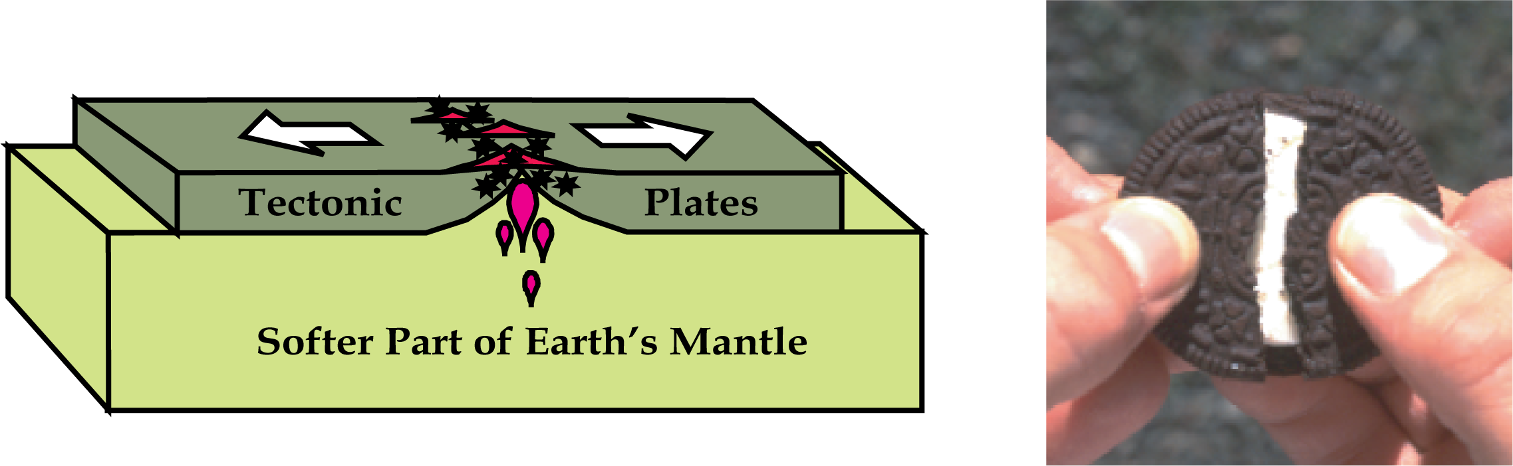
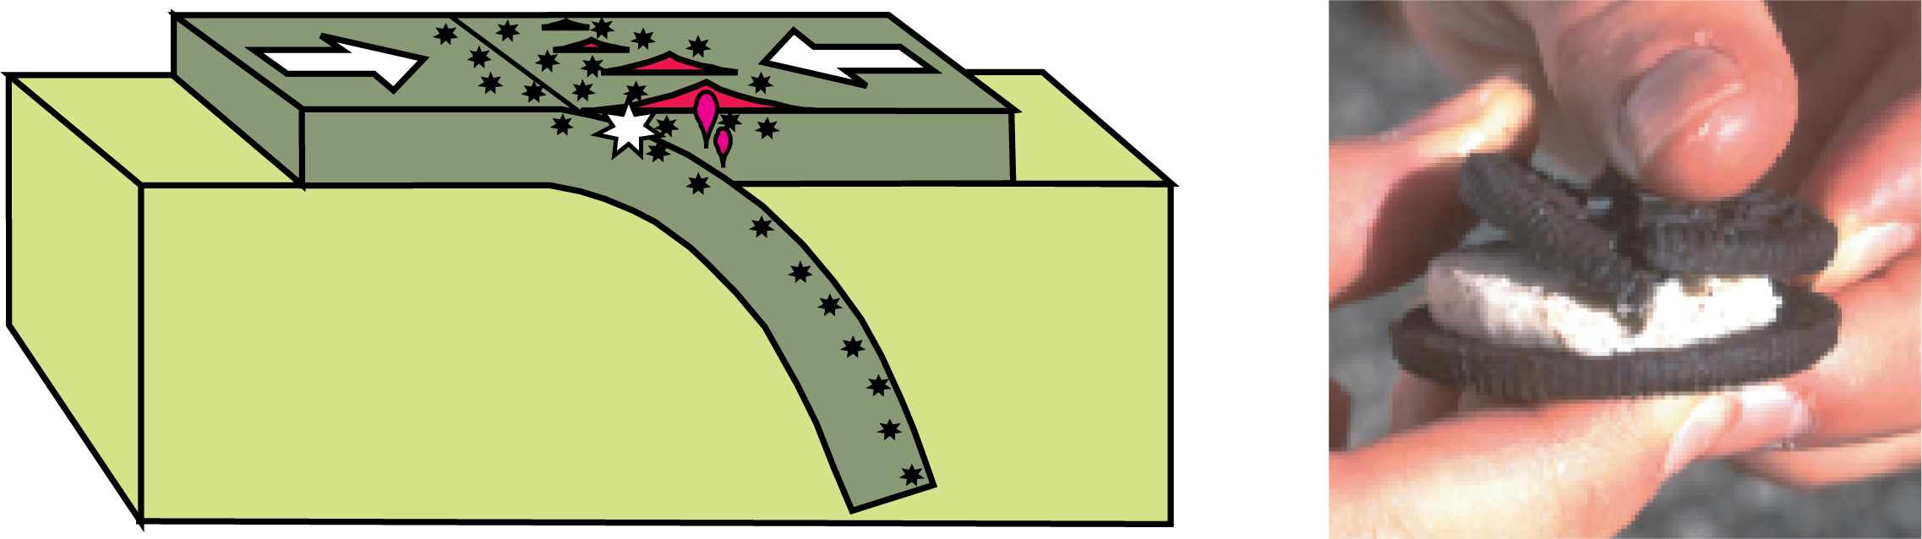
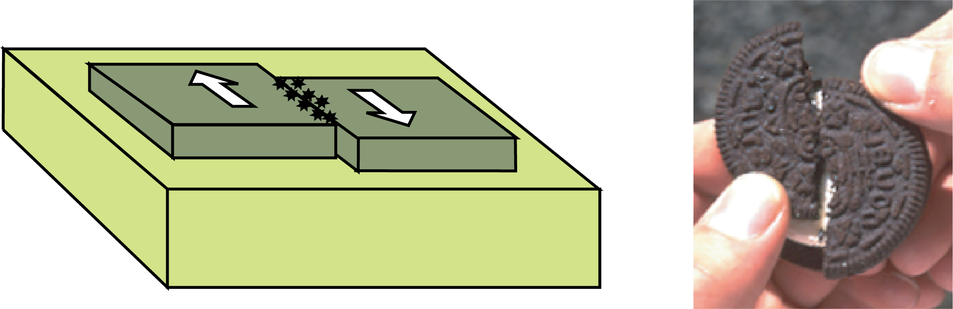
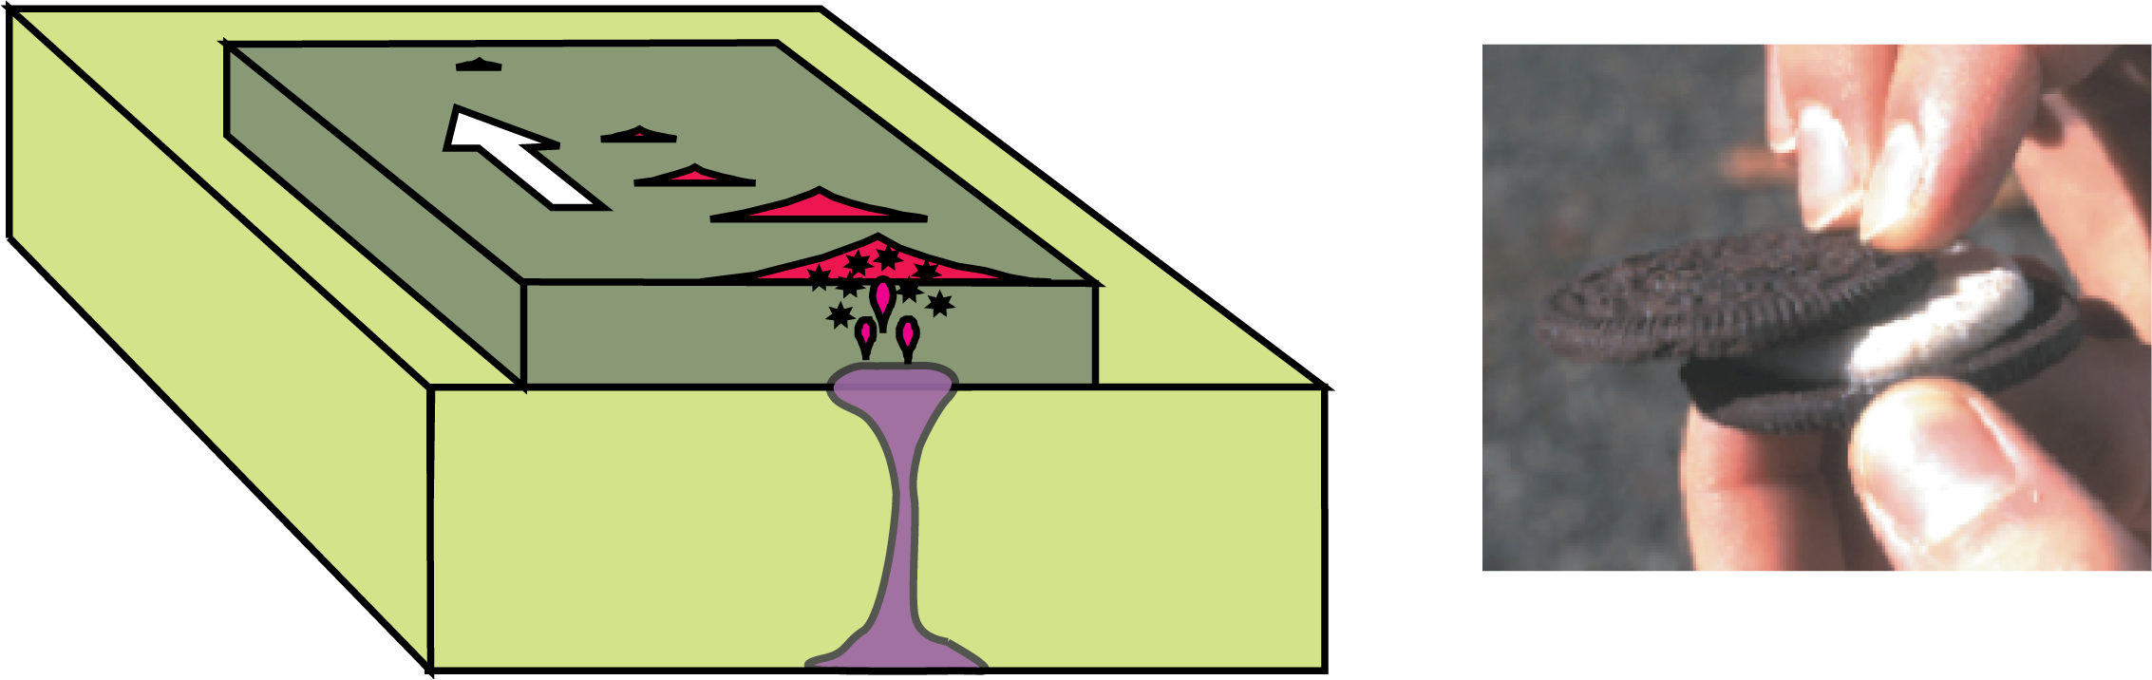
What are the Types of Plate Boundaries?
Divergent Plate Boundary Convergent Plate Boundary
Transform Plate Boundary Hotspot
Notes:
What are the Types of Plate Boundaries?
Divergent Plate Boundary
Volcanic eruptions and shallow earthquakes are common where plates rip apart.
Convergent Plate Boundary
Where plates crash together, one dive (“subducts”) beneath the other, causing volcanoes (red triangles) to erupt on the overriding plate and earthquakes (black
stars) at a variety of depths. The large white star represents the zone where plates lock together for centuries and then suddenly let go, causing the largest
earthquakes.
Transform Plate Boundary
Shallow earthquakes and little volcanism occur when one plate slides laterally past another.
Hotspot
In places like Hawaii and Yellowstone, a plate rides over a rising plume of the hot mantle, causing earthquakes and a chain of volcanoes.

Slide 5
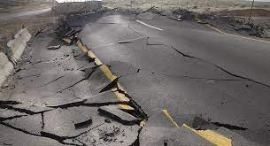
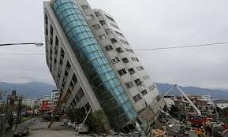
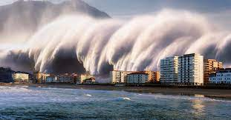
What are the Effects of an Earthquake
Notes:
What are the Effects of an Earthquake?
Earthquakes can strike suddenly and without warning. An earthquake is a violent and abrupt shaking of the ground, caused by movement between tectonic plates along a fault line in the earth’s crust. Earthquakes can result in ground shaking, soil liquefaction, landslides, fissures, avalanches, fires, and tsunamis.
Also Earthquakes can result in damage to a man-made structure like buildings , bridges and highways.
During the last four decades Earthquakes are responsible for over a million deaths around the world.
Between 1998-2017, earthquakes caused nearly 750 000 deaths globally, more than half of all deaths related to natural disasters. More than 125 million people were affected by earthquakes during this period, meaning they were injured, made homeless, displaced, or evacuated during the emergency phase of the disaster.
One of the positive effects of earthquakes is that they form oases and natural energy sources. Similarly, flaws can become a part of the natural landscape.

Slide 6
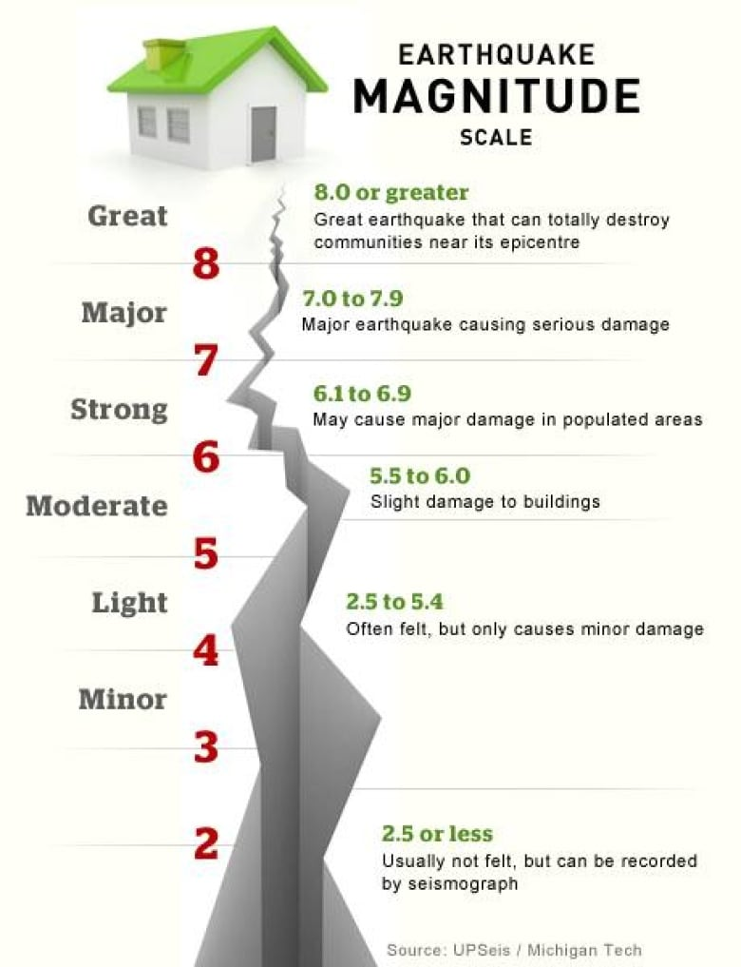
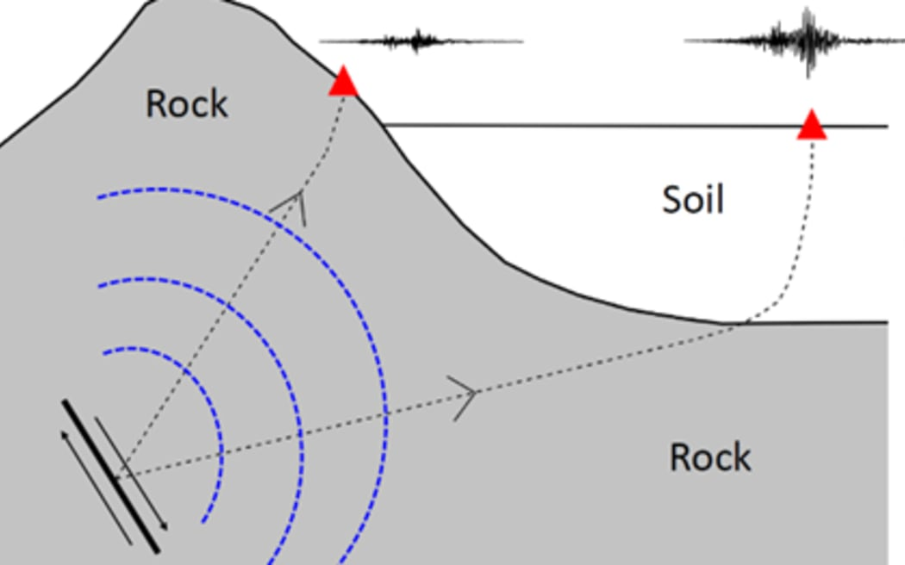
What are the factors that affect intensity and frequency of earthquake?
Notes:
What are the factors that affect the intensity and frequency of earthquakes?
The intensity of ground shaking depends on the duration, local geology, and distance.
The earthquake’s magnitude:
Typically, you will feel more intense shaking from a big earthquake than from a small one.
Bigger earthquakes also release their energy over a larger area and for a longer period.
Local geology and soil type:
Local geology is related to earthquake intensity in that earthquakes are often localized to particular geologic settings and rock types.

Slide 7
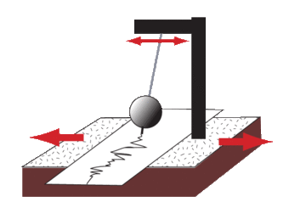
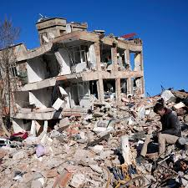
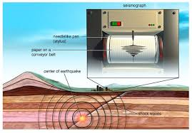
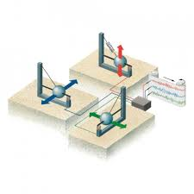
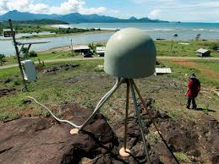
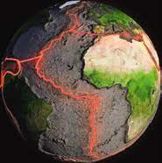
What are the Methods used to detect, measure and predict earthquakes?
How can scientists tell where the earthquake happened?
Can scientists predict earthquakes?
Notes:
What are the Methods used to detect, measure and predict earthquakes?
By studying the history of large earthquakes in a specific area and the rate at which strain accumulates in the rock.
Scientists study the past frequency of large earthquakes in order to determine the future likelihood of similar large shocks
How can scientists tell where the earthquake happened?
Triangulation can be used to locate an earthquake. The seismometers are shown as green dots.
The calculated distance from each seismometer to the earthquake is shown as a circle.
The location where all the circles intersect is the location of the earthquake epicenter
Can scientists predict earthquakes?
No. Neither the USGS (United States Geological Survey ) nor any other scientists have ever predicted a major earthquake.
We do not know how, and we do not expect to know how any time in the near future.

Slide 8
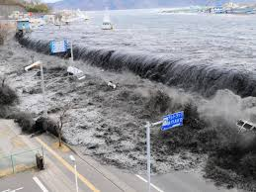
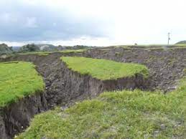
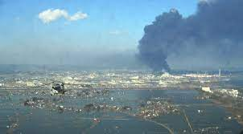
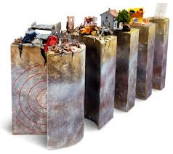
What are The impacts of earthquakes on the natural environment and ecosystem?
Notes:
What are The impacts of earthquakes on the natural environment and ecosystem?
Earthquake environmental effects are the effects caused by an earthquake, including surface faulting, tsunamis, soil liquefactions, ground resonance, landslides and ground failure, either directly linked to the earthquake source or provoked by the ground shaking.
Earthquake environmental effects are divided into two main types:
- Primary effects: which are the surface expression of the seismogenic source (e.g., surface faulting), normally observed for crustal earthquakes above a given magnitude threshold.
- Secondary effects: mostly this is the intensity of the ground shaking.

Slide 9
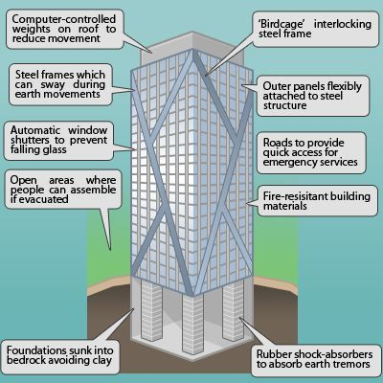
What are some solutions with some reasoning for Earthquakes?
Notes:
What are some solutions with some reasoning for Earthquakes?
Earthquakes can be induced by a wide range of causes including impoundment of reservoirs, surface and underground mining, withdrawal of fluids and gas from the subsurface, and injection of fluids into underground formations. While most induced earthquakes are small and present little hazard, larger and potentially damaging manmade earthquakes have occurred in the past.
We cannot prevent natural earthquakes from occurring, but we can significantly mitigate their effects by identifying hazards, building safer structures, providing education on earthquake safety and preparing for natural earthquakes we can also reduce the risk from human induced earthquakes.

Slide 10
Project Conclusion and Resources:
https://www.usgs.gov/programs/earthquake-hazards/science-earthquakes
https://www.earthquakecountry.org/putting-down-roots/shaking/
https://www.usgs.gov/faqs/can-we-cause-earthquakes-there-any-way-prevent-earthquakes
https://www.nps.gov/subjects/geology/plate-tectonics-types-of-plate-boundaries.htm
https://earthquake.usgs.gov/data/dyfi/
Project Team:
Mohammad Younes
Zaid Al Hishan
Murad Al Madaeen
Faisal Thalji

