Slide 1
Obesity
Prepared by: Mariana Hourani, Tala Alfarah,
Natalie Bouri.

Slide 2
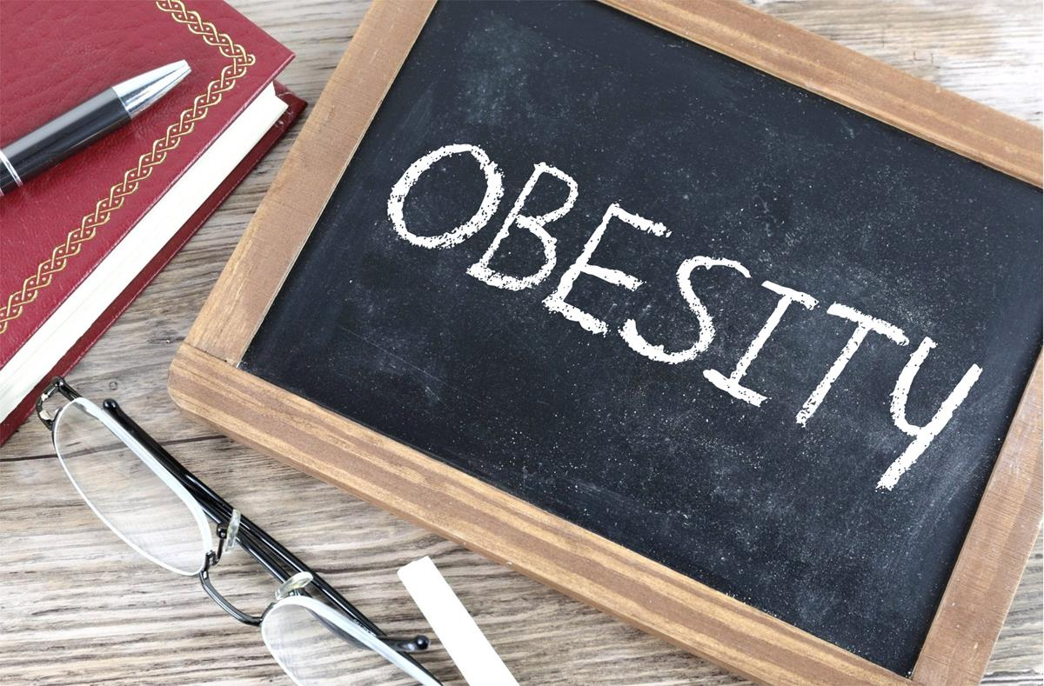
What is obesity?
Obesity means weighing more than what is healthy for a given weight, obesity is a serious, chronic disease, It can lead to plenty of health problems, which include diabetes, heart disease, and some types of cancers, at this moment in Jordan, According to the Global Obesity Observatory, Jordan ranks fourth in the Arab world and 23rd globally for obesity among men at 29.17 percent of the male population.

Slide 3
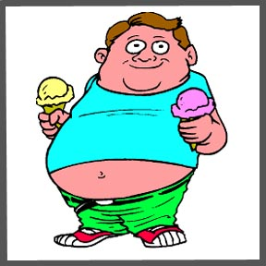
What are the main causes of obesity?
The main causes of obesity are a combination of genetic, environmental, and lifestyle factors, genetics can play a role in determining a person’s susceptibility to obesity, environmental factors, such as access to healthy food and opportunities for physical activity can also contribute to obesity, lifestyle factors, such as diet and physical activity are also important in determining a person’s risk for obesity. Other factors that can contribute to obesity include medical conditions, medications, and phycological factors such as stress and depression.

Slide 4
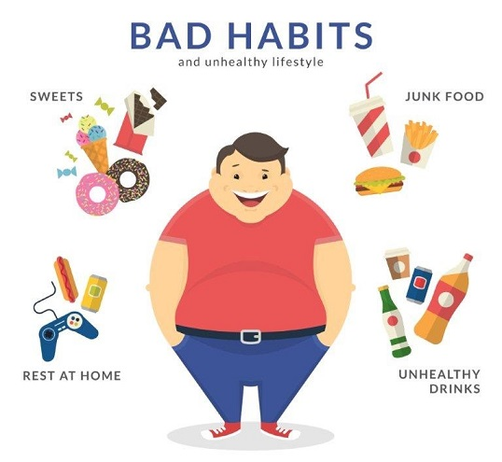
What are the problems that people are dealing with from being obese?
Obesity can lead to a range of health problems including type 2 diabetes, high blood pressure, heart disease, stroke, certain types of cancer, kidney diseases, and even shorter life expectancy. These health problems can have a significant impact on a person’s physical and mental well-being, and can make it difficult to preform everyday activities.

Slide 5
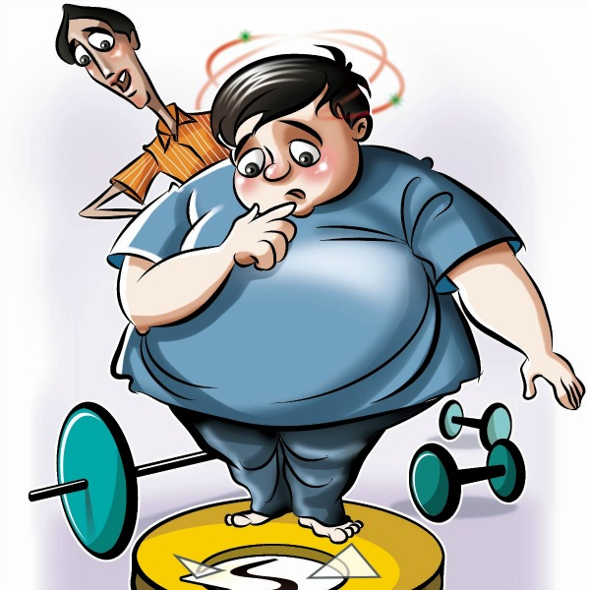
What are the consequences that people face due to being overweight?
In addition to the physical and mental health consequences of being over weight, there can also be financial costs associated with obesity. Overweight individuals may face higher healthcare costs due to the increased risk of chronic health conditions. They may also experience reduced productivity at work, which can impact their earning potential, additionally the cost of purchusing larger clothing sizes and specialized equipment can add up over time.

Slide 6
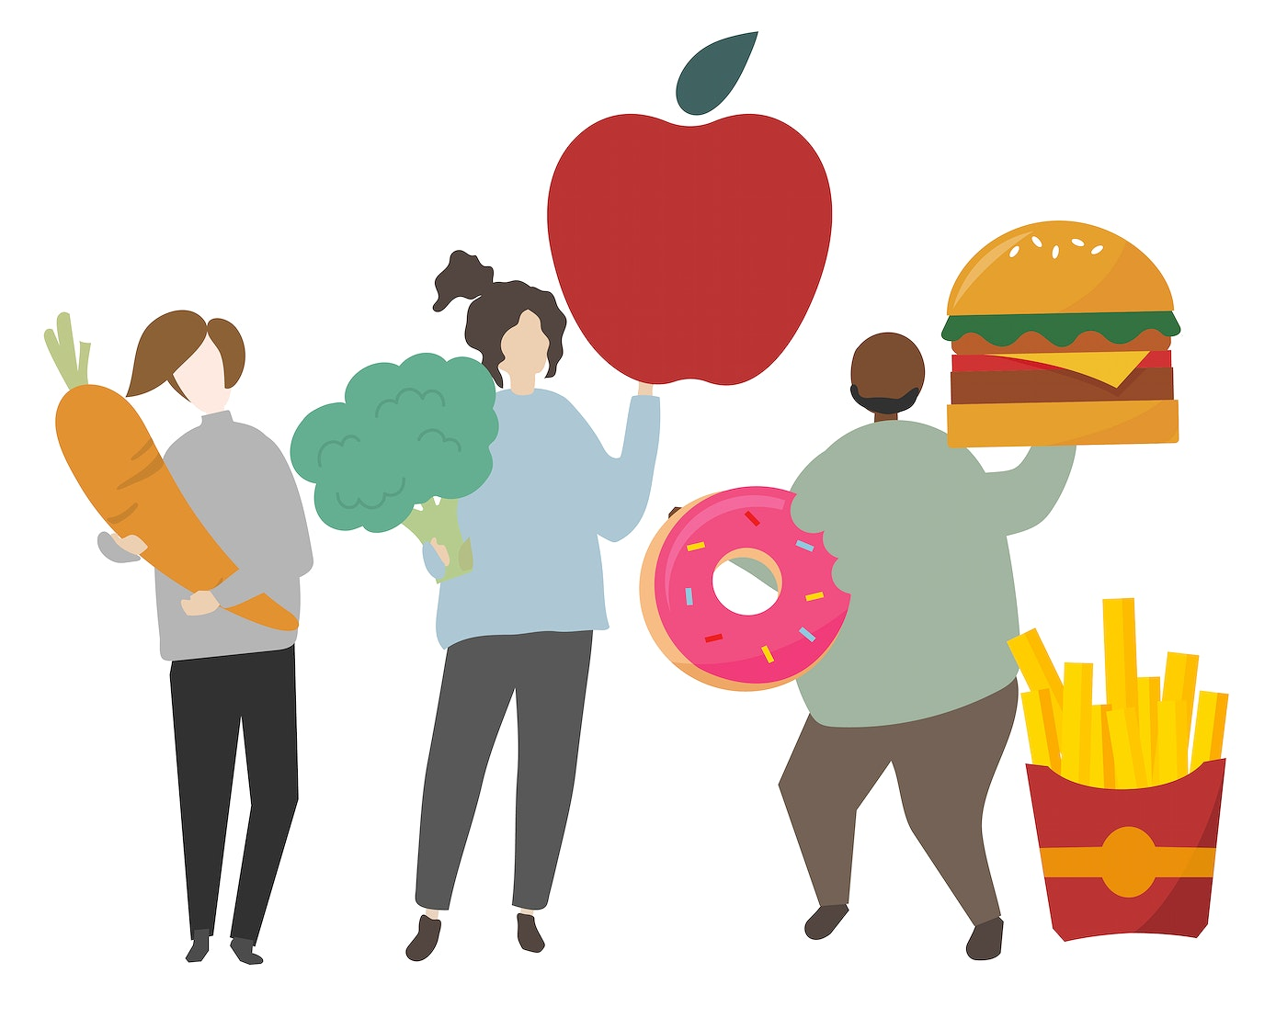
What are the solutions to those who are dealing with obesity?
Obesity can be a complex issue, but there are several steps that can be taken to help manage it. These include dietary changes, such as incorporating more fruits and vegetables into your diet, reducing potion sizes, and limiting sugary and processed foods. Regular excersise is also important, as it can help you burn calories and improve your overall health. Additionally, working with a healthcare professional, such as a dieticiam or personal trainer, can provide additional support and guidance.

Slide 7
Sources used:
U.S. National Library of Medicine. (n.d.). Defining overweight and obesity in children: Medlineplus medical encyclopedia. MedlinePlus. Retrieved May 5, 2023, from https://medlineplus.gov/ency/patientinstructions/000384.htm#:~:text=Obesity%20means%20weighing%20more%20than,much%20more%20common%20in%20childhood
U.S. Department of Health and Human Services. (n.d.). What causes obesity & overweight? Eunice Kennedy Shriver National Institute of Child Health and Human Development. Retrieved May 5, 2023, from https://www.nichd.nih.gov/health/topics/obesity/conditioninfo/cause
Psychological consequences of being overweight. MentalHelp.net. (2019, March 15). Retrieved May 5, 2023, from https://www.mentalhelp.net/recovery-and-wellness/psychological-consequences-of-being-overweight/#:~:text=Psychological%20consequences%20of%20being%20overweight%20or%20obese%20can%20include%20lowered,binge%20eating%2C%20bulimia%20and%20anorexia
Nutrition and your mental health. Nutrition and your mental health | Gundersen Health System. (2023, February 15). Retrieved May 5, 2023, from https://www.gundersenhealth.org/health-wellness/eat/nutrition-and-your-mental-health
Department of Health. Preventing Childhood Obesity: Tips for Parents. (n.d.). Retrieved May 5, 2023, from https://www.health.ny.gov/prevention/nutrition/resources/obparnts.htm#:~:text=The%20most%20important%20strategies%20for,%2C%20and%20playing%20computer%20games

Slide 8
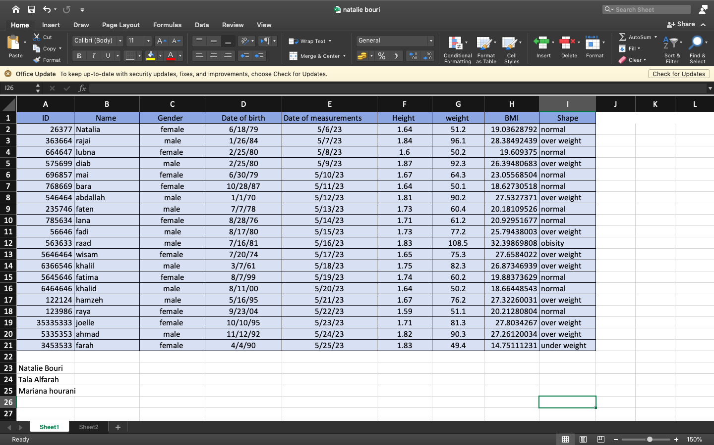
BMI weight calculations:
(computer + math only)

Slide 9
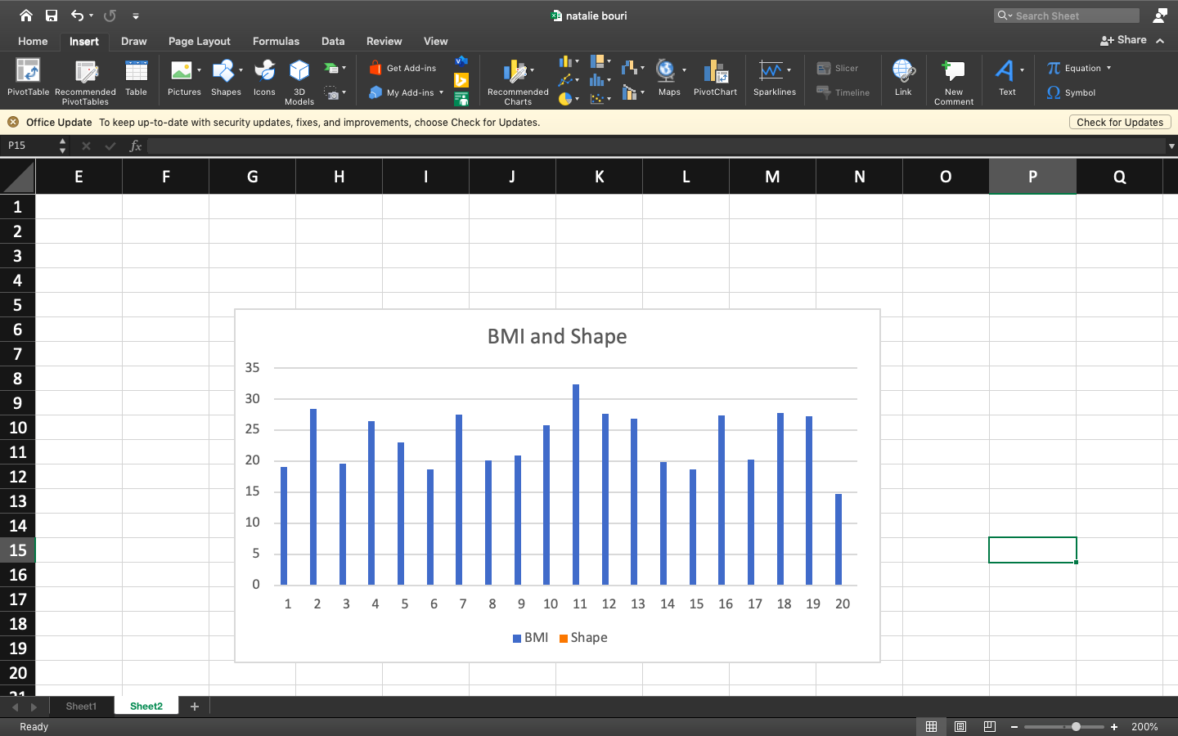
BMI weight calculations:
(computer + math only)

Slide 10
Thank you for listening!

