Slide 1
Obesity
Work of the students Dalia Al-Ahwal & Meera Wardat

Slide 2
What is obesity
A condition known as obesity involves having too much body fat. Obesity is more than simply a visual issue. It is a medical condition that raises the chance of various illnesses and conditions, including heart disease, diabetes, high blood pressure, and some malignancies. There are numerous causes for why some people struggle to lose weight. Obesity typically comes from a combination of dietary, physical activity, and exercise decisions along with genetic, physiological, and environmental factors.

Slide 3
What are the possible causes of obesity ?
Food and Exercise
->When people consume more calories than they expend through activity, they acquire weight. The main cause of weight gain is this imbalance.
Environment
->Our capacity to keep a healthy weight in check is influenced by the environment. For instance, it is difficult for people to be physically active when there are no nearby parks, sidewalks, or reasonably priced gyms.
Poor sleep, emotional factors, and stress
->When they are bored, irritated, disturbed, or stressed, some people eat more than normal.

Slide 4
Impacts of obesity
All-cause of death
Stroke
Type 2 diabetes
High blood pressure
Low quality of life
Body pain and difficulty with physical functioning
Heart diseases

Slide 5
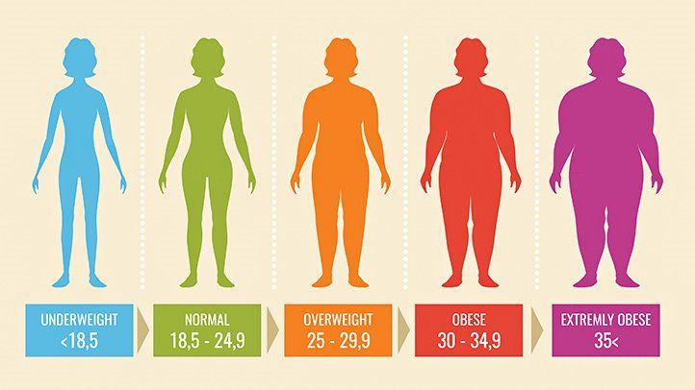
Consequences of obesity
People who have obesity, compared to those with a healthy weight, are at increased risk
for many serious diseases and health conditions

Slide 6
Solutions for obesity
Healthy eating plan and regular physical activity
Changing your habits
Weight-management programs
Weight-loss medicines
Weight-loss devices

Slide 7
The sources
Mayo Foundation for Medical Education and Research. (2021, September 2). Obesity. Mayo Clinic. https://www.mayoclinic.org/diseases-conditions/obesity/symptoms-causes/syc-20375742
U.S. Department of Health and Human Services. (n.d.). What causes obesity & overweight?. Eunice Kennedy Shriver National Institute of Child Health and Human Development. https://www.nichd.nih.gov/health/topics/obesity/conditioninfo/cause
Centers for Disease Control and Prevention. (2022, July 15). Consequences of obesity. Centers for Disease Control and Prevention. https://www.cdc.gov/obesity/basics/consequences.html#:~:text=Adults%20with%20obesity%20have%20higher,as%20clinical%20depression%20and%20anxiety.
U.S. Department of Health and Human Services. (n.d.). Treatment for overweight & obesity - niddk. National Institute of Diabetes and Digestive and Kidney Diseases. https://www.niddk.nih.gov/health-information/weight-management/adult-overweight-obesity/treatment
Obesity consequences. Obesity Prevention Source. (2016, April 12). https://www.hsph.harvard.edu/obesity-prevention-source/obesity-consequences/

Slide 8
Thank you fr listening

