Slide 1
Chemistry Project 7G
By Fuad Kassih And Raed Asali

Slide 2
Objective:
We are going to investigate and describe exothermic and endothermic changes of six substances when they are dissolved in water.

Slide 3
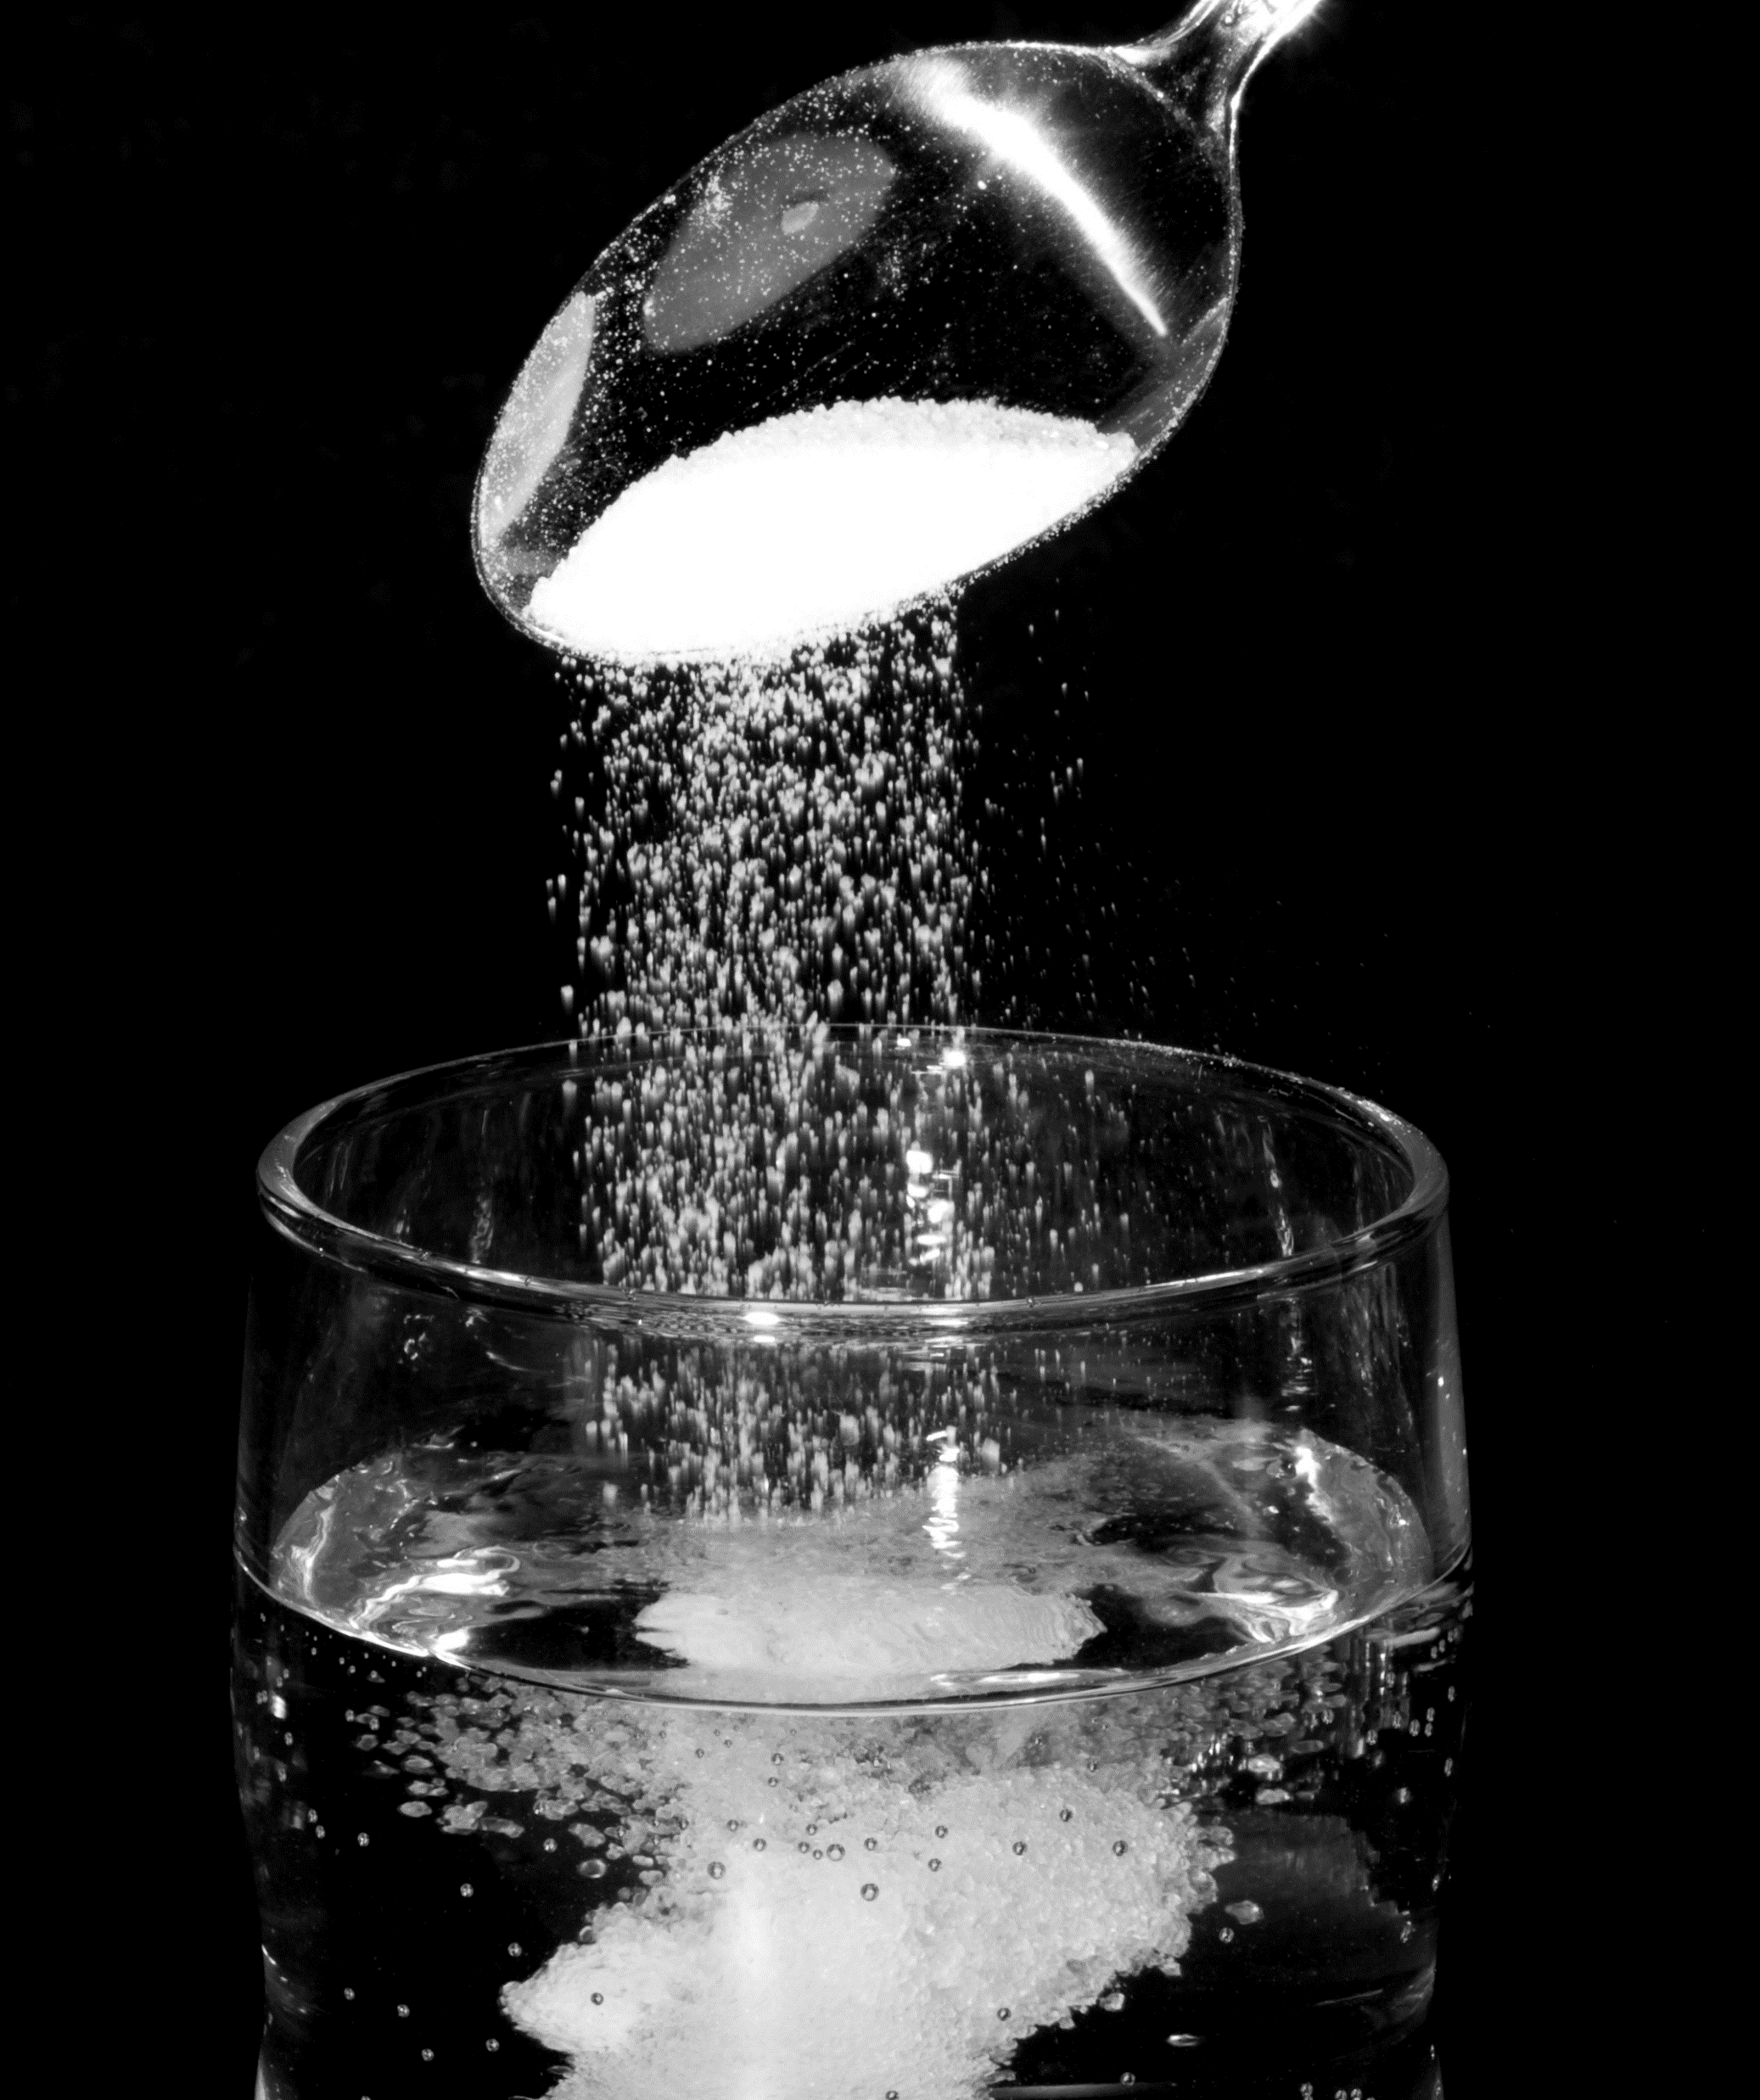
Sodium Chloride
Sodium chloride is easily soluble in water. They are white crystals which don’t have an odor but have a taste. Melting point: 801°C Boiling point: 1413°C Chemical formula: NaCl They can be used to melt ice and snow on roads, and can be used to prevent spoilage of food by stopping the growth of bacteria. When dissolved in water, it is an exothermic reaction, meaning it releases heat and energy to the surrounding during the reaction.

Slide 4
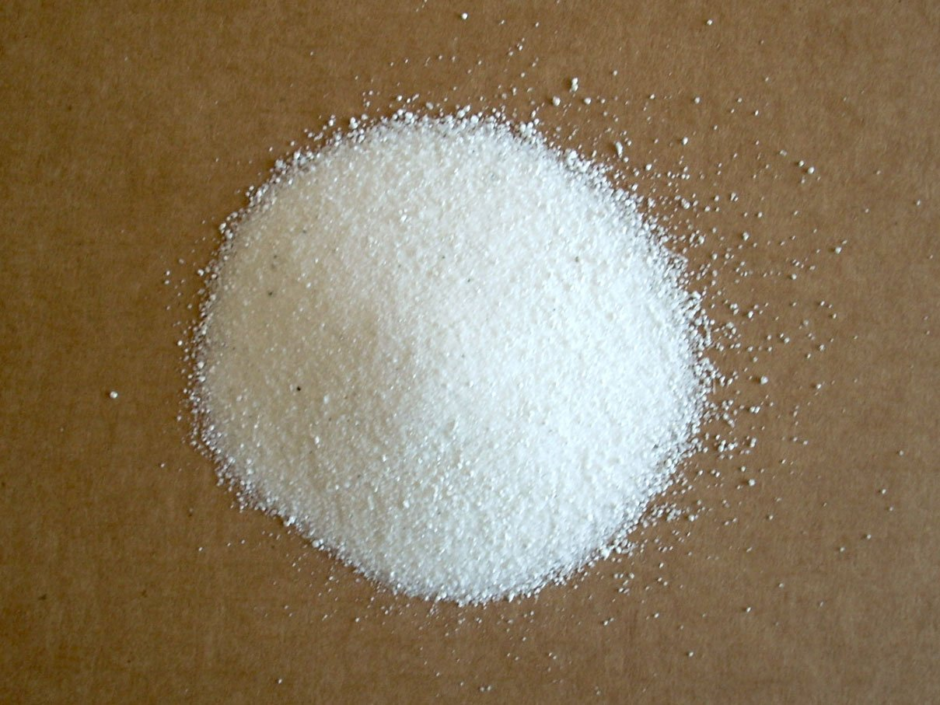
Potassium Sulphate
Potassium sulfate can dissolve rapidly and completely in water. It is a white crystalline powder or crystals Melting point: 1,069 °C Boiling point: 1,689 °C Chemical formula: K2SO4 It is dominantly used as a fertilizer for crops which include tobacco, some vegetables, and fruits. when dissolved in water it is a endothermic reaction, meaning it takes in heat from the surrounding during the reaction.

Slide 5
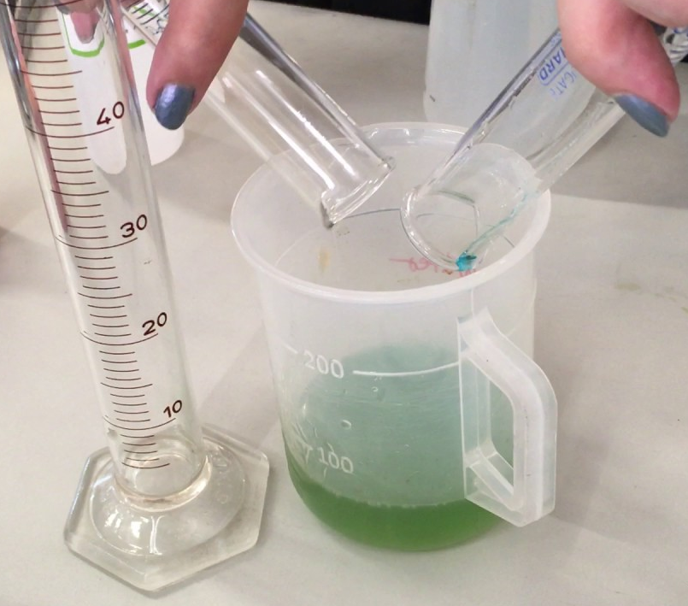
Ethanol
Ethanol is easily dissolved in water. Ethanol is a fuel made up of various plant materials. Melting point: -117°C Boiling point: 78.5°C Chemical formula: C₂H₆O Ethanol can be used to prevent skin infections, and is present in alcoholic drinks. An endothermic reaction occurs when ethanol is dissolved in water.

Slide 6
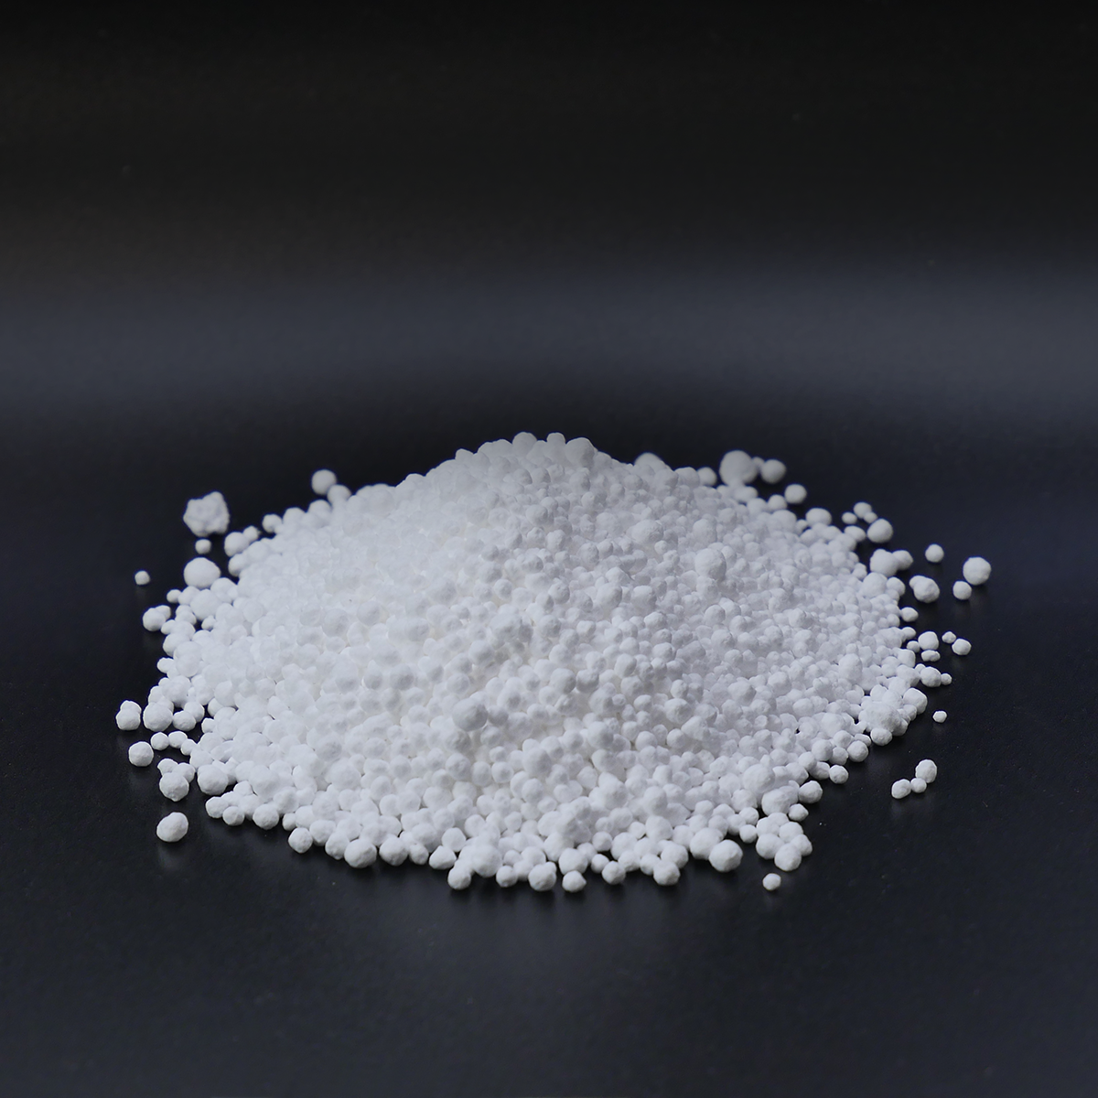
Calcium Chloride
Calcium chloride is highly soluble in water It is a white crystalline solid Melting point: 772 °C Boiling point: 1,935 °C Chemical formula: CaCl2 It is utilized in lowering blood pressure, as well as treating acid burns. The dissolution of calcium chloride is an exothermic process.

Slide 7
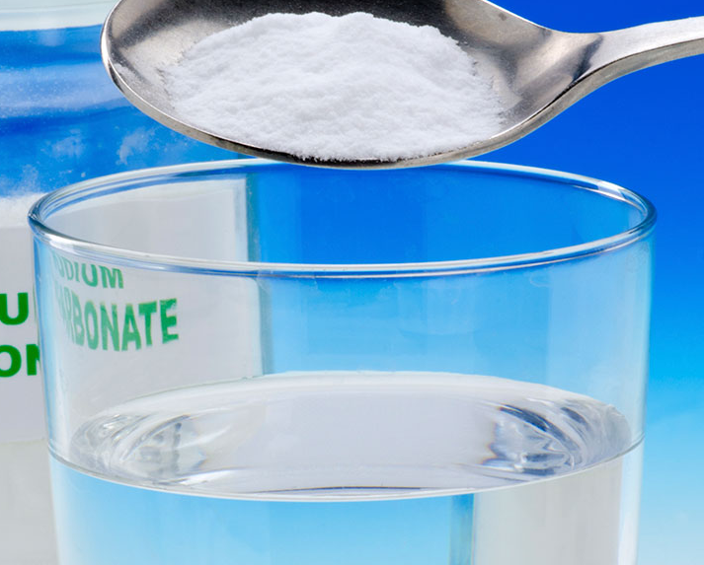
Sodium Bicarbonate
Sodium bicarbonate is highly soluble in water. It is a white crystalline powder. Melting point: 50°C Boiling point: 851°C Chemical formula: NaHCO₃ Sodium bicarbonate can be used to relieve heartburn and acid indigestion, and can be used to make blood or urine less acidic in specific conditions when dissolved in water it is an endothermic reaction.

Slide 8
The End

