Slide 1
Bullying
Made by: Rajai Samara, Yara Ali, Miral Dababneh, Martina Haddadin

Slide 2
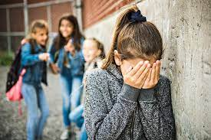
What to do if your being bullied?
Tell someone you trust.
Don’t blame yourself “it’s not you fault”.
Be proud of yourself.
Keep a record of whats happening

Slide 3

Why do people bully?
To feel popular.
Someone else is bullying them.
They have a mental health issue.

Slide 4
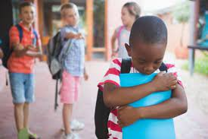
How to help someone if they being bullying?
Listen to them.
Ask them for what do they need.
Put your feelings aside.
Be there for them

Slide 5
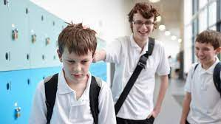
Types of bullying:
Social bullying
Verbal bullying
Cyber bullying
Physical bullying

Slide 6
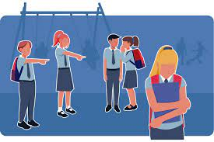
Bullying in school
https://youtu.be/4mrE5zgEvt4

Slide 7
POP QUIZ!!!!!

Slide 8
Math
كسر عادي | كسر عشري | النسبة المئوية | البلد | السنة
47 100 | 0.47 | 47% | الاردن | 2016
74 100 | 0.74 | 74% | عراق | 2015
70 100 | 0.70 | 70% | مصر | 2022
50 100 | 0.50 | 50% | السعودية | 2019
38.1 100 | 0.381 | 38.1% | قطر | 2018

Slide 9
The percentage of bullying:

Slide 10
THANK YOU FOR LISTENING

