Slide 1
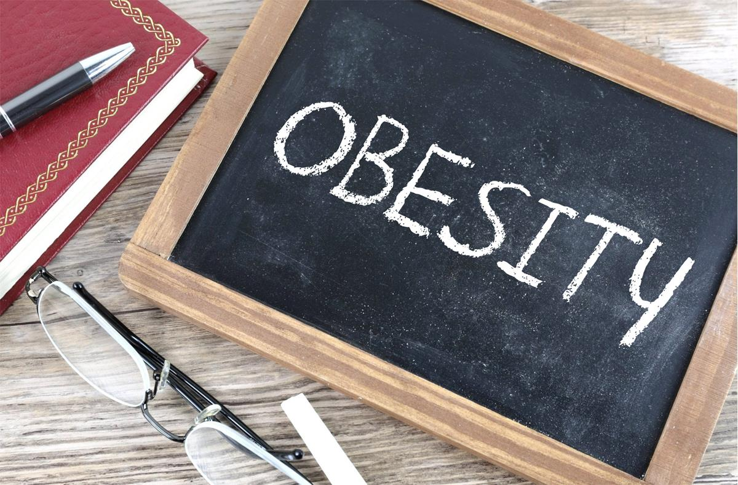
Obesity
By:Asim/Sanad/Yazan/Ghazi

Slide 2
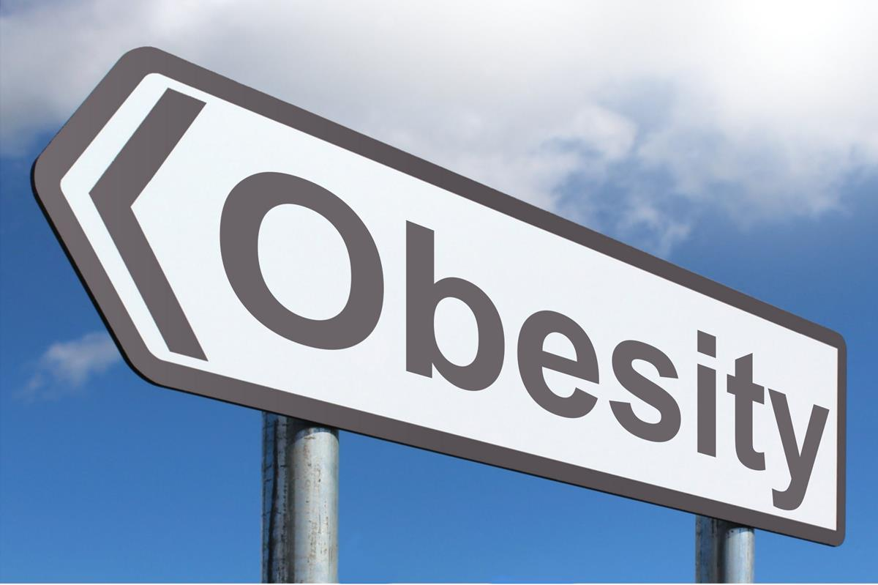
Definition of obesity?
obesity is defined as abnormal or excessive fat accumulation that presents a risk to health.

Slide 3
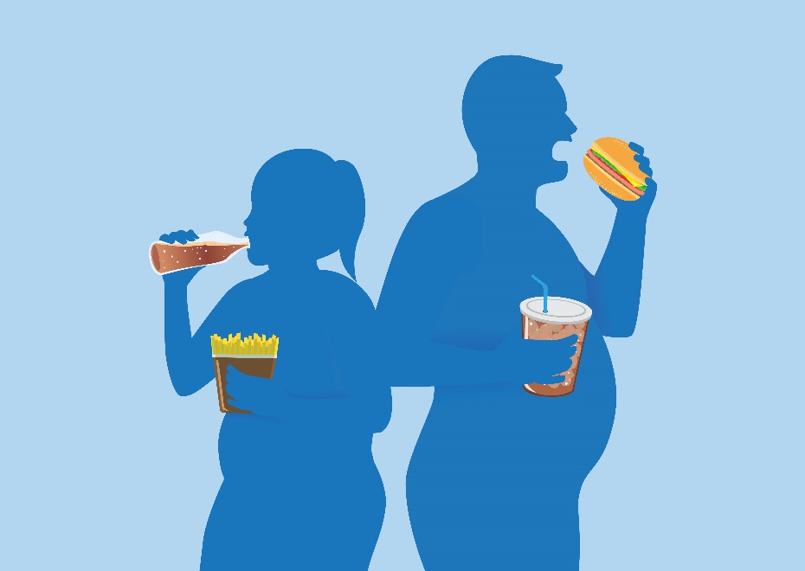
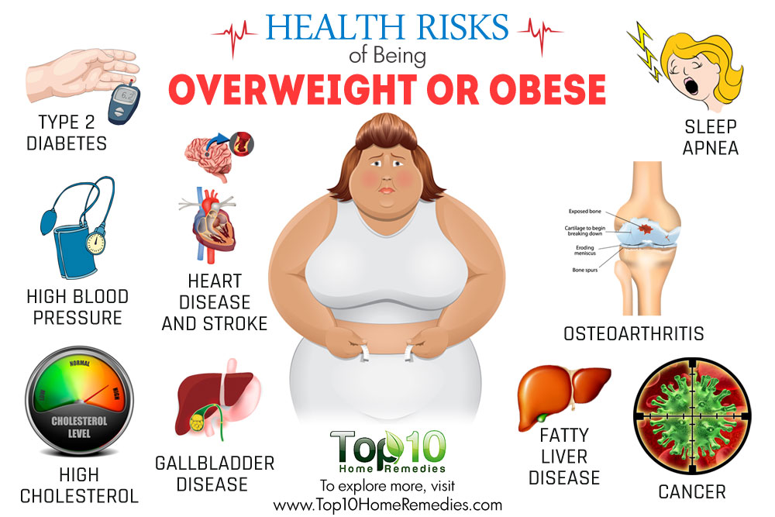
Problems of obesity
breathlessness
increased sweating
snoring
difficulty doing physical activity
often feeling very tired
joint and back pain
low confidence and self-esteem
feeling isolated

Slide 4
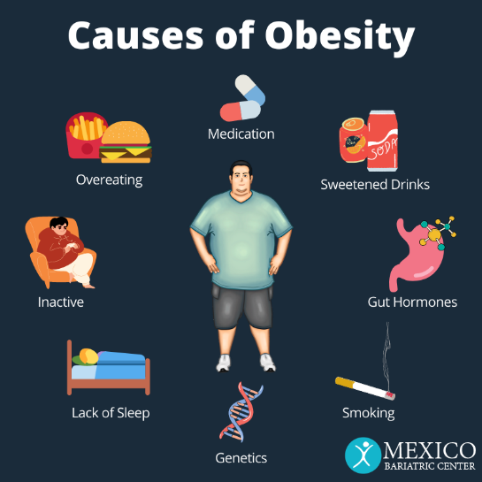
Causes of obesity
Several factors can play a role in gaining and retaining excess weight. These include diet, lack of exercise, environmental factors, and genetics, there are several factors that can cause obesity;
Environment
The world around us influences our ability to maintain a healthy weight. For example:
Not having area parks, sidewalks, and affordable gyms makes it hard for people to be physically active.
Food advertising encourages people to buy unhealthy foods, such as high-fat snacks and sugary drinks.

Slide 5
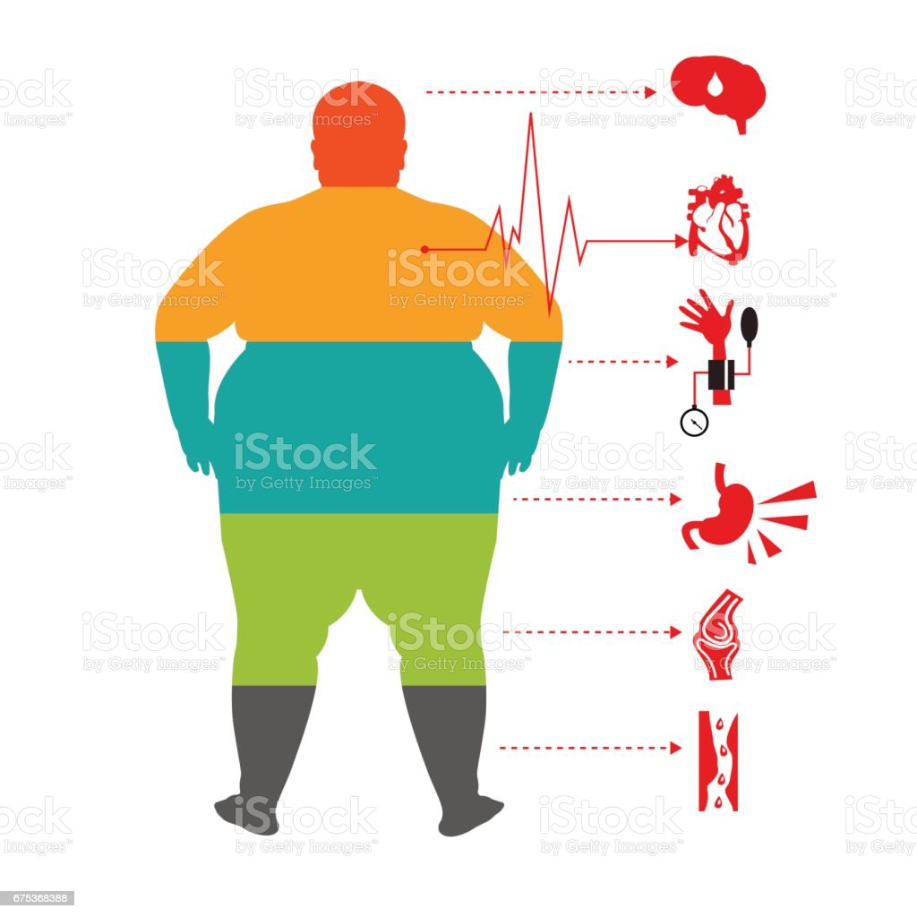
Genetics
Research shows that genetics plays a role in obesity. Genes can directly cause obesity.
Health Conditions and Medications
Some hormone problems may cause overweight and obesity.
Certain medicines also may cause weight gain, including some corticosteroids, antidepressants, and seizure medicines.
Stress, Emotional Factors, and Poor Sleep
Some people eat more than usual when they are bored, angry, upset, or stressed.
Studies also have found that the less people sleep, the more likely they are to have overweight or obesity. This is partly because hormones that are released during sleep help control appetite and the body’s use of energy.

Slide 6
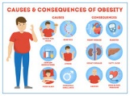
Consequences of obesity
Death
High blood pressure
Type 2 diabetes.
Coronary heart disease.
Stroke.
Gallbladder disease.
Sleep apnea and breathing problems.
Mental illness such as clinical depression, anxiety, and other mental disorders
Body pain and difficulty with physical functioning

Slide 7
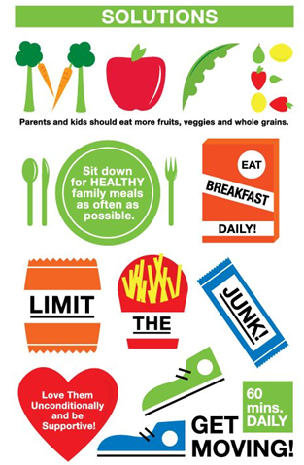
Solutions for obesity/Treating obesity
The best way to treat obesity is to eat a healthy, reduced-calorie diet and exercise regularly. To do this you should:
eat a balanced, calorie-controlled diet.
take up activities such as fast walking, jogging, swimming or other sports for two-and-a-half to five hours a week.
eat slowly and avoid situations where you know you could be tempted to overeat.
a medication called orlistat may be recommended. If taken correctly, this medication works by reducing the amount of fat you absorb during digestion.
In rare cases, weight loss surgery may be recommended.

Slide 8
Facts about obesity in Jordan/nationally
Nationally
13% of adults in the world are obese. 39% of adults in the world are overweight. One-in-five children and adolescents, globally, are overweight.
America is the heaviest nation in the world.
Jordan
the age-standardized prevalence of obesity was 60.4% in men and 75.6% in women.
Jordan ranks fourth in the Arab world and 23rd globally for obesity among men, at 29.17 percent of the male population

Slide 9
citation
U.S. Department of Health and Human Services. (n.d.). What causes obesity & overweight?. Eunice Kennedy Shriver National Institute of Child Health and Human Development. https://www.nichd.nih.gov/health/topics/obesity/conditioninfo/cause
Centers for Disease Control and Prevention. (2022, September 24). Health effects of overweight and obesity. Centers for Disease Control and Prevention. https://www.cdc.gov/healthyweight/effects/index.html
Obesity causes and treatments. causes & treatments - Illnesses & conditions | NHS inform. (n.d.). https://www.nhsinform.scot/illnesses-and-conditions/nutritional/obesity
World Health Organization. (n.d.). Obesity. World Health Organization. https://www.who.int/health-topics/obesity#tab=tab_1
Hadidi, A. A., Health, J. M. of, & Hadidi, C. A. A. (n.d.). Prevalence of obesity among adults in Jordan: National survey. Iproceedings. https://www.iproc.org/2022/1/e36398/
Ritchie, H., & Roser, M. (2017, August 11). Obesity. Our World in Data. https://ourworldindata.org/obesity#:~:text=13%25%20of%20adults%20in%20the,of%20energy%20intake%20and%20expenditure.

