Slide 1
Water Crisis in Jordan
By: Omar Jumaian, Omar Abu Zahra, Zaid El-Halah

Slide 2
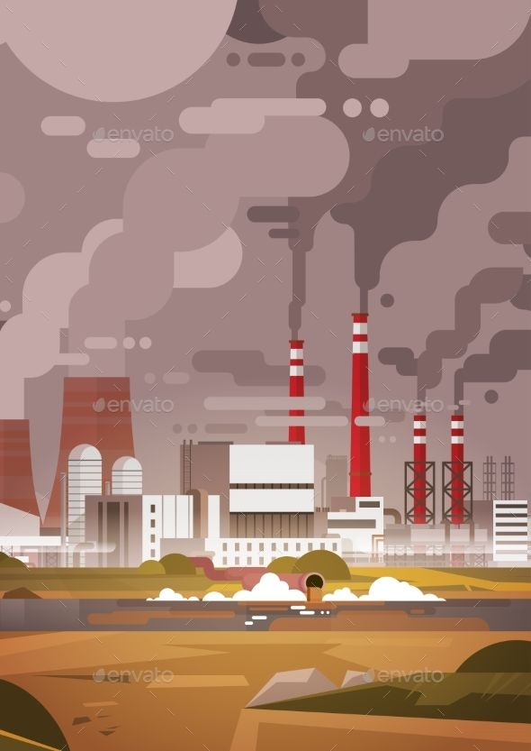
What is water crisis
The quantity of water that is actually accessible varies as supply and demand shift. As demand rises and/or as the quantity or quality of the water supply is impacted, there is an increase in water scarcity. With about 100 m3 of clean water provided per person annually, Jordan is among the nations in the world with the smallest availability of water. For reference, the UN defines water shortage as having less than 500 m3 of water per person, a startling difference that is only widening.

Slide 3
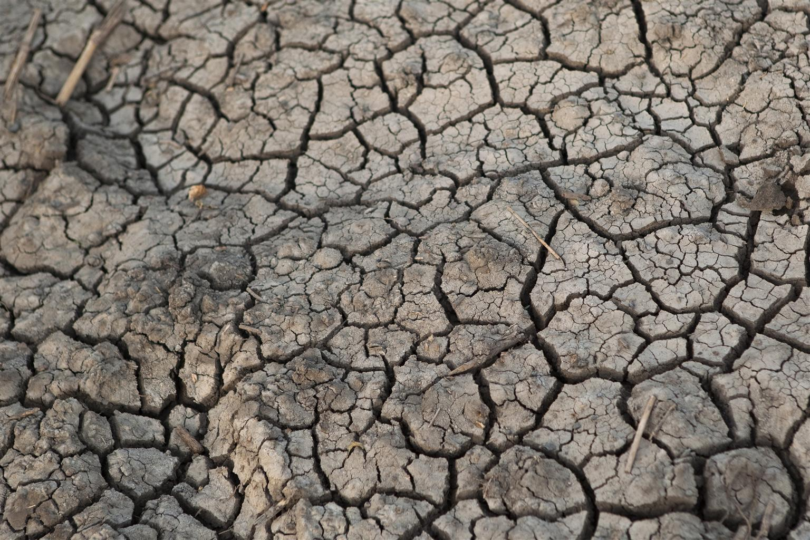
Water crisis causes and consequences
Consequences:
People cannot get enough water to consume, wash, or feed crops when there is a water shortage, which may result in economic loss. Additionally, poor sanitation, which affects 2.4 billion people, can result in cholera, typhoid fever, and other water-borne illnesses, including those that are fatal.
Causes:
Water problems are being made worse by pollution. Jordan's surface river sources are being contaminated by sewage system leaks, wastewater pumping station overflows, and exposure to commercial and industrial garbage. Water supplies have become contaminated with nitrate and phosphate as a result of this.

Slide 4
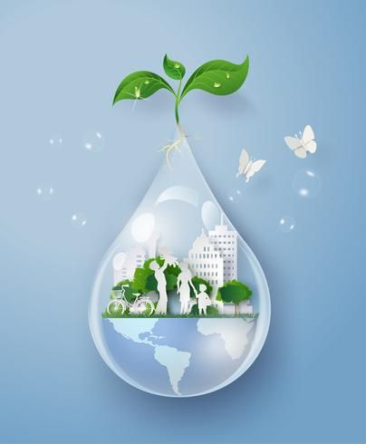
How to stop water crisis
desalination of seawater.
recycling and reuse of municipal wastewater.
reuse is the construction of wetlands.
These are some of the ways to stop water crisis in Jordan.

Slide 5
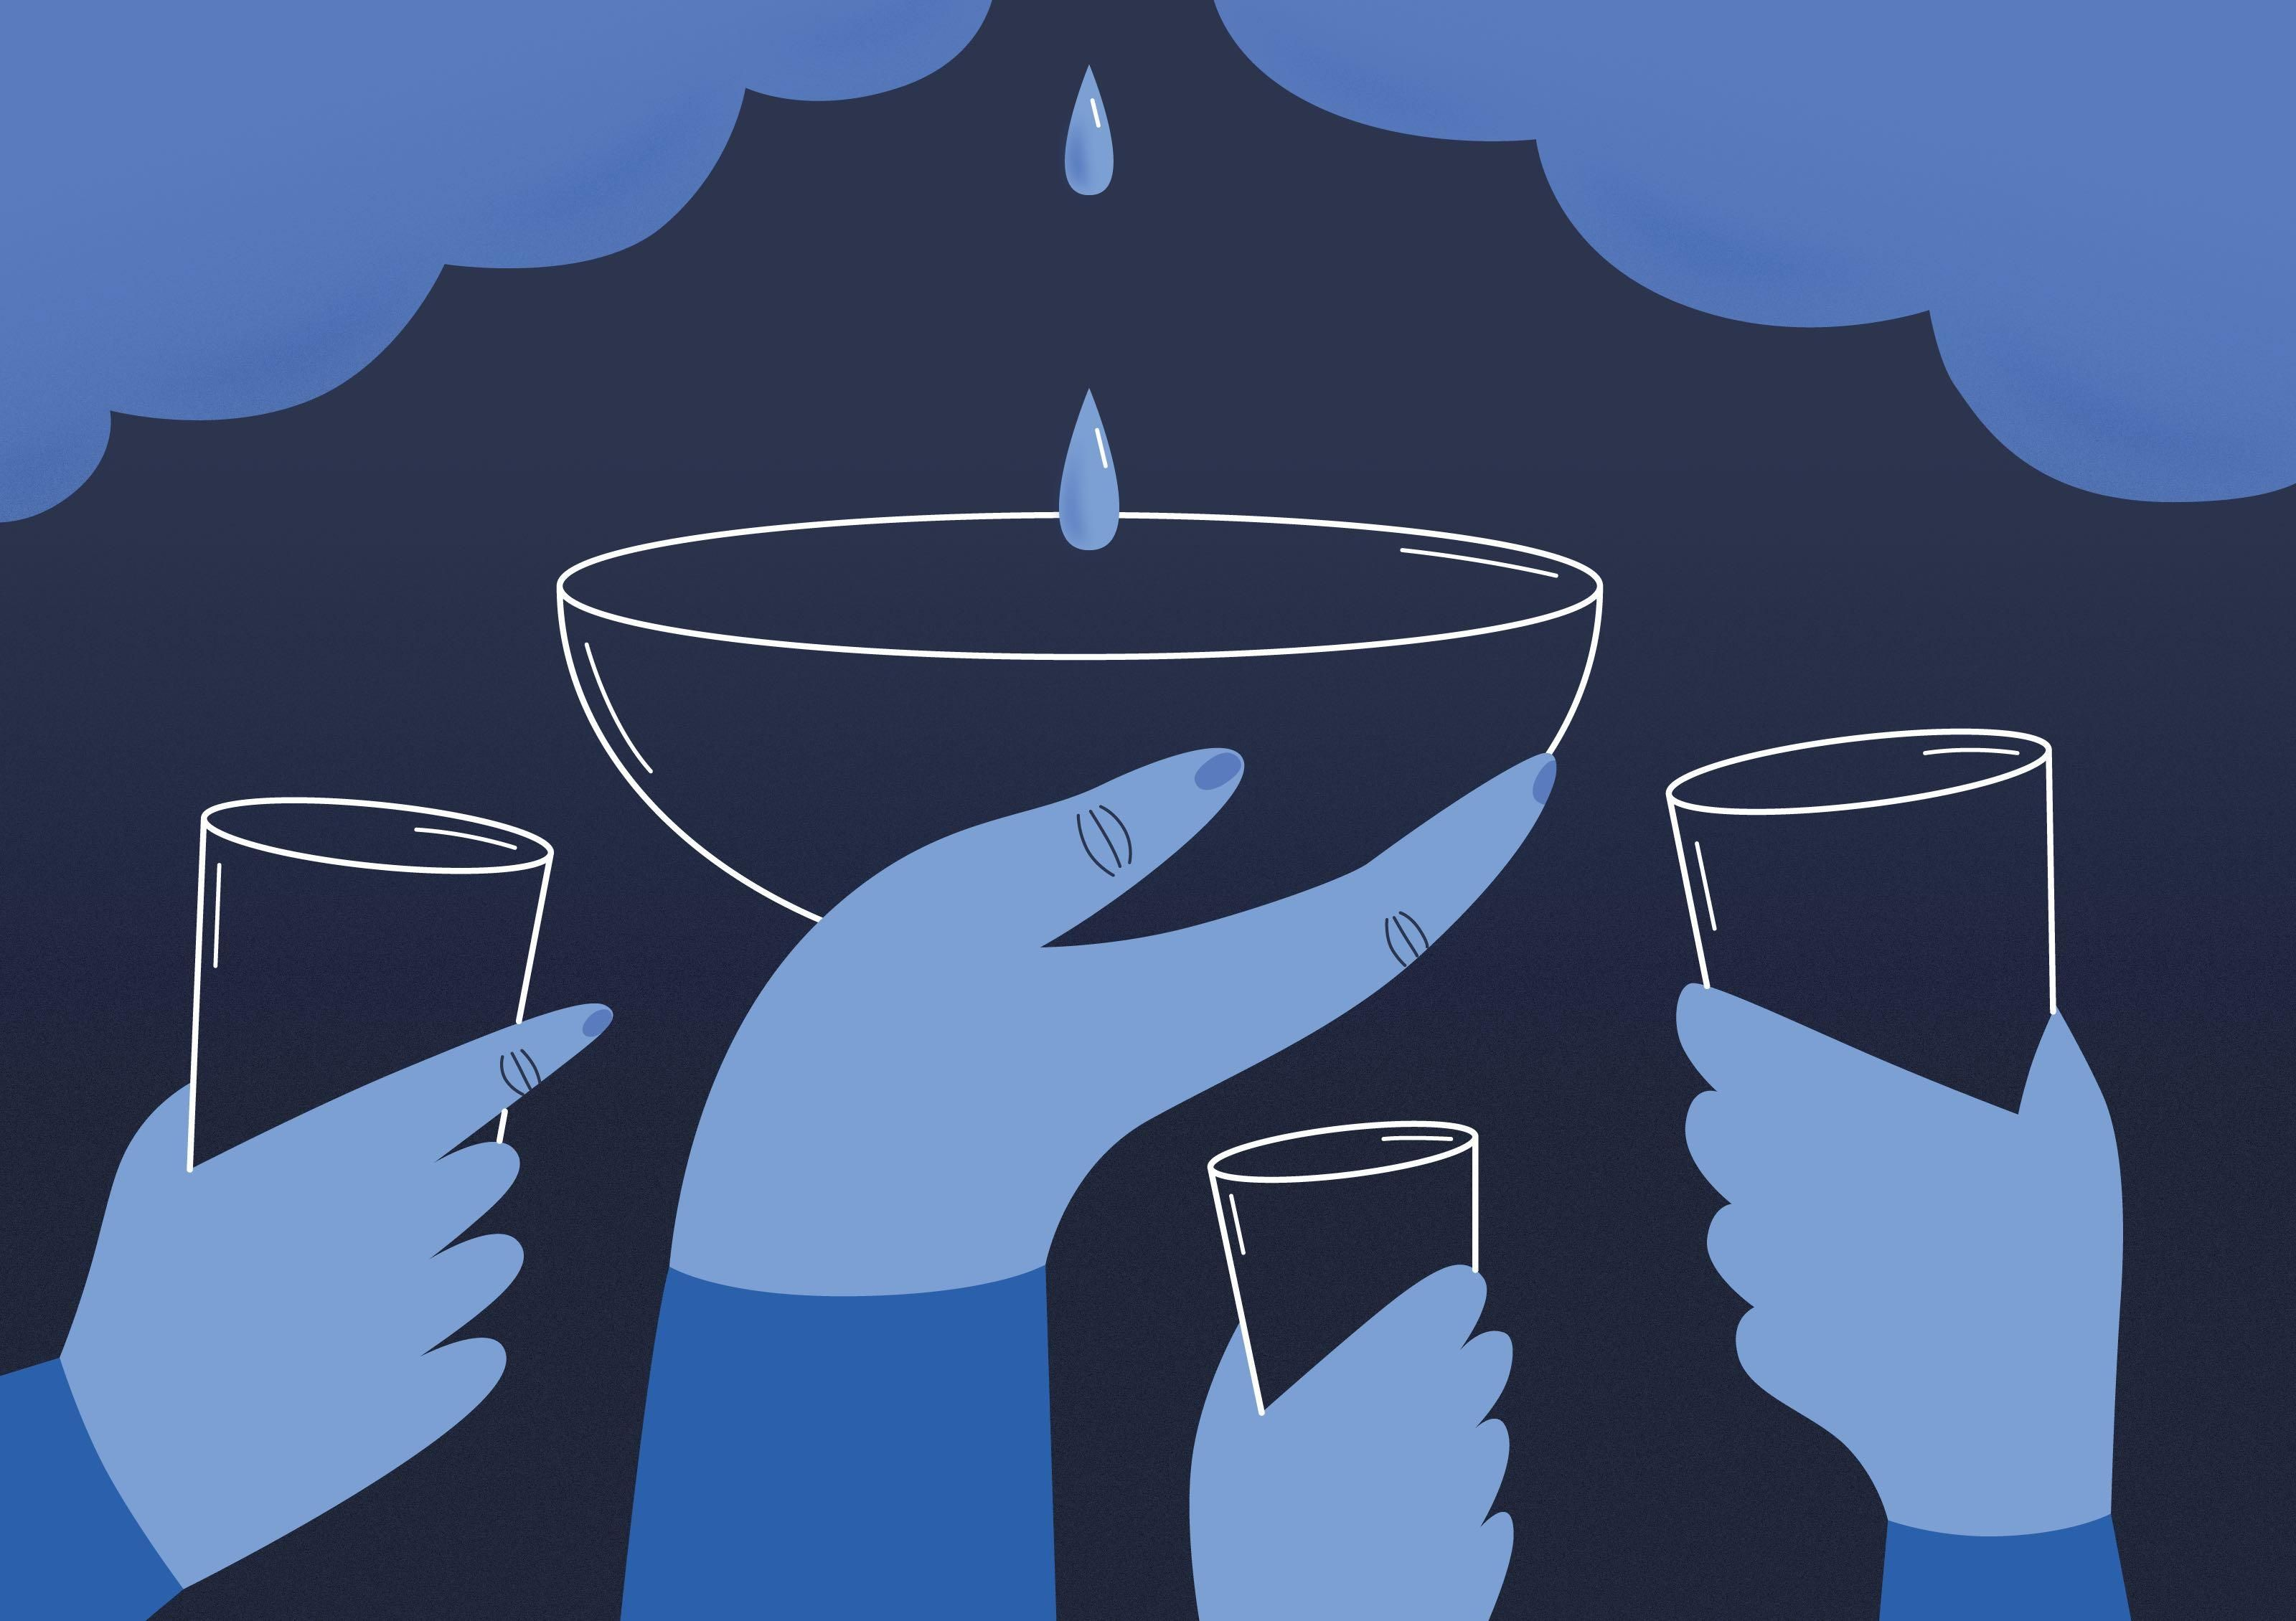
conclusion
One of the countries with the lowest accessibility to clean water is Jordan. Currently, the nation's renewable water supply suffices to supply freshwater to around two-thirds of the population, with groundwater being utilized twice as rapidly as it can be replaced.

Slide 6
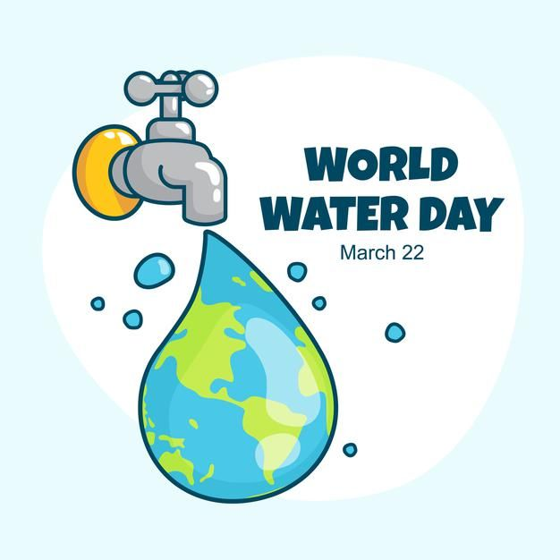
Water Resources & Environment: Basic page: Jordan. U.S. Agency for International Development. (2022b, August 16). https://www.usaid.gov/jordan/water-resources-environment#:~:text=Jordan%20is%20one%20of%20the,as%20it%20can%20be%20replenished.
| N. A. A. (2023, February 6). Ways to counter water scarcity in Jordan. EcoMENA. https://www.ecomena.org/water-scarcity-jordan/
Water, sanitation, and hygiene. UNICEF Jordan. (2020, November 4). https://www.unicef.org/jordan/water-sanitation-and-hygiene

