Slide 1

Bullying
By: Natalie Mansour, Haya baqleh, reena abuzalaf 6a
https://www.twinkl.co.uk/teaching-wiki/bullying
https://www.bullyzero.org.au/statistics-and-figures
https://newsroom.unsw.edu.au/news/health/kids-autism-spectrum-experience-more-bullying
https://www.stopbullying.gov/cyberbullying/what-is-it
https://www.positiveaction.net/blog/social-bullying
https://www.yourlifeyourvoice.org/Pages/Social-Bullying.aspx

Slide 2

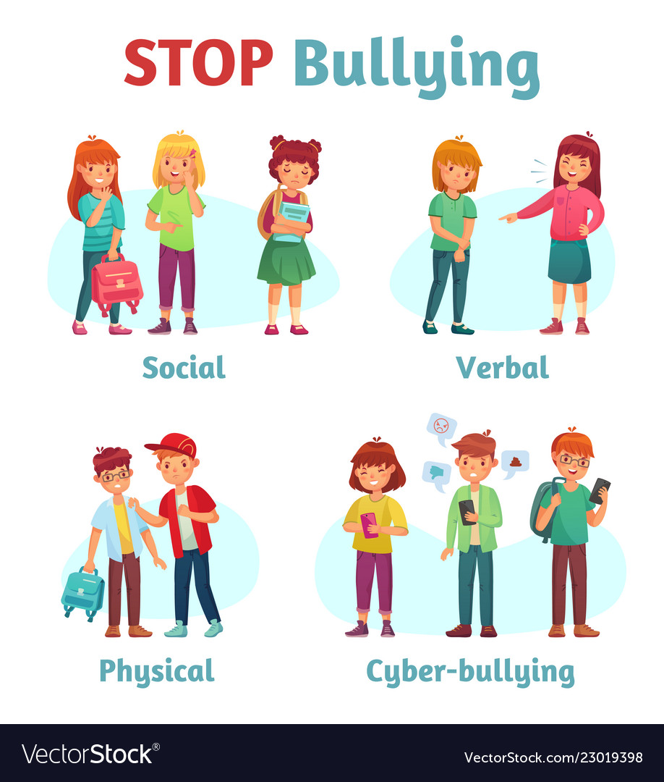
https://www.youtube.com/watch?v=iFlrCuSyhvU
Physical bullying — using violence to cause physical harm
Verbal bullying — using words to cause emotional harm
Social bullying — using various means to damage the victim’s social reputation or relationships
Cyberbullying — using digital means to bully

Slide 3
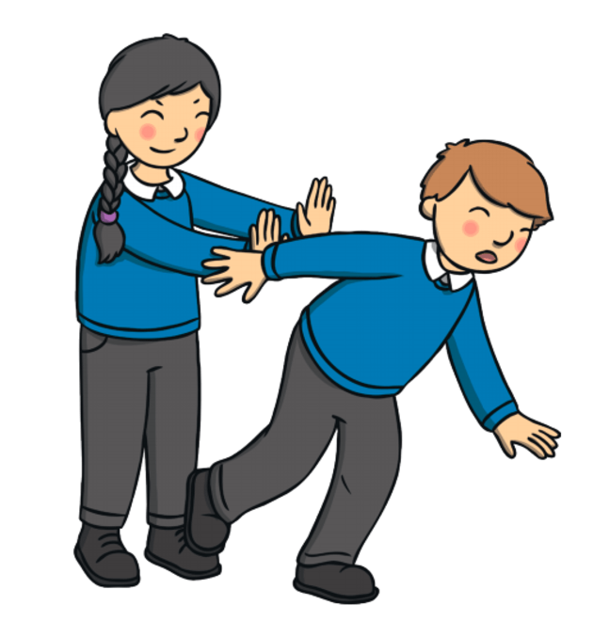
The term ‘bullying’ is often used to describe lots of different kinds of aggressive or rude behavior. Bullying is intentionally harmful behavior that is often repeated over time.

Slide 4
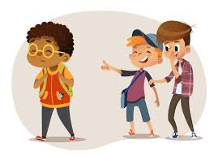

Slide 5
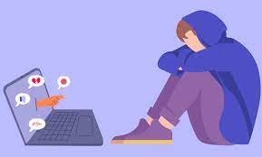
Cyberbullying is bullying that takes place over digital devices like cell phones, computers, and tablets. Cyberbullying can occur through SMS, Text, and apps, or online in social media, forums, or gaming where people can view, participate in, or share content.

Slide 6
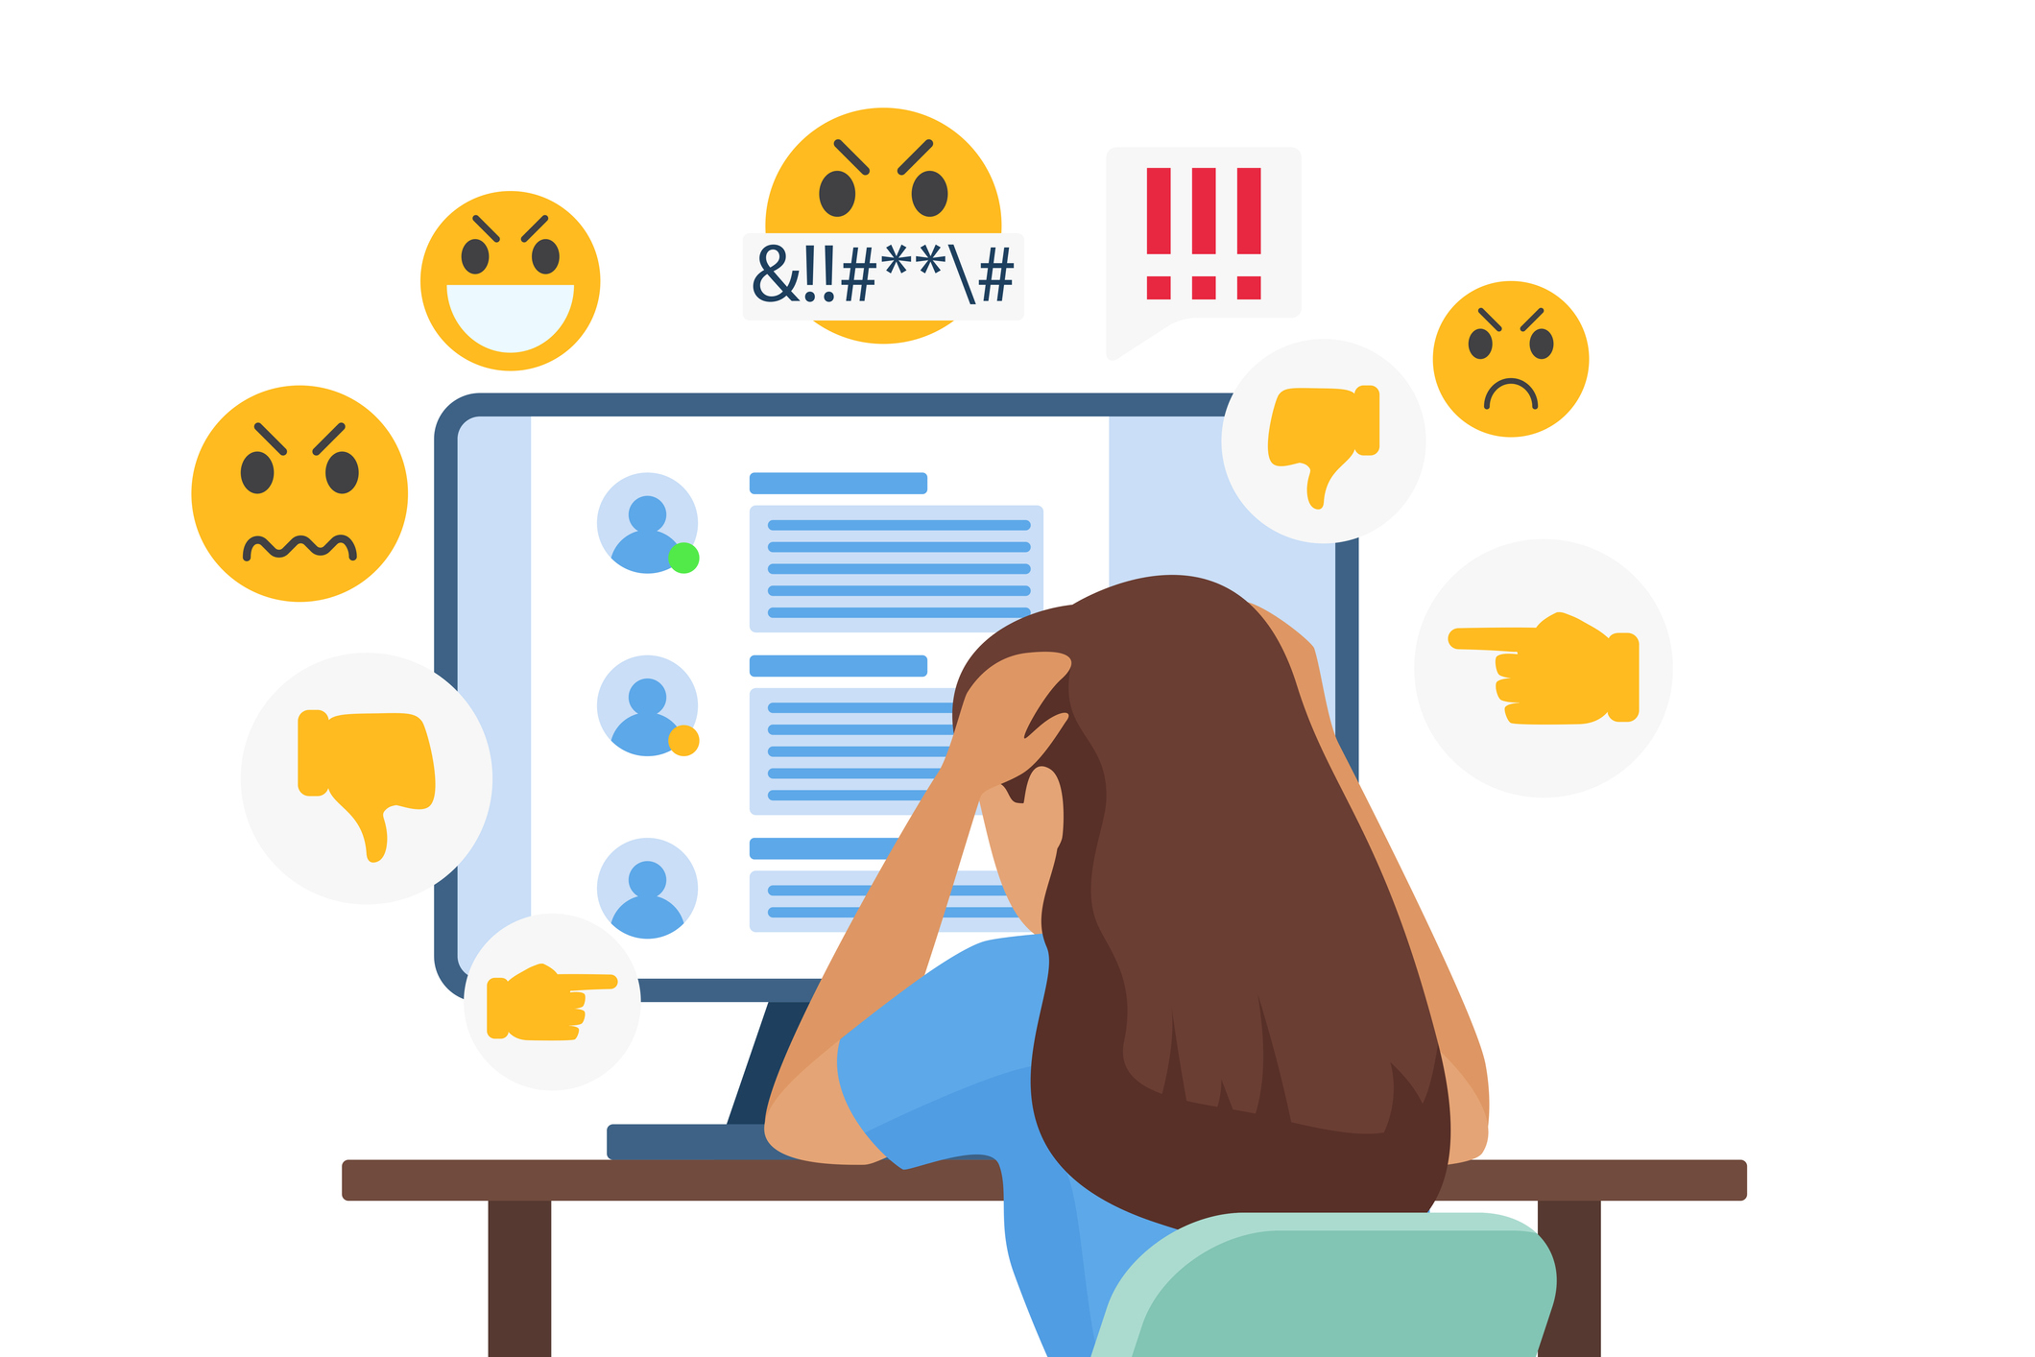
If anything, new technology is making it tougher to avoid bullying. With smartphones, tablets and laptops, kids can encounter cyberbullying, even when they aren’t at school.

Slide 7

Social bullying is done with the intent to hurt somebody's reputation, relationships, or social standing. It could include spreading a story to damage someone's reputation, or having others ignore or threaten a friend.

Slide 8
التنمر حول العالم
كسر عشري | كسر عادي | النسبة المئوية | البلد | السنة
0.24 | 24 100 | 24% | الاردن | 2023
0.29 | 29 100 | 29% | مصر | 2023
0.061 | 6.1x10............ 100x10.............. | 6.1% | العراق | 2023
0.37 | 37 100 | 37% | كوريا الجنوبية | 2023
0.04 | 4 100 | 4% | هولندا | 2023

Slide 9
