Slide 1
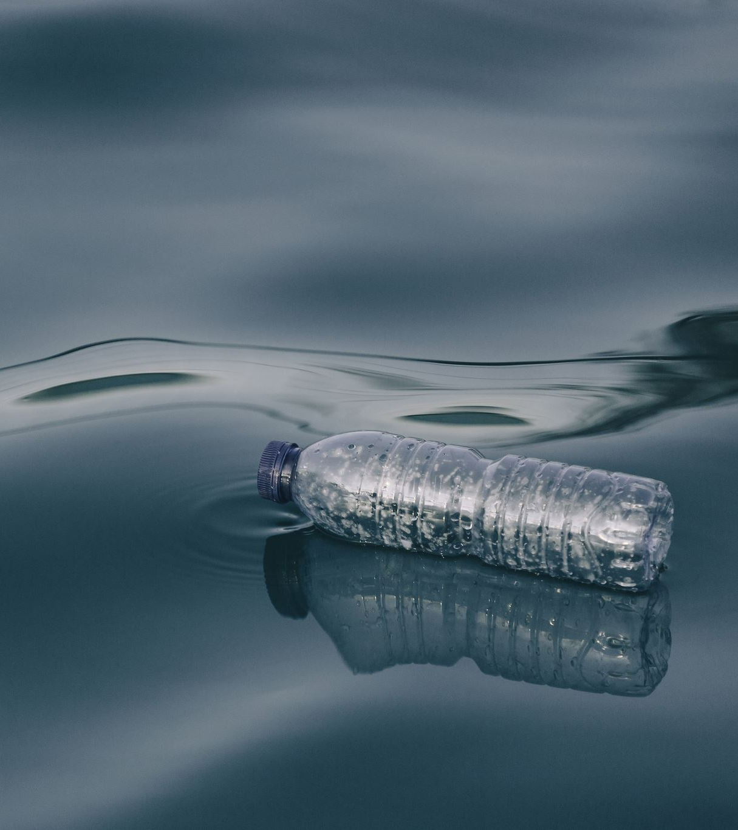
Water Crisis
Introduction:
The water crisis is a global problem that affects many countries, including Jordan. It is caused by various factors such as climate change, population growth, pollution, and mismanagement of water resources.
Issues in Jordan:
-Water scarcity and shortage
-High demand for water
-Limited access to clean water in some areas

Slide 2
Causes and Consequences
Causes:
-Climate change
-Population growth
-Pollution
-Mismanagement of water resources
Consequences:
-Droughts and water shortages
-Food and energy insecurity
-Health problems
-Environmental degradation

Slide 3
Course of Actions
Solutions:
-Increase water conservation efforts
-Promote the use of renewable energy
-Implement sustainable agriculture practices
-Improve water management and infrastructure
Reasoning:
These solutions can help reduce water demand, decrease pollution, and increase the availability of clean water. They can also help mitigate the effects of climate change and promote sustainable development.

Slide 4
Conclusion
In conclusion, the water crisis is a serious problem that requires immediate action. Jordan, like many other countries, is facing significant challenges related to water scarcity and mismanagement. However, by implementing sustainable solutions, we can mitigate the consequences of the crisis and ensure a better future for all.

Slide 5
Citations
MLA citations:
Website: "The Water Crisis in Jordan: Causes and Solutions." Water Crisis Info. Web.
Blog Post: "Tackling Jordan's Water Crisis: Why It's a Big Problem." Aqua Insights Blog, 7 Sept. 2022. Web.
News Article: Johnson, Lisa. "Jordan's Water Woes: Scarcity and High Demand Impacting Communities." Water World News, 15 Nov. 2022. Web.
Report: Sustainable Solutions Research Group. "Mitigating the Water Crisis in Jordan: Promoting Conservation, Renewable Energy, and Sustainable Agriculture." SSRG Reports, vol. 5, no. 3, 2023. Print.
Magazine: Waters, Sam. "Managing Water in Jordan: Challenges and Opportunities." AquaLife Magazine, vol. 9, no. 2, 2023. Print.

Slide 6
Seventh Grade “D”
Done by:
-Marius Sahawneh
-Kenan Awwad
-Kareem Fakhoury

