Slide 1
Consequences of Obesity and the Road to a Healthier Life
By: Zain Attiyat, Zaina Rabadi,
Nadine Hannoush
‘8f’

Slide 2
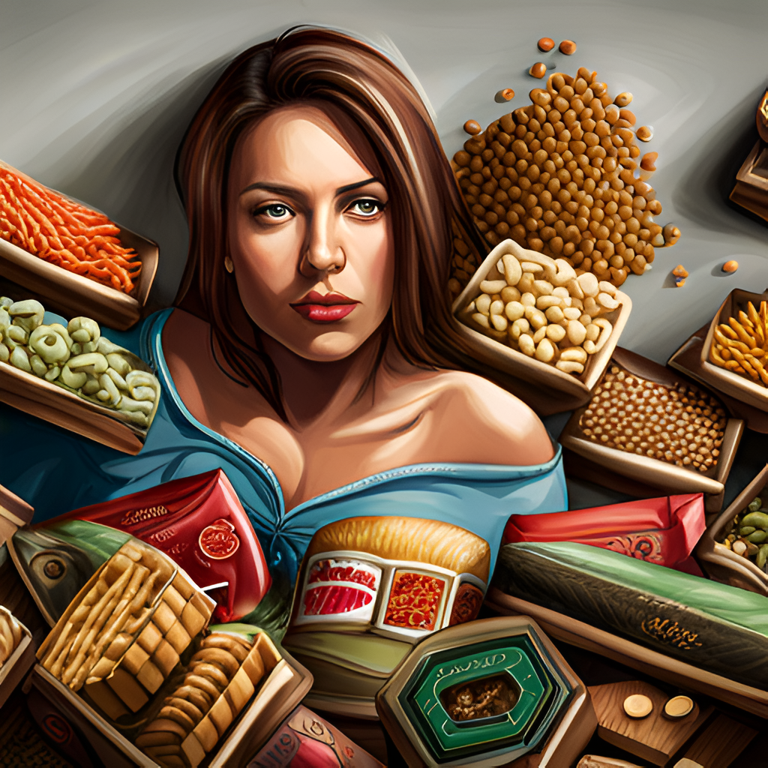
Introduction
Obesity has become a major health concern in the modern world.
Leading a healthy lifestyle is crucial in preventing and managing obesity.
This presentation aims to explore the consequences of obesity and promote the adoption of a healthy lifestyle.
zaina

Slide 3
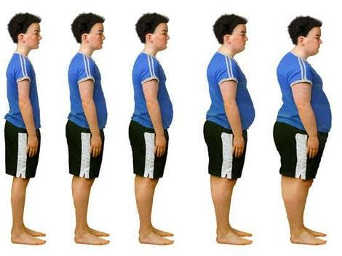
What causes Obesity and Overweight?
Food and activity. People gain weight when they eat more calories than they burn through the activities. (eating too much and moving a little).
The Environment. The world around us influences our ability to maintain a healthy weight.
Genetics.
Health conditions and Medications.
Stress , Emotional factors.
Poor sleep. zain

Slide 4
Health Consequences of Obesity
Obesity increases the risk of developing various health conditions such as heart disease, stroke, diabetes, and some types of cancer.
Additionally, obesity can lead to physical limitations, reduced mobility, and poor quality of life. It can also adversely affect mental health, leading to depression and low self-esteem.
nadine

Slide 5
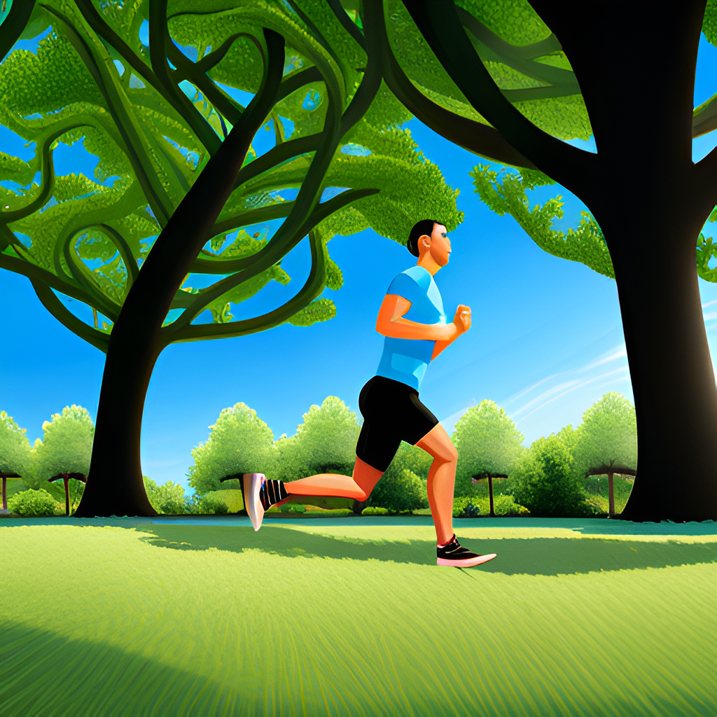
Preventing Obesity
Preventing obesity requires a combination of healthy eating habits and regular physical activity. Eating a balanced diet that is rich in fruits, vegetables, and whole grains while limiting processed foods and sugary drinks is essential.
Regular physical activity, such as brisk walking or cycling, can help maintain a healthy weight and reduce the risk of developing chronic diseases.
zaina

Slide 6
Managing Obesity
Managing obesity involves making lifestyle changes that promote weight loss and improve overall health. This can include following a healthy diet plan, engaging in regular physical activity, and seeking support from healthcare professionals.
In some cases, medication or surgery may be necessary to manage obesity effectively.
zain

Slide 7
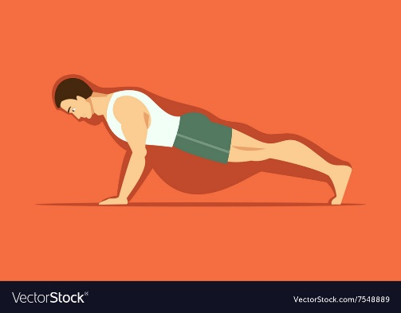
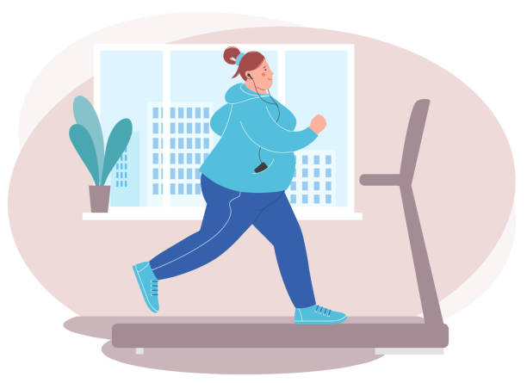
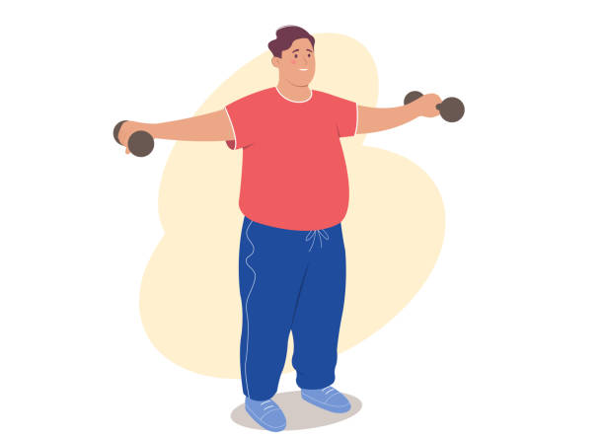
Obesity Solutions
The best way to treat obesity is to eat a healthy , reduced calorie diet and do exercises regularly.
To do this you should:
Eat a balanced , calorie controlled diet (as recommended by your weight loss management health professional (such as a dietitian).
Do workouts and activities (walking , jogging , swimming or doing any type of sport you like per week / physically active lifestyle).
Nadine

Slide 8
Conclusion
Obesity has far-reaching consequences that affect both individuals and society as a whole. Adopting a healthy lifestyle is crucial in preventing and managing obesity and its associated health and economic consequences.
By making small changes to our daily routines, we can improve our health, well-being, and quality of life.
zaina

