Slide 1
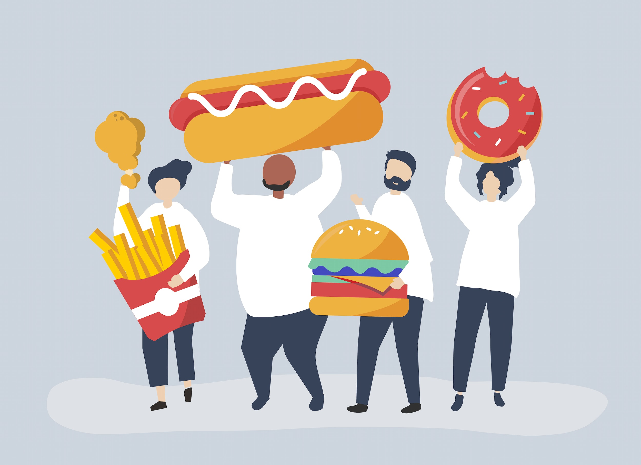
Obesity
Made by: Cynthia Nino, Katia Haddad and Maya Wardat

Slide 2
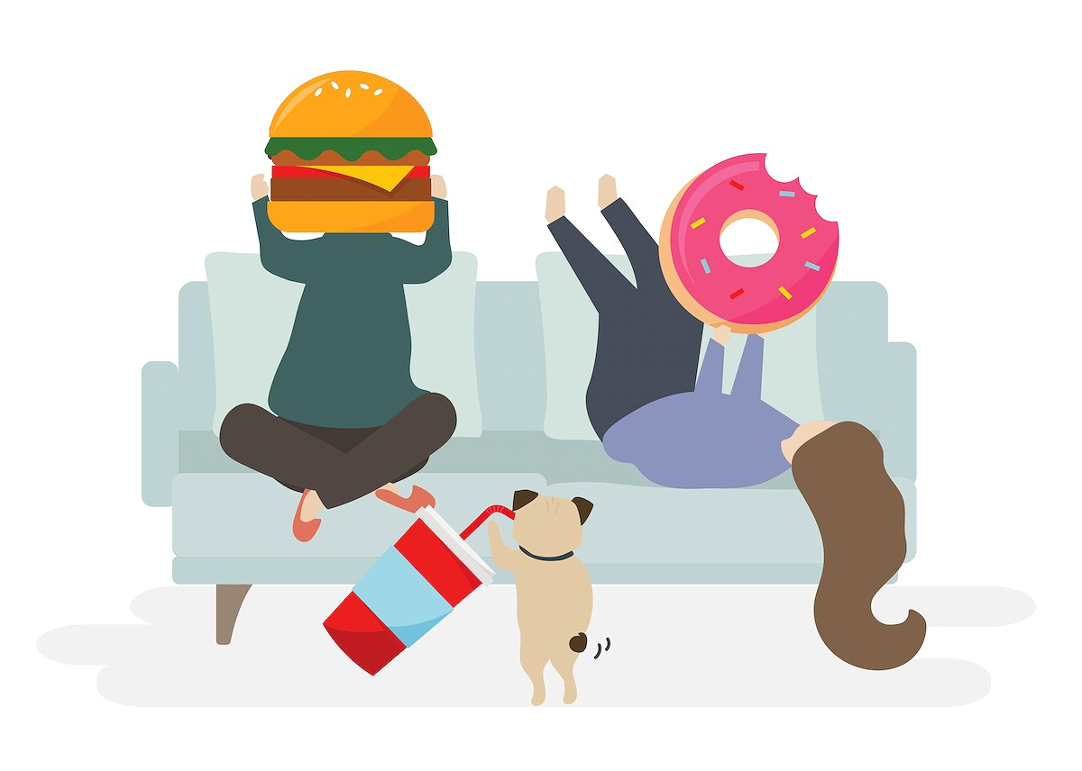

Slide 3
Here’s a YouTube video about obesity:
https://www.youtube.com/watch?v=-vNVG7XJpVE&feature=youtu.be
WATCH AND ENJOY

Slide 4
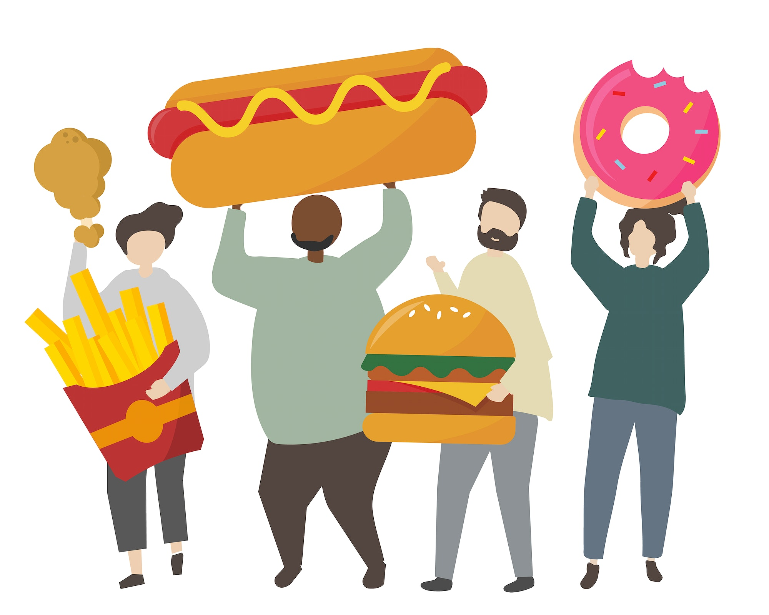
What do you think is the best definition of obesity?

Slide 5
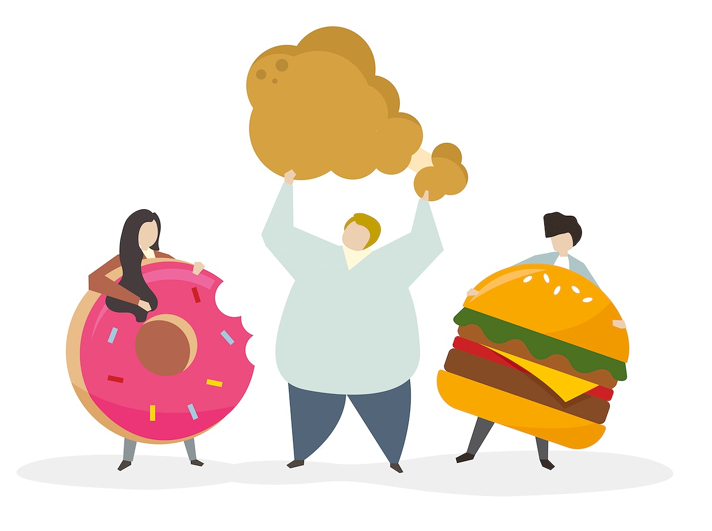
What can obesity lead to?

Slide 6
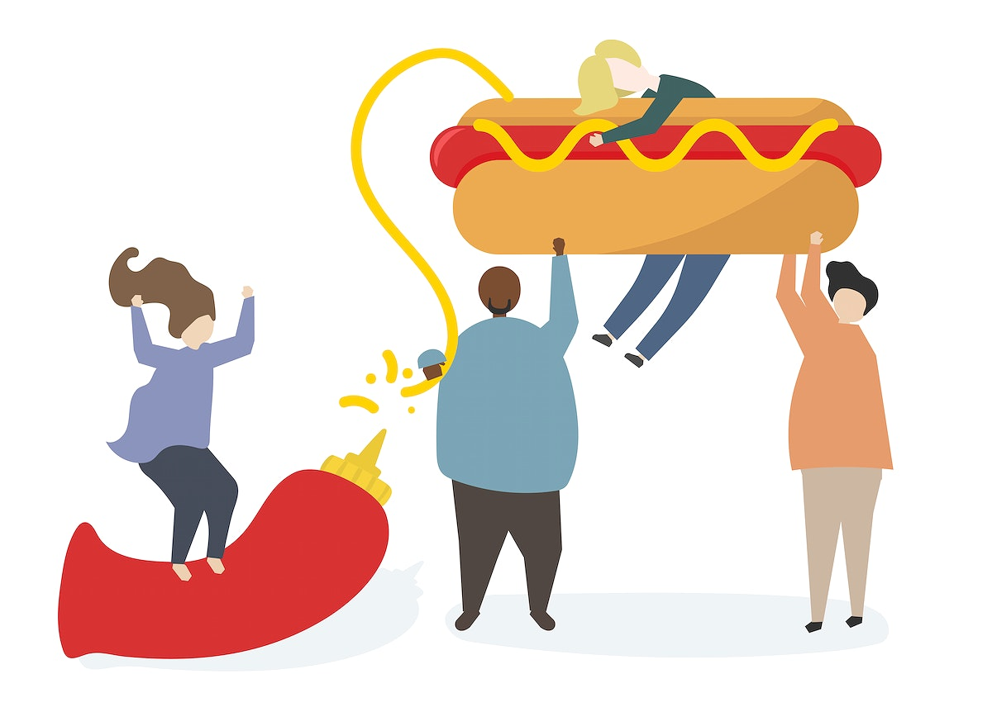
What are some possible causes of obesity?

Slide 7
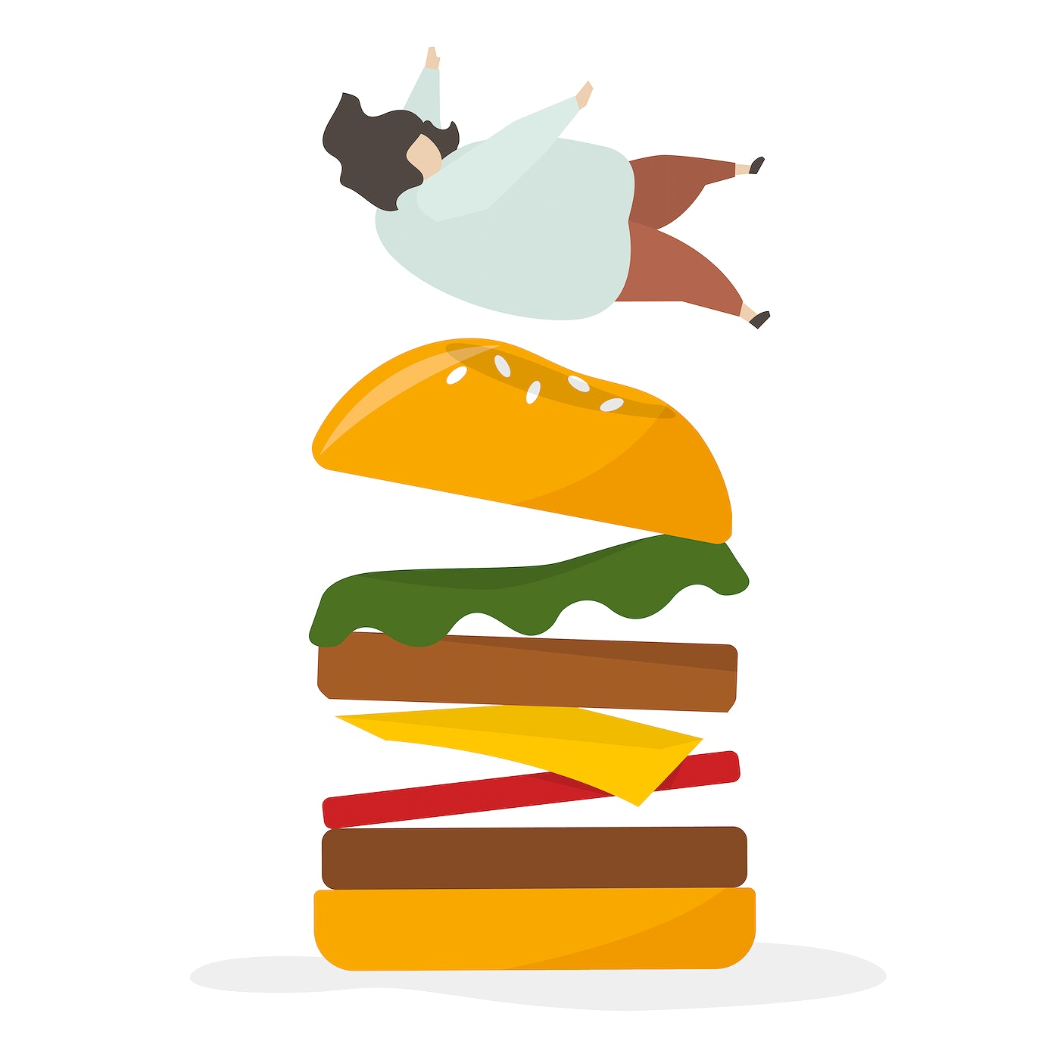
What is the worst health condition obesity can lead to?

Slide 8
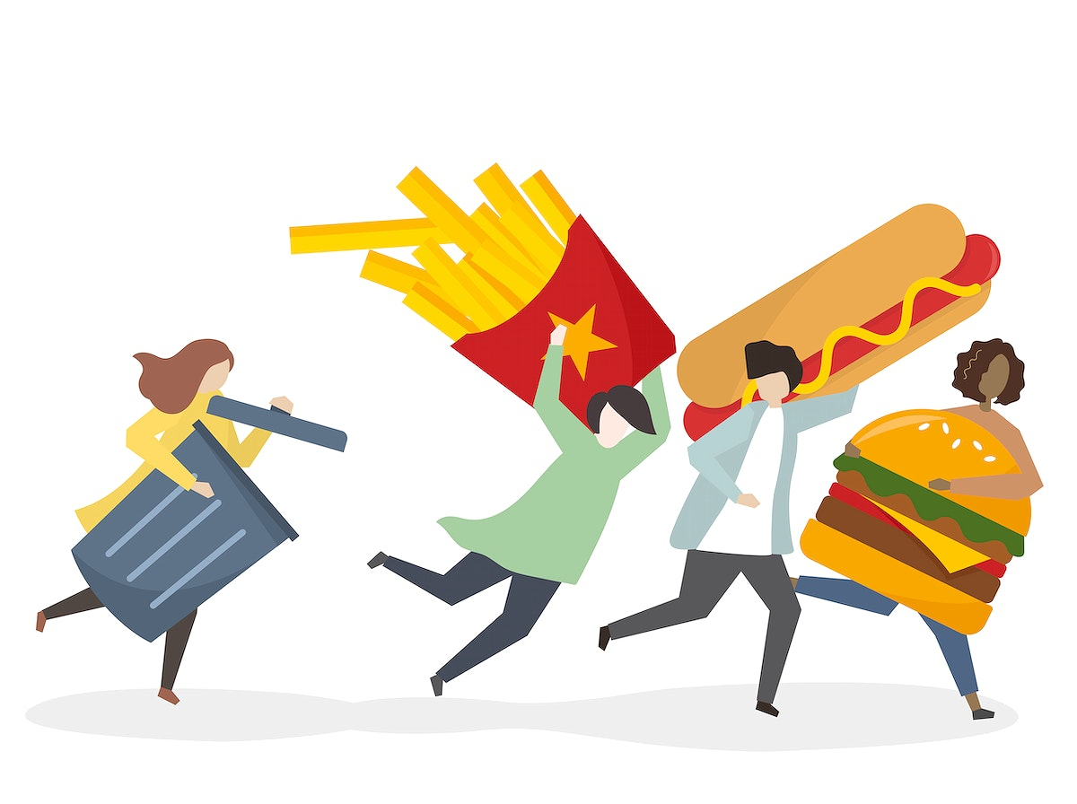
What do you think are the best solutions for obesity?

Slide 9

How can obesity ruin a human’s life?

Slide 10
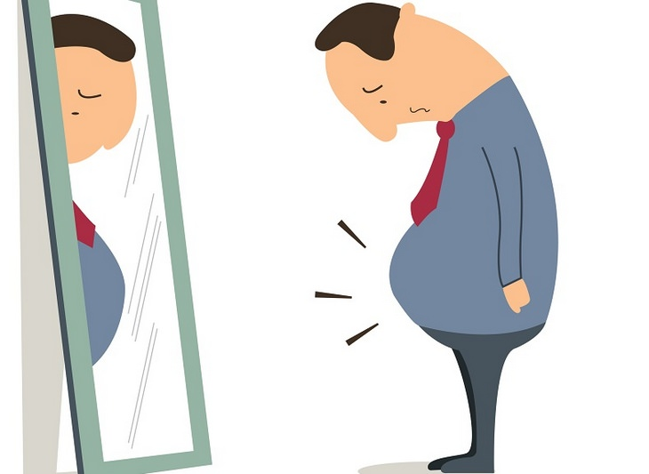
Does obesity also affect animals and how?

Slide 11
THANK YOU

