Slide 1
Obesity
By: Sanad Kakish, Saif Jumaian, George Fakes, Jad Gammoh

Slide 2
What is obesity?
Obesity is a complex disease, which is caused by excessive body fat, it is a very dangerous disease that the entire world is suffering from. Sometimes obesity can be caused by many things, not only from unhealthy diet or not exercising properly, it can be caused by inheritance.

Slide 3
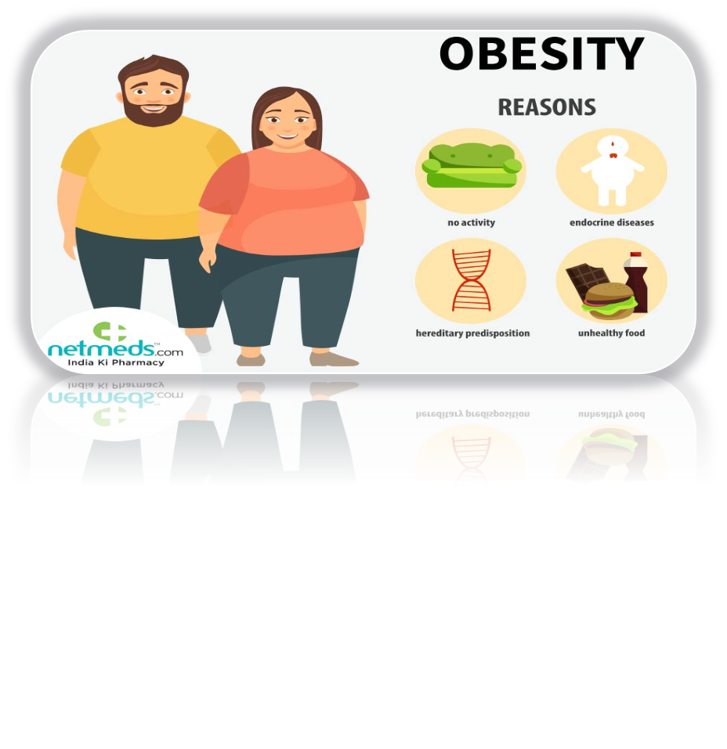
How is obesity gained?
There are 2 ways of gaining obesity:
1.From the environment, for example: bad diet (consumption of saturated fat), lack of exercise (which causes the body to store extra calories as fat).
2.When any person is born he or she may inherit some genes and that might give them a slower metabolism which could make losing weight harder for them

Slide 4
How common is obesity in America?
Around 30.7 percent of adults are overweight.
More than 2 in 5 adults suffer from obesity which is around 42.4 percent.
9.2 percent of adults have severe obesity (about 1 in 11 people).

Slide 5
Consequences of obesity:
People that have obesity are at great risk of many diseases than others that don't, examples are:
Type 2 diabetes.
Coronary heart disease.
Stroke
High blood pressure
Body pain and difficulty with physical functioning

Slide 6
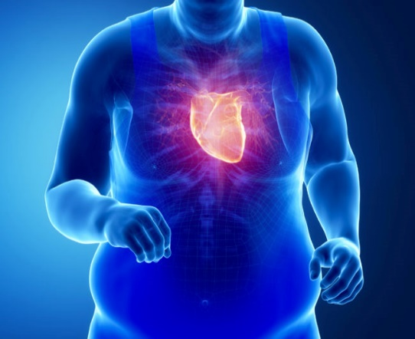
Diseases caused by obesity:
There are many life threatening diseases which can be caused by obesity, such as:
Type 2 diabetes: this can be caused by blood sugar/glucose levels being too high which of not taken care of could lead to diabetes.
Strokes: constant harm of the blood vessel leading to a formation of a blood clot which blocks anything from reaching the brain and causing a stroke
Kidney failure: the obesity of a person could stop their kidneys from working properly(they work more than they should), since they are compressed with a lot of pressure around them it could lead to kidney failure.

Slide 7
Beating obesity!
Though beating obesity can be hard for some people due to genetic factors, there still are many ways, but this can still be possible with ways such as:
Healthy diet
Exercise regularly
Weight loss and managements programs
Surgeries (risks of death may occur)

Slide 8
Raising awareness about obesity:
A way of raising awareness about obesity could be to teach kids about the consequences of the disease from a young age and teach them how to eat properly and the recommended portion which they should eat. This could help with obesity going down in the future and it could also mean that there will be less saturated fats in fast food, deli meats and other things containing unhealthy fats since they are being consumed less.
This Photo by Unknown Author is licensed under CC BY-NC-ND

Slide 9
Resources and crosschecking data:
https://www.cdc.gov/healthyweight/effects/index.html | https://www.niddk.nih.gov/health-information/weight-management/adult-overweight-obesity/treatment | https://www.niddk.nih.gov/health-information/health-statistics/overweight-obesity#
https://www.hsph.harvard.edu/obesity-prevention-source/obesity-consequences/ | https://www.mayoclinic.org/diseases-conditions/obesity/diagnosis-treatment/drc-20375749 | https://www.cdc.gov/obesity/data/adult.html

