Slide 1
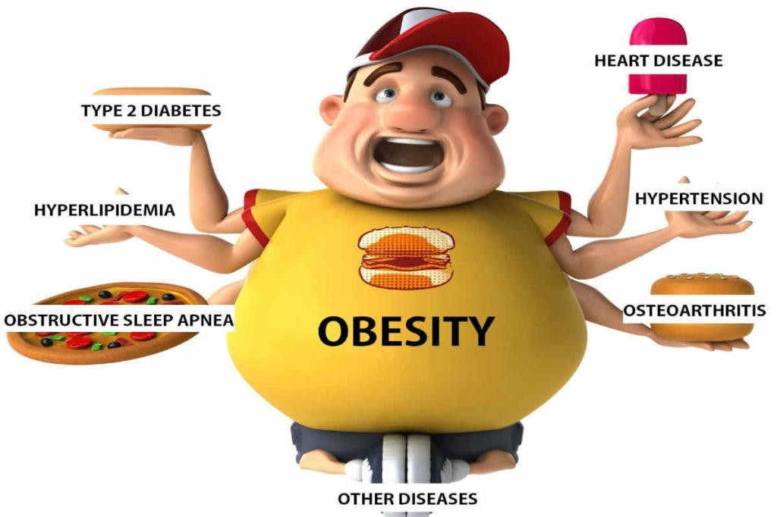
Obesity
Made by
:mohamad bsisu,zaid ali, awn sabayleh

Slide 2
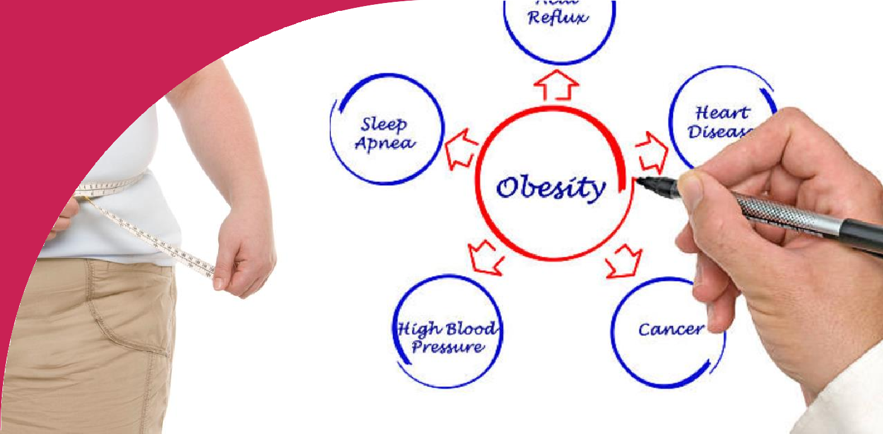
Obesity is a complex disease involving an excessive amount of body fat.
Obesity isn't just a cosmetic concern.
It's a medical problem that increases the risk of other diseases and health problems, such as heart disease, diabetes, high blood pressure and certain cancers.
What do we mean by obesity?

Slide 3
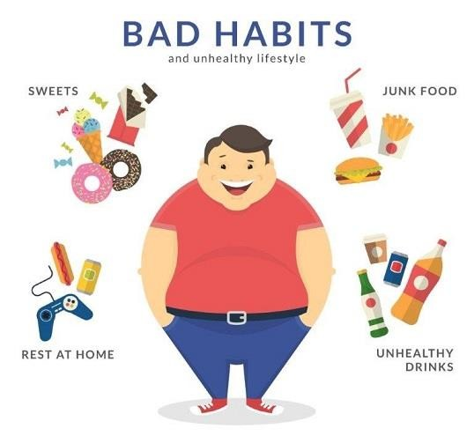
What are the causes of obesity
Calories. The energy value of food is measured in units called calories. ...
Poor diet. Obesity doesn't happen overnight. ...
Lack of physical activity. Lack of physical activity is another important factor related to obesity. ...
Genetics. ...
Medical reasons.

Slide 4
Why obesity is a problem?
Why obesity is problem?
Excess weight, especially obesity, diminishes almost every aspect of health, from reproductive and respiratory function to memory and mood. Obesity increases the risk of several debilitating, and deadly diseases, including diabetes, heart disease, and some cancers
Obesity, Depression, and Quality of Life
The high rates of obesity and depression, and their individual links with cardiovascular disease, have prompted many investigators to explore the relationship between weight and mood. An analysis of 17 cross-sectional studies found that people who were obese were more likely to have depression than people with healthy weights.
(17) Since the studies included in the analysis assessed weight and mood only at one point in time, the investigators could not say
whether obesity increases the risk of depression or depression increases the risk of obesity

Slide 5
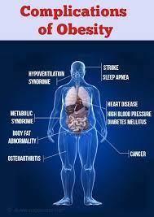
what obesity can do?
Obesity increases the risk of several debilitating, and deadly diseases including diabetes, heart disease, and some cancers. It does this through a variety of pathways, some as straightforward as the mechanical stress of carrying extra pounds and some involving complex changes in hormones
and metabolism
All-causes of death (mortality).
High blood pressure (hypertension).
High LDL cholesterol, low HDL cholesterol, or high levels of triglycerides (dyslipidemia).
Type 2 diabetes.
Coronary heart disease.
Stroke.
Gallbladder disease.
.

Slide 6
How can we solve obesity?
Choosing healthier foods (whole grains, fruits and vegetables, healthy fats and protein sources) and beverages. Limiting unhealthy foods (refined grains and sweets, potatoes, red meat, processed meat) and beverages (sugary drinks) Increasing physical activity. Limiting television time, screen time

Slide 7
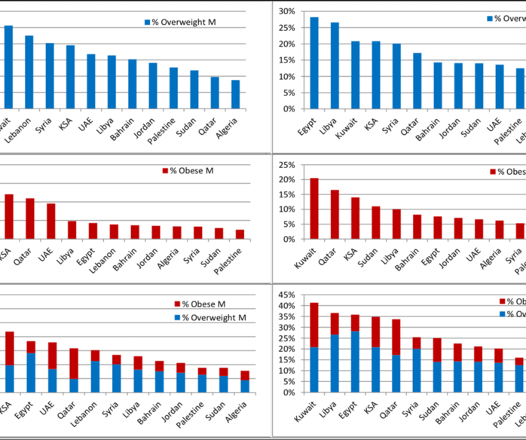
Why does middle east have high obesity rate?
his is mostly due to decreased physical activity and greater than necessary food consumption, particularly with an increase in energy coming from fat. The other factor are smoking.

Slide 8
Resources
Mayo Foundation for Medical Education and Research. (n.d.-a). Mayo Clinic. https://www.mayoclinic.org/
World Health Organization. (n.d.). World Health Organization (WHO). World Health Organization. https://www.who.int/
Centers for Disease Control and Prevention. (n.d.). Centers for Disease Control and Prevention. https://www.cdc.gov/
Team, O. W. in D., Roser, M., Mathieu, H. R. and E., Ritchie, H., & Rosado, H. R. and P. (n.d.). Our world in data. Our World in Data. https://ourworldindata.org/
Johns Hopkins Medicine, based in Baltimore, Maryland. , based in Baltimore, Maryland. (2023, April 21). https://www.hopkinsmedicine.org/
U.S. National Library of Medicine. (n.d.). National Center for Biotechnology Information. https://www.ncbi.nlm.nih.gov/
U.S. National Library of Medicine. (n.d.). Health information from the National Library of Medicine. MedlinePlus. https://medlineplus.gov/

