Slide 1
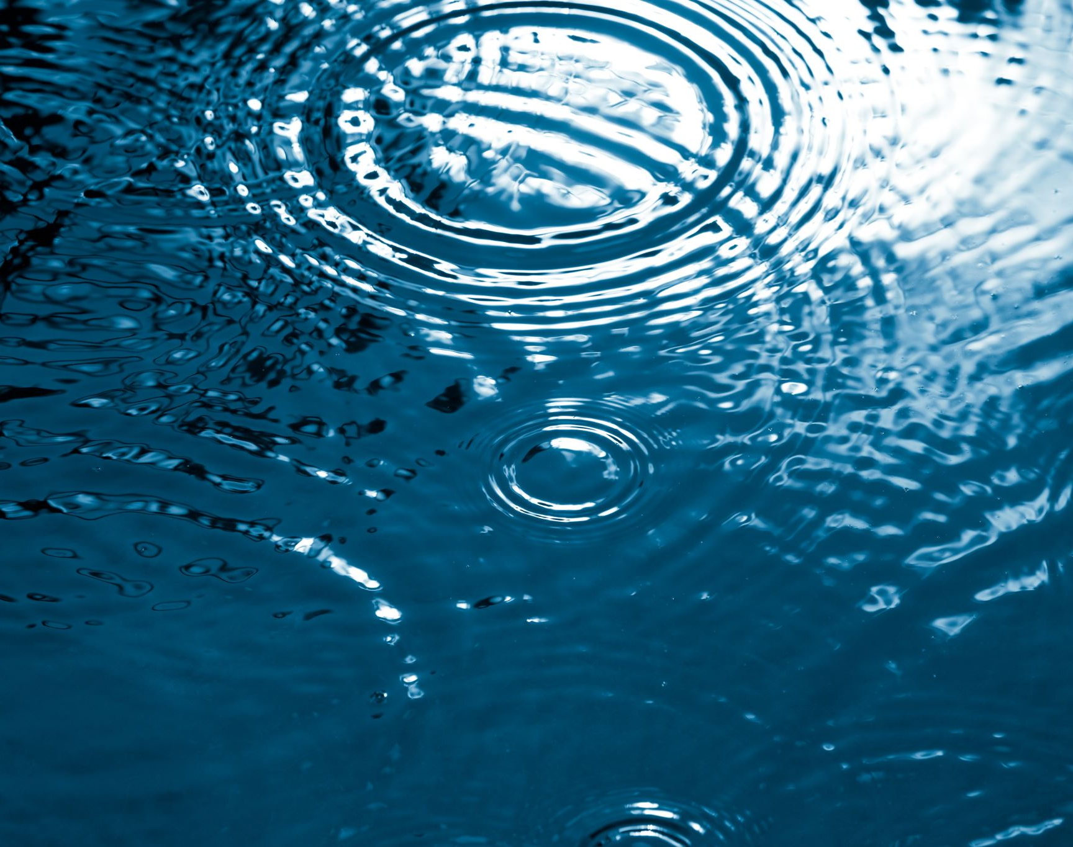
Water crisis in Jordan
By: Elena Sahawneh, Reine Talhami, Jeeda Karadsheh

Slide 2
What is the water crisis?
A water crisis is the overflow of wastewater from pumping stations, leaks from sewage systems and exposure to industrial and commercial waste. These are polluting Jordan's surface river sources.

Slide 3
Issues and problems of water crisis.
1. The overflow of wastewater from pumping stations is polluting Jordan’s waters.
2. The water crisis in Jordan is increasing global warming.

Slide 4
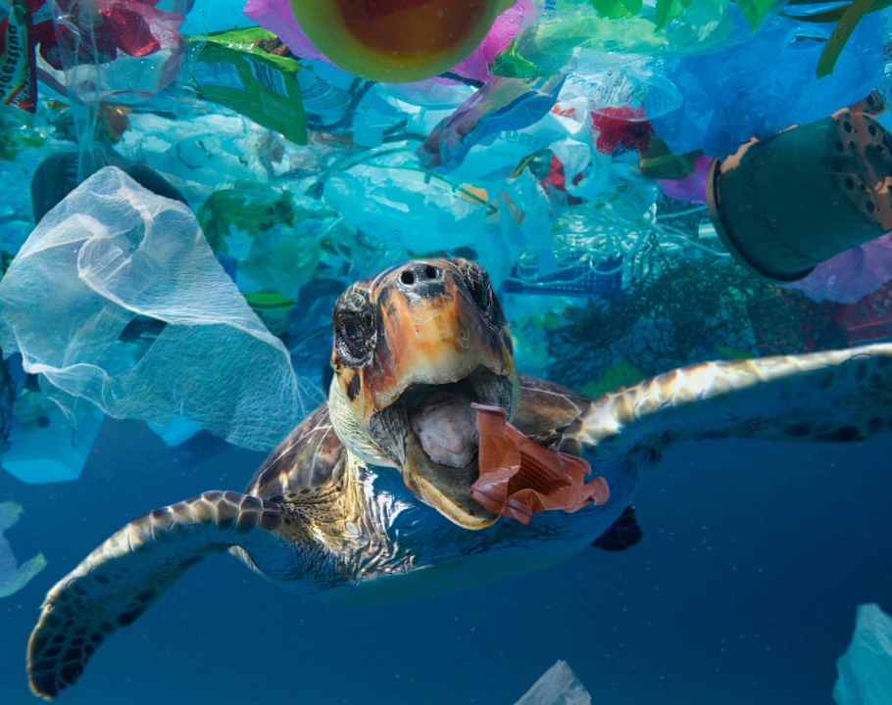
Causes of water crisis
Climate change has caused higher water temperatures, more frequent floods, and droughts are projected to worsen.
Wasting water is one of the main causes of the water crisis in Jordan, as 1billion cubic meters of water per year is wasted.

Slide 5
Consequences of water crisis
When waters run dry, people can’t get enough to drink, wash, or feed crops, and economic decline may occur.
When water is scarce, sewage systems can fail and the threat of contracting diseases like cholera surges.

Slide 6
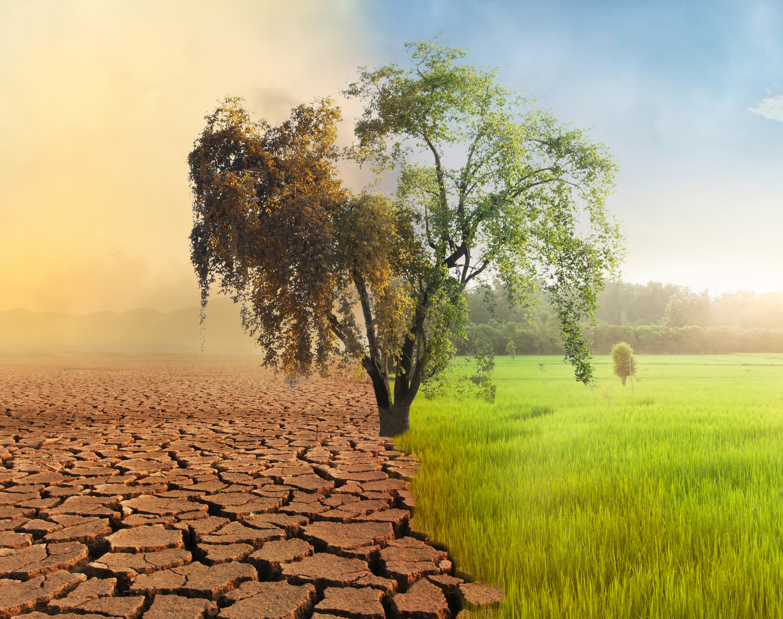
Solutions for the water crisis
Spreading awareness to children and adults
Strengthening governance
Building dams to control water

Slide 7
Thank you ☺

Slide 8
Links
.
Project, B. (2019, December 18). Sustainable water solutions in Jordan also fuel diplomatic progress. The Borgen Project. https://borgenproject.org/sustainable-water-solutions-in-jordan/#:~:text=The%20cornerstone%20of%20developing%20sustainable,to%20water%20supply%20in%20Jordan.
Water scarcity: UN-water. UN. (n.d.). https://www.unwater.org/water-facts/water-scarcity
Water crisis. Water Crisis | World Water Council. (n.d.). https://www.worldwatercouncil.org/en/water-crisis
Water Resources & Environment: Basic page: Jordan. U.S. Agency for International Development. (2022, August 16). https://www.usaid.gov/jordan/water-resources-environment#:~:text=Jordan%20is%20one%20of%20the,as%20it%20can%20be%20replenished
World Wildlife Fund. (n.d.). Water scarcity. WWF. https://www.worldwildlife.org/threats/water-scarcity#:~:text=When%20waters%20run%20dry%2C%20people,and%20other%20water%2Dborne%20illnesses.

