Slide 1
Water Crisis
Done By: Lamar, Raina, Celina. ☺

Slide 2
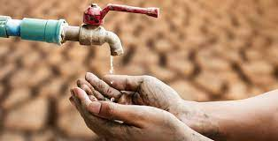
What is “Water Crisis”
Water scarcity is a seasonal, annual or multi-annual water stress condition. It occurs when water demand frequently exceeds the sustainable supply capacity of the natural system in river basins. It can be measured as the ratio between renewable freshwater resources and water abstraction or water use. Beyond water quantity, a situation of water scarcity can also emerge from acute water quality issues, when pollution (diffuse or point source pollutions) lead to reduced clean water availability.
Resource: https://environment.ec.europa.eu/topics/water/water-scarcity-and-droughts_en

Slide 3
Issues of Water Crisis In Jordan
1- Being one of the most arid countries in the Middle East, Jordan is facing severe water shortages. The current per capita water supply in the country is 200 cubic meters per year which is almost one-third of the global average. To make matters worse, it is projected that Jordan’s population (currently at 6 million) will reach 9 million by 2025 causing a drastic decline in per capita water availability to measly 91 cubic meters.
2- Groundwater resources account for 54% of Jordan’s total water supply, and are being threatened by pollution due to over-pumping of aquifers, seepage from landfill sites, and improper disposal of dangerous chemicals. Agricultural sector is responsible for about two-third of Jordan’s total water consumption.
Resource: https://www.ecomena.org/water-scarcity-jordan/

Slide 4
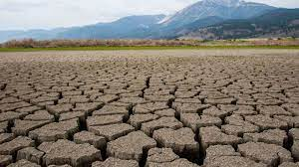
Causes of Water Crisis in Jordan
1- The overflow of wastewater pumping stations, leaks from sewage systems and exposure to industrial and commercial waste are polluting Jordan's surface river sources.
2- Rainfall: Jordan gets 110 mm of rainfall a year and ranked ninth in the top 10 countries with the lowest rainfall In 2017.
Resource: https://www.usaid.gov/jordan/water-resources-environment#:~:text=Jordan%20is%20one%20of%20the,as%20it%20can%20be%20replenished.

Slide 5
Consequences of Water Crisis
1- Limited access to water results in children and young adults being unable to practice important hygiene behavior like hand-washing and proper disposal of menstruation products. According to estimates, only around a third of schools in Jordan have adequate wash facilities.
2- Water shortages could have a significant negative impact on the service sector through increased operational costs and increased complexity in supply chains. Jordan's economy is heavily reliant on the service sector, which accounts for more than 60% of the country's GDP and 70% of employment.
Resource: https://www.usaid.gov/jordan/water-resources-environment#:~:text=Jordan%20is%20one%20of%20the,as%20it%20can%20be%20replenished.

Slide 6
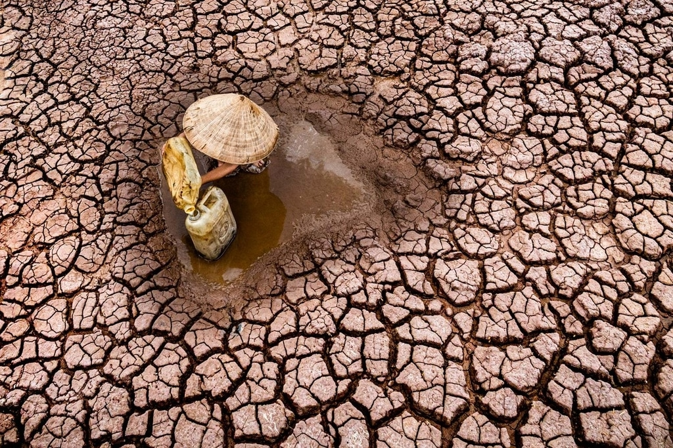
Solutions for Water Scarcity
1- There are couple of options to increase alternative water supply sources in Jordan – desalination of seawater and recycling of wastewater. Desalination can provide a safe drinking water to areas facing severe water scarcity, and may also help in resolving the conflict between urban and agricultural water requirement needs by providing a new independent water source.
2- The other way to counter water scarcity in Jordan is by recycling and reuse of municipal wastewater which is an attractive method.
Resource: https://www.ecomena.org/water-scarcity-jordan/

Slide 7

Thank you for Listening

