Slide 1
Physics diagram
Made by:saif fashho sanad madanat and Sinan shawareb

Slide 2
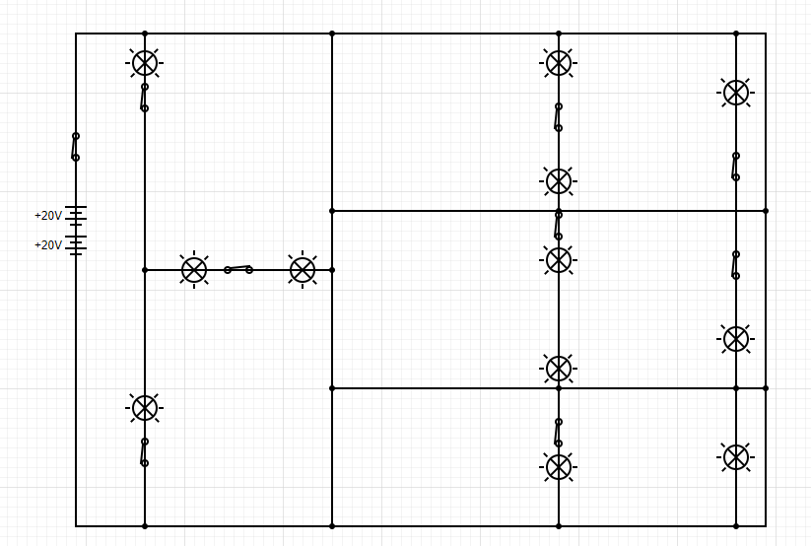
This is our house circuit diagram

Slide 3

Our cells
our house must contain at least one cell so we added 4 cells with a main switch that controls the whole house

Slide 4
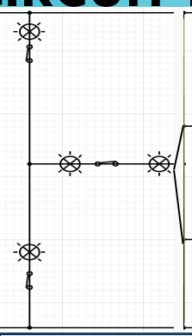
This is the living room
3m
Our living room contains 4 light bulb according to the equation (250*12=3000 /800=4 rounded)2 led light bulbs and 2 normal light bulb it also contains 2 switches one for each type of bulb in our living room there will be 3 electric sockets
(the ones that has red on top of them are led light bulbs )
2
4m
12m

Slide 5
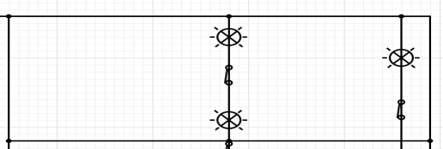
This is the bedroom
5m
2
10m
2m
The bedroom contains 3 bulb using the equation 10*250=2500/800=3 rounded it has 1 led light and 2 normal it would have two switches one for each type of bulb the bedroom contains 2 sockets

Slide 6
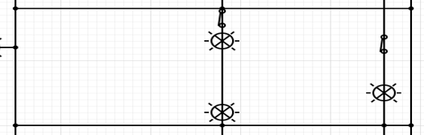
This is the kitchen
5m
2
2m
10m
The kitchen contains 3 normal light bulbs using the equation 10*250=2500/800=3 rounded ,there will be two lights connected to one switch and one bulb connected to a switch alone. the kitchen would have 5 sockets one for the microwave one for the toaster one for the kettle one for the oven and one for the refrigerator

Slide 7
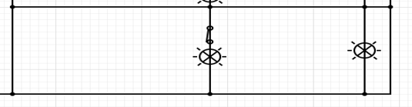
This is the bathroom
3m
6m
2m
2
The bathroom would have 2 bulbs according to the equation (6*250=1500/800=2 rounded) there will be one normal light bulb and one sensor motion bulb for the mirror (that has a blue spot on top of it ) the normal bulb will have a switch ,there will be one socket for the hairdryer

Slide 8
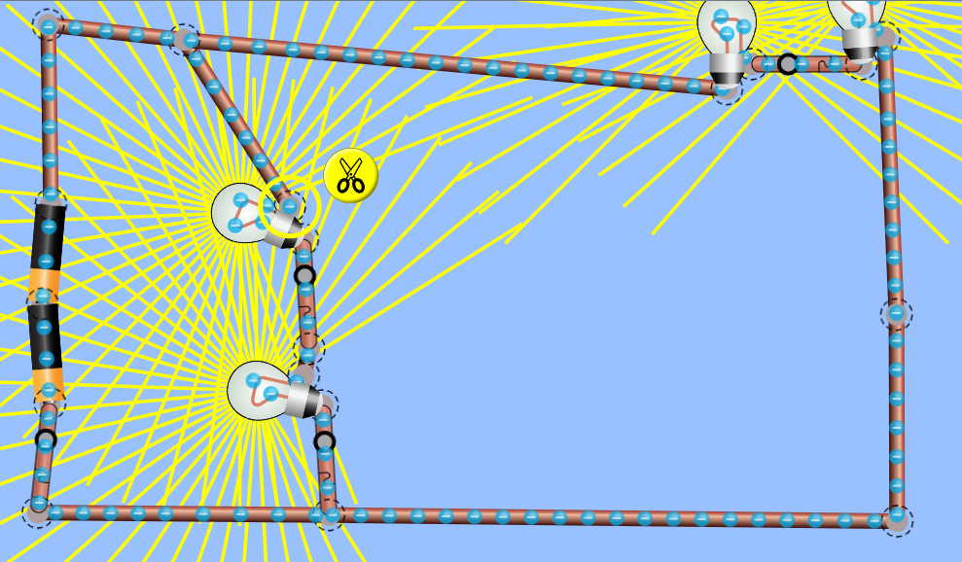
Now this is the simulation FOR OUR LIVING ROOM

Slide 9
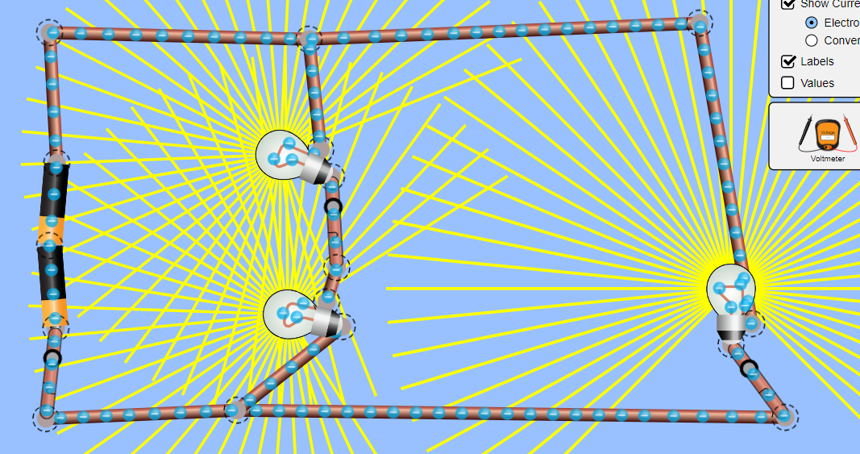
Now this is the simulation FOR OUR BEDROOM

Slide 10
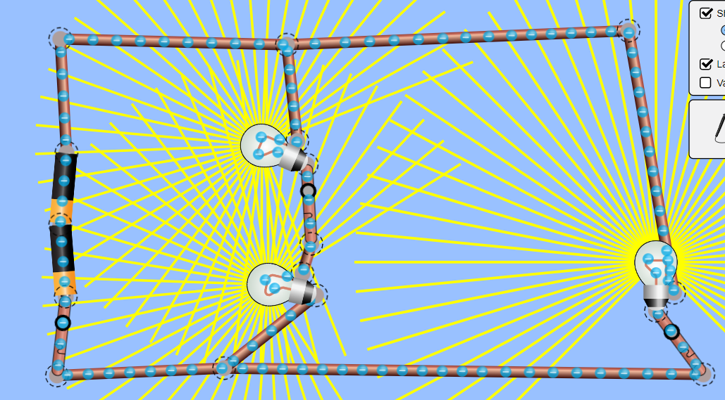
Now this is the simulation FOR OUR KITCHEN

Slide 11
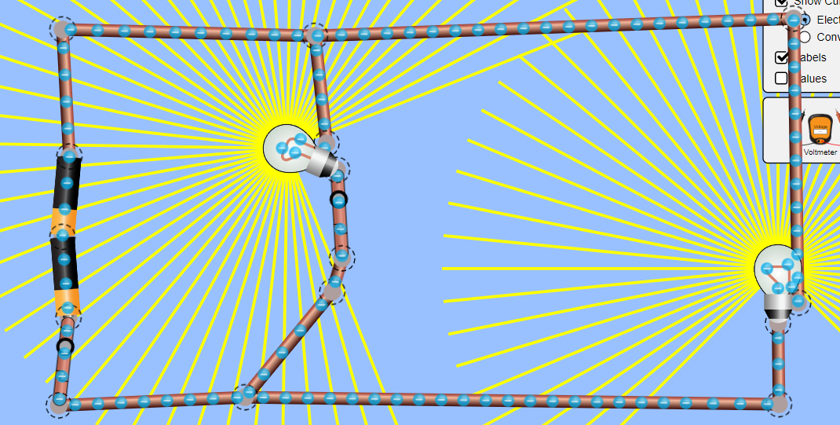
Now this is the simulation FOR OUR BATHROOM

Slide 12
Thank you for listening

