Slide 1
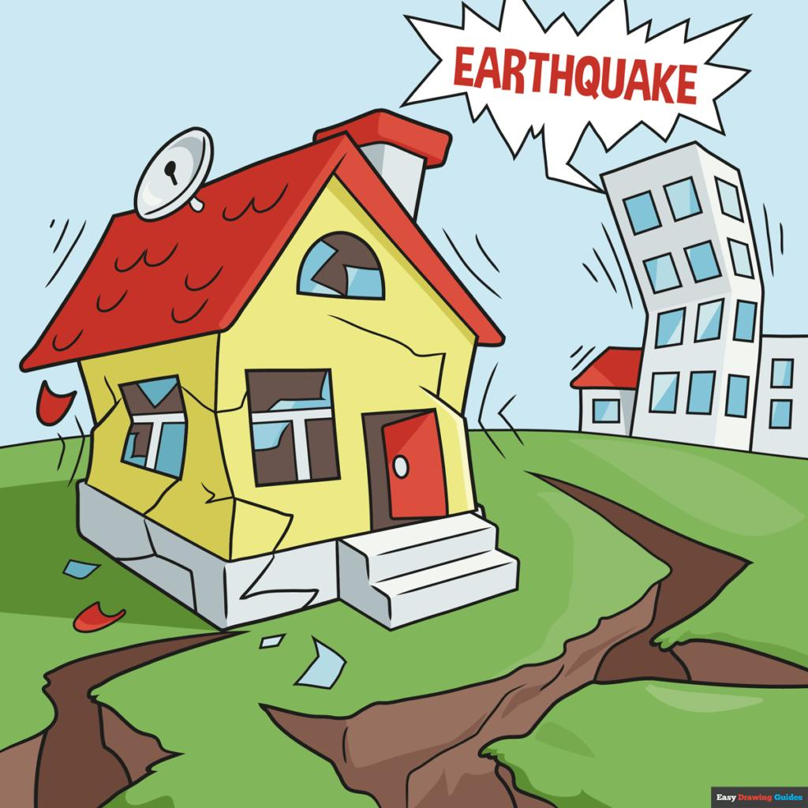
Earthquakes
by Celina , Maria, Talin, Salma, Yasmine

Slide 2
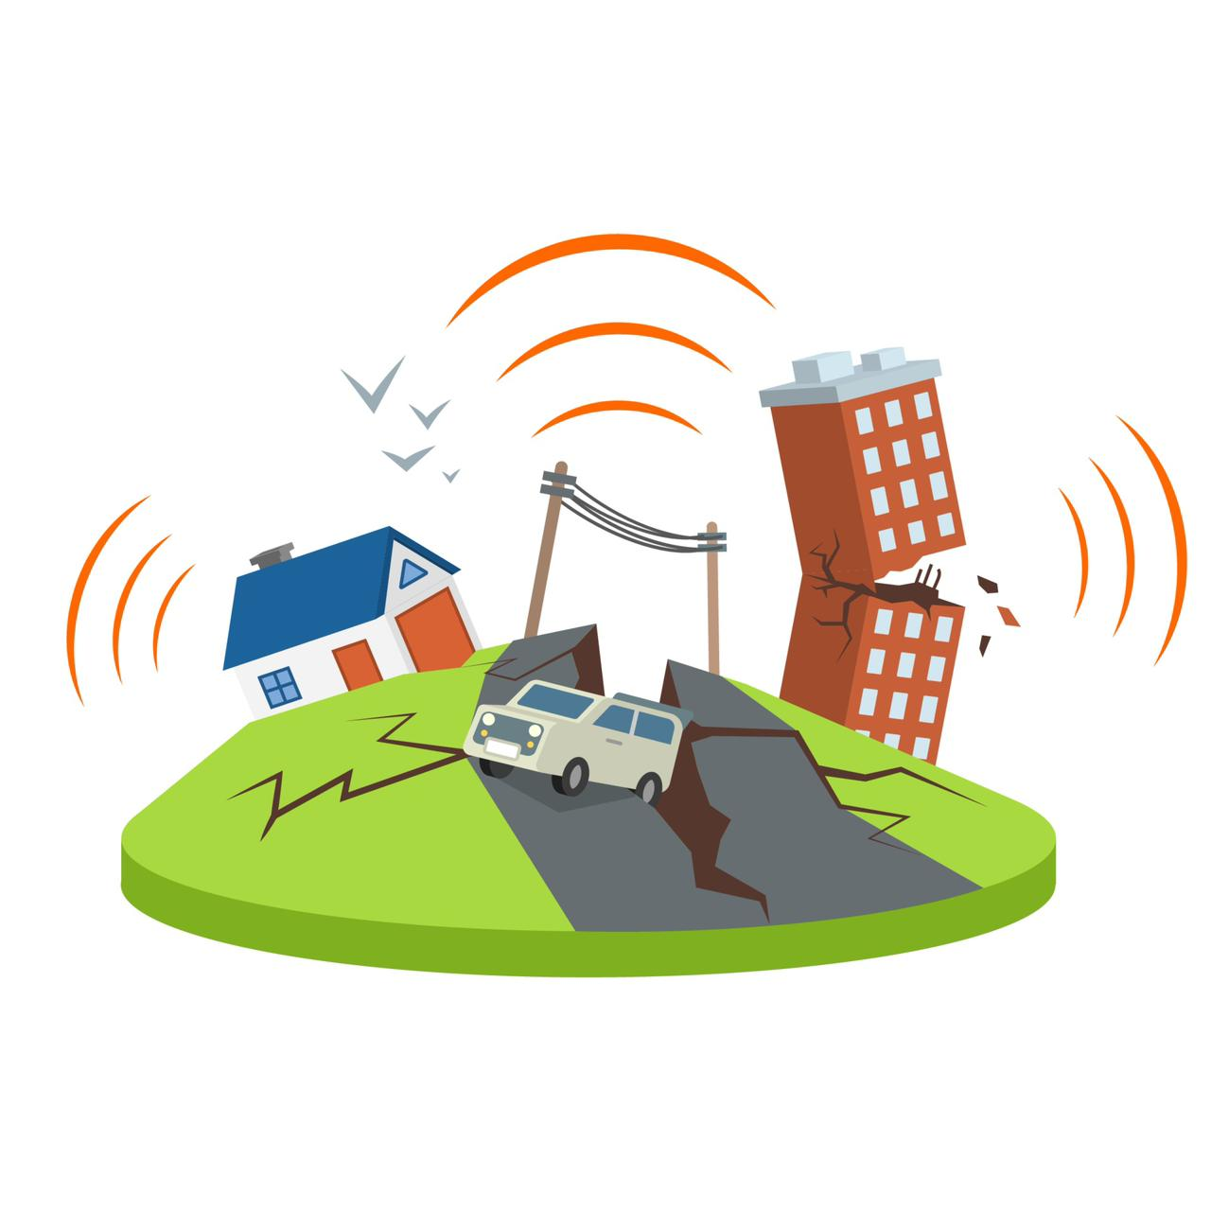
What is an earthquake?
Notes:
An earthquake is a natural event that happens when there is sudden and intense shaking of the Earth's surface.
It is what happens when two blocks of the earth suddenly slip past one another. The surface where they slip is called the fault or fault plane. An earthquake happens when the ground suddenly moves because of the Earth's plates shifting. The strength of the earthquake depends on a few things: how strong the rock is where the plates meet, how much of the area along the plates moved, and how far the ground moved.
So if the rock is really strong, or if there's a lot of area that moves, or if the ground moves a lot, then the earthquake will be stronger. It's kind of like a big wave - the bigger the wave, the more powerful it is.

Slide 3
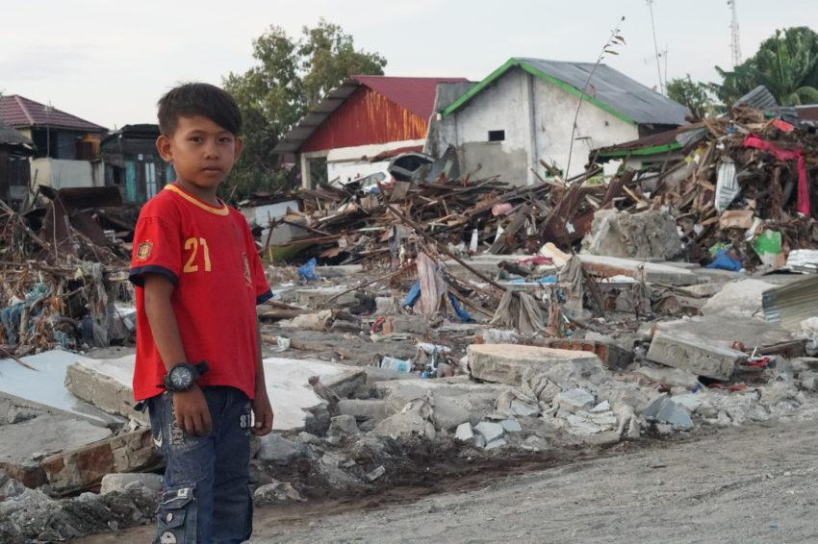
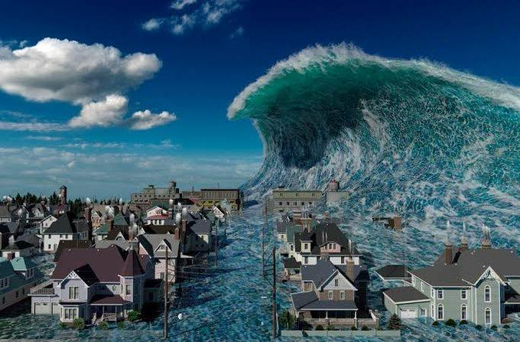
What are the issues of earthquakes?
Notes:
The effects and issues from earthquakes include ground shaking, surface faulting, land slides , and less commonly, tsunamis.
1. Ground Shaking
Ground shaking is a term used to describe the vibration of the ground during an earthquake.
2. Surface Faulting
Surface faulting is the differential movement of the two sides of a fracture at the Earth's surface and can be strike-slip, normal, and reverse (or thrust).
3. Landslides
Landslides are caused by earthquakes both by direct rupture and by sustained shaking of unstable slopes.
4. Tsunamis
Tsunamis, which are popularly -- and incorrectly -- known as ``tidal waves,'' are a grave hazard to many parts of the world, particularly around the Pacific Ocean basin.

Slide 4
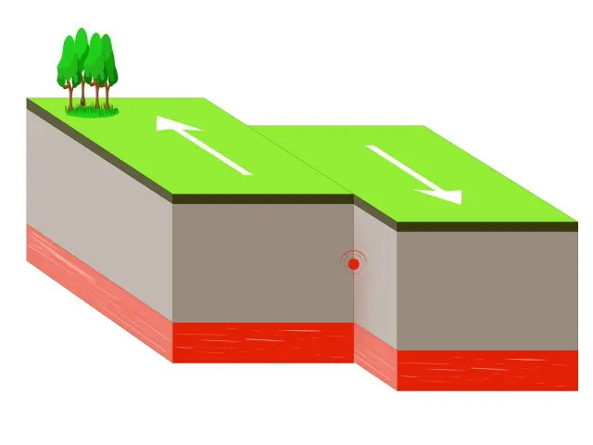
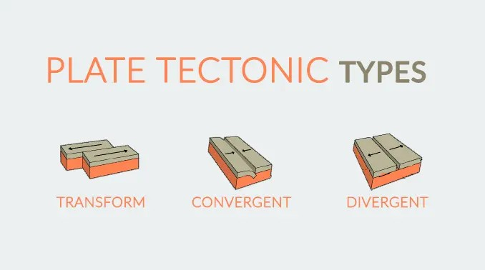
What are the causes of earthquakes ?
Notes:
Causes of a earthquake
A earthquake is caused by a sudden slip on a fault. The tectonic plates always move slowly, but they get stuck to their edge due to friction. When the stress on the edge overcome the friction, there is an earthquake that releases energy waves that are called seismic waves and that cause the shaking that we feel. This is a naturally occurring earthquake, sometimes referred to as a tectonic earthquake.
We have three types of tectonic plate boundries
A divergent boundary occurs when two tectonic plates move away from each other
A transform boundary Two plates sliding past each other
A convergent plate boundary occurs
When the tectonic plates move towords each other together

Slide 5
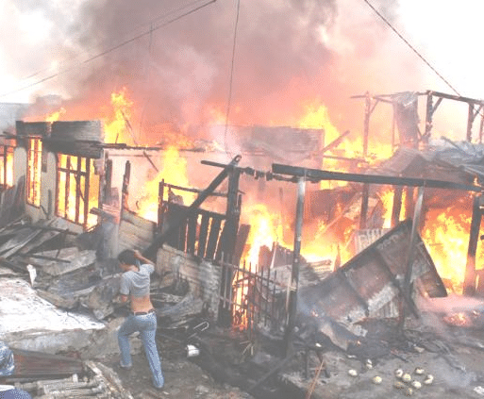
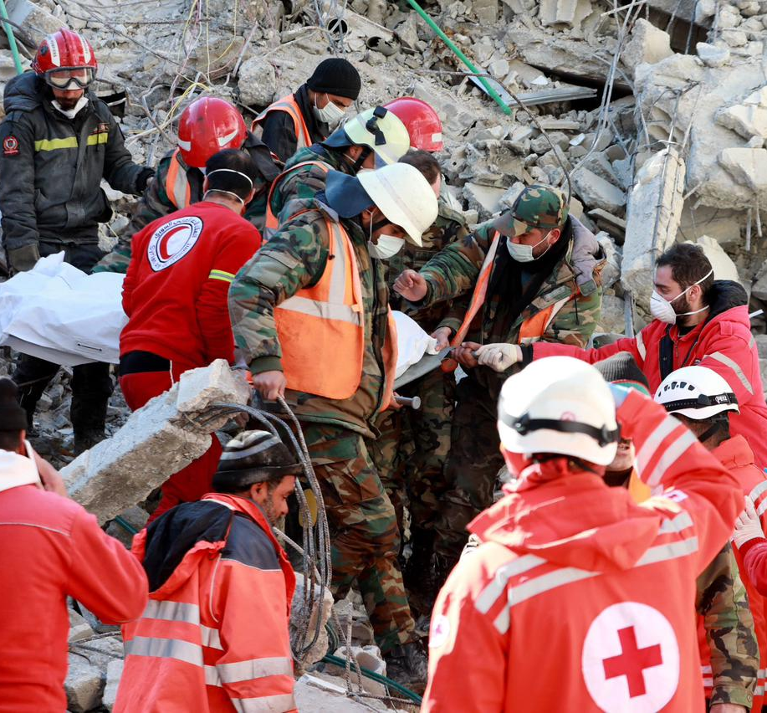
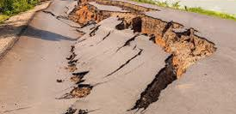
What are the consequences/ results of earthquakes?
Notes:
Serious injury and death
There are going to be people who are injured or killed during an earthquake.The shaking itself usually‏ doesn’t cause the injuries but rather is the falling objects or shattering glass or collapsing structures are mainly the culprit.
Economic impacts to local businesses
According to a 2006 small business administration study, about 25% of small businesses fail to reopen folling these types of shocks. Most of this is due to the lack of planning, but some disasters like these are just too extreme to overcome.

Slide 6
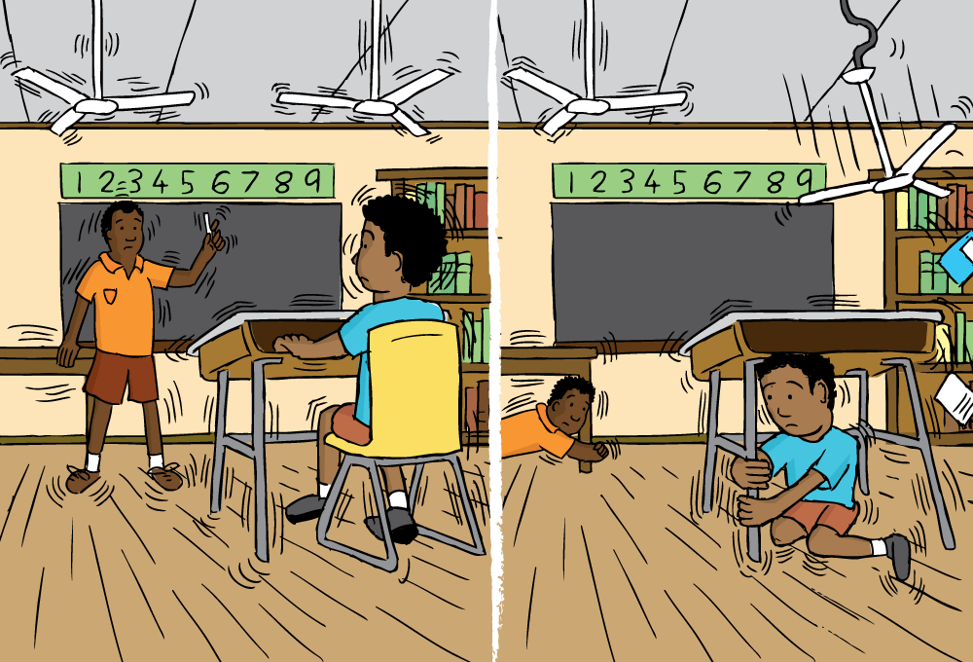

Solutions for earthquakes
Notes:
Truly their isnt a solution for earthquakes as it a natural disaster but we can mitigate their effects by building safer structures and laying out more education about earthquake saftey , to reduce their effects we can tie up large objects to walls , hanging mirrors and pictures with secured hooks , also securing water heaters with metal starps and to limit injuries from breaking glass by appling a saftey film to windows.
Normally countries deal with the effect of earthquakes by Install ledge barriers on shelves and secure large, heavy items and breakables directly to shelves to keep them from falling , students are taught What do in the case of an earthquake for example go under a desk or table and hold tightly on it or if you are in a hallway or against an inside wall, get away from windows, fireplaces, and heavy furniture objects. Stay out of places where heavy objects can fall on you and injure you if there isn’t anything you can hold onto or hide under make sure to put your hands in a way to cover your head and neck.
We can predict an earthquake studying the history of large earthquakes in a specific area and the rate at which strain accumulates in the rock, but scientists have never predicted a major earthquake.

Slide 7
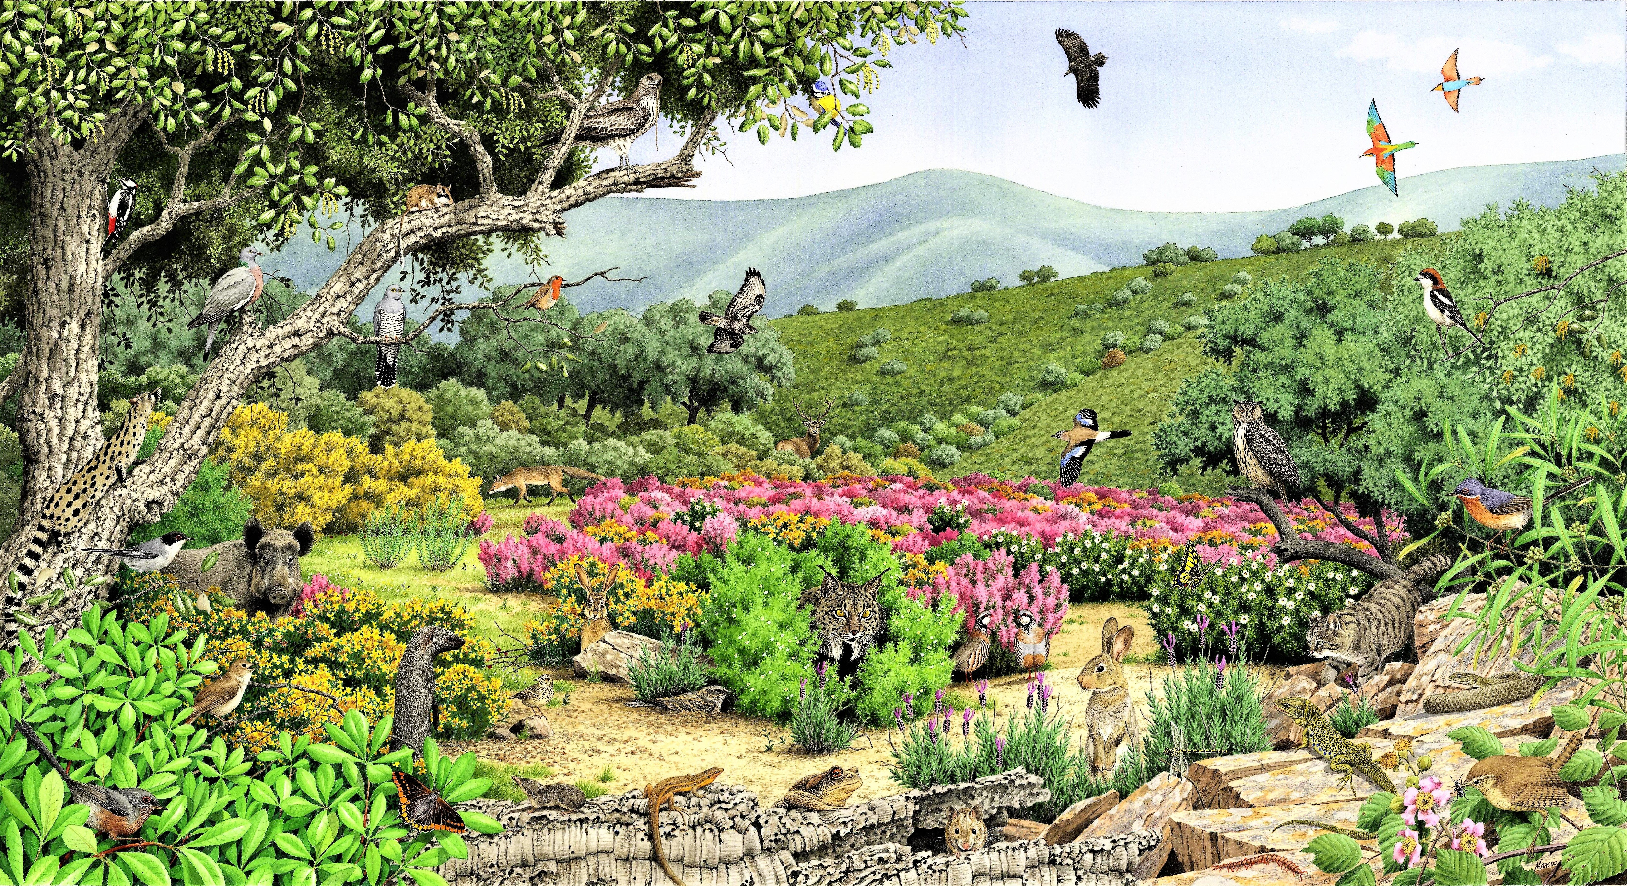
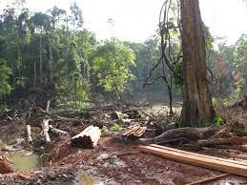
How does an earthquake effect our enviroment and ecostystem?
Before
After
Notes:
How do earthquakes affect our environment?
Earthquakes can have significant impacts on the environment, causing a range of effects that can affect both natural and human systems. One of the most immediate and visible effects of earthquakes is the damage caused to buildings, roads, and other infrastructure. This damage can be particularly severe in areas with poor construction practices or in older buildings that were not built to withstand seismic activity.
In addition to the damage to buildings and infrastructure, earthquakes can also trigger landslides, which can cause significant damage to ecosystems and habitats. These landslides can also contribute to soil erosion, which can have long-term effects on agricultural productivity and soil health

Slide 8
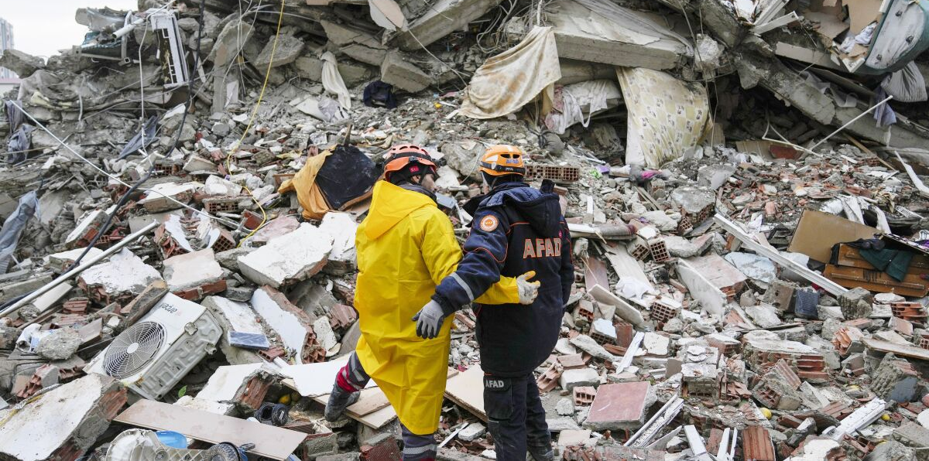
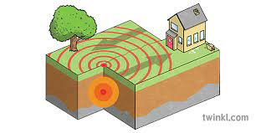
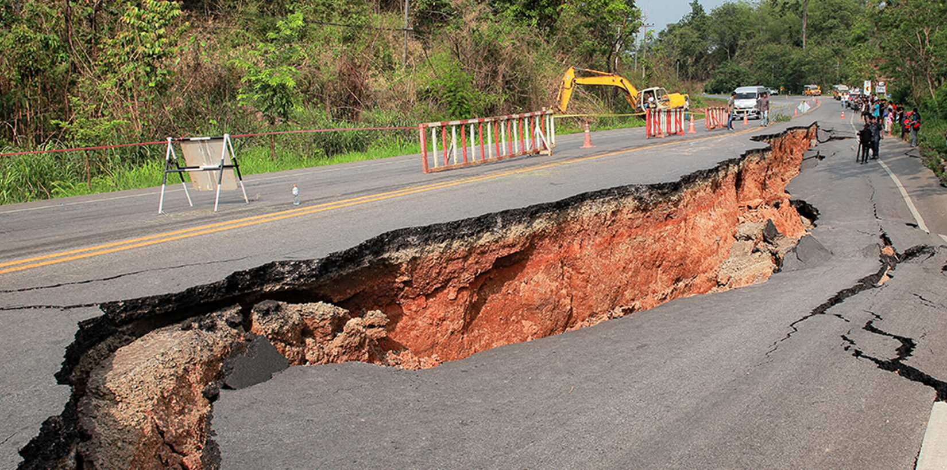
Conclusion:
Notes:
As a conclusion Earthquakes are a powerful force of nature that can cause a lot of damage and destruction. They happen when the Earth's tectonic plates move, and this can cause the ground to shake, buildings to collapse, and even tsunamis. While we can not predict when earthquakes will happen, we can take steps to prepare for them.

Slide 9
Resources
https://www.fema.gov/press-release/20210318/tips-reduce-earthquake-damage#:~:text=Install%20ledge%20barriers%20on%20shelves,and%20pictures%20with%20closed%20hooks.
https://www.usgs.gov/faqs/can-we-cause-earthquakes-there-any-way-prevent-earthquakes#:~:text=We%20cannot%20prevent%20natural%- Celina solutions
https://www.tetoncountywy.gov/409/Impacts-of-an-Earthquake Maria - causes
https://www.usgs.gov/programs/earthquake-hazards/what-are-effects-earthquakes
https://topex.ucsd.edu/es10/es10.1997/lectures/lecture20/secs.with.pics/node10.html- -Yasmine issues
https://www.tetoncountywy.gov/409/Impacts-of-an-Earthquake Talin results
https://www.who.int/health-topics/earthquakes#tab=tab_1 - Salma effects

Slide 10

THANKS FOR LISTENTING TO OUR PRESENTATION!!👍❤️🥶🤨

