Slide 1
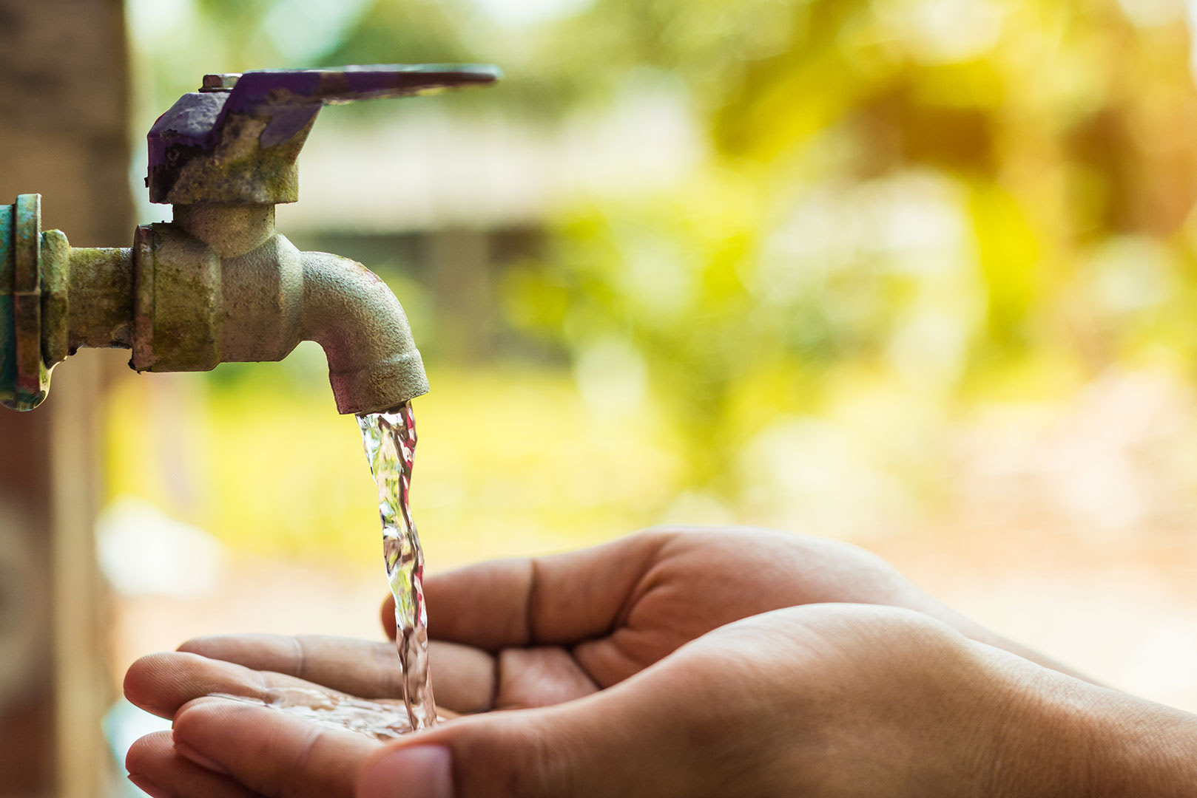
Water Crisis
By: Natali Nijmeh, Tina Bqaeen, Carol Alamat and Yasmina Alam

Slide 2
What is Water Crisis?
Water crisis is the lack of the supply of safe water or a water deficiency. Jordan is the 2nd most water scarce country in the world. Water crisis in Jordan started in the summer of 1998 of due to a malfunction that occurred in the capital’s important drinking water treatment plant. Did you know that one of the main reasons for the water crisis in Jordan is that it gets only 110 mm average of rainfall per year and it was ranked ninth in the top 10 countries with the lowest rainfall in 2017.

Slide 3
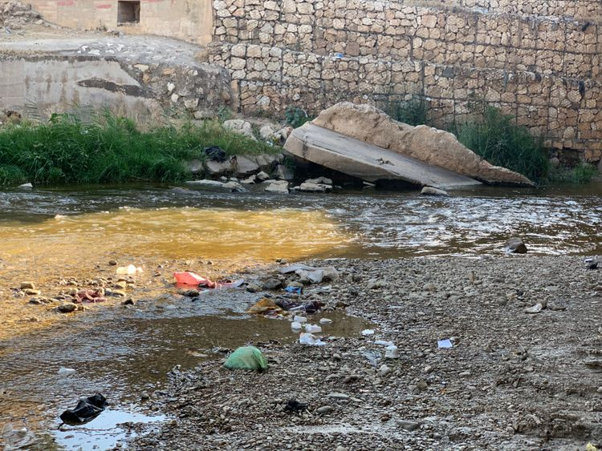
The Issues of Water Crisis
Water shortage is the lack of clean water resources especially in the remote and rural regions of Jordan. The percentage of people suffering from water shortage in Jordan is 98%.
Water pollution is when dirty pollutants such as litter get in contact with a water body making it unsuitable for human and animal consumption in Jordan.

Slide 4
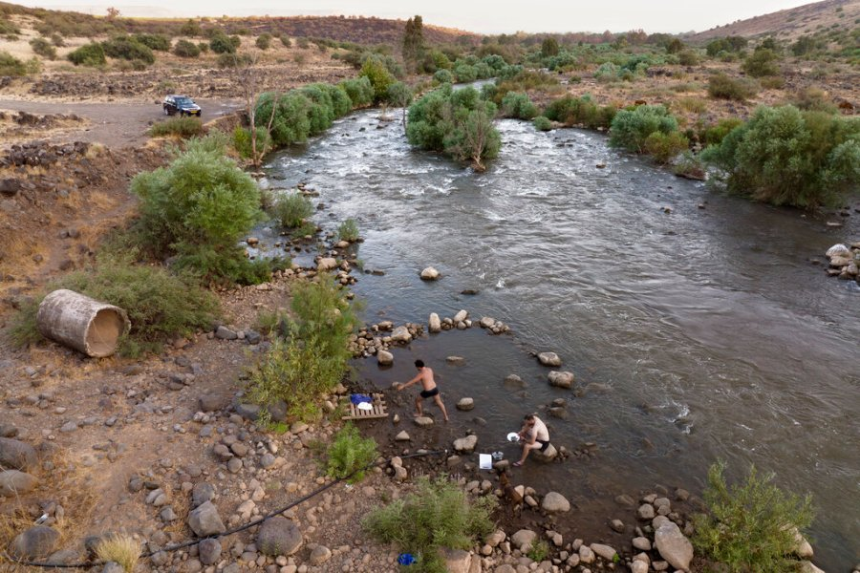
The Causes
The causes of water pollution in Jordan include industrial waste, which is when industrial sites or factories produce toxic waste, chemicals and pollutants. Also, some factories and industrial sites still do not have a proper waste management system which severely contributes to water pollution
The causes of water shortage include climate change. Climate change alters the water pattern in Jordan and around the world. In Jordan, it is causing droughts in some rivers and drying them up such as in Jordan river and Yarmouk river.

Slide 5
The Consequences
The consequences of water pollution in Jordan include bacteria and parasites will enter sewages that are poorly treated which means it may enter drinking water supply and cause diseases such as cholera, diarrhea, typhoid and polio
The consequences of water shortage include limited and little access to water which results in citizens in Jordan not being able to practice important hygiene habits

Slide 6
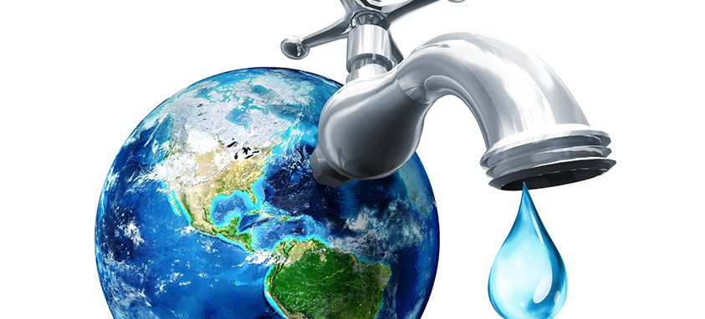
The Solutions
The solutions for water shortage include:
Developing new water treatment plants
Reducing your water usage
The Red Sea- Dead Sea water Conveyance project, which is a planned pipeline that runs from Aqaba Red Sea to The Dead Sea.
The solutions for water pollution include:
Not disposing toxic cleaning chemicals down the sink or toilet
Picking up litter and throwing it away in a garbage can before it gets into any water body

Slide 7
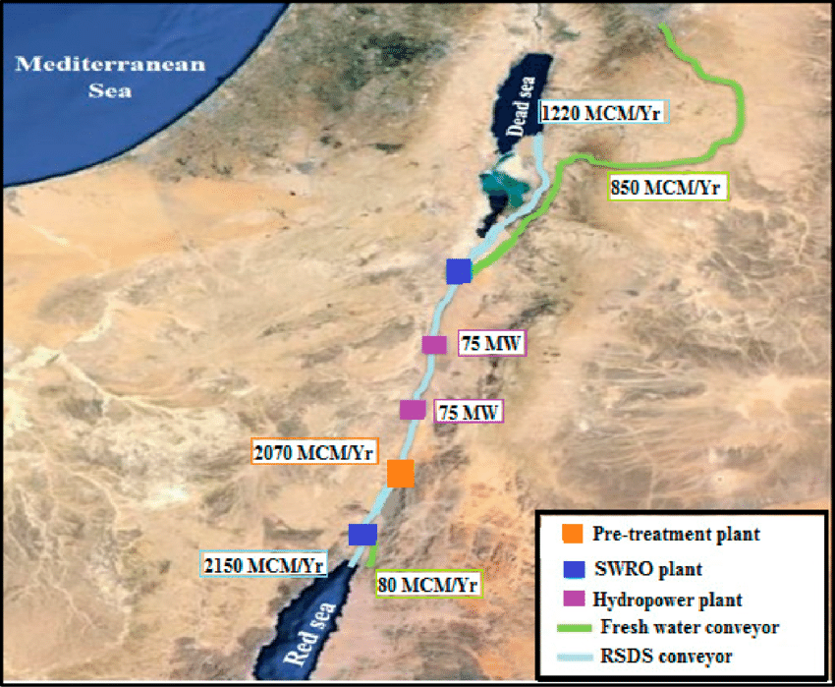
Red sea-dead sea water conveyance project

Slide 8
Citation:
Water, sanitation and hygiene (WASH). UNICEF. (2023, May 8). https://www.unicef.org/wash
Onlineecu. (2019, September 9). What are the causes of water pollution?. ECU Online. https://online.ecok.edu/articles/causes-of-water-pollution/
World Wildlife Fund. (n.d.). Water scarcity. WWF. https://www.worldwildlife.org/threats/water-scarcity#:~:text=Agriculture%20consumes%20more%20water%20than,situation%20will%20only%20get%20worse
Ten things you can do to reduce water pollution. simsburyct. (n.d.). https://www.simsbury-ct.gov/water-pollution-control/pages/ten-things-you-can-do-to-reduce-water-pollution
Libretexts. (2022, September 5). 13.3: Water scarcity and solutions. Biology LibreTexts. https://bio.libretexts.org/Bookshelves/Ecology/Environmental_Science_(Ha_and_Schleiger)/04%3A_Humans_and_the_Environment/4.02%3A_Water_Resources/4.2.03%3A_Water_Scarcity_and_Solutions

