Slide 1
Types of bullying
Made by : Maya Al Kurdi/Selena Al Khalil/Sama Al Qamhawi/Lamya Abu Dayyeh

Slide 2
A small video the explain about bullying
https://www.youtube.com/watch?v=eAj2kTQyEGw

Slide 3

What is bullying

Slide 4

WHAT ARE THE CAUSES OF BULLYING
Notes:
0000000000000000000000ko0oooo

Slide 5
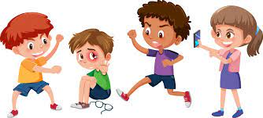
Physical Bullying

Slide 6

SOCIAL BULLYING

Slide 7
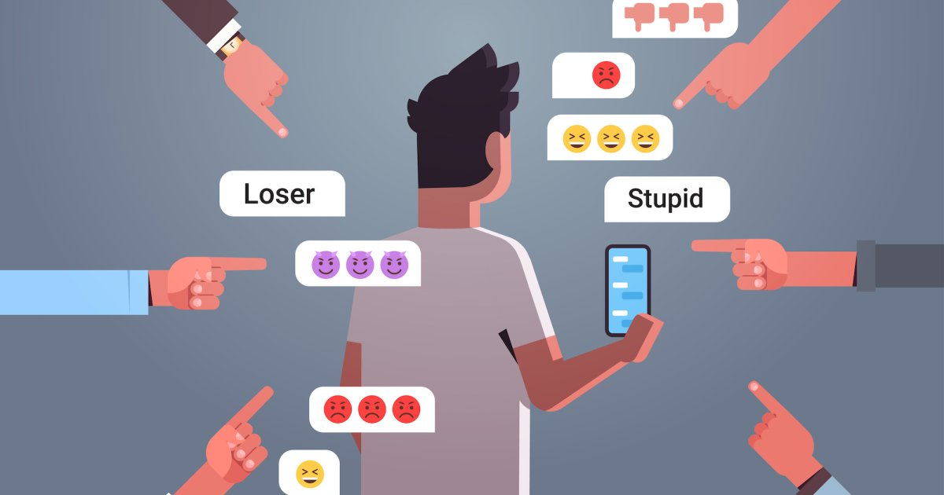
CYBER BULLYING

Slide 8
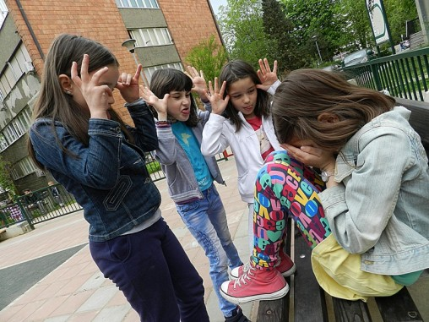
VERBAL BULLYING

Slide 9

How to prevent bullying

Slide 10
The percentage of bullying

Slide 11
The chart of the percentages
 | مواضيع الدراسة | النسبة المئوية | عادي بأبسط صورة | كسر عشري
2010 | الأردن | 47% | 47/100 | 0.47
2010 | الصين | 20% | 20/100 | 0.20
2010 | إيطاليا | 50.3% | 50.3/100 | 0.503
2010 | هند | 37.6% | 37.6/100 | 0.376
The End

Slide 12
RESOUCES
https://WWW.ogschool.org
https://www.positiveaction.net
https://www.stopbullying.gov11220
https://WWW.familylives.org.uk
https://www.richlandlibrary.com
https://www.verywellmin.com

